Slide 1
Java Thread Pool
In java each thread is created to do some job, these threads are called worker threads. Each time we receive some task to perform, we need to create a thread and there is a performance overhead associated with starting a new thread, each thread is also allocated some memory for its stack.
Suppose we got 100 jobs to run at the same time, so that our program will create 100 threads and start executing all the threads at the same time. This may cause many issue, if there is limited resources available. So, instead of starting a new thread each task to execute concurrently, this task can be passed to a thread pool.
Task
Thread

Slide 2
Java Thread Pool
Thread Pool
In Java, thread pool represent a group of worker threads that are waiting for the tasks/job and also reused many times.
In thread pool, instead of creating a new thread for every task, a group of fixed size threads are created.
Whenever a new task comes, task can be passed to a thread pool and thread pool pulled out any idle thread and assigned to it. After completion of the job, thread is contained in the thread pool again.
T1
T2
T3
Worker Threads
Worker threads life-cycle in thread pool
Get a new task to execute
Execute the task
Go back to Thread pool and waiting for new task

Slide 3
Java Thread Pool
Why Thread Pool?
In Server client applications, we may want to process each client request in parallel and we can choose traditional approach to create one thread per request.
What are the disadvantages of creating one thread per task approach?
There will overhead of creating a new thread for each request.
Server that processing request can spend more time and consume more system resources in creating and destroying threads, instead of that it would have processed actual client request.
Creating to many threads in one JVM can cause the system to run out of the memory or thrash JVM due to excessive(more than is necessary) memory consumption.

Slide 4
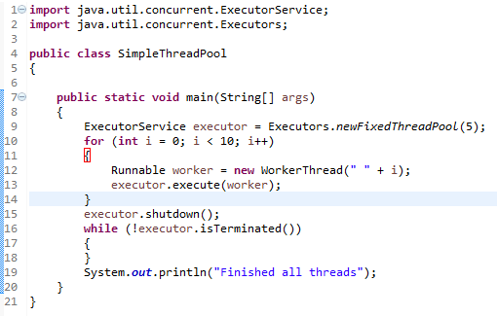
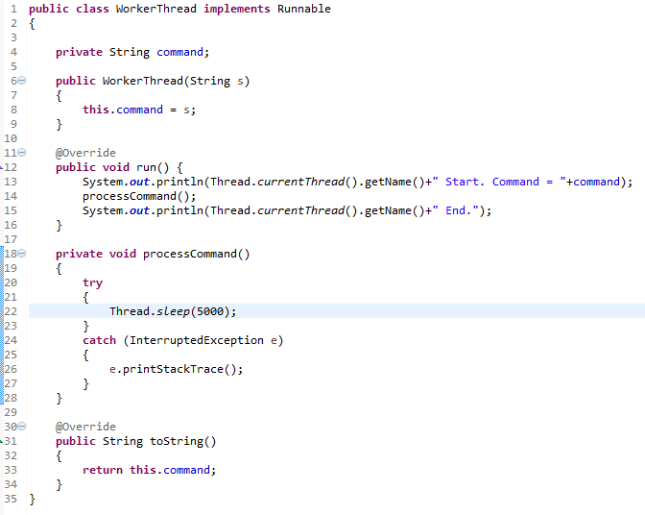
Java Thread Pool
In this program, we are creating fixed size thread pool of 5 worker threads. Then we are submitting 10 jobs to this pool, since the pool size is 5, it will start working on 5 jobs and other jobs will be in wait state, as soon as one of the job is finished, another job from the wait queue will be picked up by worker thread and get’s executed.

Slide 5
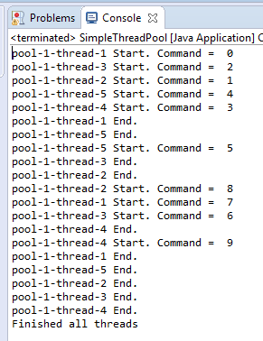
Java Thread Pool
The output confirms that there are five threads in the pool named from pool-1-thread-1 to pool-1-thread-5 and they are responsible to execute the submitted tasks to the pool.

Slide 6
Java Thread Pool
https://docs.oracle.com/javase/8/docs/api/java/util/concurrent/Executors.html
https://docs.oracle.com/javase/8/docs/api/java/util/concurrent/ExecutorService.html

