Slide 1
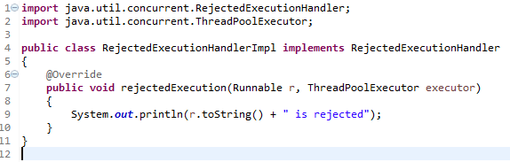
Java Thread Pool
ThreadPoolExecutor provides much more feature than Executors class. We can specify the number of threads that will be alive when we create ThreadPoolExecutor instance and we can limit the size of thread pool and create our own RejectedExecutionHandler implementation to handle the jobs that can’t fit in the worker queue.

Slide 2
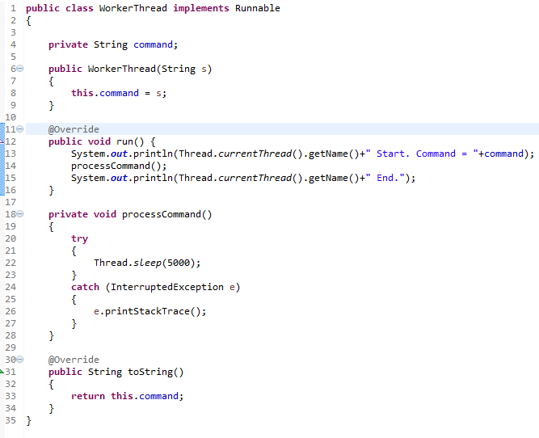
Java Thread Pool

Slide 3
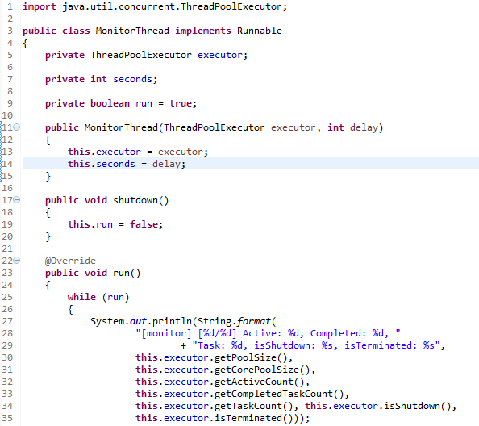
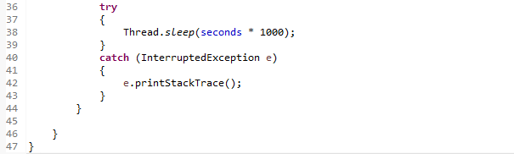
Java Thread Pool
ThreadPoolExecutor provides several methods using which we can find out the current state of executor, pool size, active thread count and task count.
So we have a monitor thread that will print the executor information at certain time interval.

Slide 4
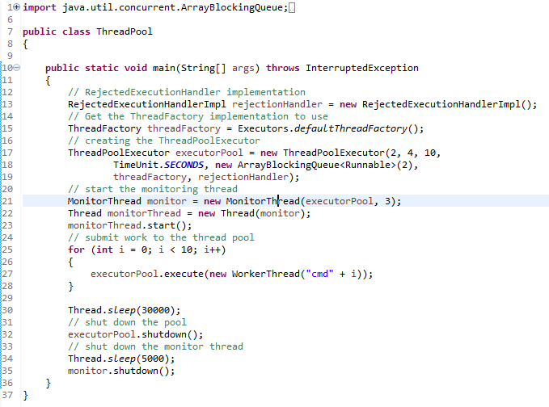
Java Thread Pool
Here is the thread pool implementation example using ThreadPoolExecutor.
While initializing the ThreadPoolExecutor, we are keeping initial pool size as 2, maximum pool size to 4 and work queue size as 2. So if there are 4 running tasks and more tasks are submitted, the work queue will hold only 2 of them and rest of them will be handled by RejectedExecutionHandlerImpl.
We can invoke shutdown()method to finish execution of all the submitted tasks and terminate the thread pool.

Slide 5
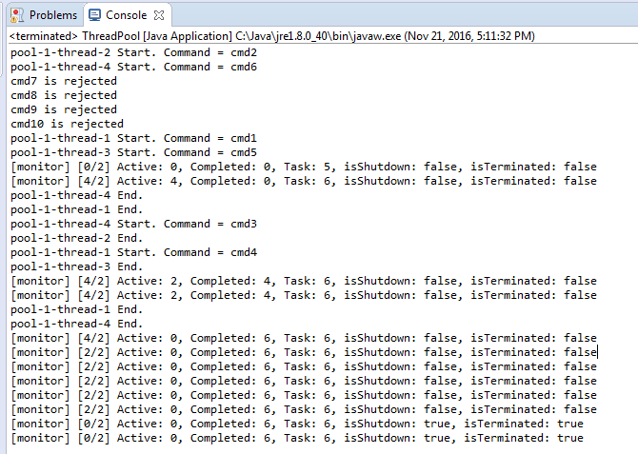
Java Thread Pool

