Slide 1
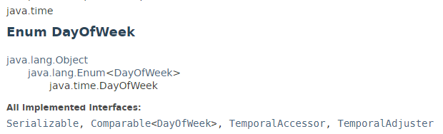
DayOfWeek
DayOfWeek is an enum representing the 7 days of the week - Monday, Tuesday, Wednesday, Thursday, Friday, Saturday and Sunday.
In addition to the textual enum name, each day-of-week has an int value. The int value follows the ISO-8601 standard, from 1 (Monday) to 7 (Sunday). It is recommended that applications use the enum rather than the int value to ensure code clarity.

Slide 2
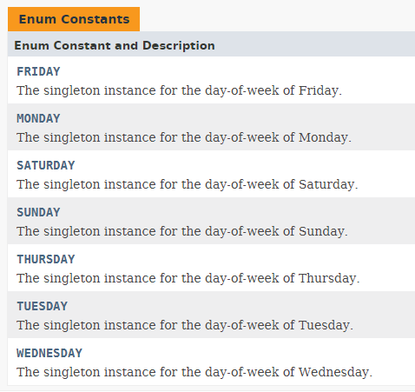
DayOfWeek

Slide 3
Java Date and Time
https://docs.oracle.com/javase/8/docs/api/index.html?java/time/DayOfWeek.html

