Slide 1
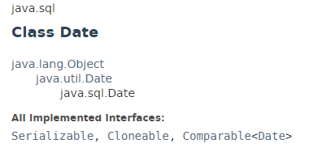
java.util.Date
The java.sql.Date class represents only date in java.
The java.sql.Date instance is widely used in JDBC because it represents the date that can be stored in database.

Slide 2
java.util.Date
https://docs.oracle.com/javase/8/docs/api/index.html?java/sql/Date.html

