Slide 1
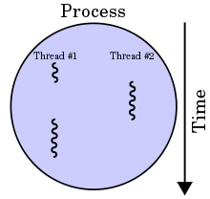
Multithreading in Java
Multithreading in java is a process of executing multiple threads simultaneously.
Thread is basically a lightweight sub-process, a smallest unit of processing.
Multiprocessing and multithreading, both are used to achieve multitasking[Multitasking is a process of executing multiple tasks simultaneously.].
We use multithreading than multiprocessing because threads share a common memory area. They don't allocate separate memory area so saves memory, and context-switching between the threads takes less time than process.
Java Multithreading is mostly used in games, animation etc.
Multithreading doesn't block the user because threads are independent and we can perform multiple operations at same time.
We can perform many operations together so it saves time.
Threads are independent so it doesn't affect other threads if exception occur in a single thread.

