Slide 1
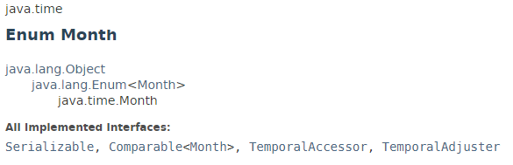
Month
Month is an enum representing the 12 months of the year - January, February, March, April, May, June, July, August, September, October, November and December.
In addition to the textual enum name, each month-of-year has an int value. The int value follows normal usage and the ISO-8601 standard, from 1 (January) to 12 (December). It is recommended that applications use the enum rather than the int value to ensure code clarity.
Do not use ordinal() to obtain the numeric representation of Month. Use getValue() instead.

Slide 2
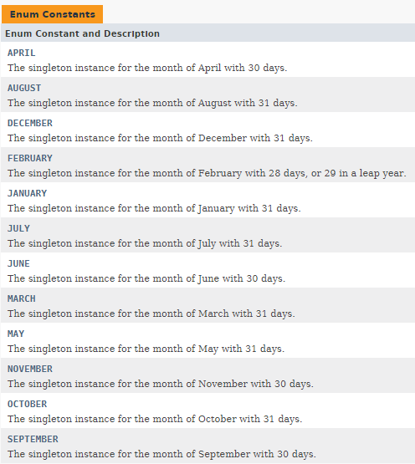
Month

Slide 3
Java Date and Time
https://docs.oracle.com/javase/8/docs/api/index.html?java/time/Month.html

