Slide 1
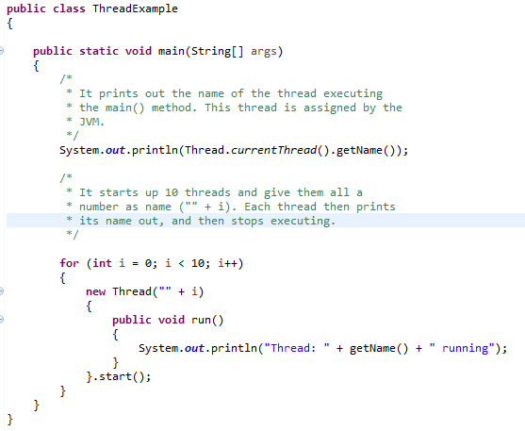
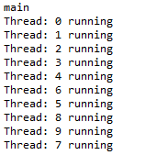
Thread
output
Note that even if the threads are started in sequence (1, 2, 3 etc.) they may not execute sequentially, meaning thread 1 may not be the first thread to write its name to System.out. This is because the threads are in principle executing in parallel and not sequentially. The JVM and/or operating system determines the order in which the threads are executed. This order does not have to be the same order in which they were started.

