Slide 1
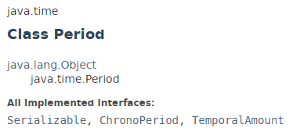
YearMonth
Java Period class is used to measures time in years, months and days.
A date-based amount of time in the ISO-8601 calendar system, such as '2 years, 3 months and 4 days'.

Slide 2
Java Date and Time
https://docs.oracle.com/javase/8/docs/api/index.html?java/time/YearMonth.html

