Slide 1
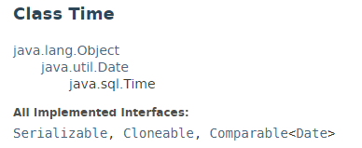
java.sql.Time
A thin wrapper around the java.util.Date class that allows the JDBC API to identify this as an SQL TIME value. The Time class adds formatting and parsing operations to support the JDBC escape syntax for time values.

Slide 2
java.util.Date
https://docs.oracle.com/javase/8/docs/api/index.html?java/sql/Time.html

