Slide 1
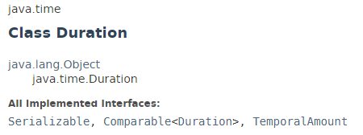
Duration
Java Duration class is used to measures time in seconds and nanoseconds.
The java.time.Duration class models a quantity or amount of time in terms of seconds and nanoseconds. It can be accessed using other duration-based units, such as minutes and hours.

Slide 2
Java Date and Time
https://docs.oracle.com/javase/8/docs/api/index.html?java/time/Duration.html

