Slide 1
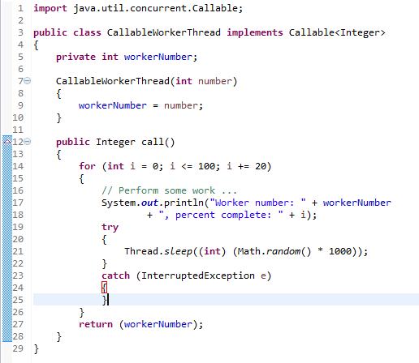
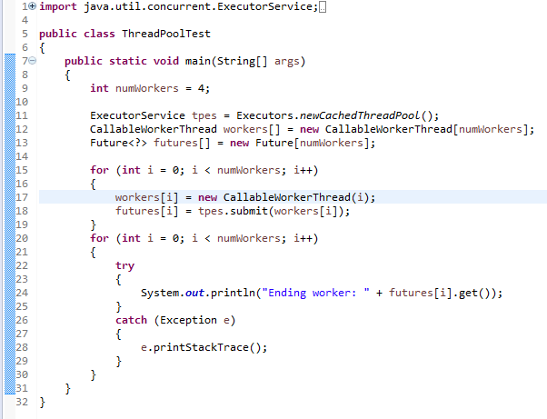
Java Thread Pool
Another way to create a task is to implement the Callable interface. A Callable is more flexible than a Runnable because it can return a value and throw an exception. To implement a Callable, you provide the call method, which returns a value, in this case an Integer that represents the tasks number:
ThreadPoolTest uses the CachedThreadPool executor service which creates as many threads as needed but reuses previously constructed threads if available. You use the submit method to ask an executor service to run a Callable. This method returns a Future object which gives you control over the task; you can use the Future to retrieve the result of running the task, monitor the task, and cancel the task. For example, to gain access to the return result, simply call the method get:

Slide 2
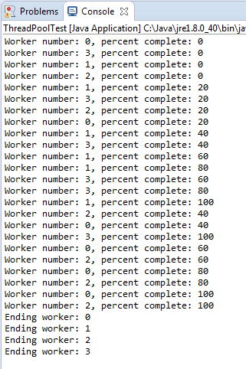
Java Thread Pool
Here’ is the result of running ThreadPoolTest. Notice how each worker task is immediately assigned a thread to run in.
As each task completes, it returns its identifier, which ThreadPoolTest retrieves from the worker task futures:

