Slide 1
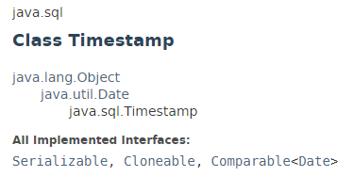
java.util. Timestamp
A thin wrapper around java.util.Date that allows the JDBC API to identify this as an SQL TIMESTAMP value. It adds the ability to hold the SQL TIMESTAMP fractional seconds value, by allowing the specification of fractional seconds to a precision of nanoseconds.
A Timestamp also provides formatting and parsing operations to support the JDBC escape syntax for timestamp values.

Slide 2
java.util.Date
https://docs.oracle.com/javase/8/docs/api/index.html?java/sql/Timestamp.html

