Slide 1
Java Thread Pool
A thread pool is a managed collection of threads that are available to perform tasks. Thread pools usually provide:
Improved performance when executing large numbers of tasks due to reduced per-task invocation overhead.
A means of bounding the resources, including threads, consumed when executing a collection of tasks.
Thread Pool
T1
T2
T3

Slide 2
Java Thread Pool
To use thread pools, you instantiate an implementation of the ExecutorService interface and hand it a set of tasks.
The choices of configurable thread pool implementations are ThreadPoolExecutor and ScheduledThreadPoolExecutor. These implementations allow you to set the core and maximum pool size, the type of data structure used to hold the tasks, how to handle rejected tasks, and how to create and terminate threads.
However, we recommend that you use the more convenient factory methods of the Executors class listed in the following table. These methods preconfigure settings for the most common usage scenarios.
Executors Thread Pool Factory Methods
newFixedThreadPool(int) | Creates a fixed size thread pool.
newCachedThreadPool | Creates unbounded thread pool, with automatic thread reclamation.
newSingleThreadExecutor | Creates a single background thread.

Slide 3
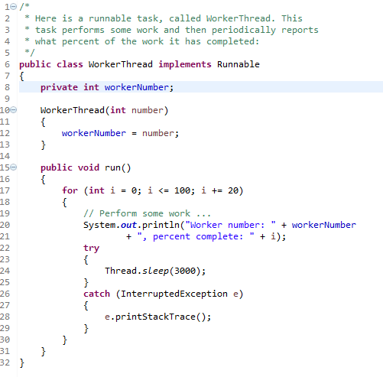
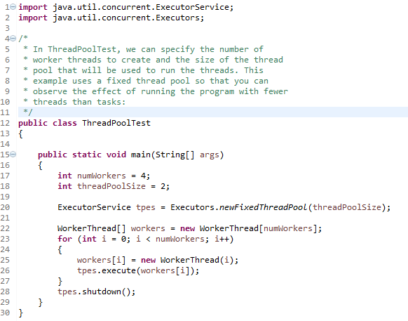
Java Thread Pool

Slide 4
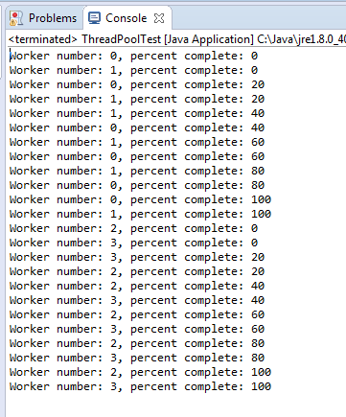
Java Thread Pool
Here is the result of running the test with
4 workers and a pool of 2 threads:
Notice how workers 0 and 1 are assigned to the two threads in the pool and they alternately run to completion and then tasks 2 and 3 are assigned to the threads.

Slide 5
Java Thread Pool
https://docs.oracle.com/javase/8/docs/api/java/util/concurrent/Executors.html
https://docs.oracle.com/javase/8/docs/api/java/util/concurrent/ExecutorService.html

