Slide 1
Java Thread Pool
Thread Pool
A Thread pool manages the pool of worker threads.
Thread pool contains a queue that keeps tasks waiting to get executed.
java.util.concurrent.Executors provide implementation of java.util.concurrent.Executor interface to create the thread pool in java.
T1
T2
T3
Worker Threads

Slide 2
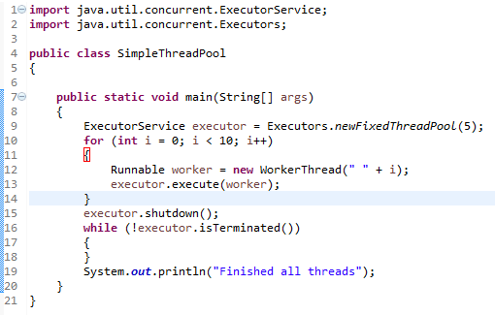
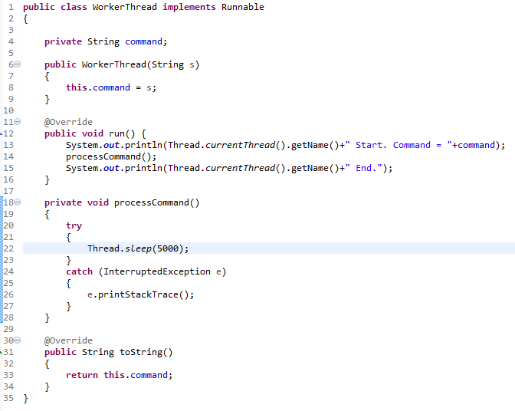
Java Thread Pool
In this program, we are creating fixed size thread pool of 5 worker threads. Then we are submitting 10 jobs to this pool, since the pool size is 5, it will start working on 5 jobs and other jobs will be in wait state, as soon as one of the job is finished, another job from the wait queue will be picked up by worker thread and get’s executed.

Slide 3
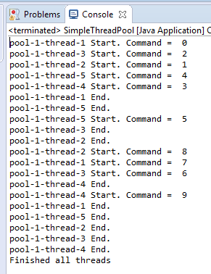
Java Thread Pool
The output confirms that there are five threads in the pool named from pool-1-thread-1 to pool-1-thread-5 and they are responsible to execute the submitted tasks to the pool.

Slide 4
Java Thread Pool
https://docs.oracle.com/javase/8/docs/api/java/util/concurrent/Executors.html
https://docs.oracle.com/javase/8/docs/api/java/util/concurrent/ExecutorService.html

