Slide 1
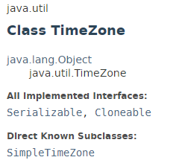
java.util.Date
TimeZone represents a time zone offset, and also figures out daylight savings.
Typically, you get a TimeZone using getDefault which creates a TimeZone based on the time zone where the program is running. For example, for a program running in Japan, getDefault creates a TimeZone object based on Japanese Standard Time.

Slide 2
java.util.Date
https://docs.oracle.com/javase/8/docs/api/index.html?java/util/TimeZone.html

