Slide 1
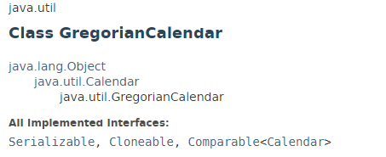
java.util.calendar
GregorianCalendar is a concrete subclass of Calendar and provides the standard calendar system used by most of the world.
GregorianCalendar is a hybrid calendar that supports both the Julian and Gregorian calendar systems

Slide 2
java.util.Date
https://docs.oracle.com/javase/8/docs/api/index.html?java/util/GregorianCalendar.html

