Slide 1
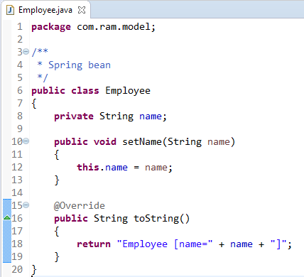
ApplicationContextAware

Slide 2
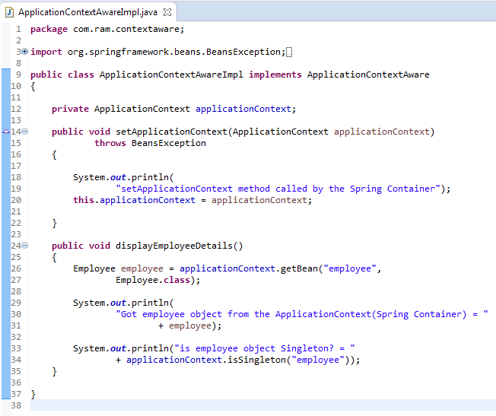
ApplicationContextAware
Bean implementing ApplicationContextAware interface can get the current application context and this can be used to call any service from the application context
In below class, we are trying to access ApplicationContext by implementing ApplicationContextAware.
So using ApplicationContext, we have accessed the Employee bean from the context And also we have checked whether Employee bean is singleton or not using ApplicationContext.

Slide 3
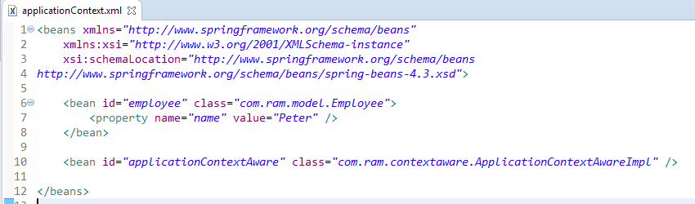
ApplicationContextAware

Slide 4
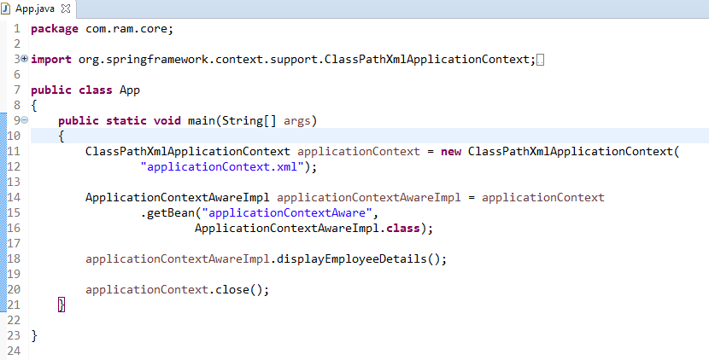
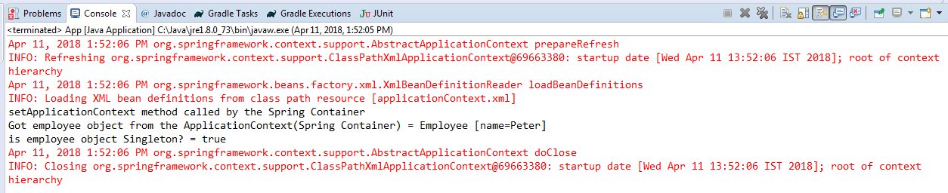
ApplicationContextAware

