Slide 1
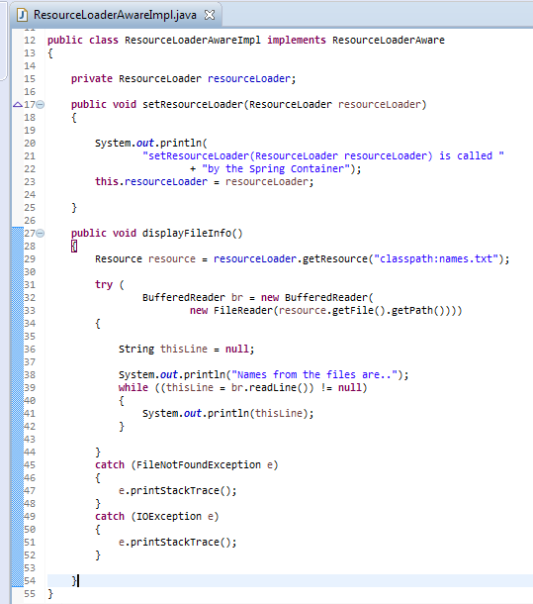
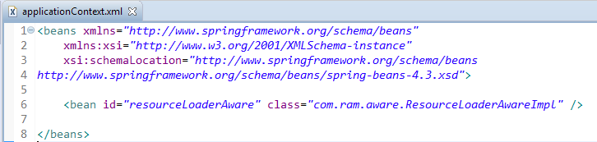
ResourceLoaderAware
Bean implementing ResourceLoaderAware interface can load the resources from the classpath or any external file.
We have implemented ResourceLoaderAware interface using which we have accessed the file content of the file available in the classpath.

Slide 2

ResourceLoaderAware

Slide 3
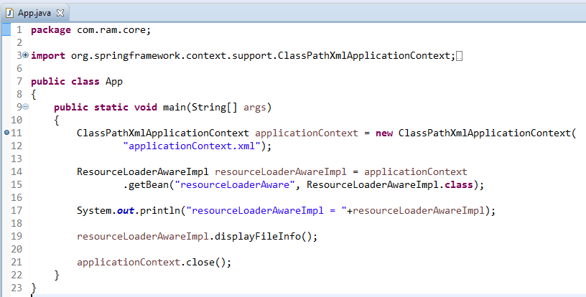
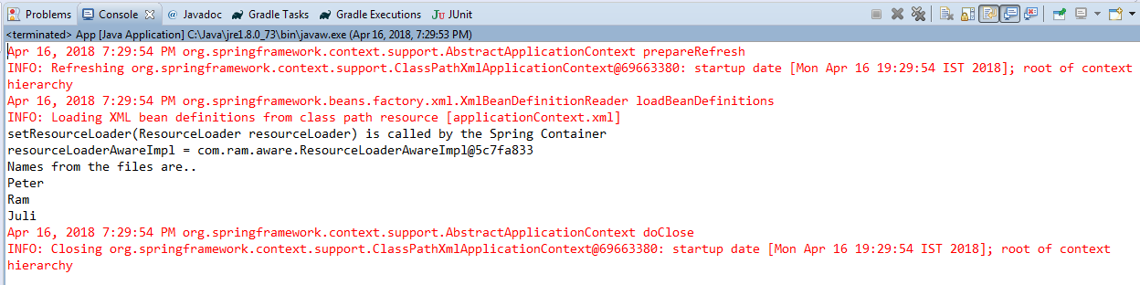
ResourceLoaderAware

