Slide 1
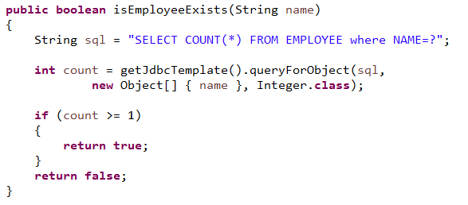
isEmployeeExists

