Slide 1
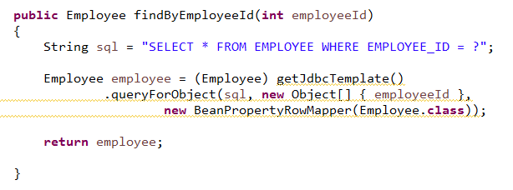
BeanPropertyRowMapper
In Spring 2.5, comes with a handy RowMapper implementation called ‘BeanPropertyRowMapper’, which can maps a row’s column value to a property by matching their names. Just make sure both the property and column has the same name, e.g property ‘employeeId’ will match to column name ‘EMPLOYEEID’ or with underscores ‘EMPLOYEE_ID’.

