Slide 1
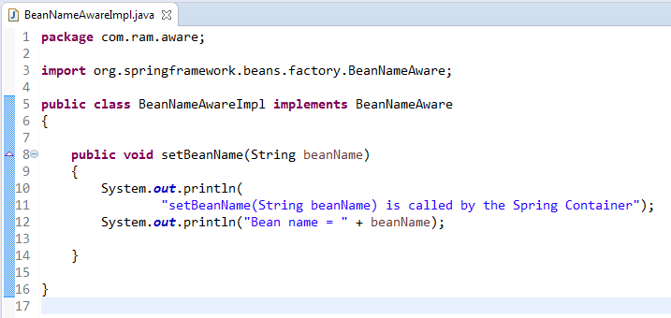
BeanNameAware
Bean implementing BeanNameAware interface can get its name defined in the Spring container.

Slide 2
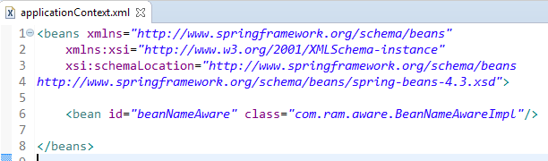
BeanNameAware

Slide 3
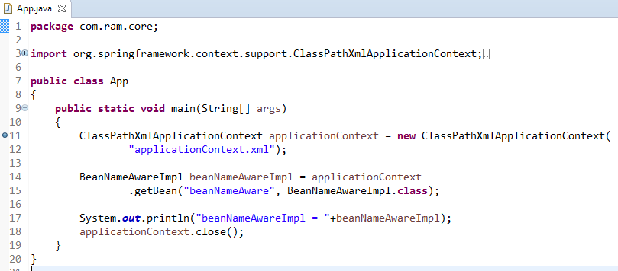
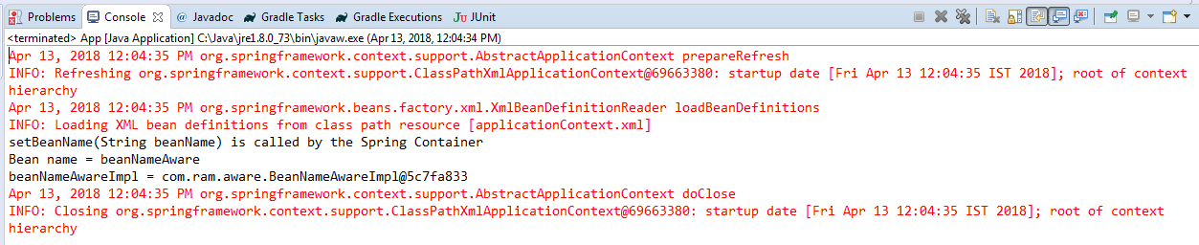
BeanNameAware

