Slide 1
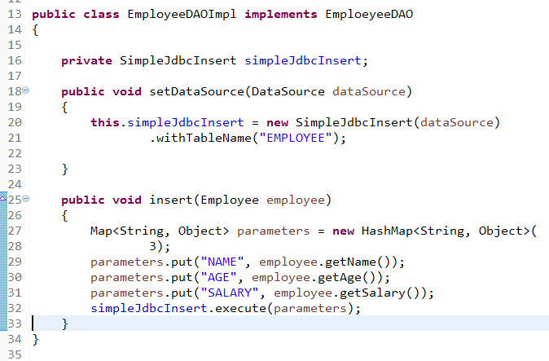
Inserting data using SimpleJdbcInsert
Let’s start by looking at the SimpleJdbcInsert class with the minimal amount of configuration options. You should instantiate the SimpleJdbcInsert in the data access layer’s initialization method. For this example, the initializing method is the setDataSource method. You do not need to subclass the SimpleJdbcInsert class; simply create a new instance and set the table name using the withTableName method. Configuration methods for this class follow the "fluid" style that returns the instance of the SimpleJdbcInsert, which allows you to chain all configuration methods. This example uses only one configuration method

