Slide 1
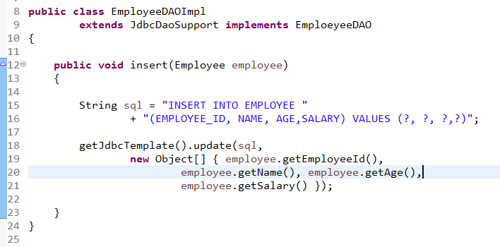
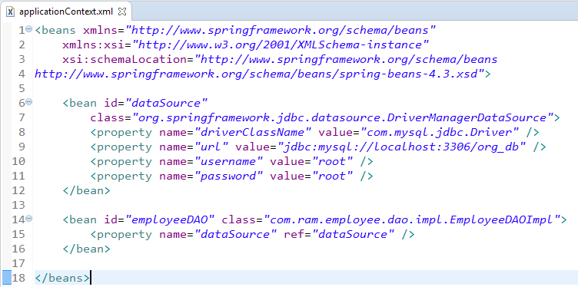
Spring + JdbcDaoSupport
By extended the JdbcDaoSupport, set the datasource and JdbcTemplate in our class is no longer required, we just need to inject the correct datasource into EmployeeDAOImpl. And we can get the JdbcTemplate by using a getJdbcTemplate() method.

