Slide 1
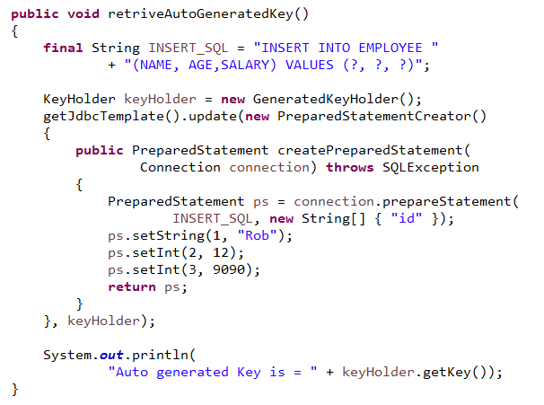
Retrieving auto-generated keys
An update() convenience method supports the retrieval of primary keys generated by the database. This support is part of the JDBC 3.0 standard;
The method takes a PreparedStatementCreator as its first argument, and this is the way the required insert statement is specified. The other argument is a KeyHolder, which contains the generated key on successful return from the update.

