Slide 1
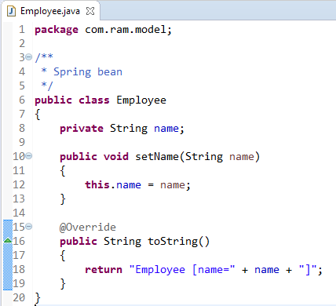
BeanFactoryAware

Slide 2
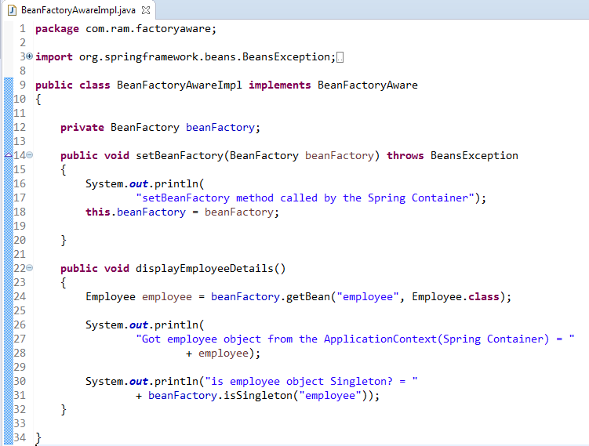
BeanFactoryAware
Bean implementing BeanFactoryAware interface can get the current bean factory and this can be used to call any service from the bean factory
In below class, we are trying to access BeanFactory by implementing BeanFactoryAware.
So using BeanFactory, we have accessed the Employee bean from the Spring Container, and also we have checked whether Employee bean is singleton or not using BeanFactory.

Slide 3
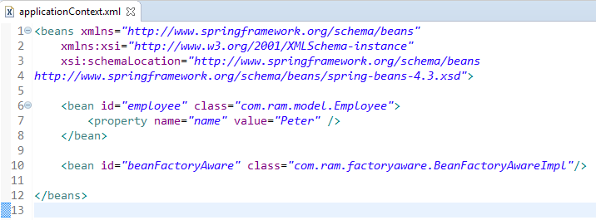
BeanFactoryAware

Slide 4
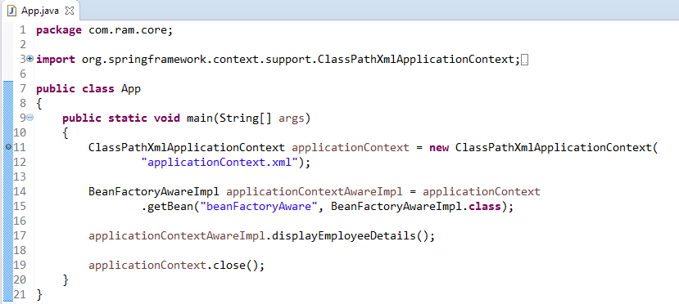
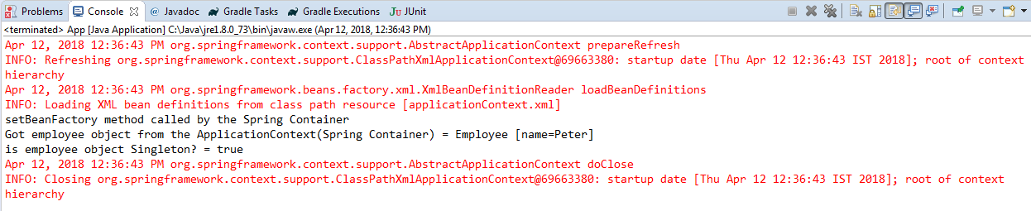
BeanFactoryAware

