Slide 1
Quantum Communication : Sources
Presented By
Abhishek Anand Alok Anand
Electrical & Computer Engineering Electrical & Computer Engineering
December 15, 2021
ELEMENTS OF QUANTUM COMMUNICATIONS AND NETWORKS (18-819E)
Professor Elias Towe
Notes:
Main title: 40 pt. Arial
Presenter Name: 16 pt. Arial
Presenters Title: 16 pt. Arial Italic

Slide 2




Classical Communication – Basic Form
Electrical signal
Convert
Optical signal
Optical signal
Convert
Electrical signal
Channel
Transceiver
...
Transceiver
Data in-form of ‘0’ and ‘1’
Encoding/Decoding
Encryption/Decryption
Encoding/Decoding
Encryption/Decryption
Data in-form of ‘0’ and ‘1’
Encrypted Data
I can clone and make
copy of their information
without their knowledge
Quantum Computing
Optical Signal ON represent ‘1’ value
Optical Signal OFF represent ‘0’ value
1
0
1
Encrypted Data

Slide 3
Why Quantum Network
Secure Communication
Exploit the concept of quantum mechanics – Superposition with Teleportation
Data is encoded in quantum properties of photon.
Polarization
Provide data security
Bunched Multiple Photon
Single Photon

Slide 4
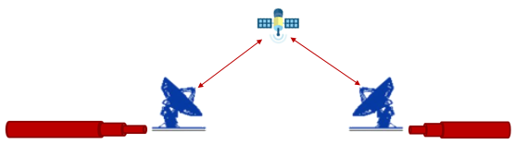
Quantum Communication Carrier
Ideal requirement of quantum communication source
Generate single/entangled photon
Stable photon generation
Consistent emission
On demand
Photon at telecom wavelength
Works at room temperature
Chip integrated
Compatibility - Network Integrated -
Optical fiber/Free-Space

Slide 5
Photon Source
Second order correlation function
Type
G2(0) > 1
Bunched
G2(0) = 1
Random
G2(0) < 1
Anti-Bunched
Laser
g2(0) = 1
Photon emission fluctuating
Requires filters
Probabilistic
Quantum Dot
g2(0) < 1
On demand
Deterministic
Scaling and network integration
Room temperature source
E
G

Slide 6
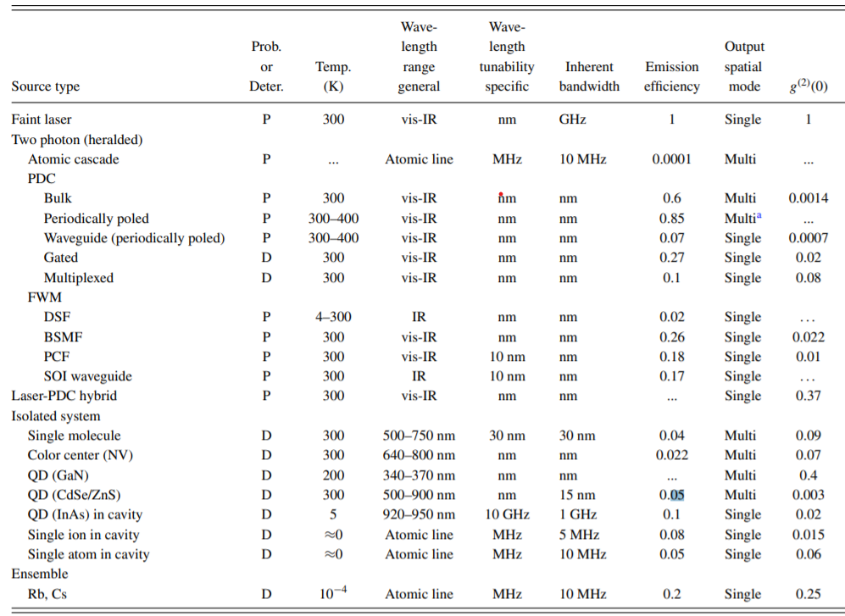
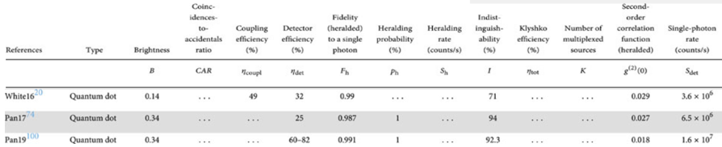
Quantum Dots
At room temperature, deterministic
Rev. Sci. Instrum. 82, 071101 (2011); https://doi.org/10.1063/1.3610677

Slide 7
SINGLE PHOTON SOURCE USING QUANTUM DOTS IN NANO-ANTENNA

Slide 8
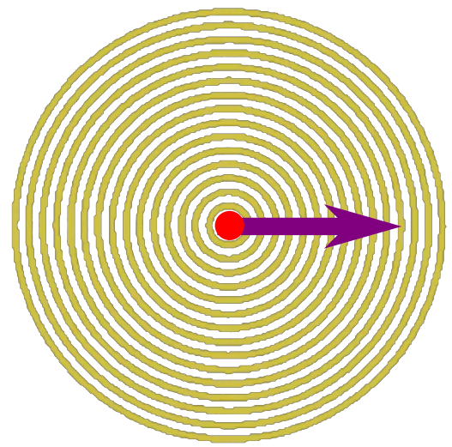
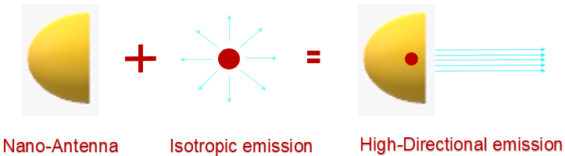
Problem with QD : Single Photon source
Quantum Dots as photon source faces challenges for practical integration as :
Most sources are at cryogenic temperature
Isotropic emission
Broadband emission
Low single-photon purity
Unstable emission
Quantum Dots : In Nano-Antenna

Slide 9
Nano-Antenna structure
Metallic structure
Advantage
Low mode volumes
Low quality factors,
Enabling emission modification over a broadband spectrum.
Disadvantage
Stringent distance requirements locating emitter relative to antenna
Increasing the rate of non-radiative recombination processes
Metal induced losses
Dielectric structures
Advantage
High radiative enhancement factors
Low-loss
Disadvantage
Narrow frequency bandwidth
Hamza Abudayyeh, Boaz Lubotzky, Anastasia Blake, Jun Wang, Somak Majumder, Zhongjian Hu, Younghee Kim, Han Htoon, Riya Bose, Anton V. Malko, Jennifer A. Hollingsworth, and Ronen Rapaport , "Single photon sources with near unity collection efficiencies by deterministic placement of quantum dots in nanoantennas", APL Photonics 6, 036109, Mar. 2021. https://doi.org/10.1063/5.0034863

Slide 10
How it’s made ? : QD in Nano-Antenna
Hybrid metal–dielectric bullseye nano-antennas
Photon source located at the center of the bullseye
At a large distance from the metal emits into a dielectric layer that
Acts as a slab waveguide guiding light radially outward toward circular gratings.
In the far-field, the interference between various diffracted waves occurs only at low angles.
This results, in a highly directional photon stream in a broad spectral range.
Hamza Abudayyeh, Boaz Lubotzky, Anastasia Blake, Jun Wang, Somak Majumder, Zhongjian Hu, Younghee Kim, Han Htoon, Riya Bose, Anton V. Malko, Jennifer A. Hollingsworth, and Ronen Rapaport , "Single photon sources with near unity collection efficiencies by deterministic placement of quantum dots in nanoantennas", APL Photonics 6, 036109, Mar. 2021. https://doi.org/10.1063/5.0034863

Slide 11
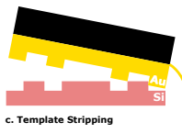
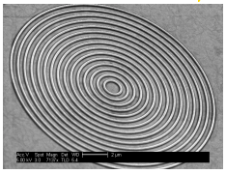



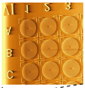
Fabrication : Nano antenna
Template Stripping
Ultra smooth
Nano-antenna
First dielectric layer
Poly-methyl methacrylate
Spin-coated
Quantum Dot
CdSe/CdS (range of 640nm)
InAs/GaAs (QD) heterostructure (940nm to 980 nm)
Photon generation process
Pulsed excitation comes from : A 400 nm pulsed laser diode.
Gas-phase deposition
(Room-temperature)
thin layer - AlOx
For stability
Hamza Abudayyeh, Boaz Lubotzky, Anastasia Blake, Jun Wang, Somak Majumder, Zhongjian Hu, Younghee Kim, Han Htoon, Riya Bose, Anton V. Malko, Jennifer A. Hollingsworth, and Ronen Rapaport , "Single photon sources with near unity collection efficiencies by deterministic placement of quantum dots in nanoantennas", APL Photonics 6, 036109, Mar. 2021. https://doi.org/10.1063/5.0034863
Notes:
Softened by the DPN solvent, QDs to sink through the dielectric layer toward metal layer over time, resulted in quenching of QD emission.

Slide 12
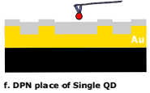

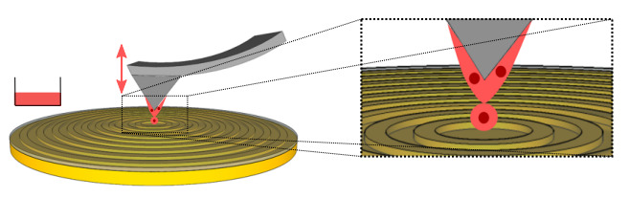
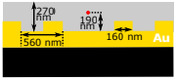
Fabrication : Nano antenna
CdSe/CdS or InAs/GaAs(QD)
+
Dichlorobenzene
(High-boiling solvent)
Integrated scanning probe microscope with optical microscope
Observation of writing process
AFM probe - High-resolution nanoscale topographical map
QD-solvent suspension (ink) – liquid state at room temperature
Integrated microscope determine success or failure of writing step
Second dielectric layer
coated
Polymethyl methacrylate
Hamza Abudayyeh, Boaz Lubotzky, Anastasia Blake, Jun Wang, Somak Majumder, Zhongjian Hu, Younghee Kim, Han Htoon, Riya Bose, Anton V. Malko, Jennifer A. Hollingsworth, and Ronen Rapaport , "Single photon sources with near unity collection efficiencies by deterministic placement of quantum dots in nanoantennas", APL Photonics 6, 036109, Mar. 2021. https://doi.org/10.1063/5.0034863

Slide 13
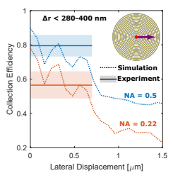
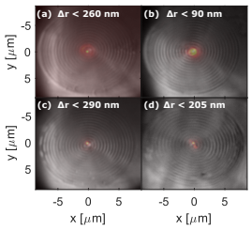
Antenna : Collection efficiency
Importance of high precision positioning on the performance of the devices
Degradation of performance for even sub-500 nm displacements
Hamza Abudayyeh, Boaz Lubotzky, Anastasia Blake, Jun Wang, Somak Majumder, Zhongjian Hu, Younghee Kim, Han Htoon, Riya Bose, Anton V. Malko, Jennifer A. Hollingsworth, and Ronen Rapaport , "Single photon sources with near unity collection efficiencies by deterministic placement of quantum dots in nanoantennas", APL Photonics 6, 036109, Mar. 2021. https://doi.org/10.1063/5.0034863

Slide 14
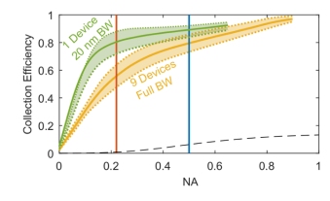
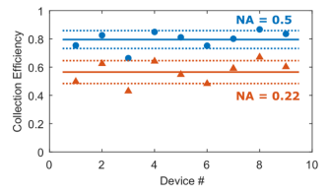
Antenna : Collection efficiency
Collection efficiency
Collection efficiency for emitter-antenna devices are compared to emmission in free space.
High directionality.
Two NAs (0.22,0.5) of commercially available fibers supports direct coupling to optical fibers.
Free Space
Hamza Abudayyeh, Boaz Lubotzky, Anastasia Blake, Jun Wang, Somak Majumder, Zhongjian Hu, Younghee Kim, Han Htoon, Riya Bose, Anton V. Malko, Jennifer A. Hollingsworth, and Ronen Rapaport , "Single photon sources with near unity collection efficiencies by deterministic placement of quantum dots in nanoantennas", APL Photonics 6, 036109, Mar. 2021. https://doi.org/10.1063/5.0034863

Slide 15
Antenna : Advantages
Efficient room-temperature nano antenna-emitter devices
On-Demand photon source.
Antibunching of the fluorescence
Collection efficiencies of > 80% into a low NA of 0.5
Brightness levels of up to 0.76 photons/pulse
High single photon purities
QD are easily isolated at the single-particle level
No lifetime reduction
Photon rate of 380 kHz (330 kHz) at an optical pump rate of 500 kHz
Maximal photon rate of ∼11.5 MHz (10.1 MHz) for a collection NA of 0.9 (0.5).
Hamza Abudayyeh, Boaz Lubotzky, Anastasia Blake, Jun Wang, Somak Majumder, Zhongjian Hu, Younghee Kim, Han Htoon, Riya Bose, Anton V. Malko, Jennifer A. Hollingsworth, and Ronen Rapaport , "Single photon sources with near unity collection efficiencies by deterministic placement of quantum dots in nanoantennas", APL Photonics 6, 036109, Mar. 2021. https://doi.org/10.1063/5.0034863

Slide 16
ENTANGLED PHOTON SOURCE USING MICRO-RING RESONATOR

Slide 17
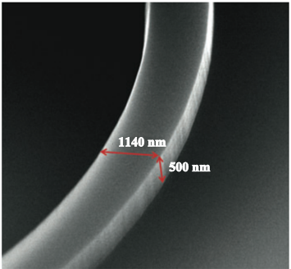
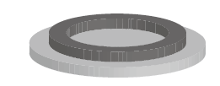

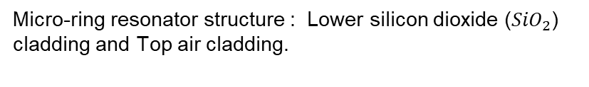
Micro-ring Resonators
Core – Design : High-Q ${Si}_{3}N_{4}$ micro-ring
25um
Micro-ring resonator structure : Lower silicon dioxide (${SiO}_{2}$) cladding and Top air cladding.
Micro-ring thickness and width
Lu, X., Li, Q., Westly, D.A. et al. “Chip-integrated visible–telecom entangled photon pair source for quantum communication,” Nat. Phys. 15, 373–381, Jan. 2019. https://doi.org/10.1038/s41567- 018-0394-3

Slide 18
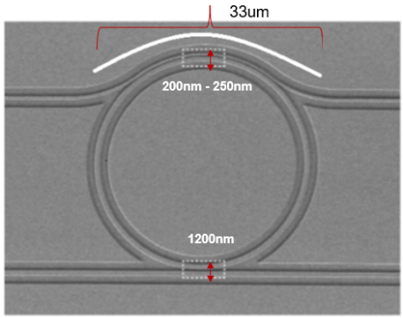
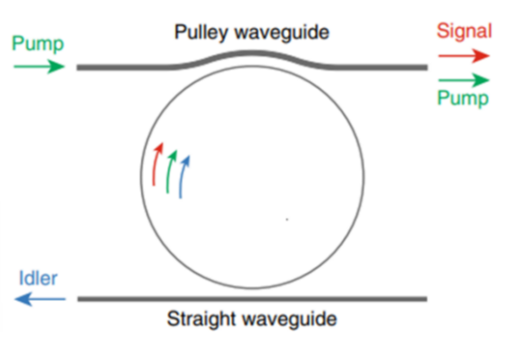
Coupling – Design
Top pulley waveguide :
Supports single-mode operation for the pump mode, and is cut off for the telecom mode, because of the asymmetric cladding core.
Bottom straight waveguide :
Supports single-mode operation at telecom wavelengths, coupling gap for the straight waveguide to couple the telecom mode, not coupling pump and signal modes
Lu, X., Li, Q., Westly, D.A. et al. “Chip-integrated visible–telecom entangled photon pair source for quantum communication,” Nat. Phys. 15, 373–381, Jan. 2019. https://doi.org/10.1038/s41567- 018-0394-3

Slide 19
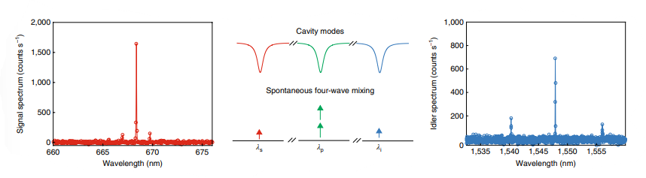
Entangled photons band within cavity
Visible band (667 nm) SFWM - Pump(930 nm) Telecom band(1546 nm)
A fabricated device with a pulley waveguide on the top, for injecting the 930 nm band pump and extracting the 660 nm band signal, and a straight waveguide on the bottom, for extracting the 1,550 nm band idler
Lu, X., Li, Q., Westly, D.A. et al. “Chip-integrated visible–telecom entangled photon pair source for quantum communication,” Nat. Phys. 15, 373–381, Jan. 2019. https://doi.org/10.1038/s41567- 018-0394-3
Notes:
On-chip pair generation rate depends on several factors and is given by : R is the ring-resonator radius, γ is the nonlinear coefficient of the material, which also takes the confinement factor into account, Q is the quality factor, ωp is the angular frequency, vg is the group velocity at the pump wavelength, and Pp is the on-chip pump power.

Slide 20
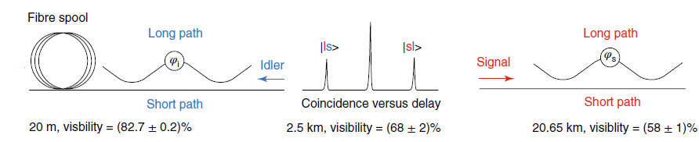

Distribution of entanglement over the distance on the optical fiber
Visibility of entanglement generated from this setup is observed to be 82.7 ± 0.2 for 20m fiber length, 68 ± 2 for fiber length of 2.5km and 58 ± 1 for 20.65km length in fiber.
Lu, X., Li, Q., Westly, D.A. et al. “Chip-integrated visible–telecom entangled photon pair source for quantum communication,” Nat. Phys. 15, 373–381, Jan. 2019. https://doi.org/10.1038/s41567- 018-0394-3

Slide 21
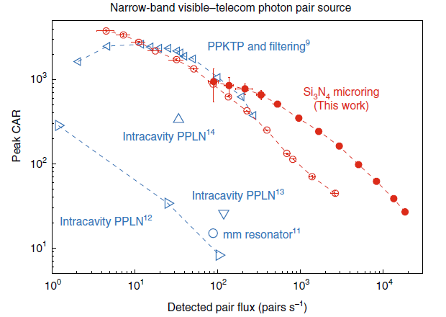
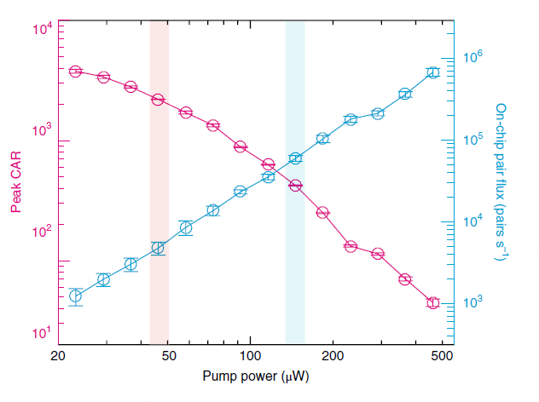
Performance of micro-ring (On-chip flux)
Pump-power dependence of the visible–telecom photon pair source CAR and on-chip photon pair flux
Peak CAR values and the raw detected photon pair flux for narrow-band visible–telecom photon pair sources
Lu, X., Li, Q., Westly, D.A. et al. “Chip-integrated visible–telecom entangled photon pair source for quantum communication,” Nat. Phys. 15, 373–381, Jan. 2019. https://doi.org/10.1038/s41567- 018-0394-3
Notes:
On-chip pair generation rate depends on several factors and is given by : R is the ring-resonator radius, γ is the nonlinear coefficient of the material, which also takes the confinement factor into account, Q is the quality factor, ωp is the angular frequency, vg is the group velocity at the pump wavelength, and Pp is the on-chip pump power.

Slide 22
Performance of micro-ring (On-chip flux)
 | CAR ratio | Photon pair flux (pairs/second)
At 46uW, Pump power | 2200 ± 14 | 4800 ± 900
At 146uW, Pump power | 423 ± 4 | 62000 ± 5000
Highest CAR Ratio | 3780 ± 140 | 1200 ± 300
Highest Photon flux (pairs/second) | 26.8 ± 0.1 | 18400 ± 1000
Residual pump photon is removed using edge-pass filters but without narrow-band spectral filtering.
In this residual pump and signal photon is passed through a series of filters, to provide which provide path only to Signal photon.
Lu, X., Li, Q., Westly, D.A. et al. “Chip-integrated visible–telecom entangled photon pair source for quantum communication,” Nat. Phys. 15, 373–381, Jan. 2019. https://doi.org/10.1038/s41567- 018-0394-3
Notes:
On-chip pair generation rate depends on several factors and is given by : R is the ring-resonator radius, γ is the nonlinear coefficient of the material, which also takes the confinement factor into account, Q is the quality factor, ωp is the angular frequency, vg is the group velocity at the pump wavelength, and Pp is the on-chip pump power.

Slide 23
Advantages : Micro-ring resonator
Key points : Long distance quantum communication using fiber optics
Operating wavelength range → Near-ultraviolet to mid-infrared
Power → Sub-milliwatt optical pump laser
Output → High spectral brightness, High Photon purity
Photon pair generated → 667.0nm and 1,555.2nm has a frequency mismatch of 3.86GHz,
about 10 times larger than that of the brightest pair.

Slide 24

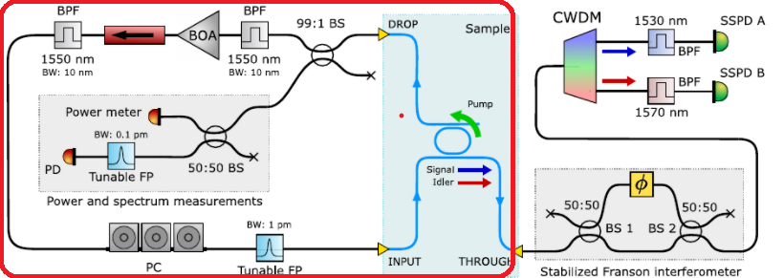

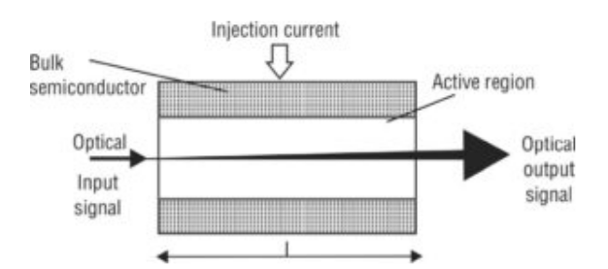
Self-pumping – Ring resonator Scheme
In this self-pump configuration, part shown in red box, the optical amplifier provides the optical feedback required for lasing action and micro-ring resonances modulates the round-trip losses of cavity (around 10.5 dB), automatically causing resonances at one of the ring’s resonance frequencies required to produce signal and idle pair by SFWM
Setup (RED Box): BOA, booster optical amplifier; BPF, band pass filter; FP, Fabry–Perot; PC, polarization controller
F. Garrisi, F. A. Sabattoli, S. Sam, A. Barone, M. Massara, F. Pirzio, F. Morichetti, A. Melloni, M. Liscidini, M. Galli, and D. Bajoni, “An electrically-driven source of time-energy entangled photons based on a self-pumped silicon microring resonator,” Optics Letters, vol. 45, 04 2020.

Slide 25
Micro-ring resonator with self-pumping scheme
Optical amplifier provides gain for the radiation of one of the ring resonances to obtain lasing and is fed back to the micro-ring resonator loop.
Lifts the need of external bulky and costly laser sources in the cavity.
Provides compatibility with classical photonics technology, low-cost, high performance and scalable.
Produce high-quality photonic entanglement in the visible–telecom wavelength range on a single integrated photonic on-chip.

Slide 26
Solution : Existing infrastructure
For increasing coupling efficiency of entangled photon with existing infrastructure.
Utilize entangled photon source that generate in broad spectral range
Telecom band photons at low efficiency or having low intensity.
Spectral filtering like optical cavities or very narrow bandpass filters
Provides the telecom band entangled photon at lower intensity.
Entangled Photon
Source
Spectral Filter
(Telecom band)
Telecom Band Photon
Other than telecom band photon

Slide 27
Approach : Existing infrastructure
Multiple entangled photon source is coupled in the channel, optical fiber
Number of sources must be selected precisely to match :
Satisfies our overall entangled photon requirement with an aim to establish continuous channel for communication
Certainty of entangled photons at telecom band at all points in time.

Slide 28
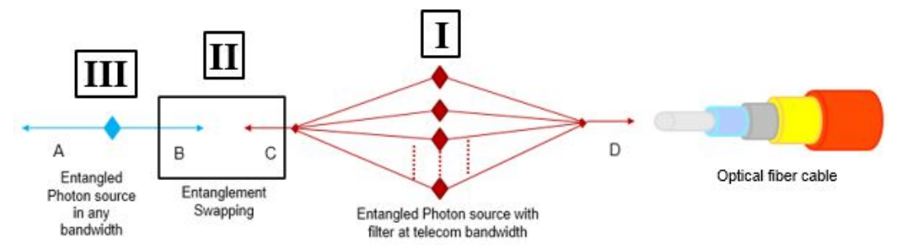
Approach : Existing infrastructure
At Interface I : Use of multiple low efficiency entangled photon source with filters to generate only telecom band entangled photon.
At Interface III : Entangled photon pair source that resides with user for quantum information encoding.
At Interface II : User entangled photon B with C from source that is at telecom band. Bell state measurement on the photon pairs

Slide 29
Impacts of Proposed Suggestions
Increased collection efficiency, for single photon source.
Integrated on-chip, visible and telecom entangled photon, makes easier
local quantum systems and optical infrastructure connection
No requirement of bulky laser, makes source viable, low cost, scalable.
Efficient coupling with the telecom band, source viable for real-world/practical communication through optical
Utilization of existing optical fiber infrastructure.

Slide 30
THANK YOU !!

