Slide 1
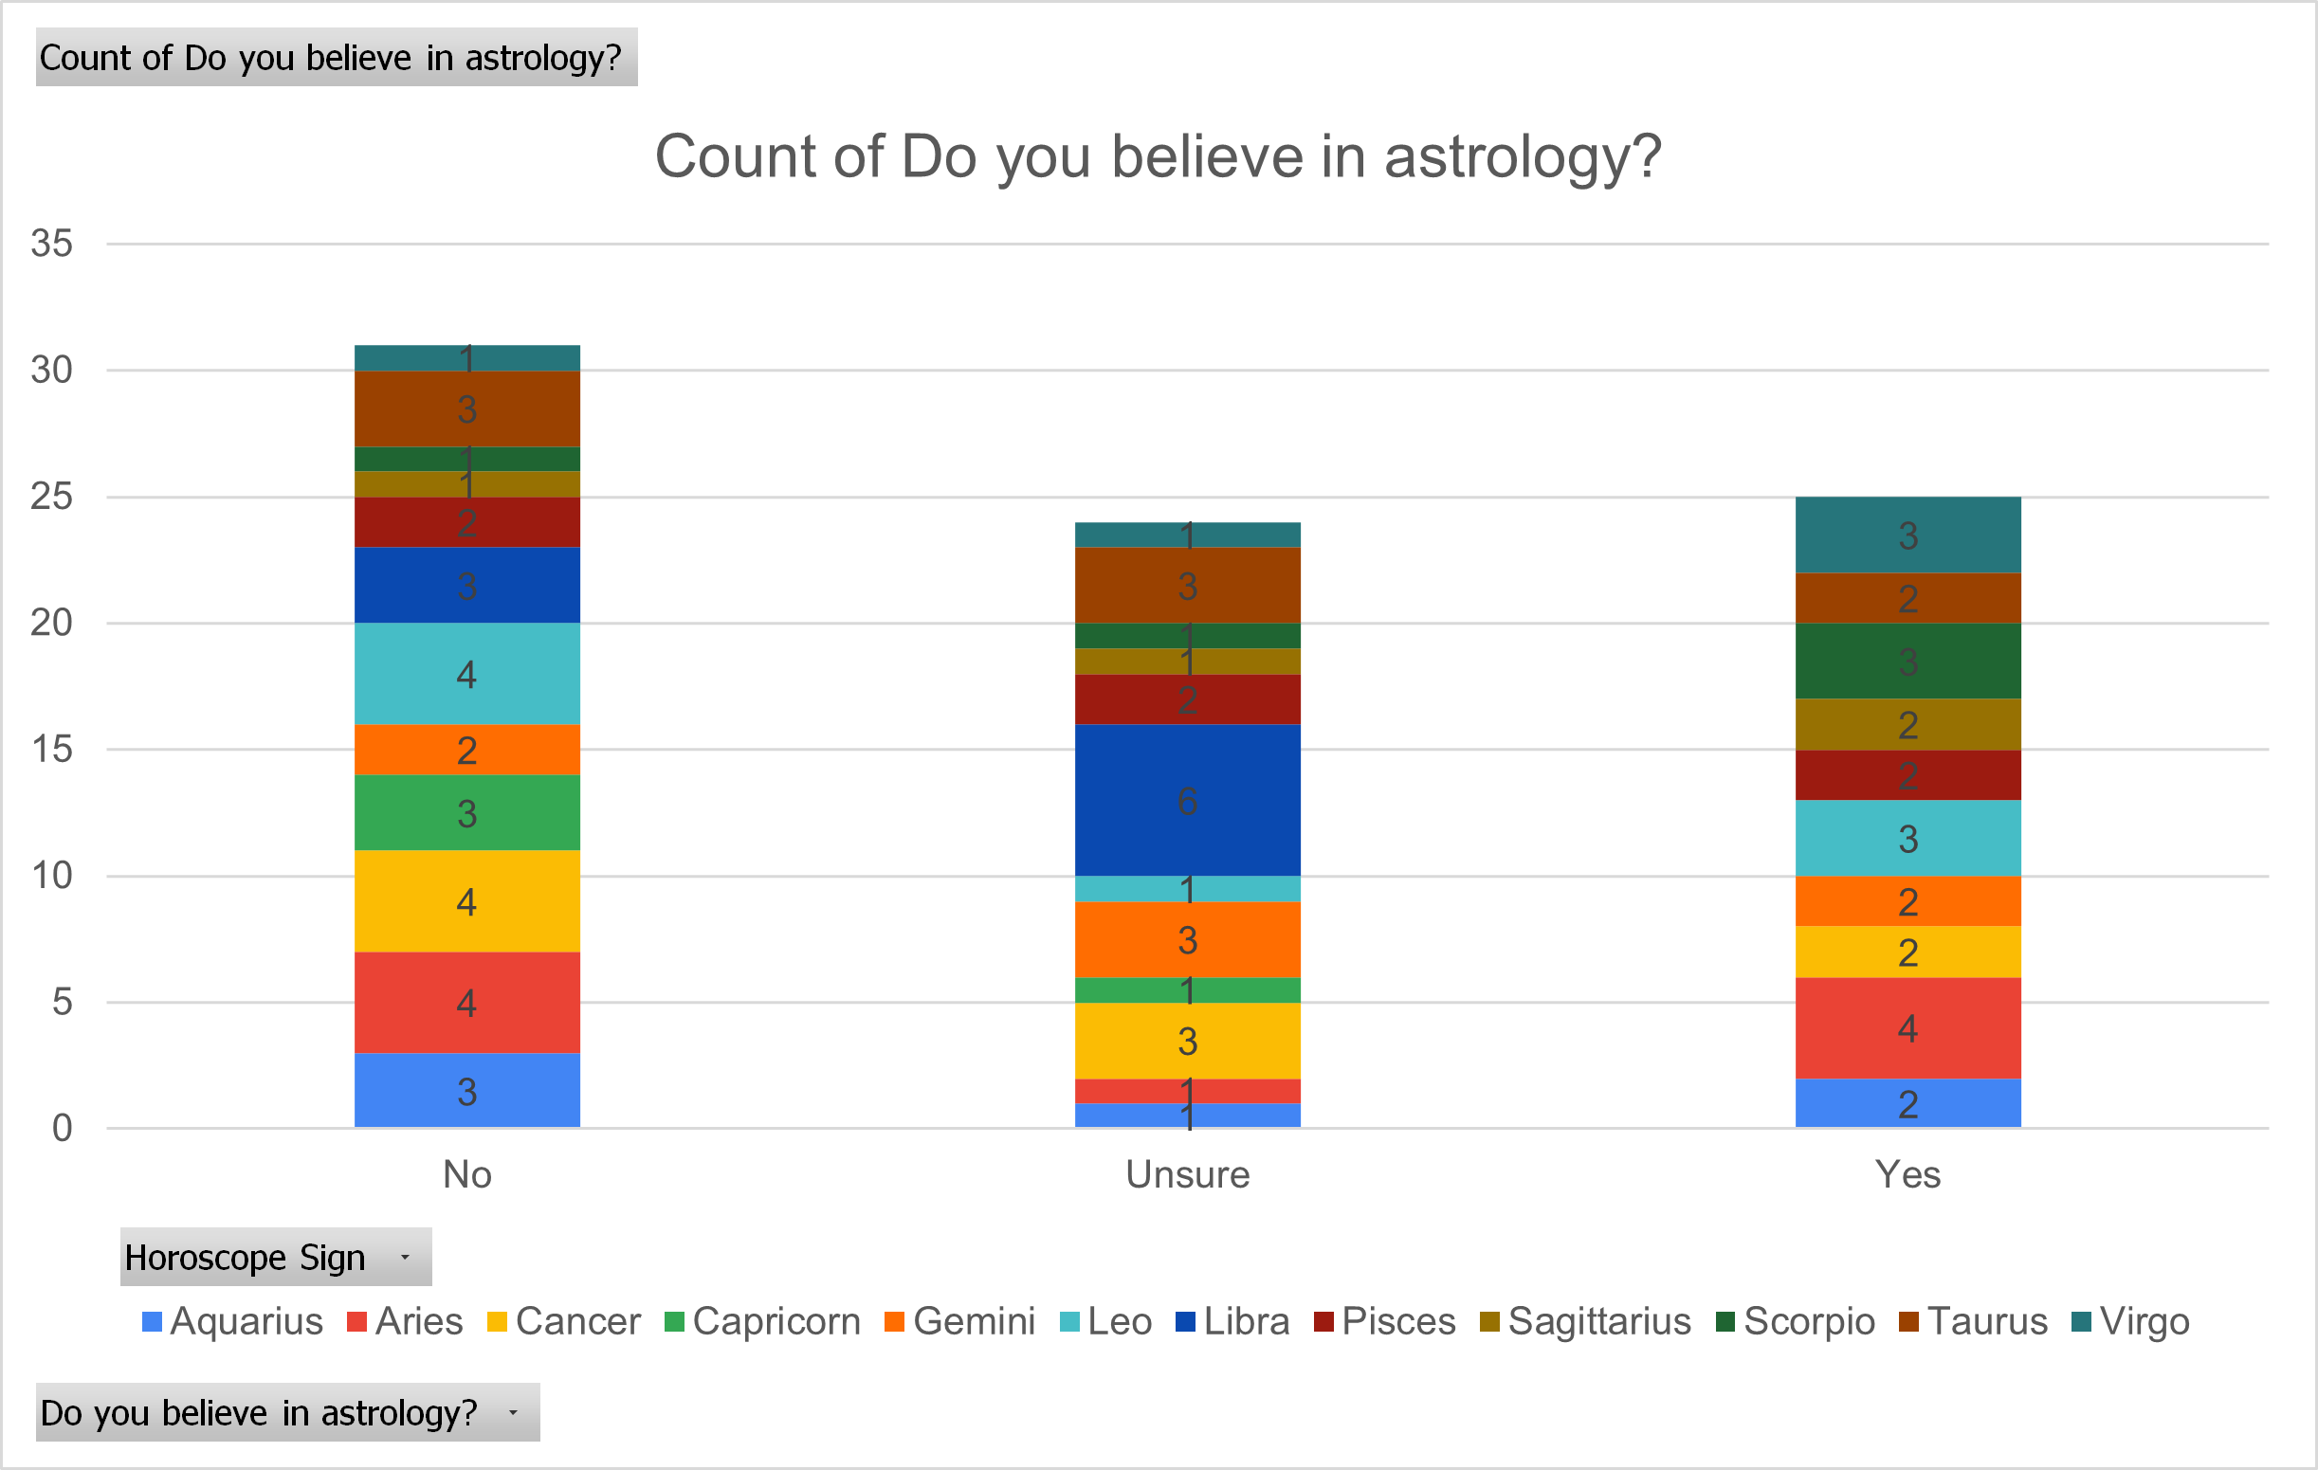
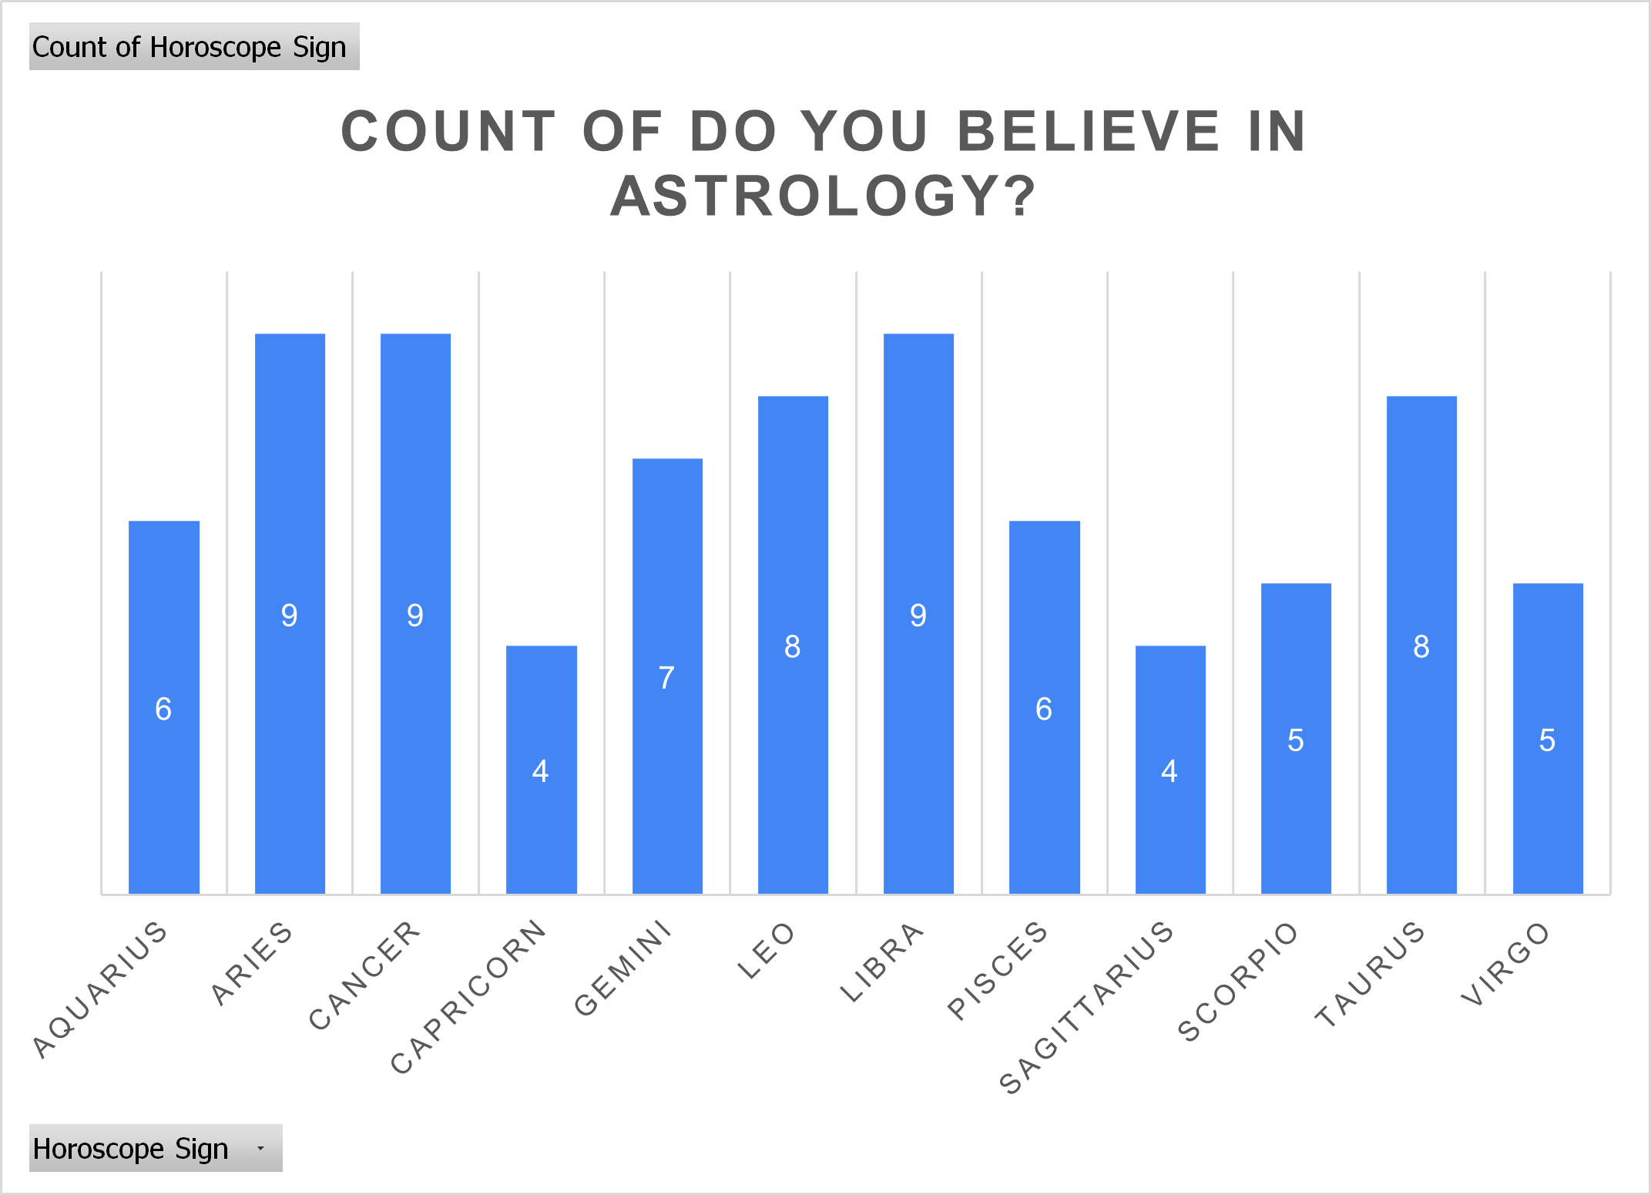
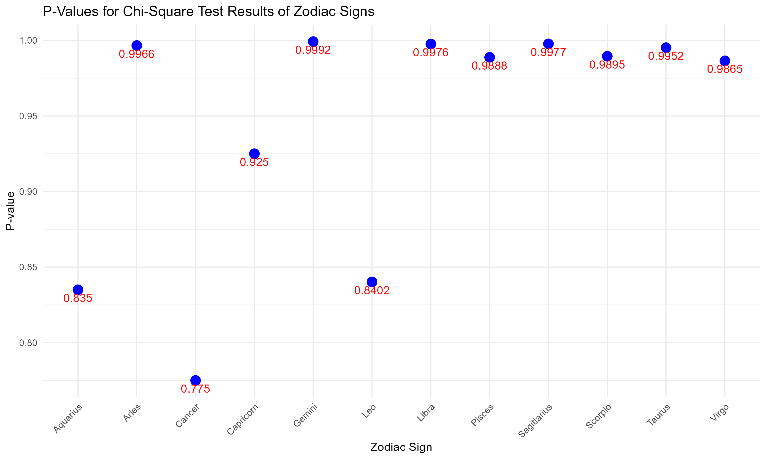
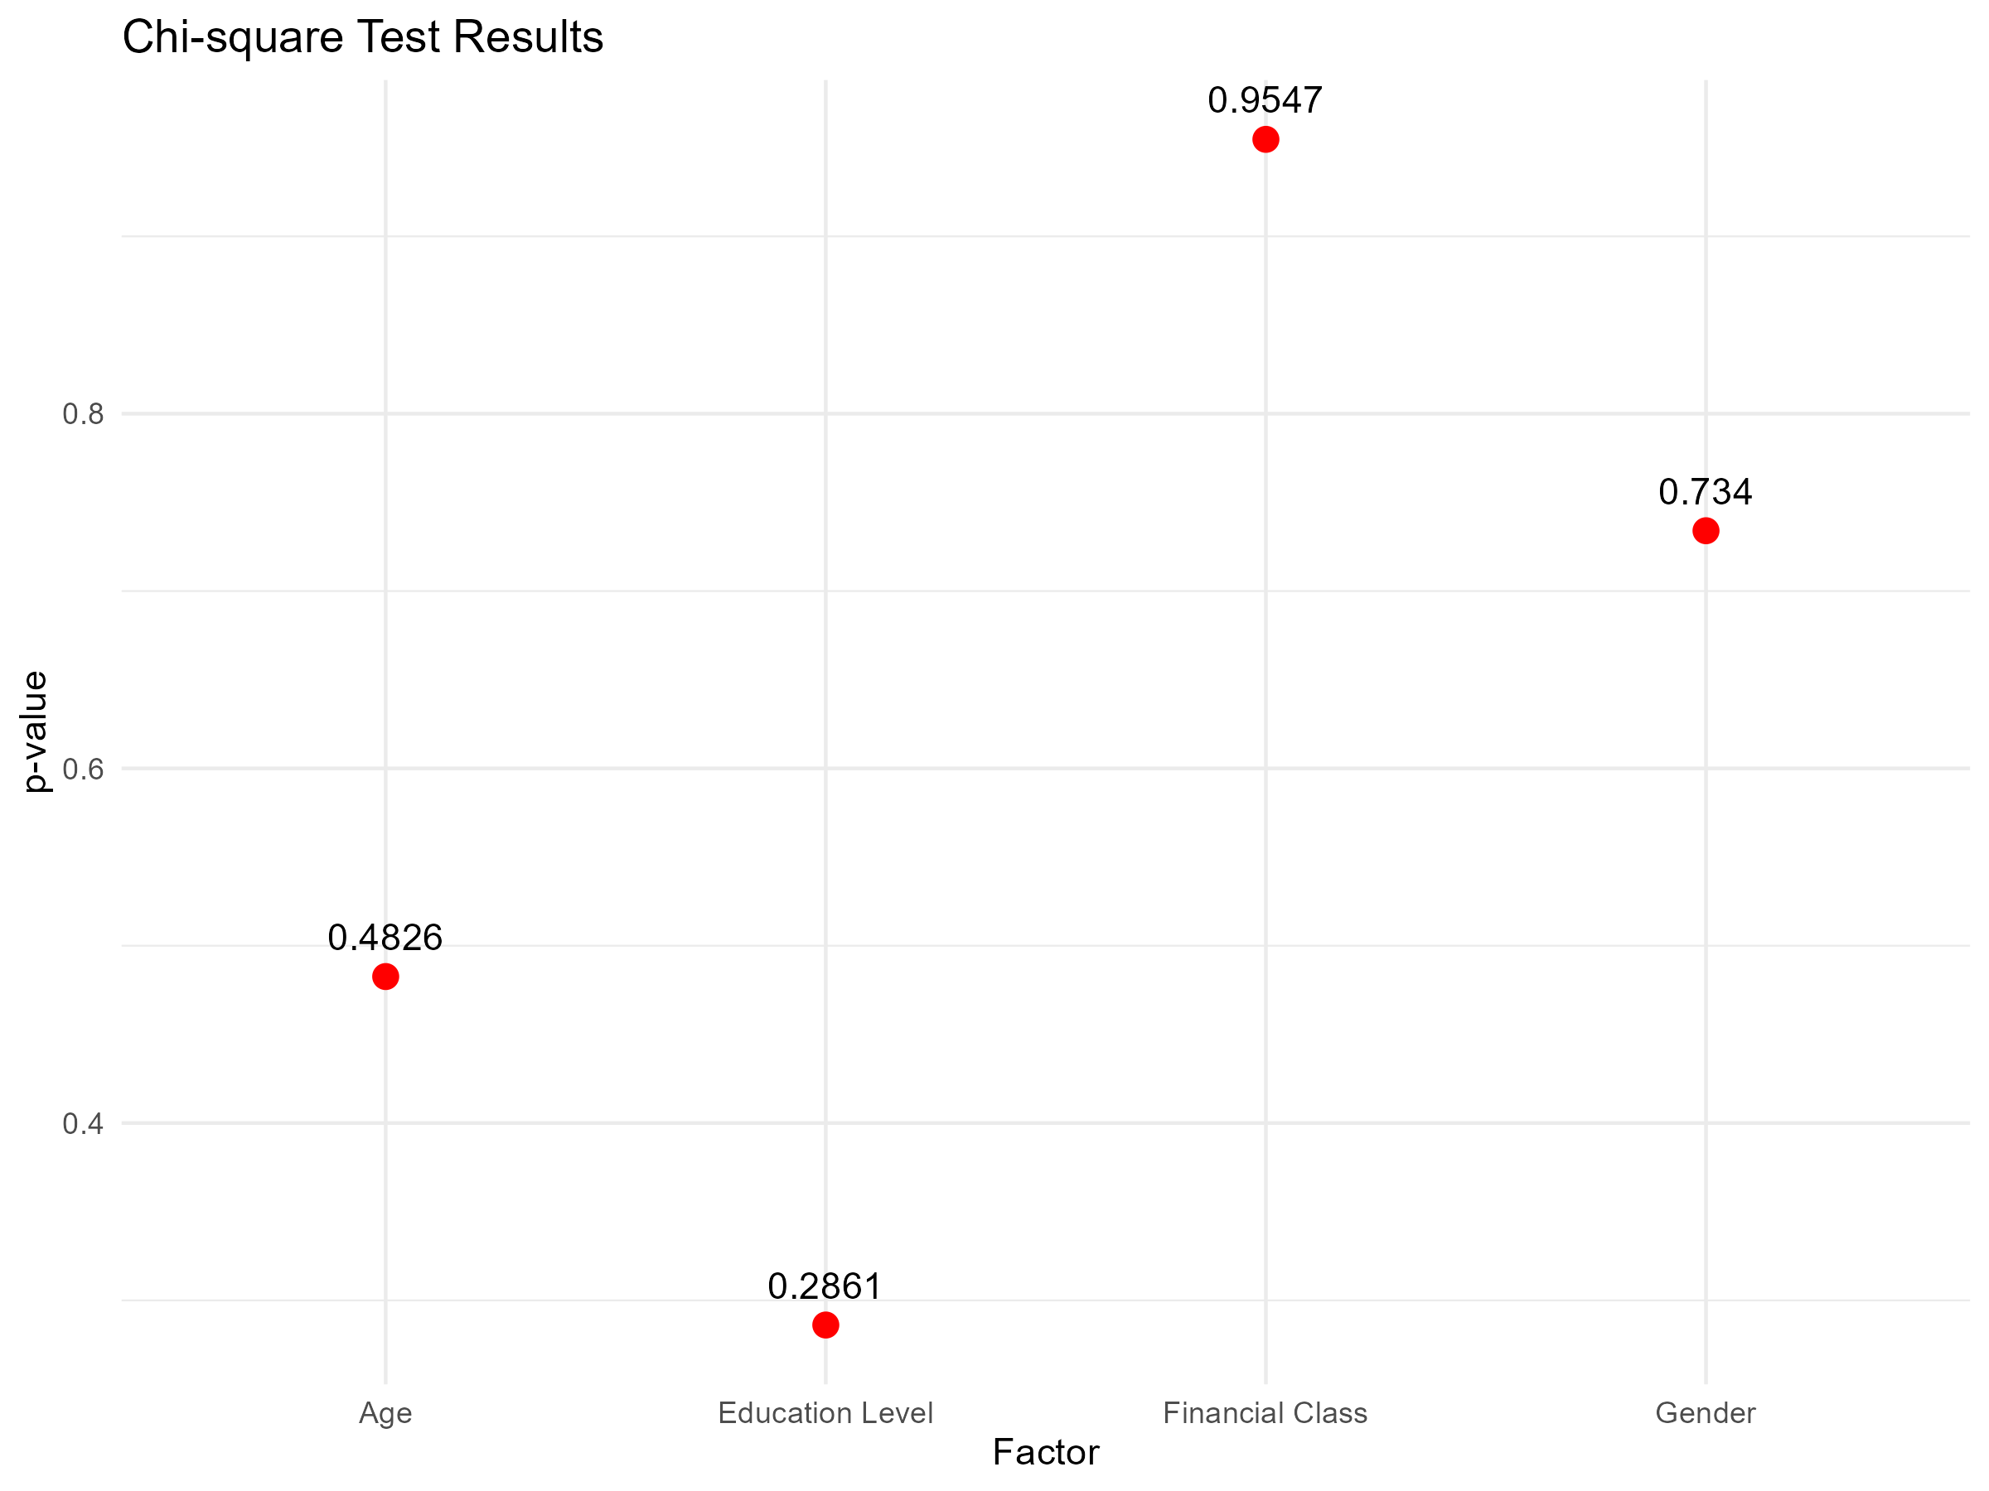
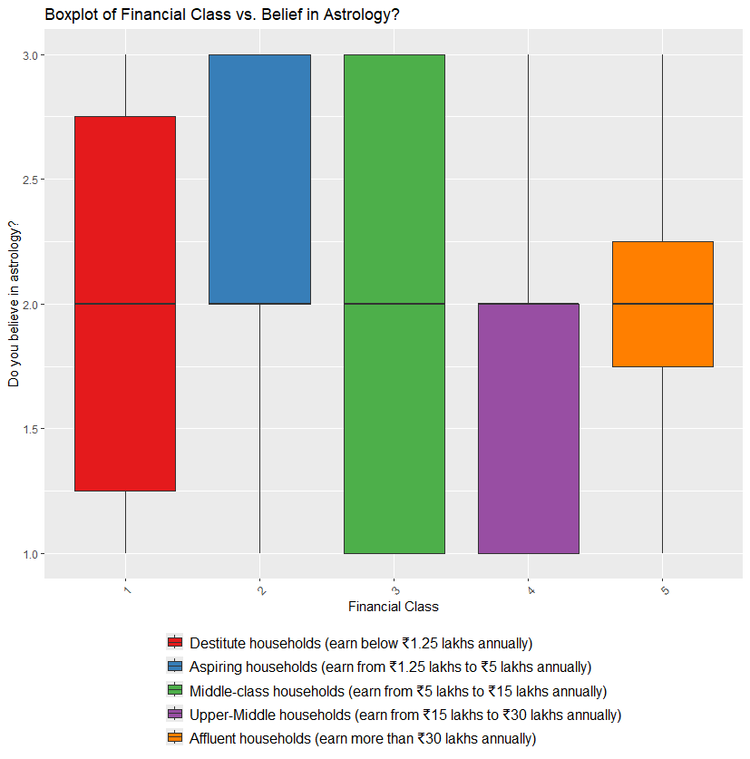
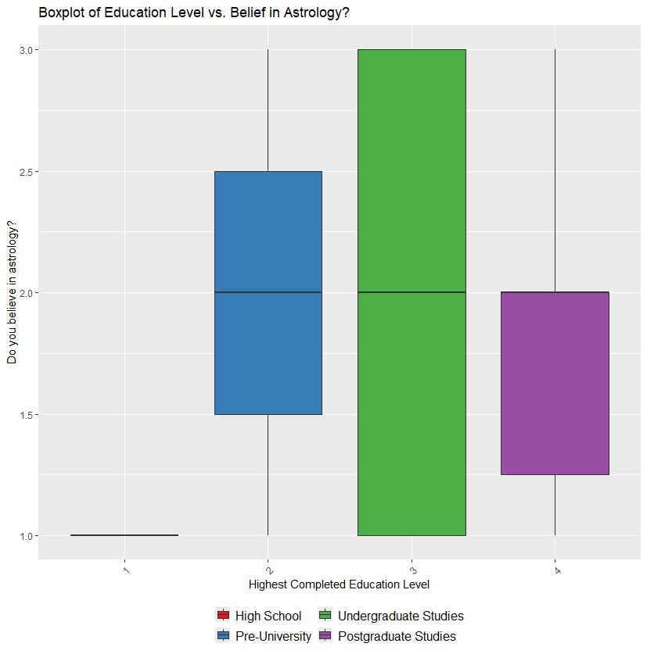
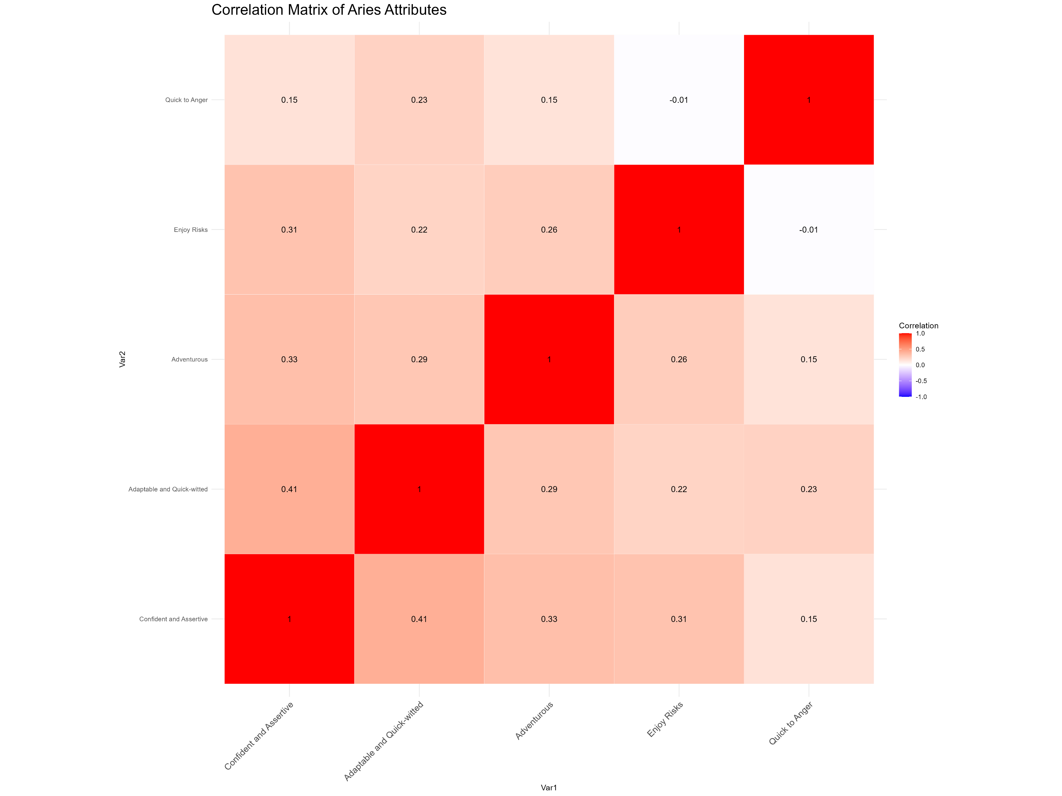
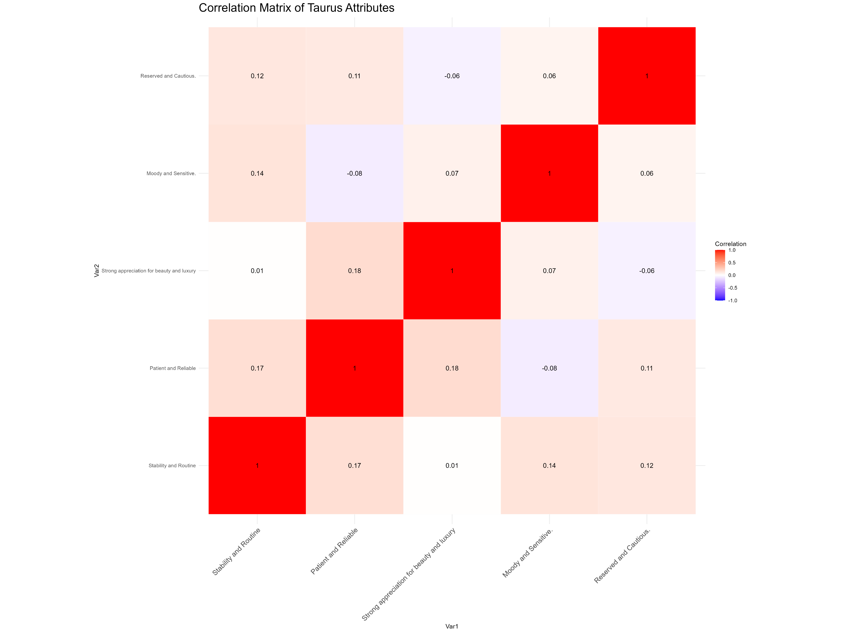
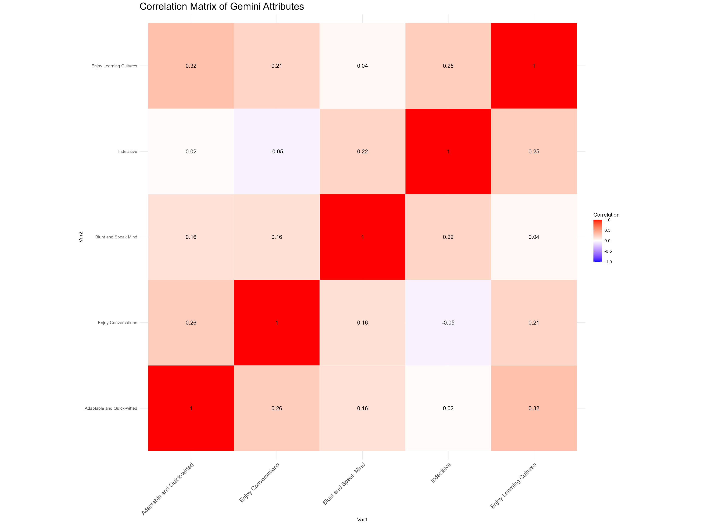
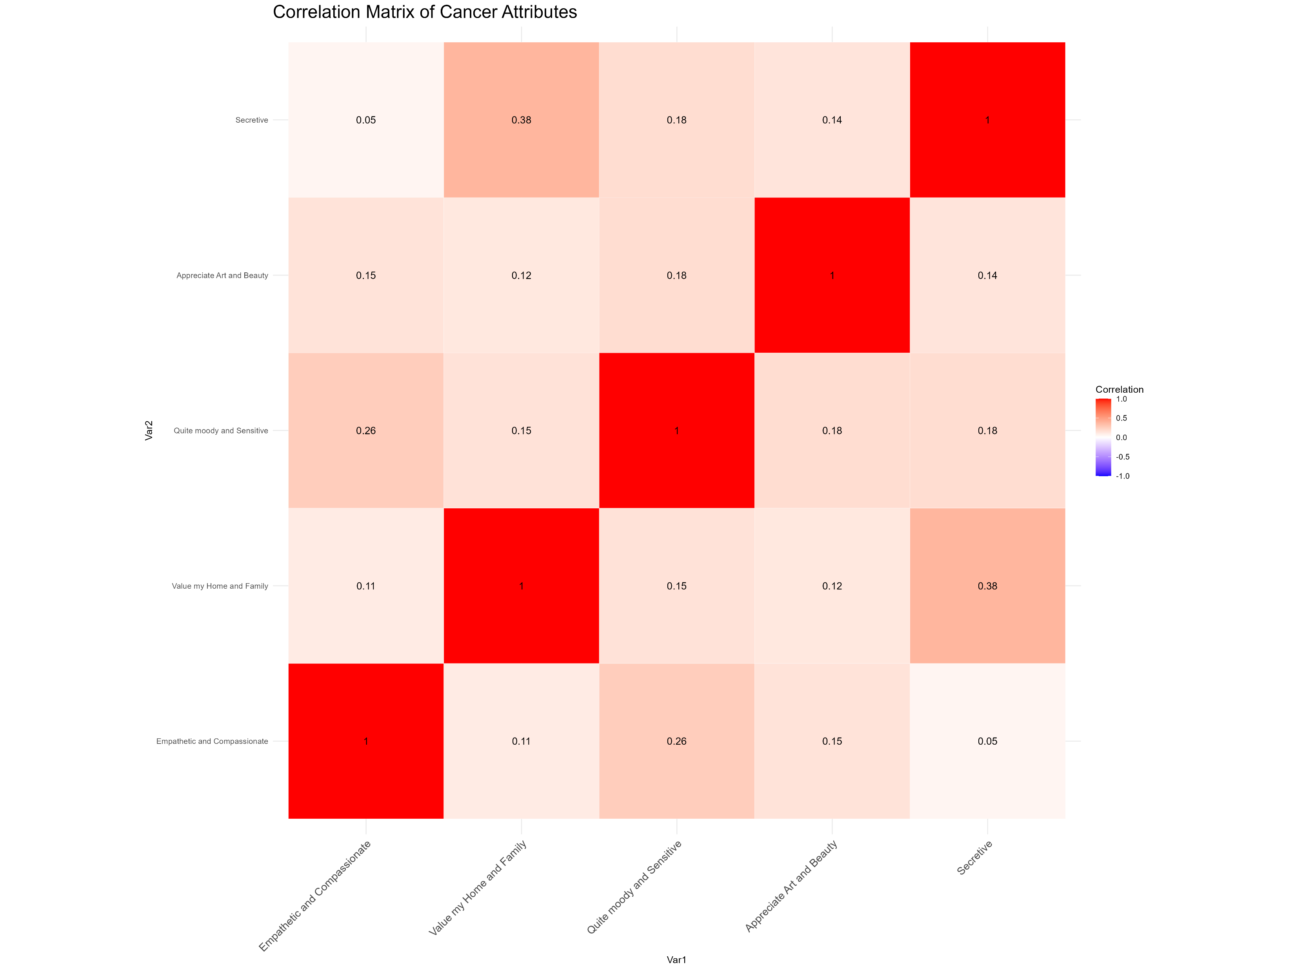
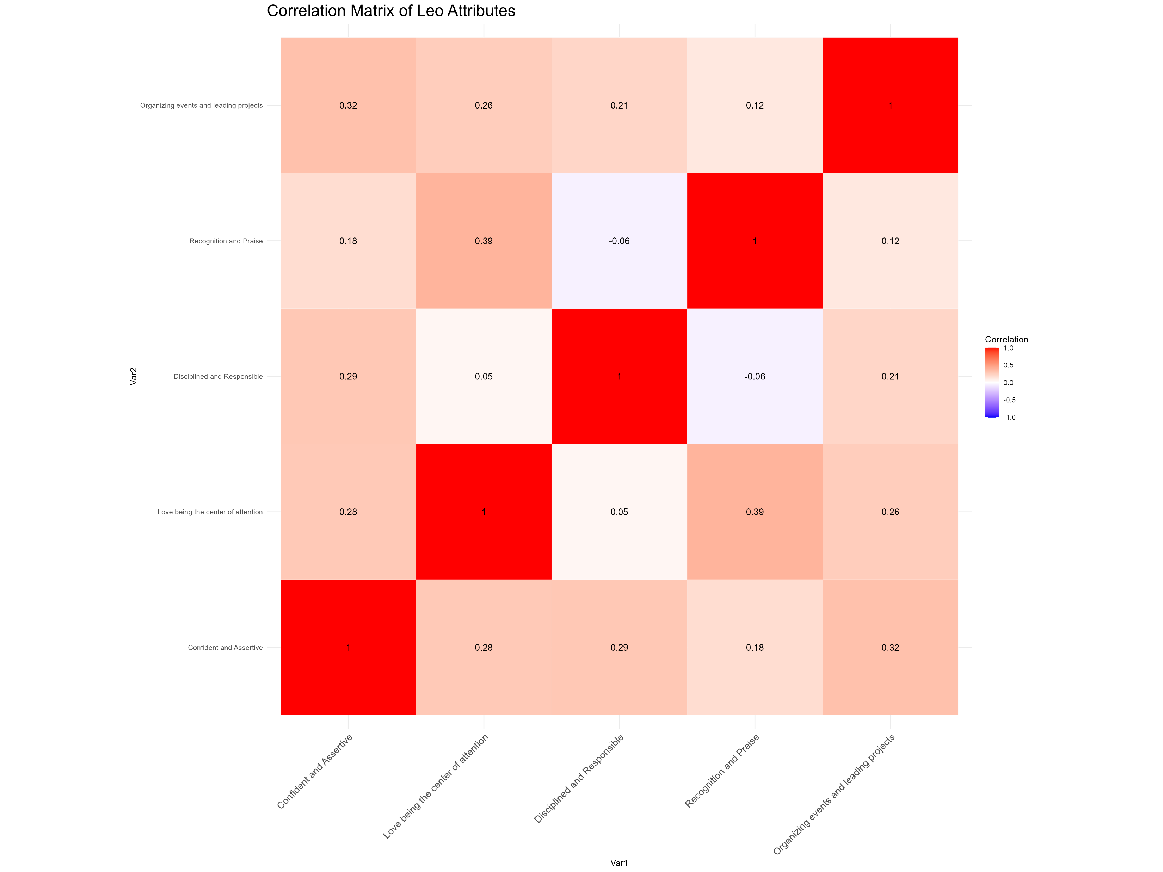
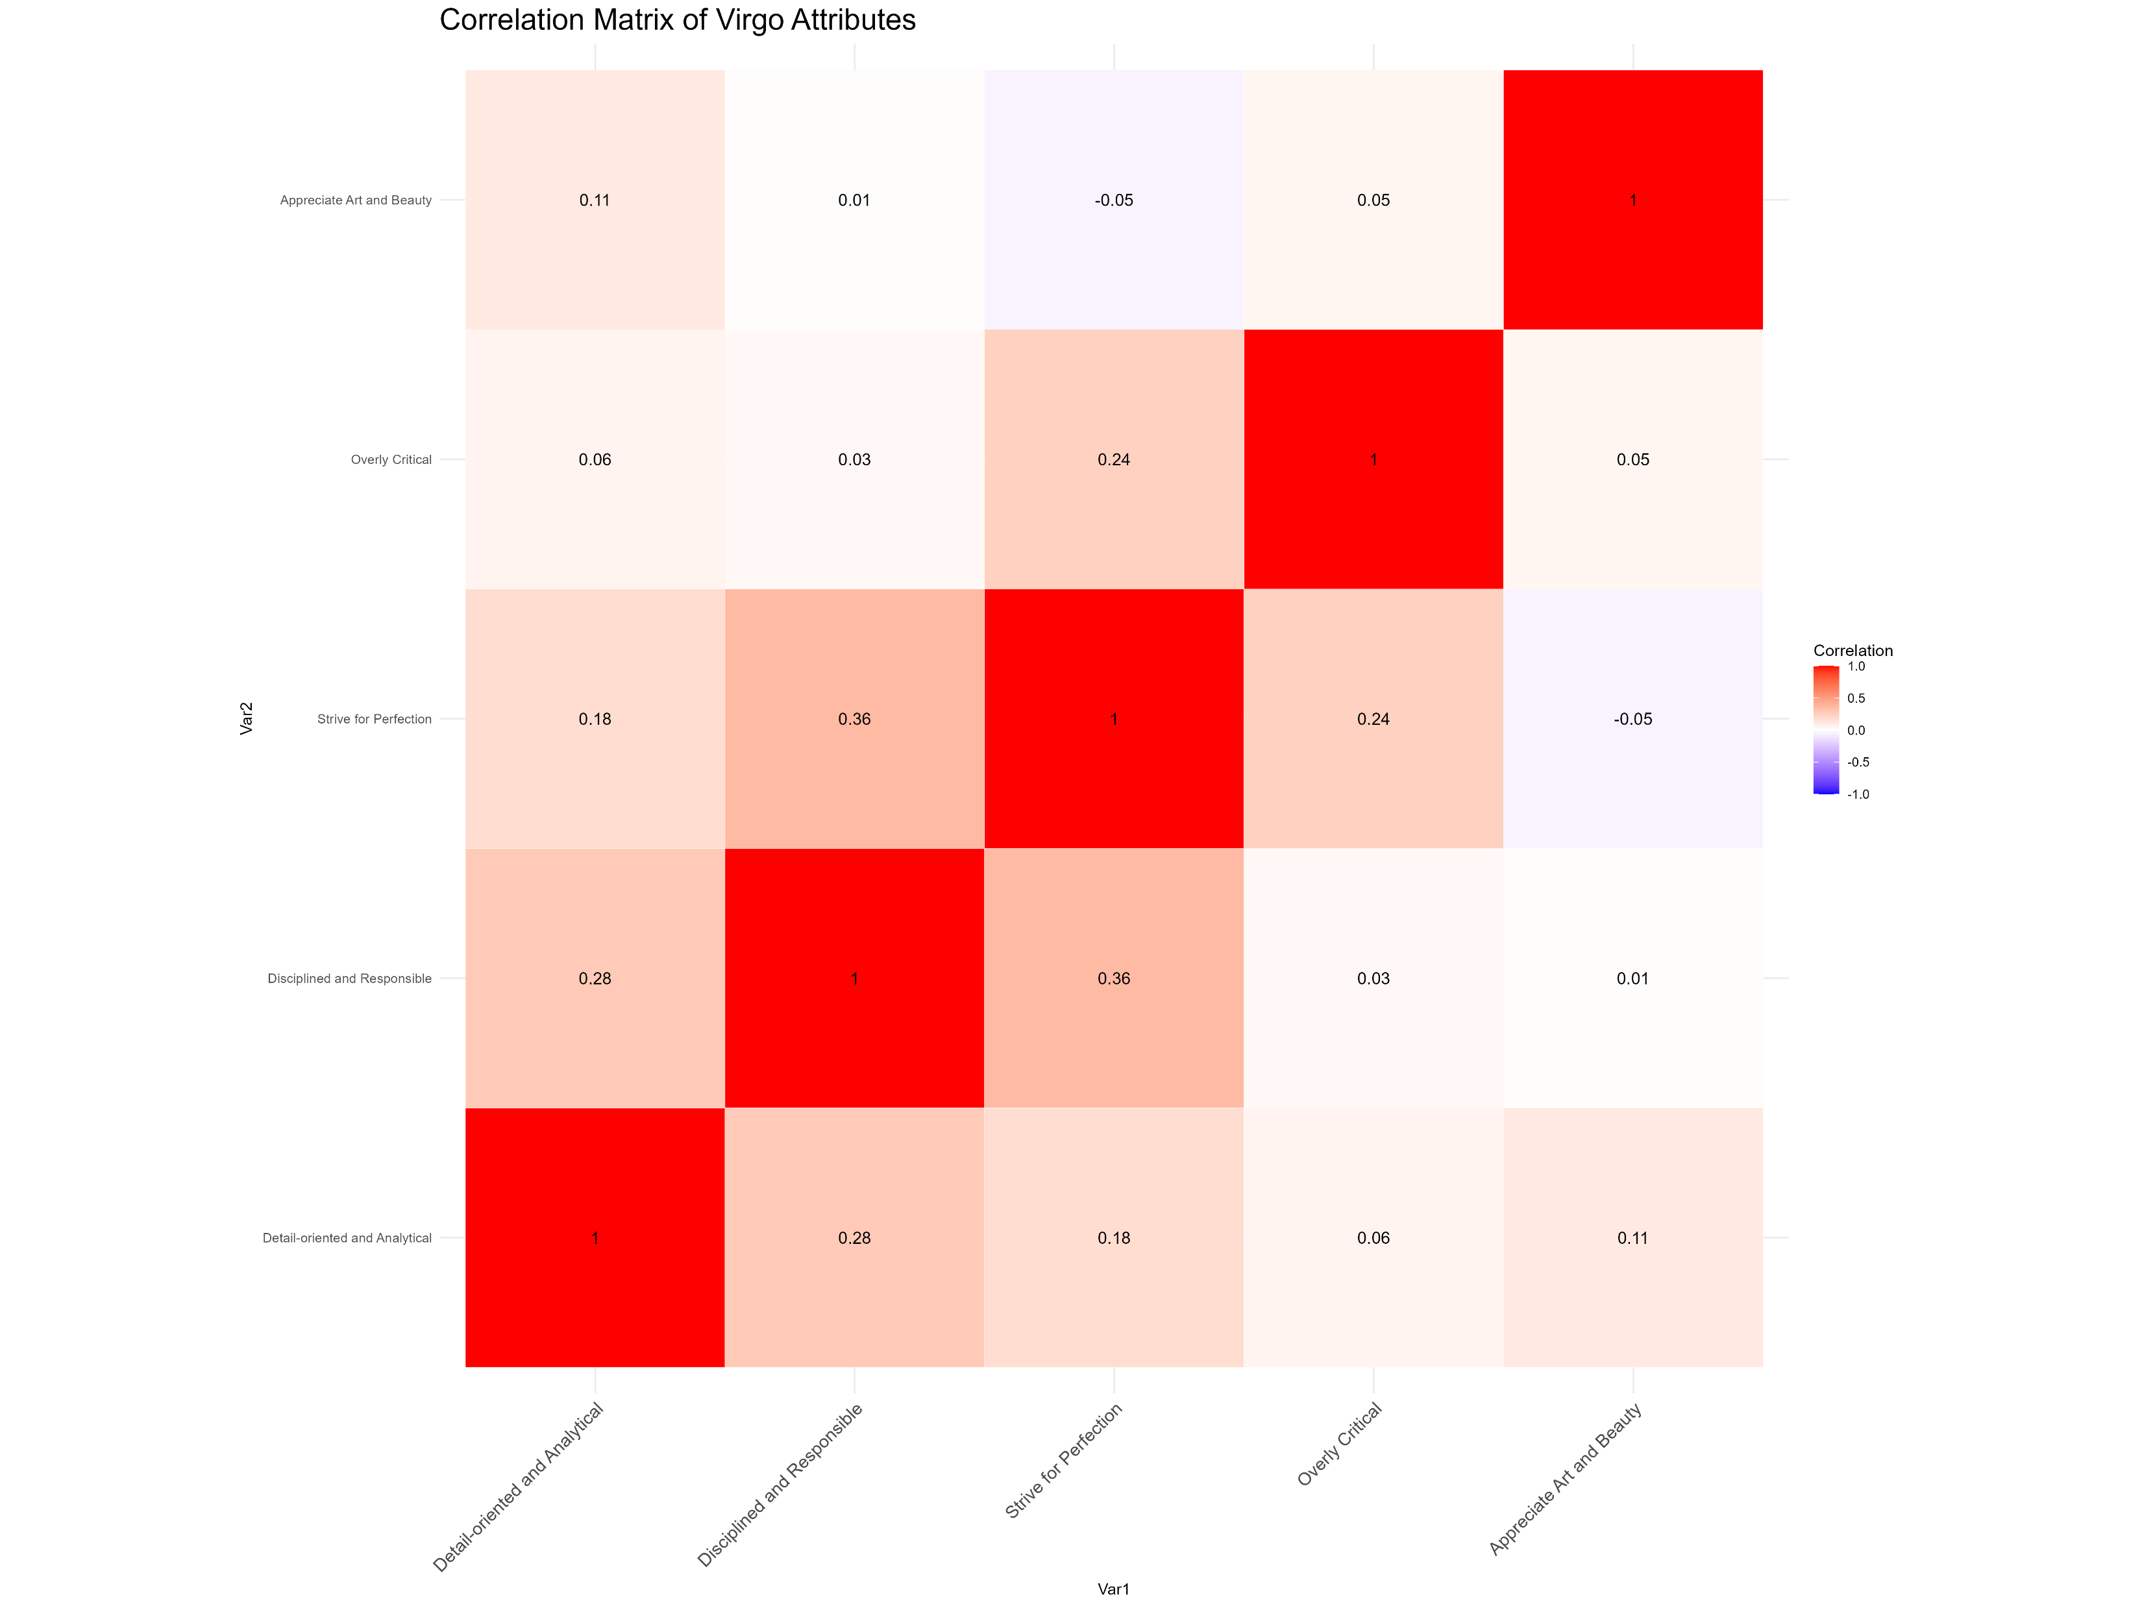
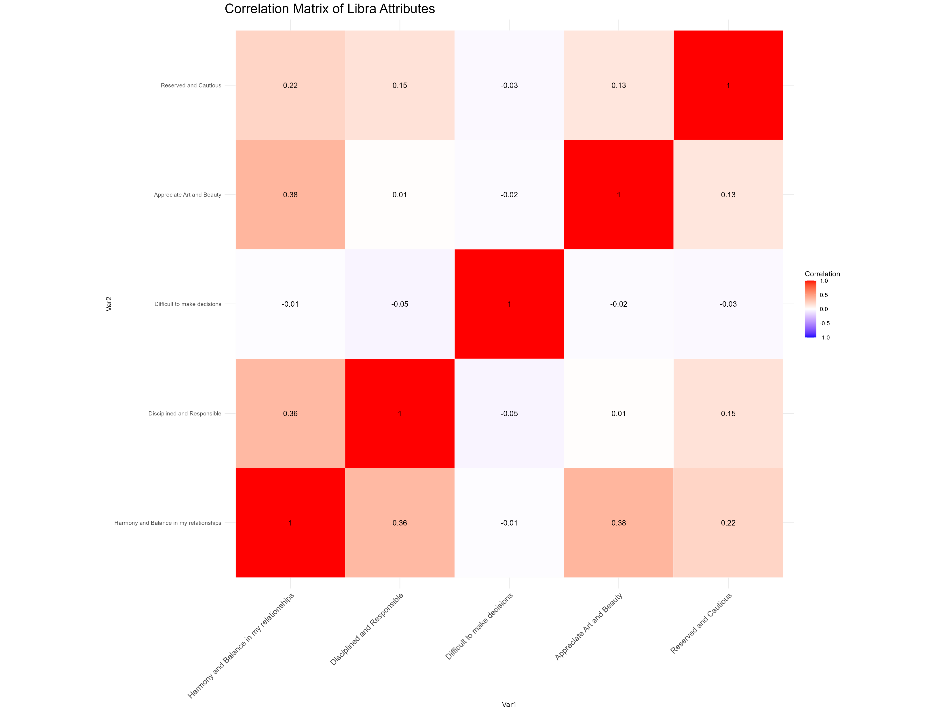
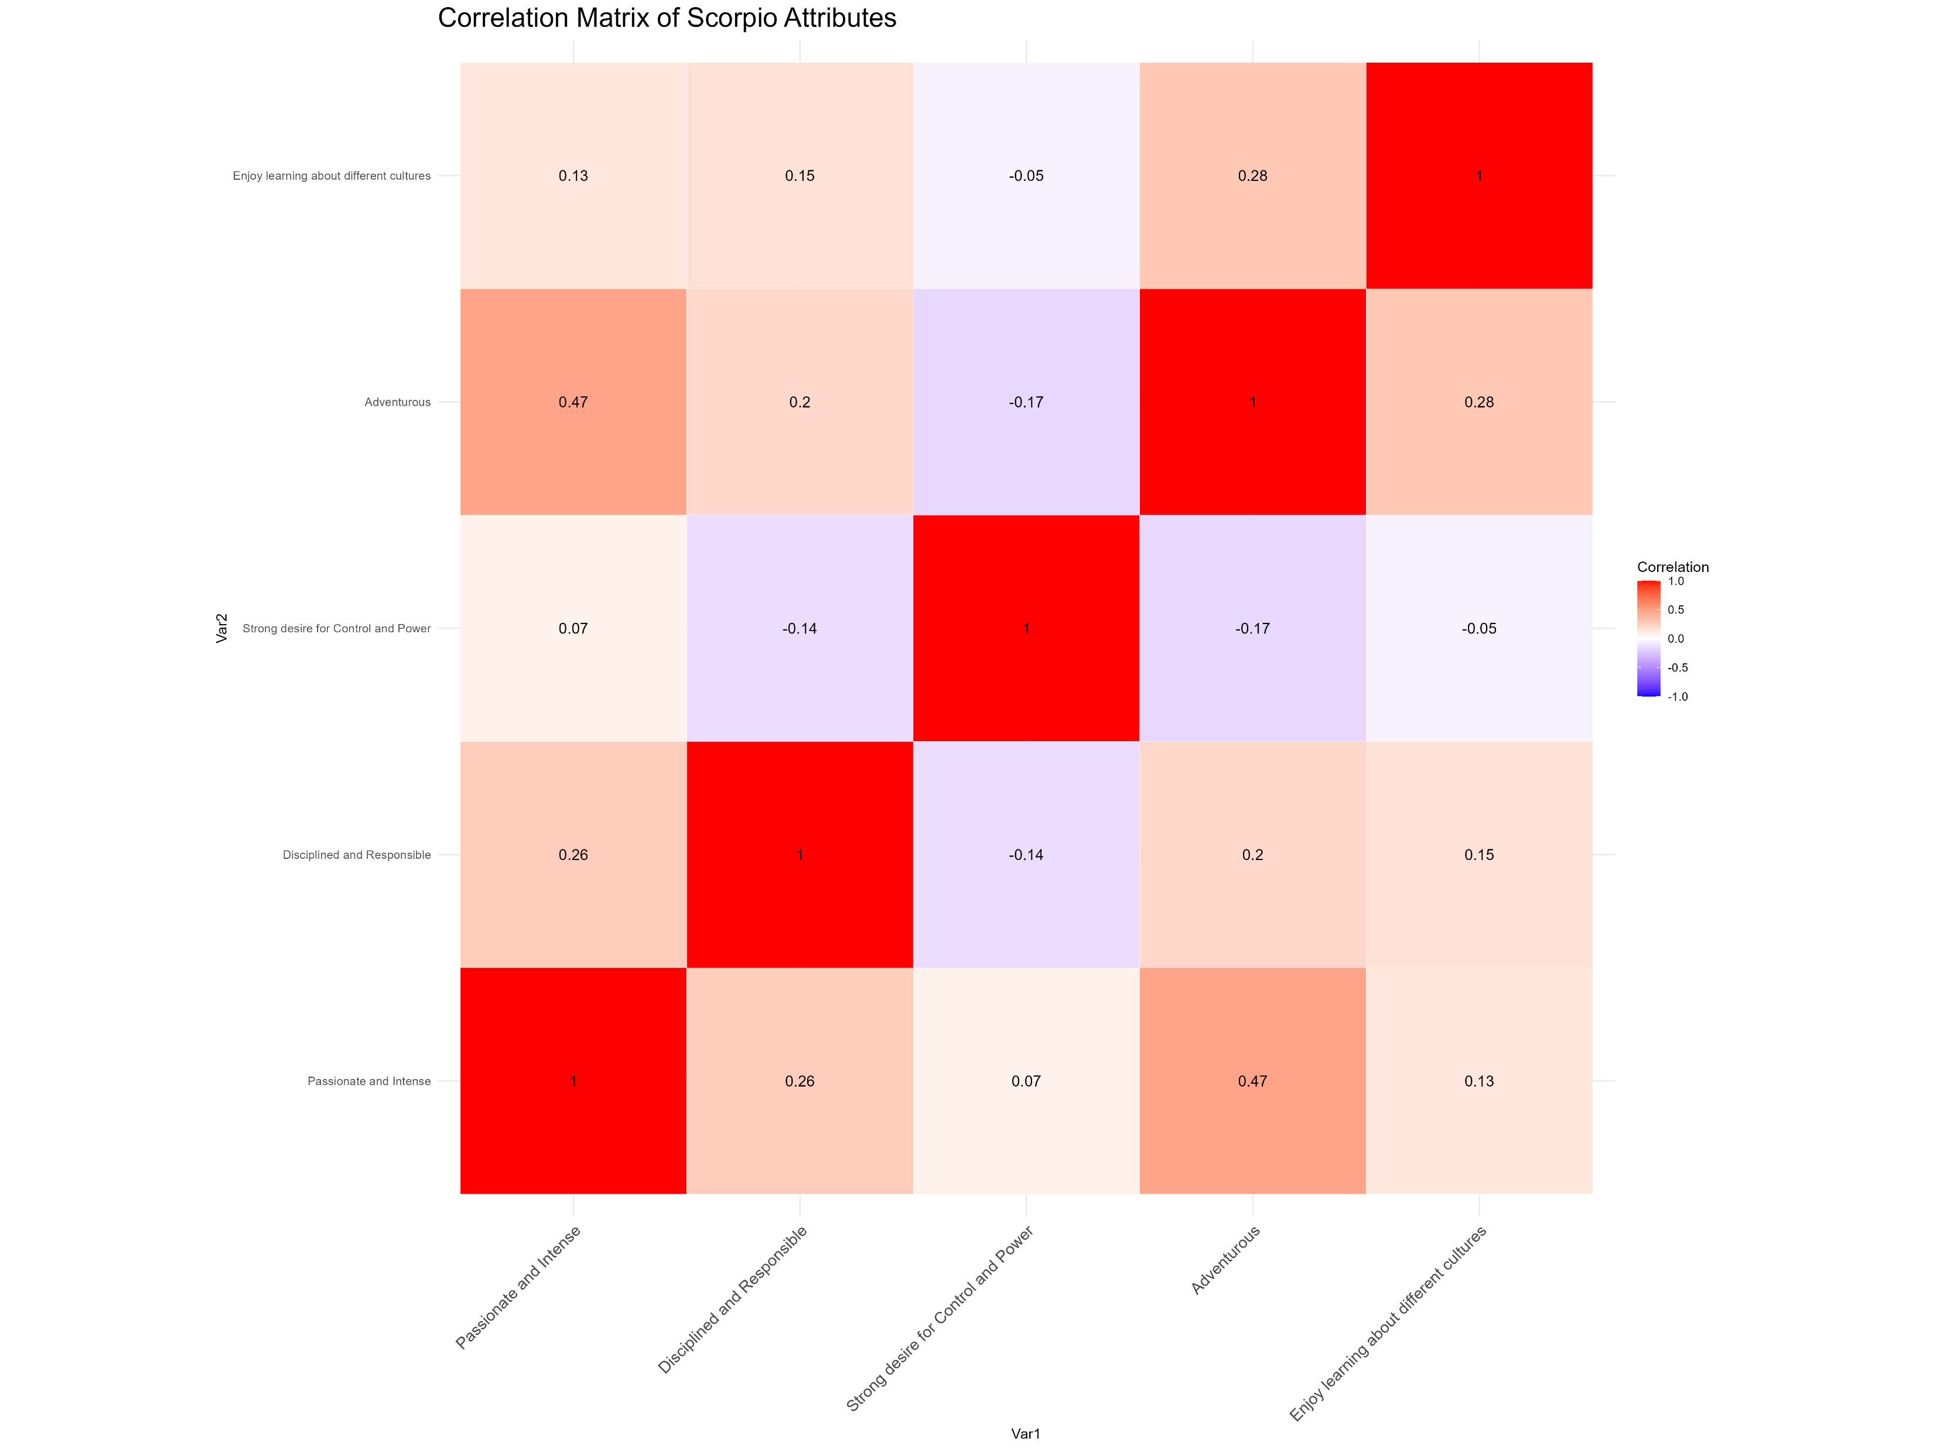
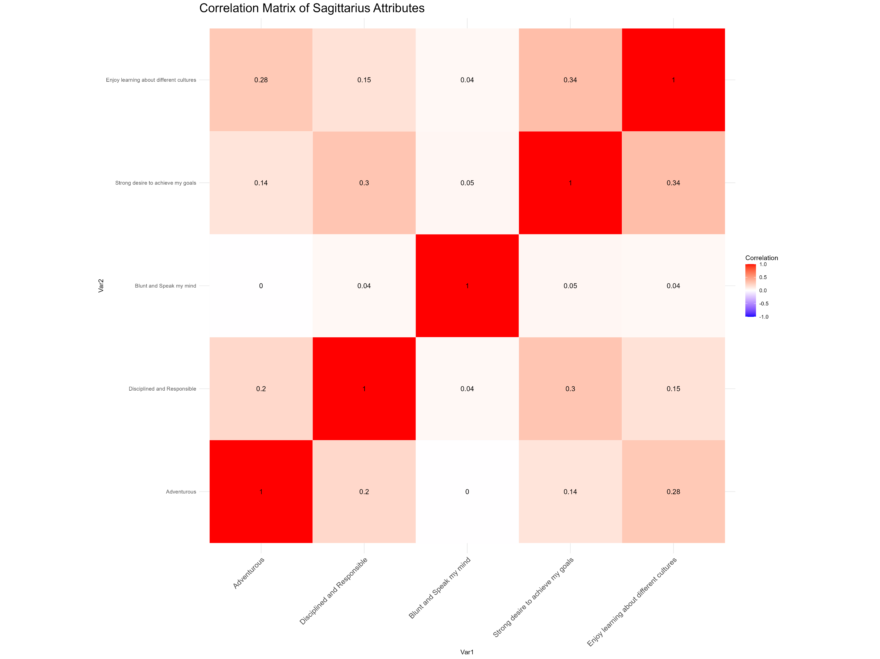
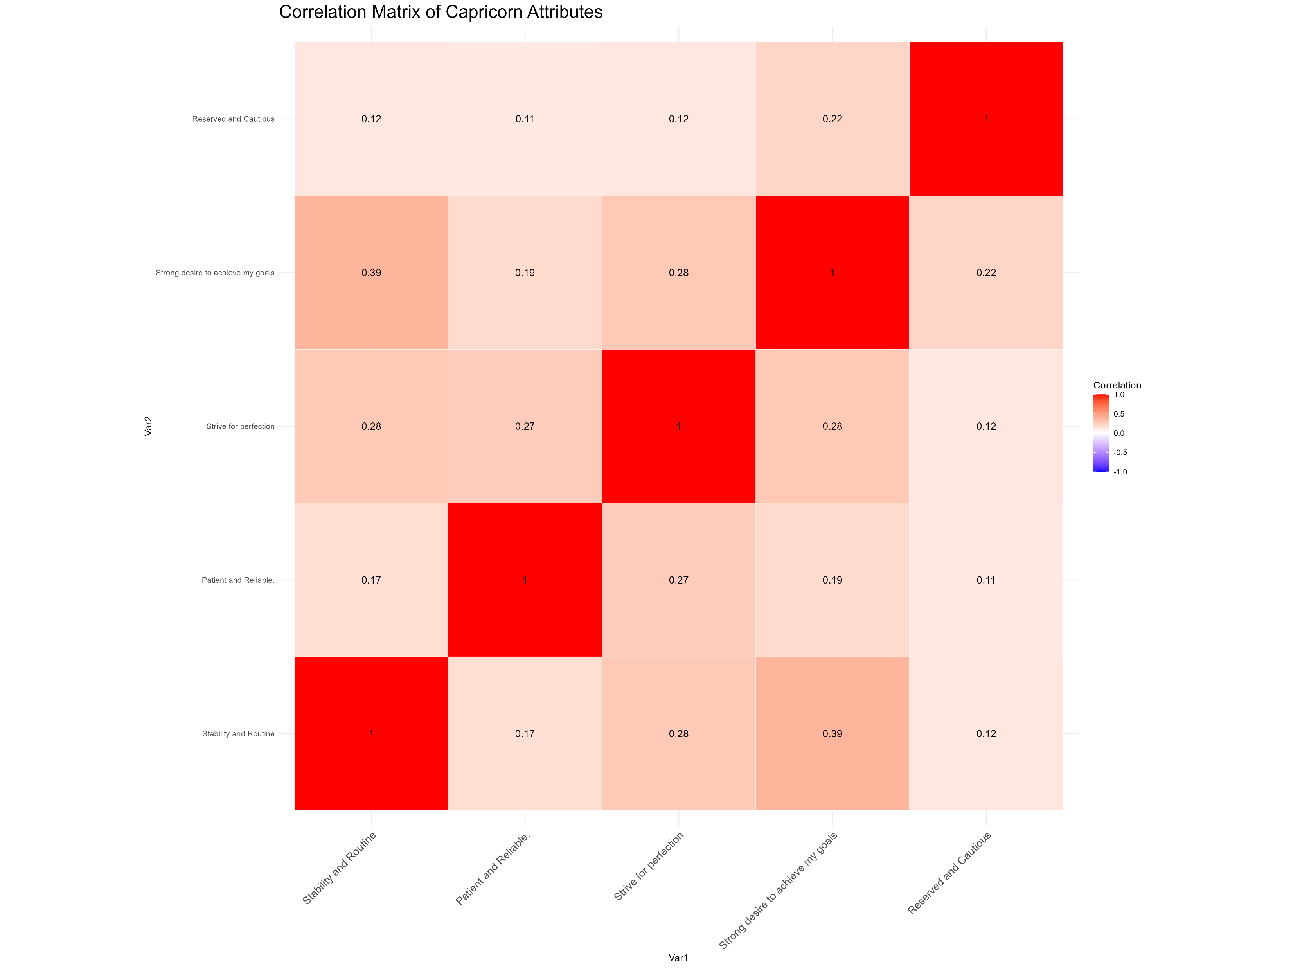
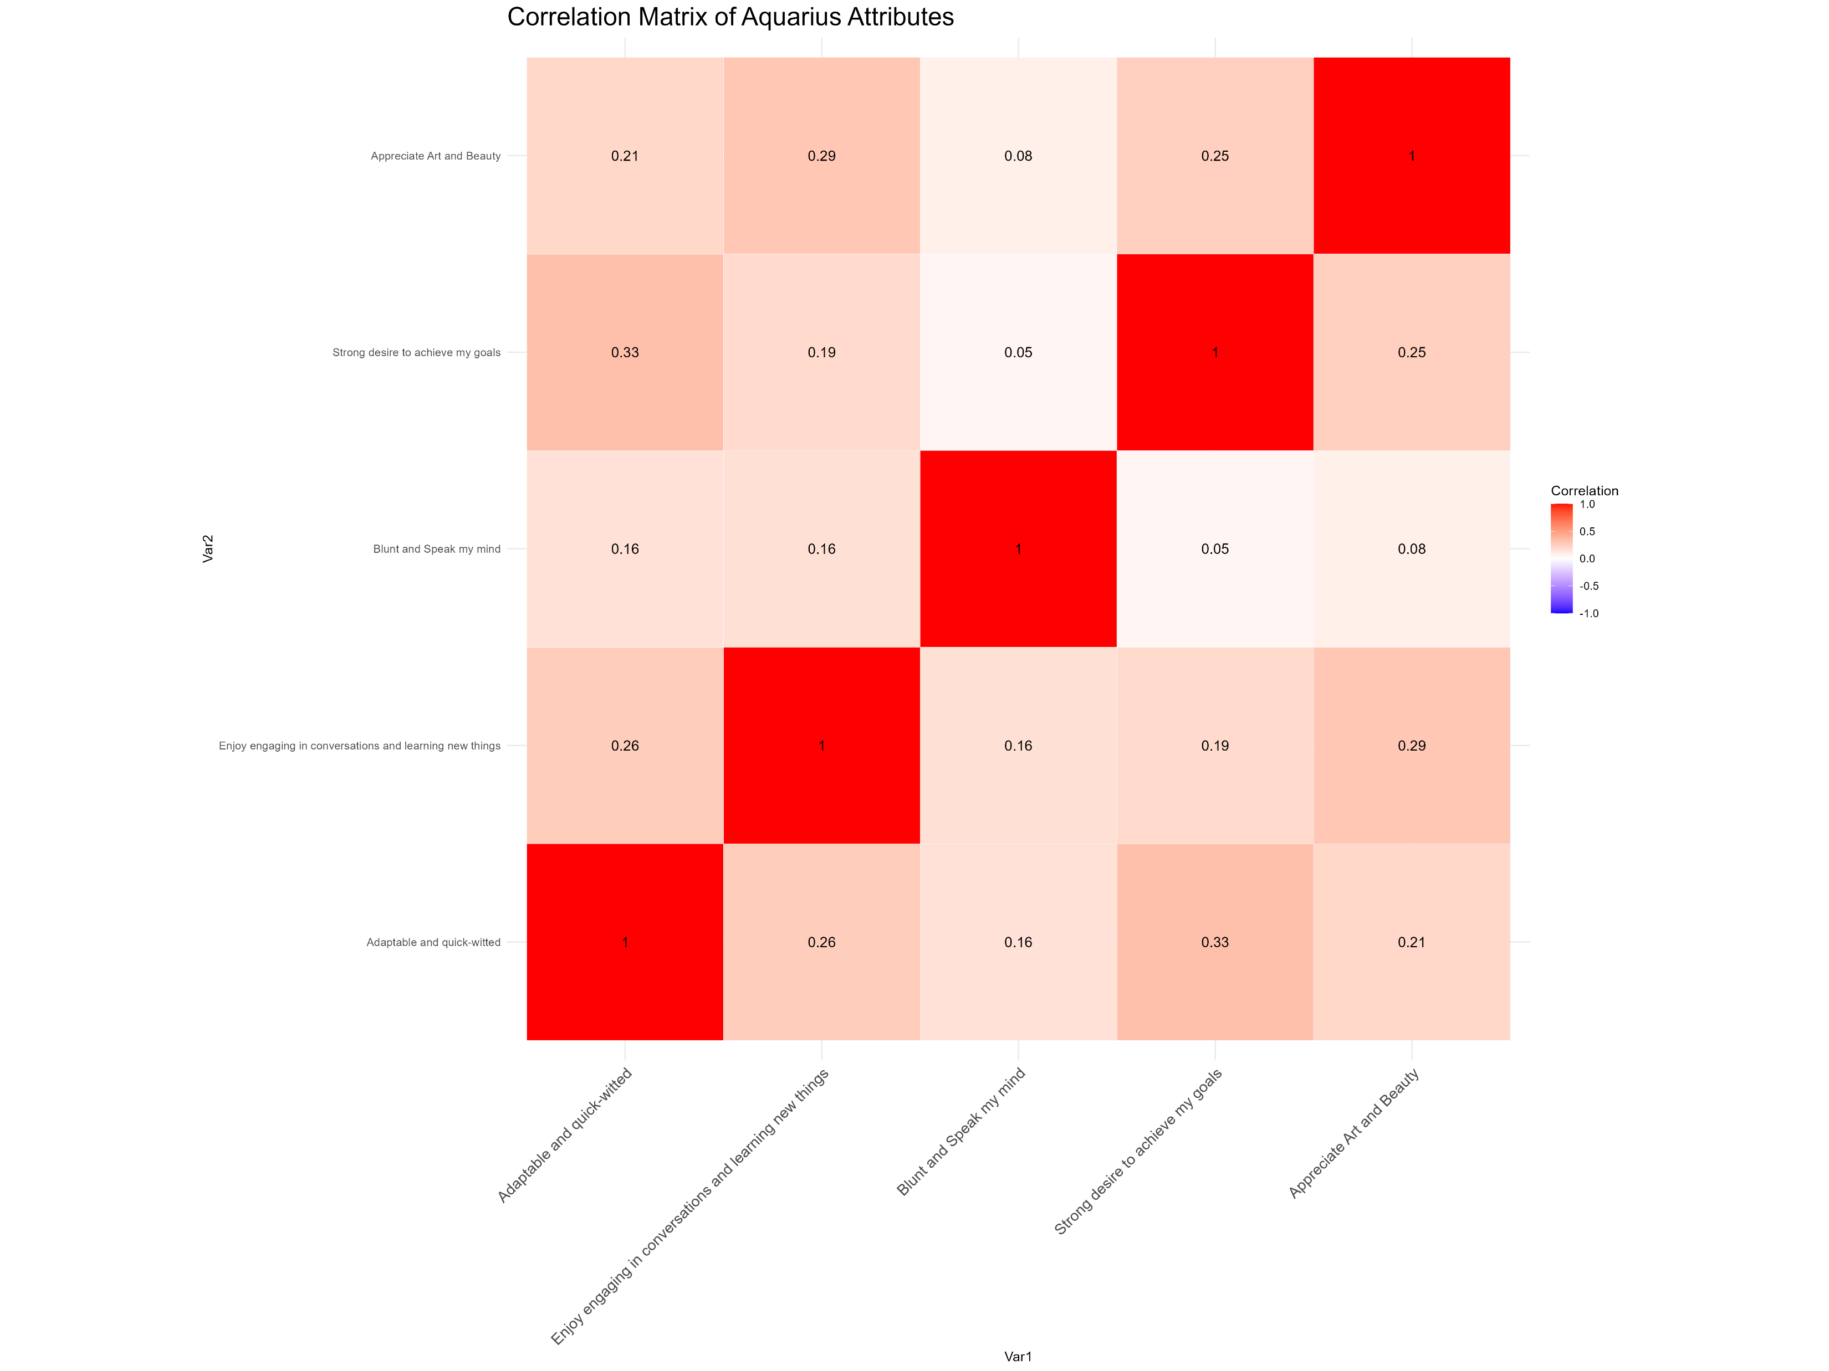
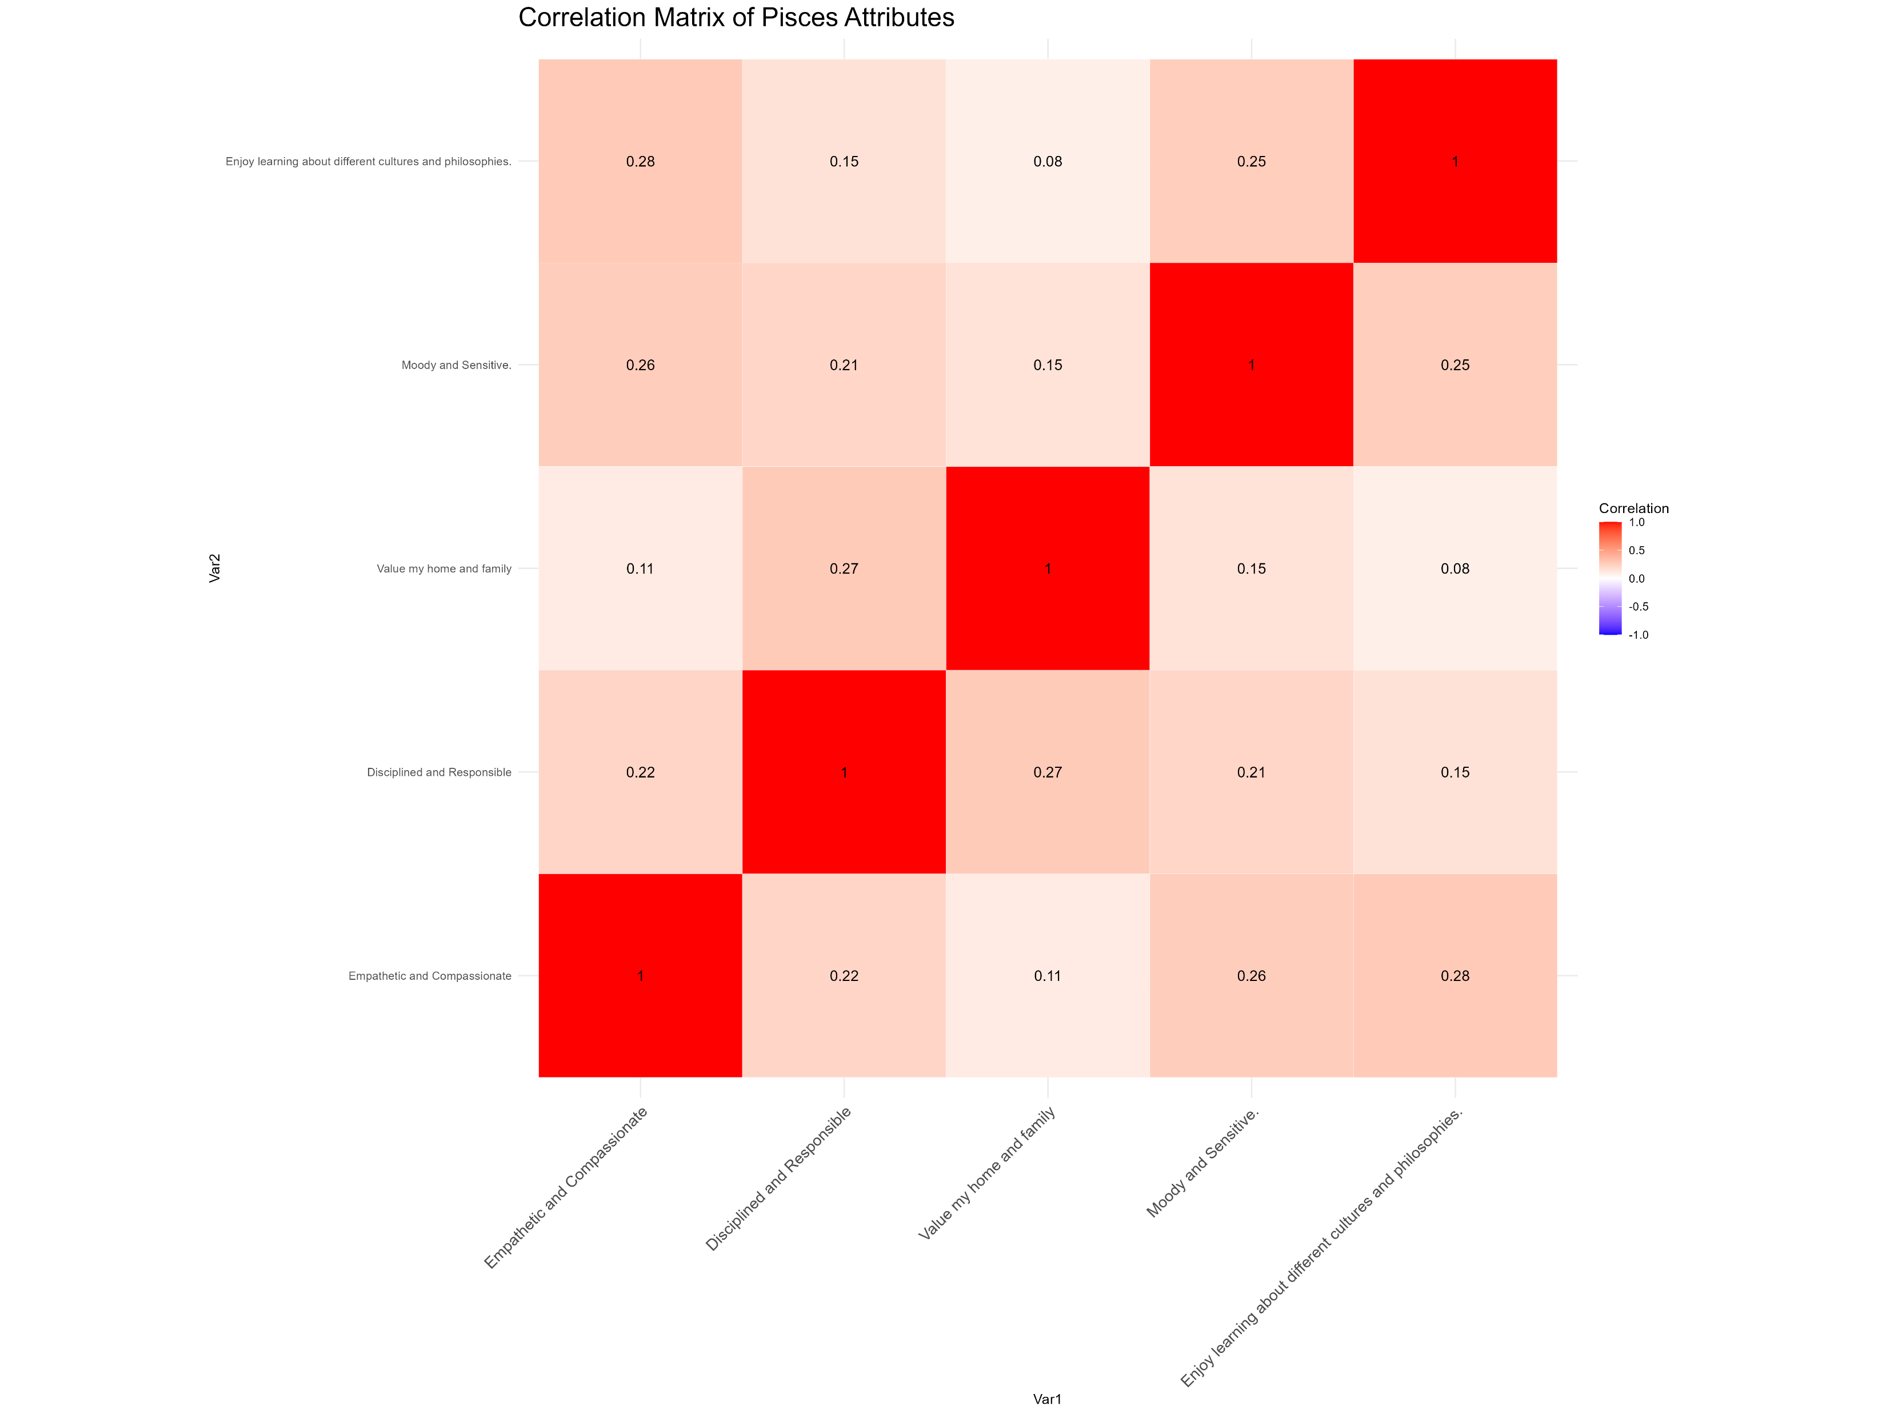
Are people like the descriptions of their horoscope sign?
Anand Baliga Bantwal, 88196, MA23w1-M, email: abaligab@hs-Mittweida.de
Department of Applied Mathematics, Hochschule Mittweida University of Applied Sciences
Supervised by: Prof. Dr. rer. nat. Dr.-Ing habil. Florian Zaussinger
Introduction:
Astrology has fascinated humanity for centuries, with many turning to their horoscope for insights into their personalities and destinies. But how accurate are these celestial descriptions? Do our star signs truly reflect who we are, or is it all just a cosmic coincidence? This presentation explores the world of horoscopes, examining whether the traits attributed to each zodiac sign align with the personalities of those born under them.
Astrology, the ancient practice of interpreting celestial influences on human affairs, manifests in two primary traditions: Vedic Astrology and Western Astrology. Both aim to provide insights into personality, life events, and future prospects, but differ significantly in their methodologies and principles.
Vedic Astrology, originating from India, is based on the Sidereal Zodiac. This system considers the actual positions of stars and constellations, correcting for the axial precession of the Earth. Vedic Astrology emphasizes lunar mansions (Nakshatras) and planetary positions. The calculation of the birth chart uses the Sidereal Zodiac and local solar time, taking into account the birthplace's longitude and latitude. Additionally, Vedic Astrology places significant importance on planetary periods (Dasha) and their transits, which are crucial for predicting life events. The Vedic system divides the birth chart into 12 equal houses. Western Astrology uses the Tropical Zodiac, based on the Sun’s apparent orbit around the Earth and the seasons. Widely used in the Western world, it focuses on the individual’s birth chart, ascendant (rising sign), and planetary positions. The calculation of the birth chart uses the Tropical Zodiac and mean solar time. Unlike Vedic Astrology, Western Astrology employs a system of 12 unequal houses, with the Ascendant playing a more prominent role.
This presentation aims to investigate the relationship between zodiac signs and their respective traits using the Vedic astrology system. By assigning zodiac signs based on the Sidereal Zodiac and analyzing personality traits through our comprehensive questionnaire, we will explore whether the characteristics attributed to each sign align with the personalities of those born under them. This study will provide valuable insights into the accuracy and relevance of horoscopic descriptions in understanding human behavior.
Count of belief in astrology with respect to zodiac signs
Count of individuals from each zodiac sign
P-Values for Chi-Square Test Results for association between zodiac signs and their assumed traits
P-Values for Chi-Square Test Results for association between zodiac signs and the different factors
Figure 1.6
Figure 1.1
Figure 1.2
Figure 1.3
To analyze the association between zodiac signs and personality traits, we conducted a Chi-Square test for independence between the two categories: individuals of the respective zodiac sign and individuals of different zodiac signs. The Chi-Square test is a statistical method used to determine if there is a significant association between two categorical variables. In this context, it helped us understand whether the distribution of personality traits was significantly different between individuals who belong to a specific zodiac sign and those who do not. The Chi-Square test results indicated no significant association between personality traits and zodiac signs. This means that, the traits of individuals belonging to the respective zodiac sign were not significantly different from those of individuals from other signs. Consequently, we concluded that there is no meaningful association between personality traits and zodiac signs based on the data collected [Figure 1.2].
A similar methodology was applied to examine the relationship between belief in astrology and other demographic factors such as gender, financial class, educational level, and age. We categorized participants based on their responses and conducted Chi-Square tests for each factor against belief in astrology. The results indicated that age, educational level, gender, and financial class are not significantly associated with belief in astrology. This suggests that belief in astrology is independent of these demographic variables [Figure 1.3].
The first boxplot shows that belief in astrology tends to decrease as financial class increases, with affluent households showing the least belief. The second boxplot indicates that belief in astrology also tends to decrease with higher education levels, with postgraduate individuals showing the least belief. Both plots suggest an inverse relationship between belief in astrology and higher socioeconomic status, whether measured by education or income. However, there is noticeable variability within each category, as indicated by the spread of the boxes and whiskers. The plots suggest that belief in astrology is more prevalent among individuals with lower education and income levels [Figure 1.4].
Additionally, we applied correlation analysis [Figure 1.5] to further investigate the relationships between zodiac signs and personality traits. Using R programming, we calculated the correlation coefficients for the assigned traits for the respective zodiac signs. This analysis helped us identify any potential positive or negative relationships, providing a more nuanced understanding of how traits might be related to specific zodiac signs. However, the correlations found were generally low, indicating that while there may be some slight correlations, they are not strong or definitive.
Methods:
This study aimed to investigate the relationship between zodiac signs, as determined by the Vedic astrology system, and personality traits. Our objective was to describe the characteristics associated with each zodiac sign and evaluate their alignment with the self-reported traits of participants. We collected quantitative data through an online questionnaire using Google Forms, ensuring that primary data was directly obtained from participants.
A total of 80 [Figure 1.1] individuals (mainly from Mangaluru, Karnataka, India) participated in the study. The questionnaire consisted of 30 Likert Scale questions with 7 levels to assess various personality traits. Additional questions were included to gather information on educational levels, financial class, belief in astrology, and gender. Participants provided their birth dates, which were used to assign their zodiac signs according to the Vedic astrology system. The Sidereal Zodiac system was used to assign zodiac signs based on participants' dates of birth. This was done through a third-party website, which was verified against previously known zodiac signs for accuracy. Geographic coordinates for Mangaluru were used to standardize the local solar time in the calculations.
The collected data was thoroughly checked for completeness, with follow-ups conducted to address any missing responses. Data cleaning involved the removal of outliers and inconsistent entries to ensure the reliability of the dataset. Statistical analyses were performed using R programming. The Chi-Square test was applied to examine associations between personality traits and zodiac signs, as well as between belief in astrology and financial class, educational levels, gender and age.
Firstly, we tallied individuals who rated 4 and above on the Likert scale for the five traits associated with each zodiac sign using Microsoft Excel. This group was then divided into two categories: those belonging to the respective zodiac sign and those from different zodiac signs. This process was systematically repeated for all 12 zodiac signs to ensure consistency and reliability in the data analysis.
Figure 1.4
Figure 1.5
Results and Conclusion:
Our study examined the relationship between zodiac signs, personality traits, and belief in astrology using data from 80 participants. The Chi-Square tests indicated no significant association between personality traits and zodiac signs, suggesting that personality traits are not meaningfully different across the zodiac signs. Similarly, when examining the relationship between belief in astrology and demographic factors such as age, educational level, gender, and financial class, the results showed no significant associations, indicating that belief in astrology is independent of these variables.
The boxplots revealed that belief in astrology tends to decrease with higher education levels and higher financial class, suggesting an inverse relationship between belief in astrology and socioeconomic status. Despite this trend, there was noticeable variability within each category, indicating that belief in astrology is more complex and not solely determined by education or income.
Correlation analysis was conducted to explore the relationships between zodiac signs and personality traits further. While some slight positive and negative correlations were found, these were generally low, indicating that any potential relationships between zodiac signs and traits are weak and not definitive. Overall, our findings suggest that zodiac signs do not significantly influence personality traits, and belief in astrology is not strongly linked to demographic factors such as age, education, gender, or financial class.
References: 1] Hartmann, P. (2022). The final word on astrology and personality. Psychology Today.
2] Nasifoglu, H. (2023). The unconscious mind and planetary influences on the human unconscious mind and personality. ResearchGate.
3] Drik Panchang (n.d.). Drik Panchang - Online Panchang, Panchangam and Hindu Calendar for the world. Drik Panchang.
Selected Topics in Computational Statistics - Hochschule Mittweida | University of Applied Sciences

