Slide 1
The Enterprise Service Bus
Introduction using Mule
Introduction to Open-Source ESB
Authors: Dan McCreary and Arun Batchu
Date: 11/20/2006
Version: DRAFT 0.2

Slide 2
Agenda
What is Mule?
How do you use Mule?
What are the core Mule concepts?
Learning mule with File endpoints

Slide 3
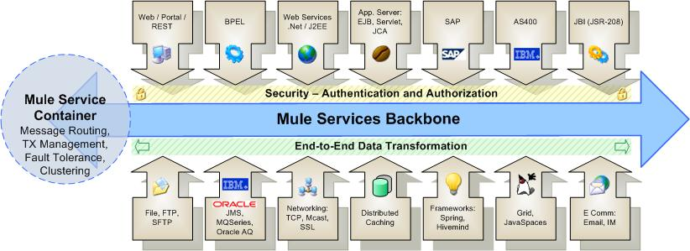
Enterprise Service Backbone
Mule is an open-source Enterprise Service Backbone (ESB)

Slide 4
Mule is Has Advanced Technologies
SEDA
  Staged Event-Driven Architecture
Java NIO
  Java New Input/Output

Slide 5
SEDA
SEDA decomposes a complex, event-driven software application into a set of stages connected by queues
This design avoids the high overhead associated with thread-based concurrency models, and decouples event and thread scheduling from application logic
By performing admission control on each event queue, the service can be well-conditioned to load, preventing resources from being overcommitted when demand exceeds service capacity
SEDA employs dynamic control to automatically tune runtime parameters (such as the scheduling parameters of each stage) as well as to manage load, for example, by performing adaptive load shedding
Decomposing services into a set of stages also enables modularity and code reuse, as well as the development of debugging tools for complex event-driven applications

Slide 6
Java NIO
NIO is a collection of Java programming language APIs that offer advanced features for intensive I/O operations
NIO facilitates an implementations that can directly use the most efficient operations of the underlying platform
NIO includes:
  Buffers for data of primitive types
  Character set encoders and decoders
  A pattern-matching facility based on Perl-style regular expressions (in package java.util.regex)
  Channels, a new primitive I/O abstraction
  A file interface that supports locks and memory mapping
  A multiplexed, non-blocking I/O facility for writing scalable servers

Slide 7
Mule’s “Moves Things Around”
Folder to folder
Queue to queue
Shared memory to shared memory
Using different types of transports
In a flexible way

Slide 8
XML Pipeline
An XML pipeline is a series of operation that are performed on one or more XML files
Examples include:
  validate
  transform
  prune (remove nodes)
  split (break a single XML file into many files)
  merge (join two or more files together)

Slide 9
CRV Example
SSN
Stripped
CRV
County
Audit
County
Approval
State
Audit
State
Approval
Submit
CRV
Deed
Matched
CRV
Income
Tax
Audit
Flow of XML document through approval processes

Slide 10
Decomposition
Remove
SSN
Element
Modify
Value
Add
Element
Modify
Value
Add
Element
Validate
Split
Store
Example of XML Operations used on CRV

Slide 11
Declarative Approach
Focus on specifying "What" not "How"
Empower business analysis to write machine-readable specifications
Hide the "How" behind services with clear interfaces (SOA)

Slide 12
Core Mule Concepts
Mule Manager
Mule Model
Universal Message Object (UMO)
Endpoints
External Applications

Slide 13
Universal Message Object (UMO)
A UMO is a type of Java object that can
  receive events "from anywhere"
  send events
UMO Components are usually your business objects. They are components that execute business logic on an incoming event
UMO are standard JavaBeans (containers)
There is no Mule-specific code in your components
Mule handles all routing and transformation of events to and from your objects based on the configuration of your component

Slide 14
Transport
A transport or "provider", is a set of objects that add support to Mule to handle a specific kind of transport or protocol
Examples
  the "Email Provider" enables Mule to send and receive messages via the SMTP, POP and IMAP protocols

Slide 15
Connector
A connector is the object that sends and receives messages on behalf of an endpoint.
Connectors are bundled as part of specific transports or providers.
For example, the FileConnector can read and write file system files.

Slide 16
Router
A router is the object that do something with messages once they have been received by a connector, or prior to being sent out by the connector

Slide 17
Filter
A filter optionally filters incoming or outgoing messages that are coming into or going out from a connector.
For example, the File Provider comes with a FilenameWildcardFilter that restricts which files are read by the connector based on file name patterns. For example only files with the .xml extension can be routed.
Filters are used in conjunction with Routers.

Slide 18
Transformer
A transformer optionally changes incoming or outgoing messages in some way
This is usually done to make the message format useable by a downstream function
Examples:
  the ByteArrayToString transformer converts byte arrays into String objects.

Slide 19
Mule Event Flow
Endpoint
(Message Receiver)
Inbound
Inbound Router
The nine stages of a mule event
  first 2 – inbound
  middle 4 – component
  last 2 – outbound
Interceptor
Inbound Transformer
Component
Service Invocation
Interceptor
Outbound Router
Outbound Transformer
Outbound
Endpoint
(Message Dispatcher)
Optional Step

Slide 20
Message Receiver Endpoint
Endpoint
(Message Receiver)
Inbound Router
Some event triggers a message flow
  A file being written into a folder
  A message arriving on a message queue
  A record in a database
  Data written to a socket
Interceptor
Inbound Transformer
Service Invocation
Interceptor
Outbound Router
Outbound Transformer
Endpoint
(Message Dispatcher)

Slide 21
Inbound Router
Endpoint
(Message Receiver)
The inbound router is the fist step in a message. Functions typically performed by an inbound router
  Filtering
  Remove duplicate messages
  Matching messages
  Aggregation (combining)
  Re-sequence data
  Forwarding
See also
  IdempotentReceiver
  CorrolationAggregator
  CorrelationResequencer
Inbound Router
Interceptor
Inbound Transformer
Service Invocation
Interceptor
Outbound Router
Outbound Transformer
Endpoint
(Message Dispatcher)

Slide 22
Interceptor
Endpoint
(Message Receiver)
Used to intercept message flow into your service component
Used trigger monitor/events or interrupt the flow of the message
Example: an authorization interceptor could ensure that the current request has the correct credentials to invoke the service.
Inbound Router
Interceptor
Inbound Transformer
Service Invocation
Interceptor
Outbound Router
Outbound Transformer
Endpoint
(Message Dispatcher)

Slide 23
Inbound Transformer
Endpoint
(Message Receiver)
Inbound Router
If the inbound data is not in the correct format for the service it must be transformed at this point
Interceptor
Inbound Transformer
Service Invocation
Interceptor
Outbound Router
Outbound Transformer
Endpoint
(Message Dispatcher)

Slide 24
Service Invocation
Endpoint
(Message Receiver)
Inbound Router
The actual service is performed
In mule, this is generally a Java object
Service invocation can also be a "pass through"
Interceptor
Inbound Transformer
Service Invocation
Interceptor
Outbound Router
Outbound Transformer
Endpoint
(Message Dispatcher)

Slide 25
Outbound Router
Endpoint
(Message Receiver)
Inbound Router
Dispatching the data to all the relevant endpoints
Interceptor
Inbound Transformer
Service Invocation
Interceptor
Outbound Router
Outbound Transformer
Endpoint
(Message Dispatcher)

Slide 26
Built-in Router Classes
Inbound | Outbound | Response
Idempotent Receiver | Filtering Outbound Router | Response Aggregator
Selective Consumer | Recipient List
Aggregator | Multicasting Router
Resequencer | Chaining Router
Forwarding Consumer | Message Splitter
 | Filtering List Message Splitter
 | Filtering Xml Message Splitter
 | Exception Based Router

Slide 27
Outbound Transformer
Endpoint
(Message Receiver)
Any transformations that needs to be done on the message after a service has been performed on the message can be executed before it is put into the endpoint
See Also
  EnvelopeInterceptor
Inbound Router
Interceptor
Inbound Transformer
Service Invocation
Interceptor
Outbound Router
Outbound Transformer
Endpoint
(Message Dispatcher)

Slide 28
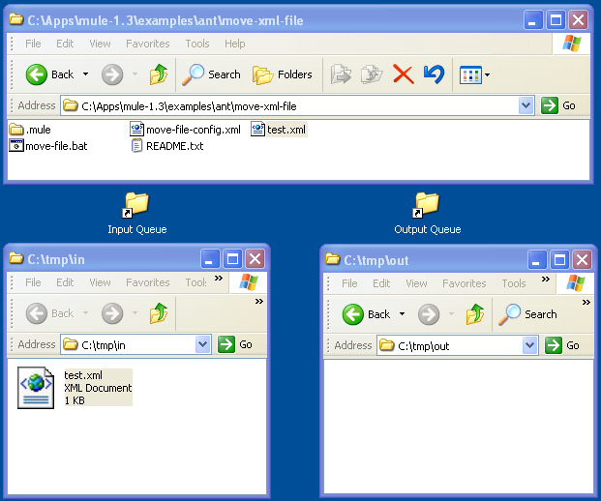
Test Environment

Slide 29
Omitted From Examples for Brevity
<?xml version="1.0" encoding="UTF-8"?>
<!DOCTYPE mule-configuration PUBLIC "-//MuleSource //DTD mule-configuration XML V1.0//EN"
"http://mule.mulesource.org/dtds/mule-configuration.dtd">

Slide 30
Outline of Move All Files
<mule-configuration>
<model>
<mule-descriptor>
<inbound-router>
<endpoint
address="file:///c:/mule-class/in"/>
</inbound-router>
<outbound-router>
<router>
<endpoint
address="file:///c:/mule-class/out"/>
</router>
</outbound-router>
</mule-descriptor>
</model>
</mule-configuration>

Slide 31
Move All Files – Procedural Details
<mule-configuration id="Mule_File_Move" version=" 1.0">
<connector name="SystemStreamConnector" className="org.mule.providers.stream.SystemStreamConnector"/>
<model name="move-all-files">
<mule-descriptor name="move-file" implementation="org.mule.components.simple.BridgeComponent">
<inbound-router>
<endpoint address="file:///c:/tmp/in"/>
</inbound-router>
<outbound-router>
<router className="org.mule.routing.outbound.OutboundPassThroughRouter">
<endpoint address="file:///c:/tmp/out"/>
</router>
</outbound-router>
</mule-descriptor>
</model>
</mule-configuration>

Slide 32
Only Moving XML Files
<inbound-router>
<endpoint address="file:///c:/mule-class/in">
<filter pattern="*.xml"
className=
"org.mule.providers.file.filters.FilenameWildcardFilter"/>
</endpoint>
</inbound-router>
Add the filter line to only move files with the extension "*.xml". If you add a file "foobar.txt to the input folder it will not be moved.

Slide 33
Keeping the Name The Same
<outbound-router>
<router className="org.mule.routing.outbound.OutboundPassThroughRouter">
<endpoint
address=
"file:///c:/mule-class/out?outputPattern=$[ORIGINALNAME]"
/>
</router>
</outbound-router>
Add the outputPattern parameter to keep the output name the same as the input.

Slide 34
Happy Path and Exceptions
Stop
Stop
Stop
Start
Step 1
Step 2
Step 3
Stop
By default, error free documents follow a central path known as the "happy path"
Documents that have errors may be handled in different ways (rejected, warnings etc.)

Slide 35
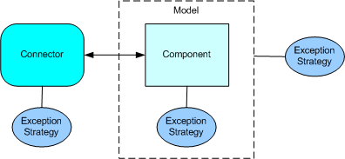
Exception Handling
Mule has a special way of handling non-happy path processing. This is called an "Exception Strategy" but is it really just and exception path and there is very little strategy involved.
There are three places you can associate an exception strategy
  connector
  component
  model (set for all components in a model)

Slide 36
Exception Strategy
<exception-strategy className=org.mule.impl.DefaultComponentExceptionStrategy">
<endpoint address="file:///c:/mule-class/error"/>
</exception-strategy>
We want all invalid documents to be moved into the error folder.

Slide 37

Sample XML
Given the following XML Schema file:
XML Schema validation will generate an error message when it gets to the fourth invalid data element:
<?xml version="1.0" encoding="UTF-8"?>
<Data>
<Element1>Hello World!</Element1>
<Element2>String</Element2>
<Element3>String</Element3>
<DansInvalidDataElement>This is Dans invalid data element</DansInvalidDataElement>
</Data>

Slide 38
Validating against an XML Schema
<outbound-router>
<router className="org.mule.routing.outbound.FilteringXmlMessageSplitter">
<endpoint
address="file:///c:/mule-class/out?outputPattern=$[ORIGINALNAME]"/>
<properties>
<property name="validateSchema" value="true"/>
<property name="externalSchemaLocation"
value="file:///c:/mule-class/labs/07-validate/my-schema.xsd"/>
</properties>
</router>
</outbound-router>
To validate the XML Schema, just add two properties:
1) tell it to validate the document
2) tell it what file to use and where to find it

Slide 39
Error Message
document : cvc-complex-type.2.4.d: Invalid content was found starting with element 'DansInvalidDataElement'. No child element is expected at this point.
This error message is generated on the Mule console when an invalid data element is found. But what should we do with it? How do we redirect it to the appropriate user?

Slide 40
Thank You!
Please contact me for more information:
Enterprise Service Bus
Enterprise Integration
Metadata Management
Metadata Registries
Service Oriented Architectures
Business Intelligence and Data Warehouse
Semantic Web
Dan McCreary, President
Dan McCreary & Associates
Metadata Strategy Development
dan@danmccreary.com
(952) 931-9198

