Slide 1
Loan Default Risk Modelling and Profit-Based Decision Analytics
End-to-end Data Science project on consumer loan approvals.
Focus on aligning machine learning predictions with business profitability.
Dataset: LendingClub Accepted Loans (2007–2018). Kaggle Link
Anand Ghugare
B.Tech CSE
Manipal University Jaipur

Slide 2
Business Context & Problem Statement
Objective:
Predict loan default risk.
Convert predictions into profit-aware approval decisions.
Which loans defaulted?
Which made money?
Can we do better than the past? How?
Financial institutions approve or reject loans based on default risk.
Traditional ML models optimize prediction accuracy, not profit.
Poorly aligned decisions can cause large financial losses.

Slide 3
Dataset Overview
Source: LendingClub accepted loan records (2007–2018)
Original Dataset :
- 2,260,701 rows (2.26 million)
- 151 features
Includes loan amount, interest rate, borrower income, repayment outcome, dti, employment tenure, home ownership, mortgage, annual income etc.
Each row represents one customer’s details

Slide 4
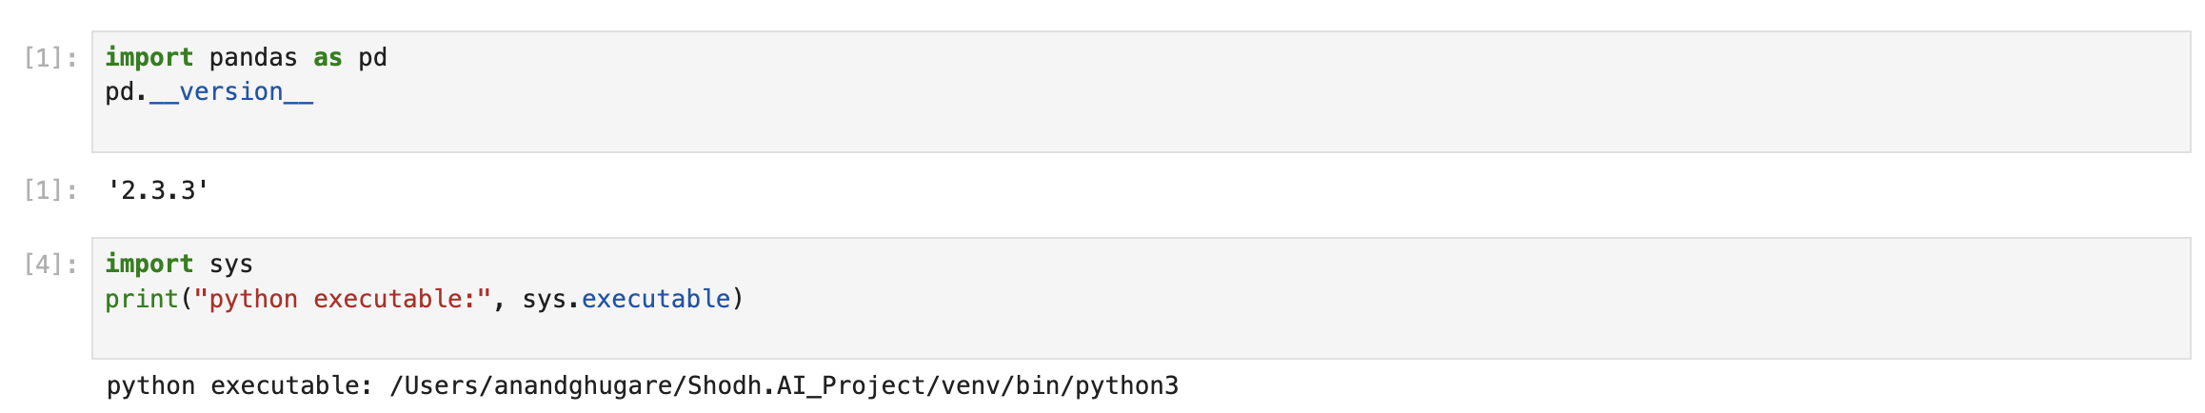
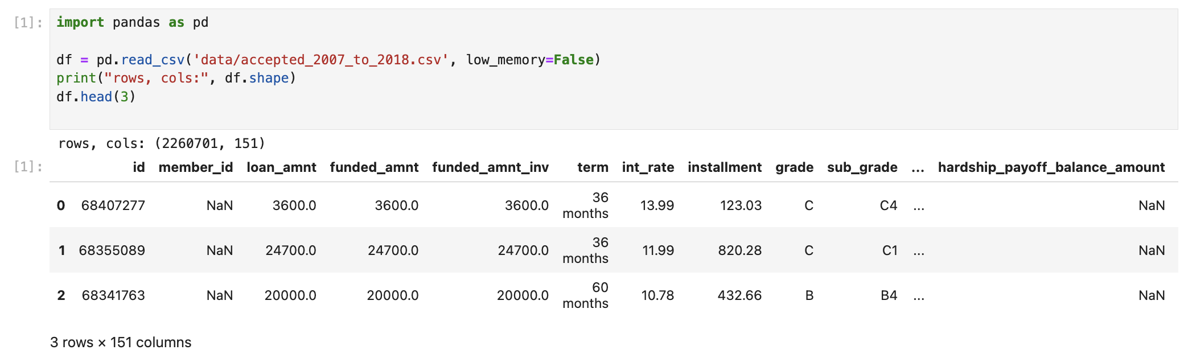

Slide 5
Data Cleaning, Target Definition & Feature Selection
Selected only loans with final outcomes:
- Fully Paid
- Charged Off / Default
Created binary target variable:
- 0 → Fully Paid
- 1 → Default
Ensured clean labels for supervised learning
Selected a small, interpretable feature set:
loan_amnt
int_rate
annual_inc
dti
Simple features
Easy to explain to business stakeholders
Strong baseline for modelling
Final usable dataset:
1,344,976 rows (1.34 million)
4 features + 1 target

Slide 6
Train-Test Split Strategy
Why is a split required anyway?
Split data into:
80% training
20% testing
Stratified split to preserve default rate distribution
Ensures fair and unbiased evaluation

Slide 7
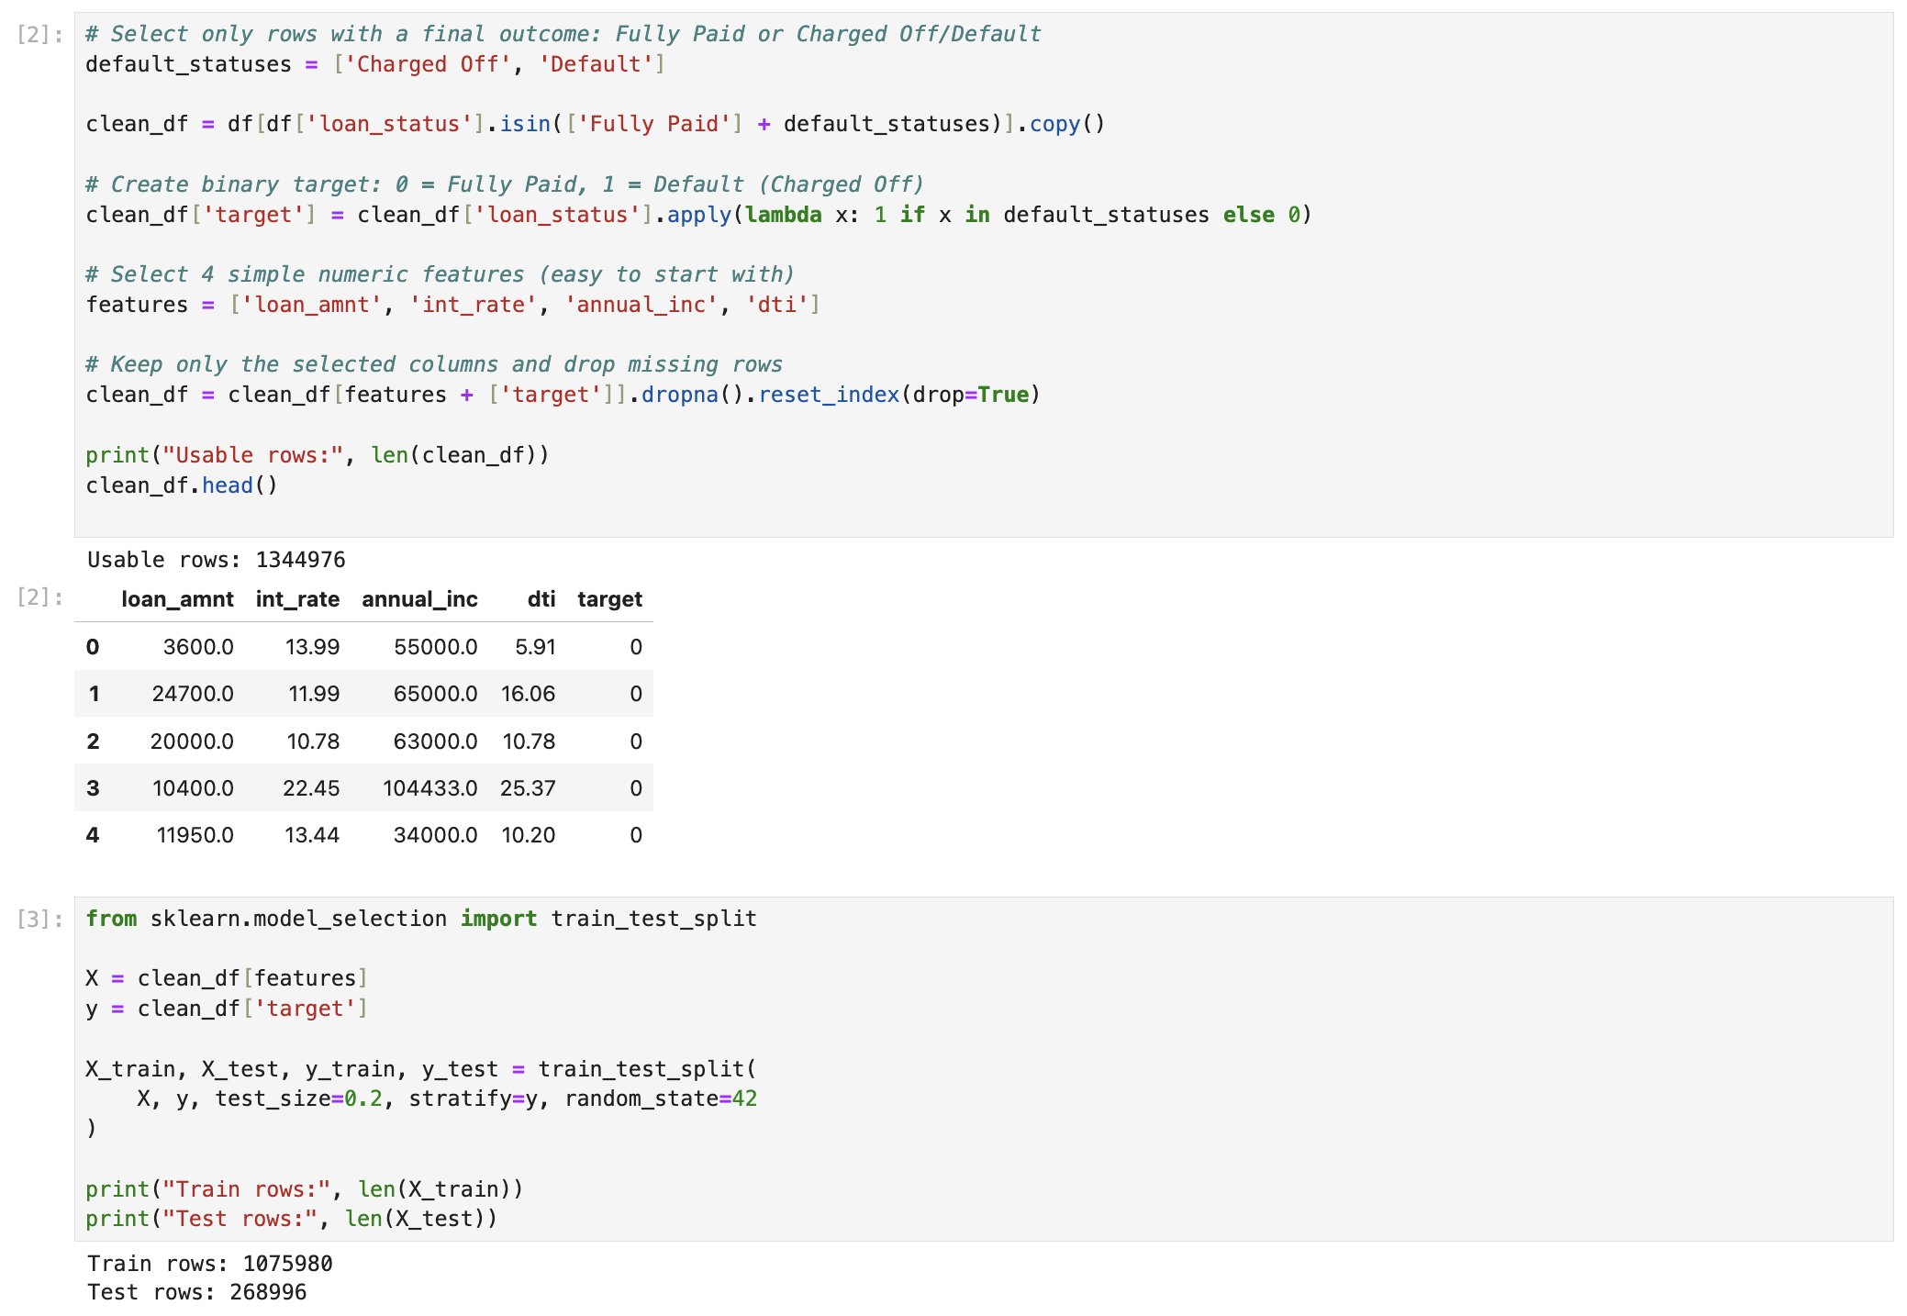

Slide 8
Supervised Learning Model & Eval Metrics
Model choice:
Logistic Regression with feature scaling
Reason for choice:
Binary classification
Industry-standard baseline in credit risk
Produces probabilities
ROC - AUC:
Measures ranking ability of default risk.
Is it ranking default as default or not?
F1 - score:
It checks if we predicted correct w.r.t reality.

Slide 9
Results & Learning from Supervised ML
Question : Is the model good enough?
Results:
AUC ≈ 0.69
F1 ≈ 0.11
Insight:
Model separates risk reasonably well
Classification performance alone is not sufficient for business decisions
High AUC does not guarantee profitable decisions
Approving low-risk but high-loss loans can be dangerous
Prediction ≠ decision
Business objective must drive model usage

Slide 10
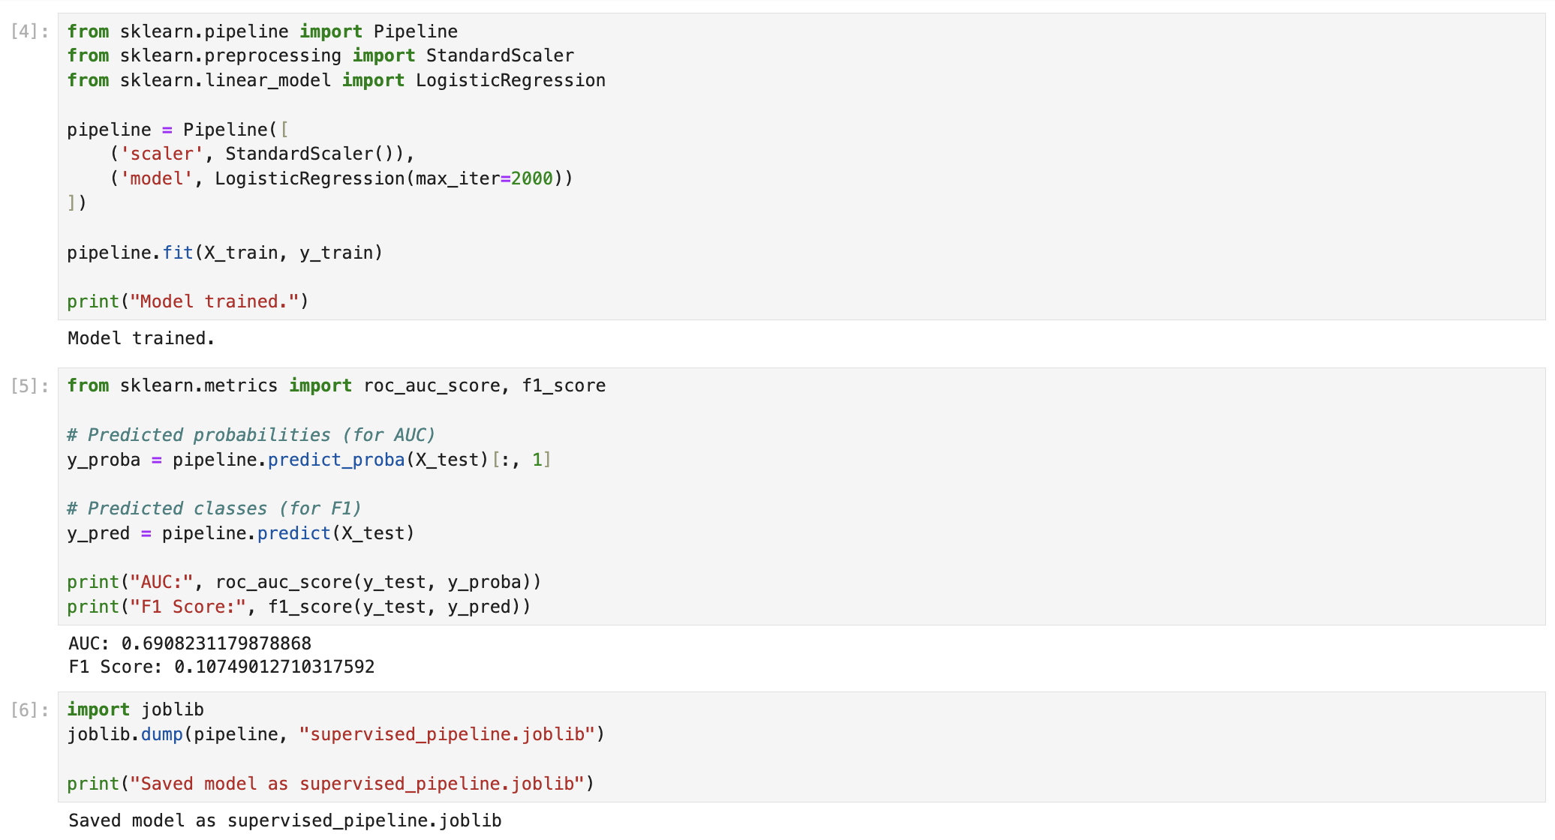

Slide 11
Reward Engineering (Business Value Layer)
Understanding the Past : How much did we lose and gain?
Defined financial reward per loan:
If Fully Paid:
Profit = loan amount × interest rate
If Default:
Loss = - full loan principal
Created a reward column representing actual monetary outcome This converts prediction into business impact

Slide 12
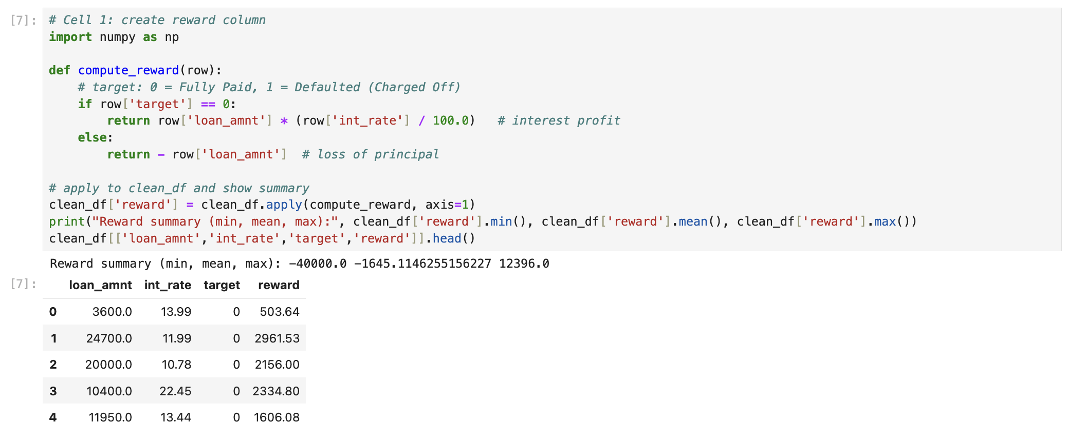

Slide 13
Predicting Default Probability (p_default)
If I were the Bank || Net profit-loss for each loan before approval.
Used trained ML model to predict probability of default for each loan
p_default ∈ [0,1]
Interpreted as model’s confidence that a borrower will default
This probability becomes the input for decision policies
Expected Profit = Loan × Interest × (1 − p_default) − Loan × p_default
Policy Creation :
Approve loan only if expected profit > 0 Otherwise reject
This creates a profit-aligned baseline policy

Slide 14
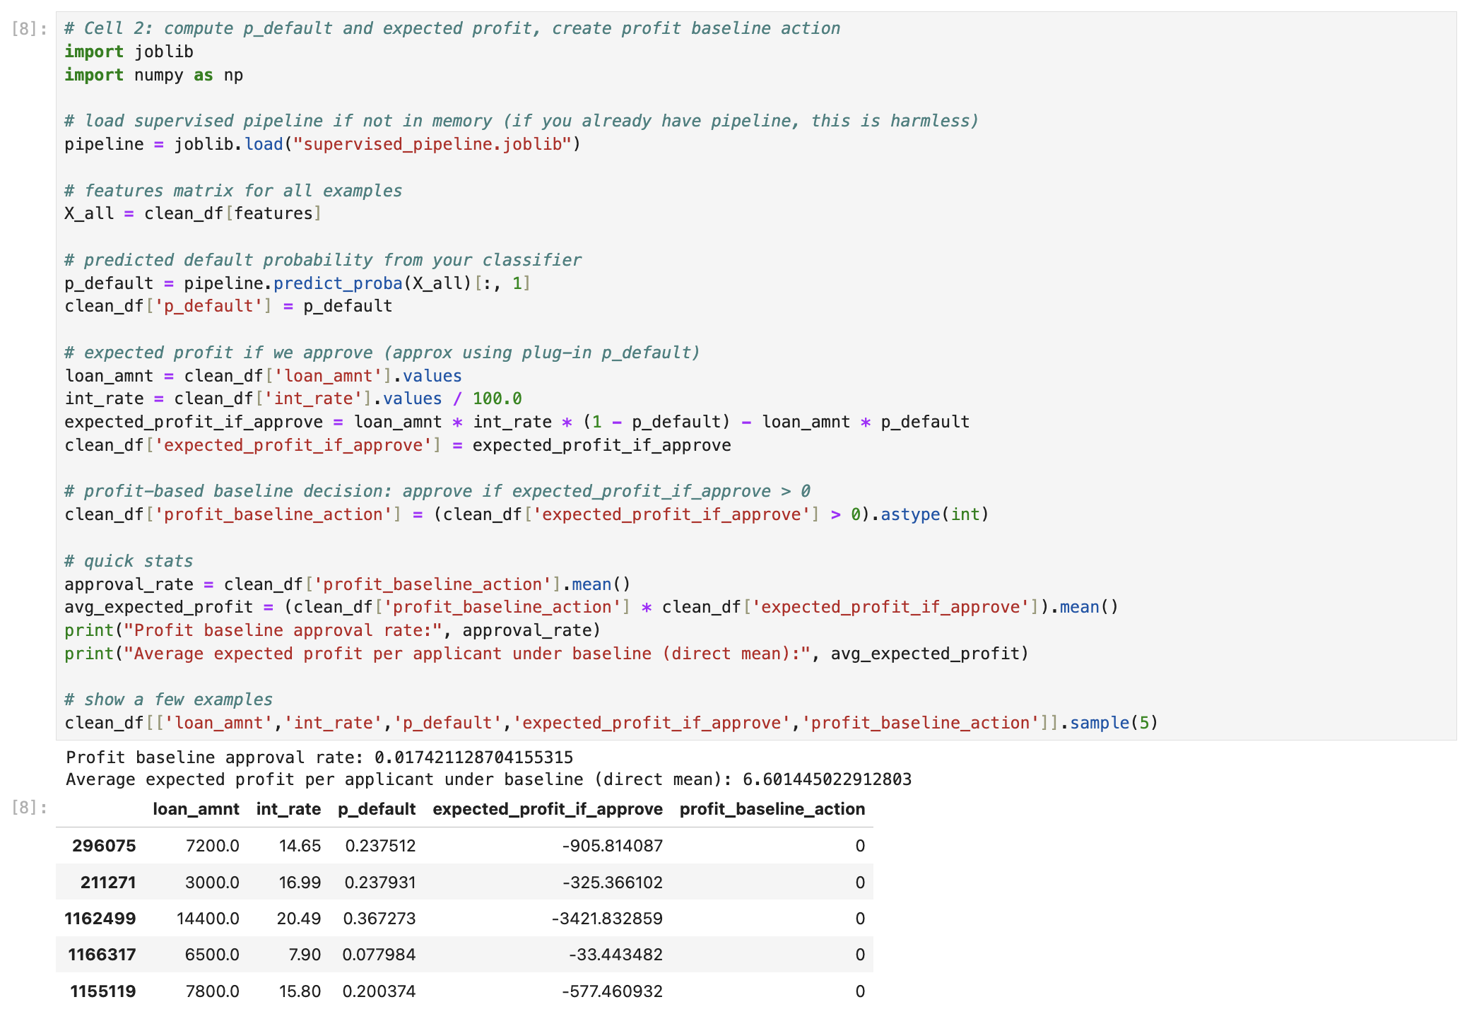

Slide 15
Profit Policy Results & Evaluation?
Approval rate ≈ 1.7%
Every 2 out of 100 will be approved.
Average expected profit per applicant ≈ ₹6.6
Insight:
Very selective approvals
Strong risk control
Significantly safer than ML threshold rule
Why Evaluation?
We need to evaluate the profit-based policy because creating a rule is not the same as knowing whether it actually works well across the entire dataset.
A rule can sound logical and still be bad at large scale.
How?
Offline Policy Evaluation
Direct Method

Slide 16
Profit Policy Evaluation
Train a reward model for all X (features) and target (reward)
Predict all profit and loss (reward) with this model
Mean() for both :
- Supervised ML - Profit Policy
Estimate “what would have happened” if a policy was applied
No real money at risk
Model used: Random Forest Regressor
Purpose: Learn relationship between loan features and monetary outcome

Slide 17
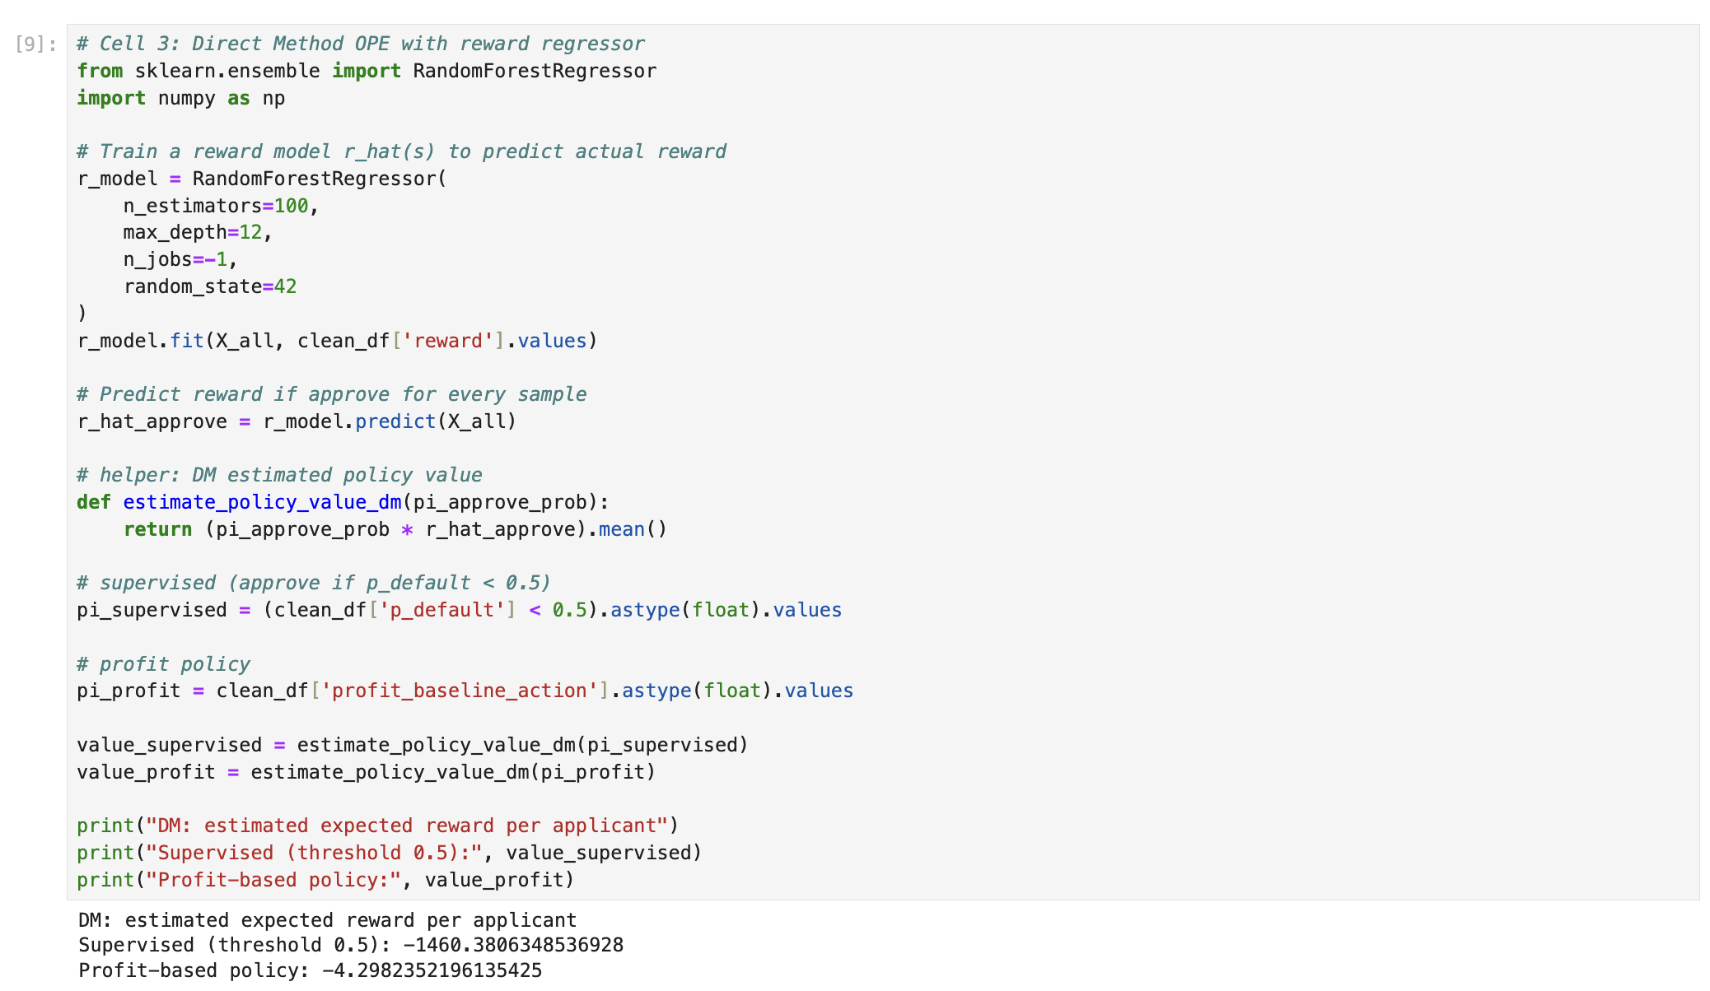

Slide 18
Profit Policy Evaluation
Policy | Approve | Loss
Supervised ML | if p_default < 0.5 | −1460 per applicant
Profit Rule | if expected profit > 0 | −4 per applicant
Loan details
Loan amount = ₹40,000
Interest rate = 10%
p_default = 0.4
ML decision
0.4 < 0.5 → Approve
Profit calculation
Expected profit =
(0.6 × ₹4,000) − (0.4 × ₹40,000)
= ₹2,400 − ₹16,000
= −₹13,600
Profit policy decision
Negative profit → Reject

Slide 19
Comparison for disagreements
Compared decisions made by:
Supervised ML rule
Profit-based rule
Over 1.28 million cases where decisions differ
Insight:
ML approves large, risky loans
Profit policy rejects them due to downside risk
Conclusion:
Accuracy-driven decisions can be financially harmful
Profit-aware policy dramatically reduces loss

Slide 20
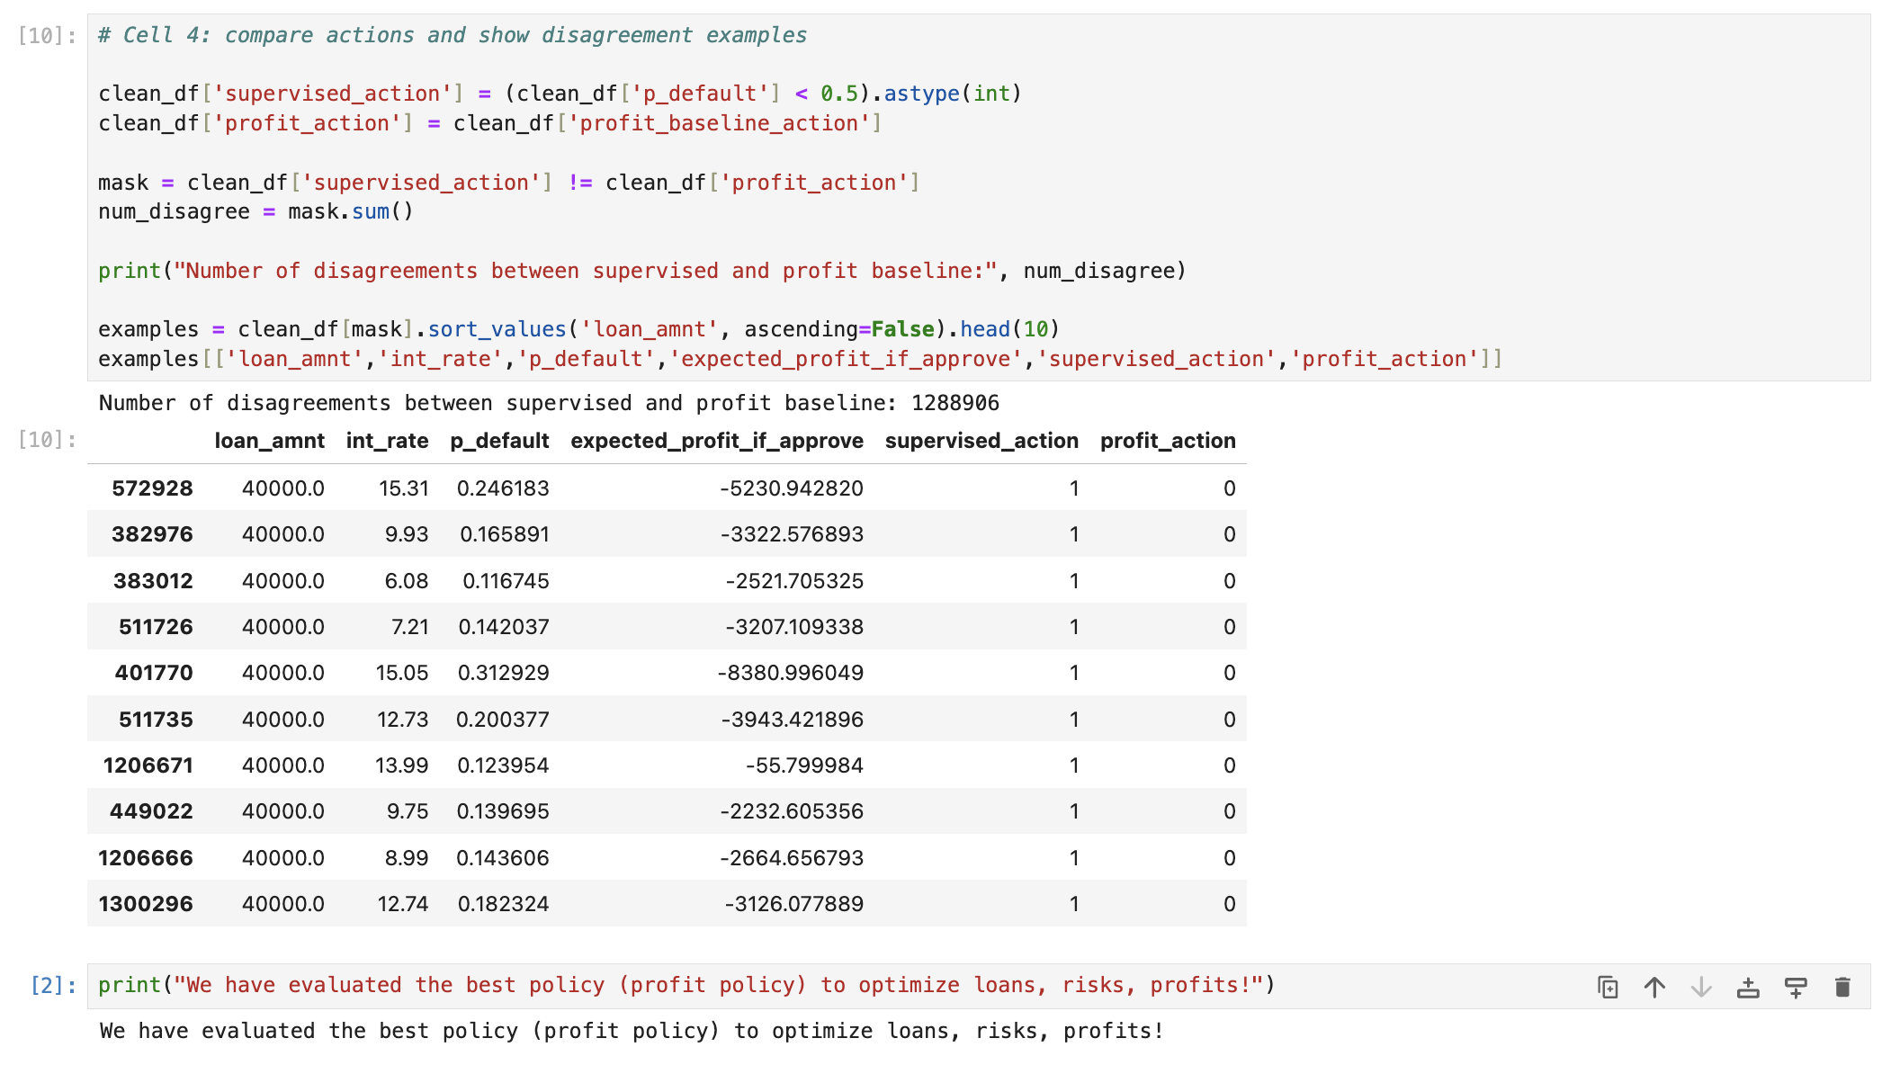

Slide 21
Key Takeaways
Predictive accuracy alone is not enough
Decisions must be aligned with business objectives
Policy evaluation is critical before deployment
Combines data science with business reasoning
Focuses on decision impact and profitability
Uses structured, consulting-style problem solving
Directly applicable to real word problems

Slide 22
Thank You for being patient! Questions Please?

