Slide 1
OBSTACLES
Anand Khinvasara & Sumit kaulkar

Slide 2
OVERVIEW
The objective of the game is to move the mouse pointer from source to destination without touching the obstacles.
Technology used – Mouse pointer functions, detections & drawing algorithms with inbuilt functions
The shape of obstacles varies from moving blocks to circles.
There are two stages.

Slide 3
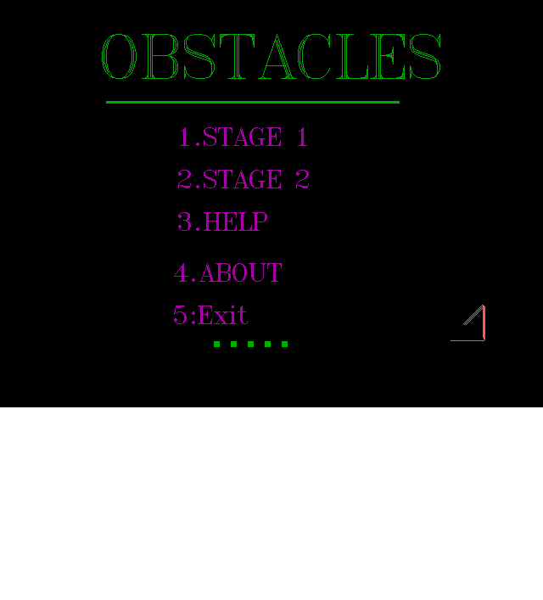

Slide 4
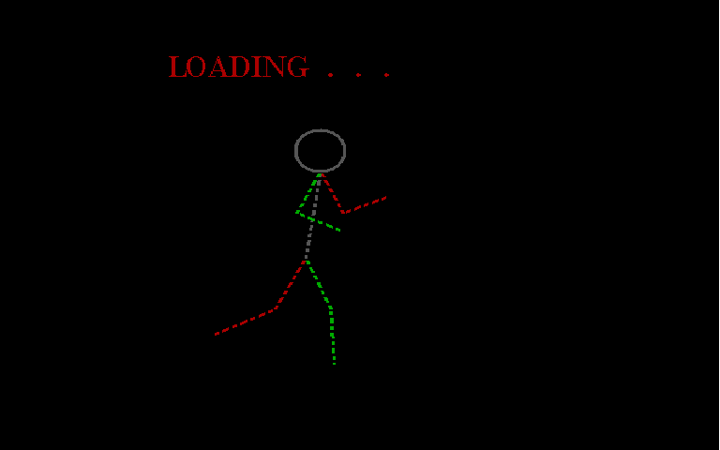

Slide 5
STAGE 1

Slide 6
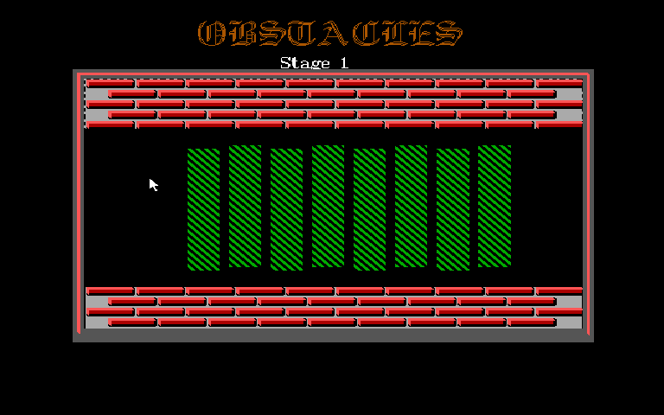
Destination
Source
Object

Slide 7
Stage 1
The stage is made as simple as possible.
Algorithm used - Even-odd method to detect whether the polygon is inside or outside a polygon.
Also algorithms like DDA line, Scan-line etc are used.
The bricks have been given 3d looks by

Slide 8
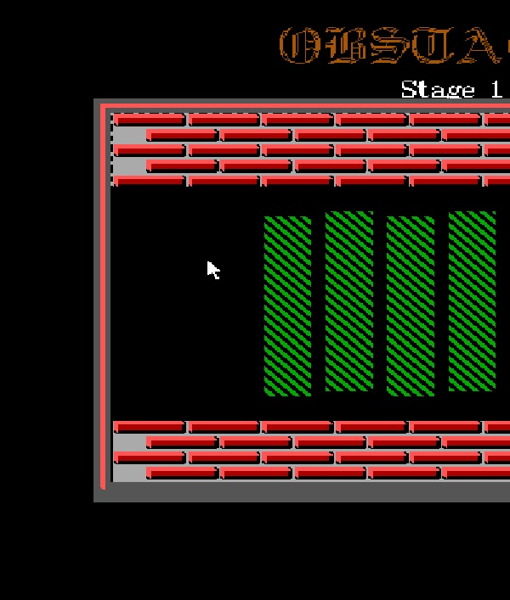
(x,y)
x
y

Slide 10
STAGE 2

Slide 11
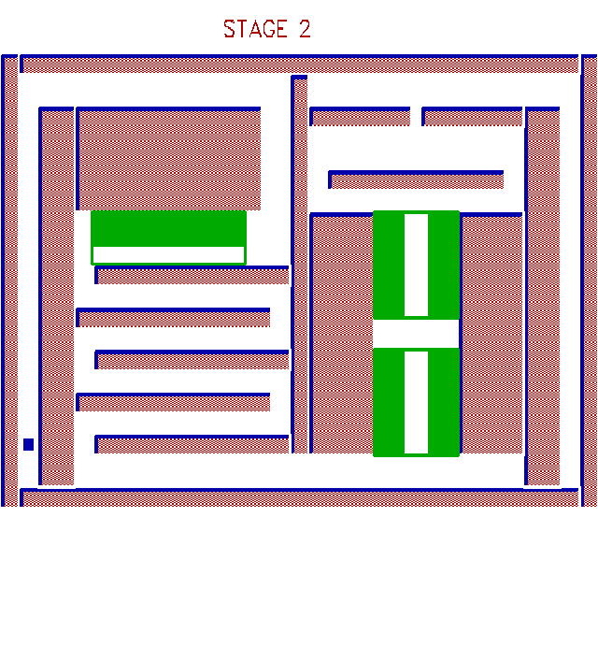
Source
Destination

Slide 12
Stage 2
In this stage the object can move only in white spaces
Here pixel colour logic is used to detect collision.
The fuctions such as getpixel and putpixel is used.
Algorithms
DDA line
Scan line

Slide 13
Future Enhacements
To translate this code into JavaScript so as to upload it on a website.
Include more dynamic Stages.
GUI with better animated Effects.

Slide 14
References
Websites
Google
Planetsource
Cprogramming
Books
Computer graphics-by BAKER
Local author books

Slide 15

Sincere thanks to Sharma Sir and & Meshram Sir for there help and guidance.

