Slide 1
Cardiovascular Risk Prediction
CAPSTONE PROJECT
Presented By:
Name of Student : ANAND KUMAR DALWAIE
College Name : ANNAMACHARYA INSTITUTE OF TECHNOLOGY & SCIENCES TIRUPATHI
Department : ARTIFICIAL INTELLIGENCE & DATA SCIENCE

Slide 2
OUTLINE
Problem Statement
Proposed System/Solution
System Development Approach
Algorithm & Deployment
Result
Conclusion
Future Scope
References

Slide 3
Problem Statement
EXAMPLE :
The dataset is from an ongoing cardiovascular study on residents of the town of Framingham, Massachusetts.
The classification goal is to predict whether the parent has a 10-year risk of future coronary heart disease (CHD).
The dataset provides the parents’ information. It includes over 4,000 records and 15 attributes. Variable Each attribute is a potential risk factor. There are both demographic, behavioral, and medical risk factors.

Slide 4
Proposed Solution
The solution involves developing a machine learning model to predict the 10-year risk of coronary heart disease (CHD) based on patient data, which includes demographic, behavioral, and medical factors.
1.Data Preprocessing:
Data Cleaning: Removed null values and duplicates.
Balancing the Dataset: Used SMOTE and under-sampling to address class imbalance, ensuring the model can effectively predict CHD.
2.Feature Engineering:
Created new features like Hypertension, Diabetes Severity, and Smoking Factor to enhance the model's predictive power.
3.Model Development:
Algorithm: Used XGBoost for its efficiency in binary classification.
Training: Applied GridSearchCV for hyperparameter tuning to optimize model performance.
Evaluation: Focused on Recall to minimize false negatives, crucial for early diagnosis of CHD.
4.Deployment:
Scalability: Deployed on a cloud platform, allowing healthcare providers to input data and receive CHD risk predictions through a user-friendly interface.

Slide 5
System Approach
Data Preprocessing:
Data cleaning (handling missing values and duplicates)
Balancing the dataset using SMOTE and random under-sampling
Feature Engineering:
Creating new features like 'Hypertension,' 'Diabetes Severity,' and 'Smoking Factor'
Modeling:
XGBoost for prediction
Grid search and cross-validation for parameter tuning
Technology Stack:
Python for data processing and modeling
Scikit-learn for machine learning
Pandas and NumPy for data manipulation

Slide 6
Algorithm & Deployment
Algorithm Selection:
XGBoost is chosen for its high performance in binary classification tasks and its ability to handle large, structured datasets efficiently. It is particularly effective in managing imbalanced datasets, reducing overfitting through regularization, and providing fast predictions.
Training Process:
The model is trained using a balanced dataset achieved through SMOTE and random under-sampling.
Hyperparameter tuning is conducted using GridSearchCV, while cross-validation ensures the model generalizes well.
Emphasis is placed on Recall to minimize false negatives, critical for accurate CHD risk prediction.
Deployment:
The model is deployed on a cloud platform (e.g., AWS, Azure), ensuring scalability and real-time data processing.
A user-friendly interface allows healthcare providers to input patient data and receive immediate CHD risk predictions.
The system is designed for scalability and reliability, with continuous monitoring and updates to maintain accuracy in real-world applications.

Slide 7
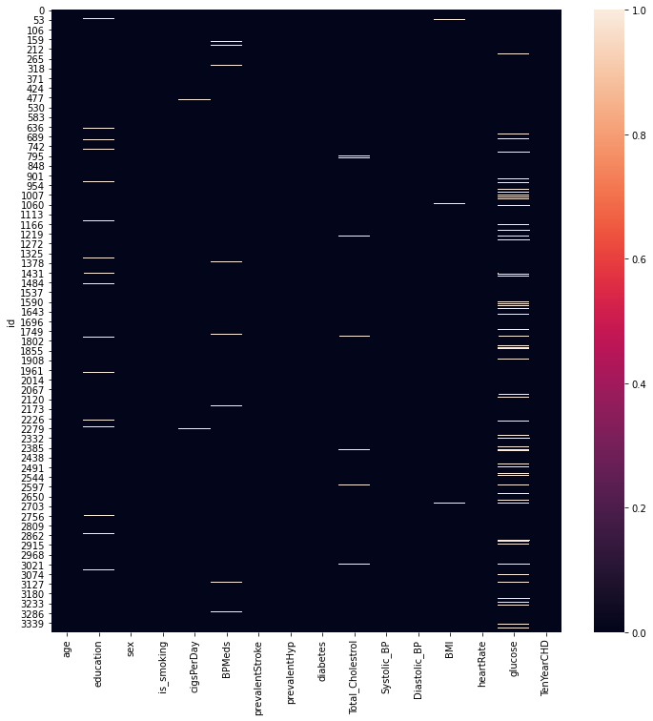
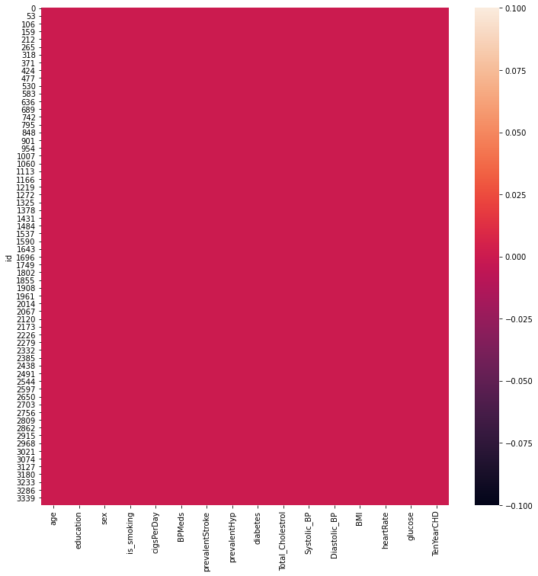
Missing Values & After ϐilling NaN Values

Slide 8
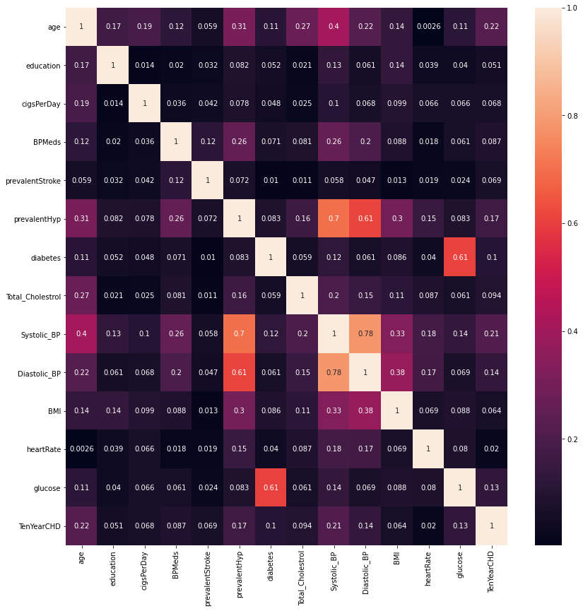
Correlation between features

Slide 9
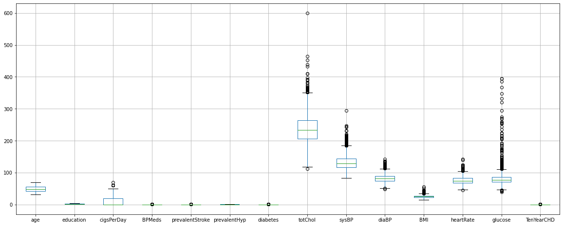
Outlier detection

Slide 10
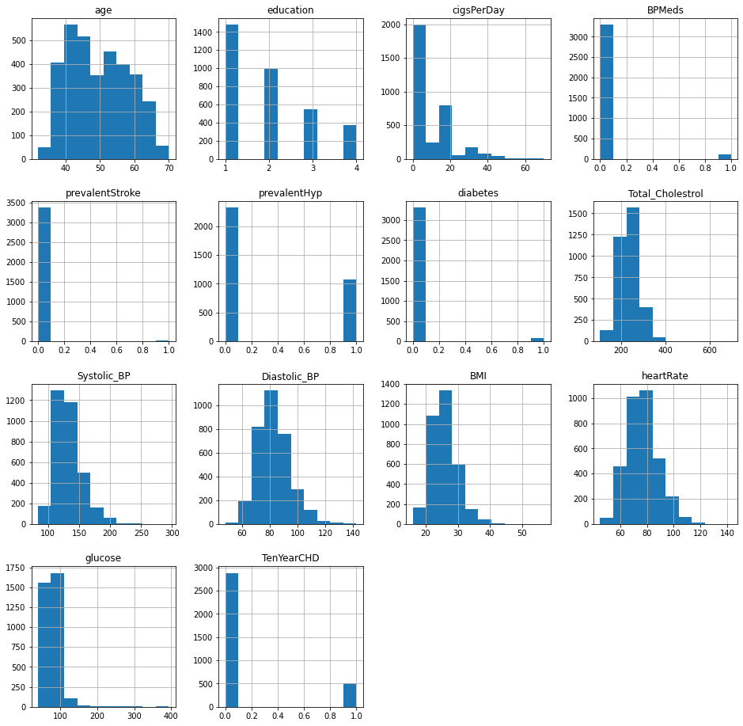
Distribution of data

Slide 11
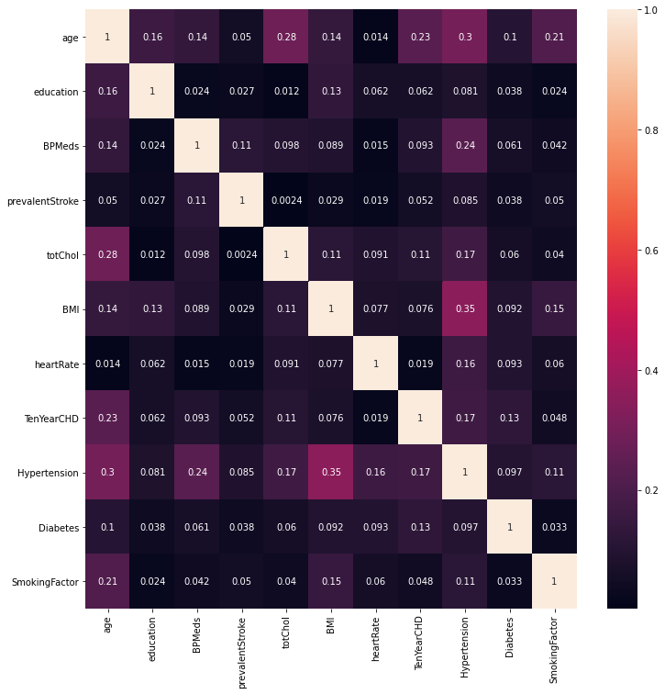
Correlation between features after feature engineering

Slide 12
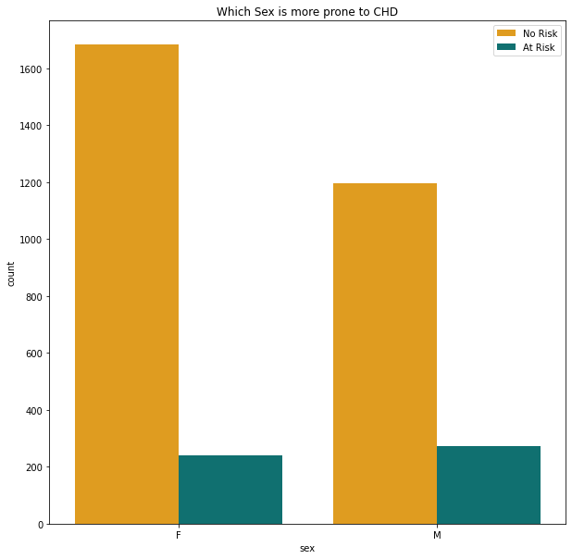
Which Sex is more prone to CHD ?

Slide 13
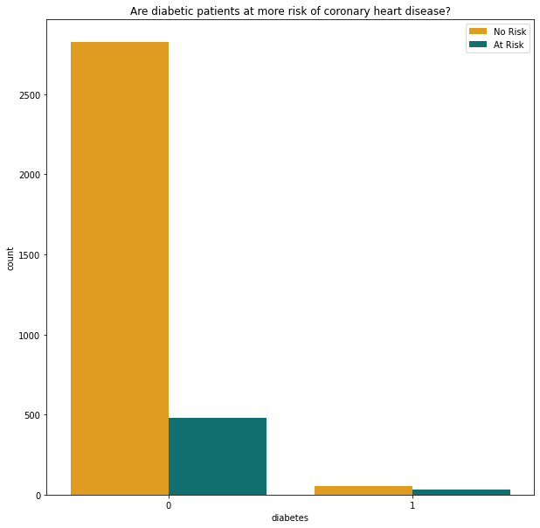
Are diabetic patients at more risk of chd ?

Slide 14
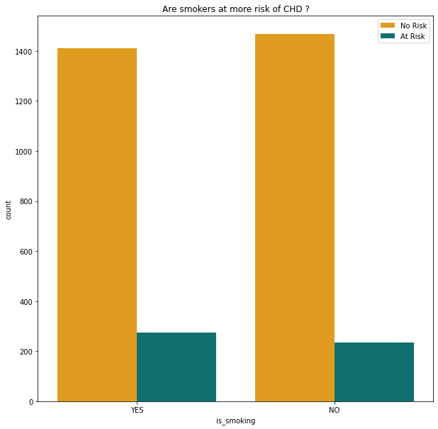
Are smokers at more risk of chd ?

Slide 15
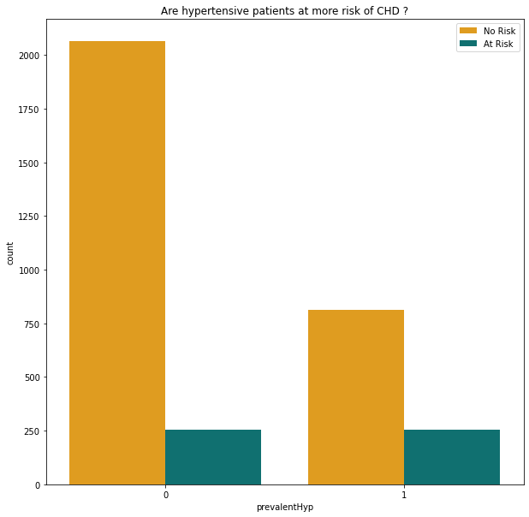
Are hypertensive patients at more risk of chd?

Slide 16
Are patients on bp medication at more risk of chd ?

Slide 17
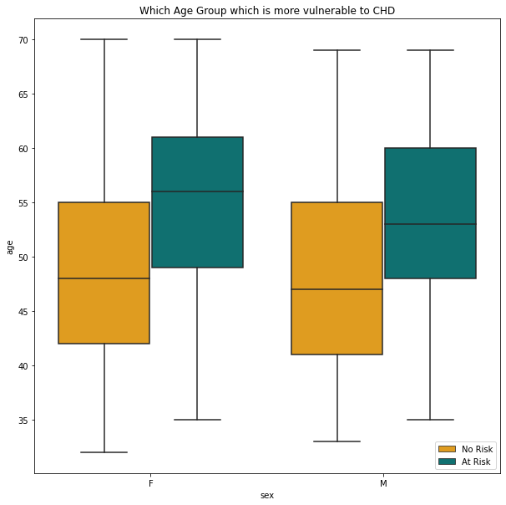
Which age group is more vulnerable to chd ?

Slide 18
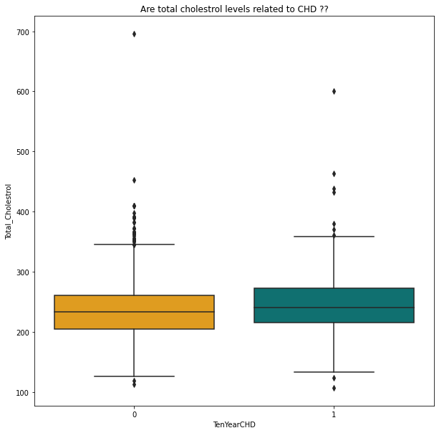
Are total cholesterol levels related to chd ?

Slide 19
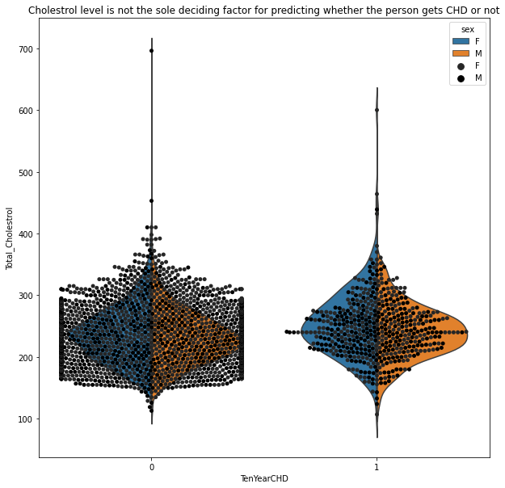
Cholesterol level is not the sole deciding factor for chd

Slide 20
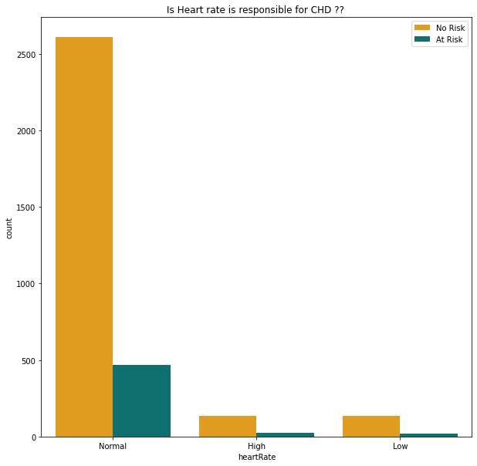
Can Heart rate possibly define the risk of chd ?

Slide 21
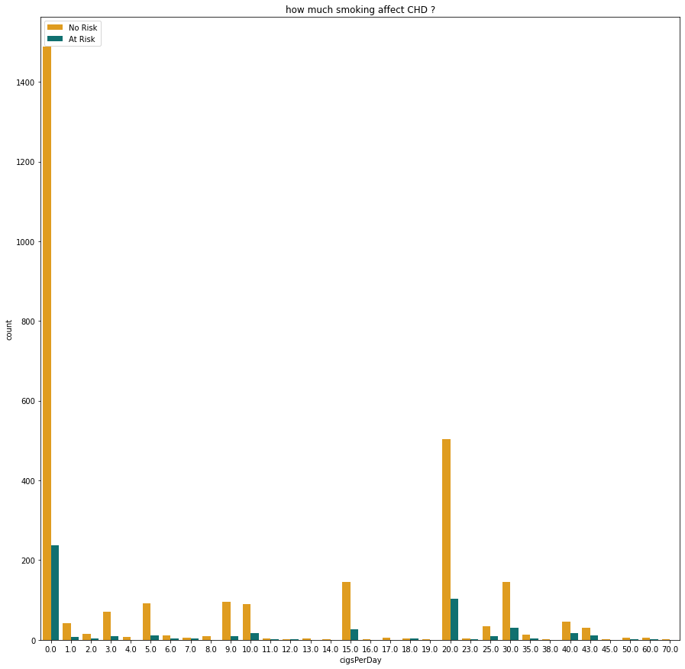
Can smoking number of cigarettes per day lead to chd?

Slide 22
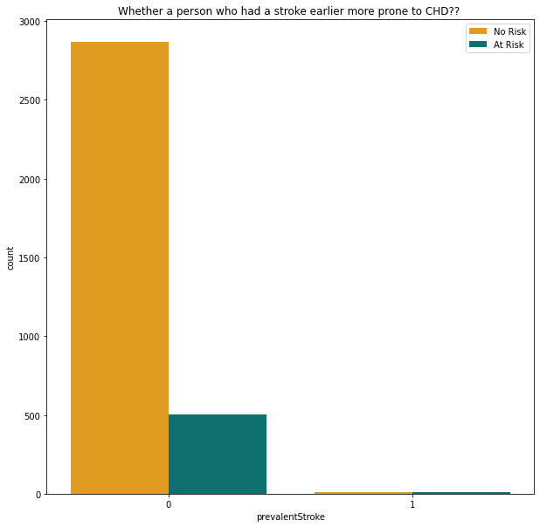
One who had a stroke earlier more prone to chd ?

Slide 23
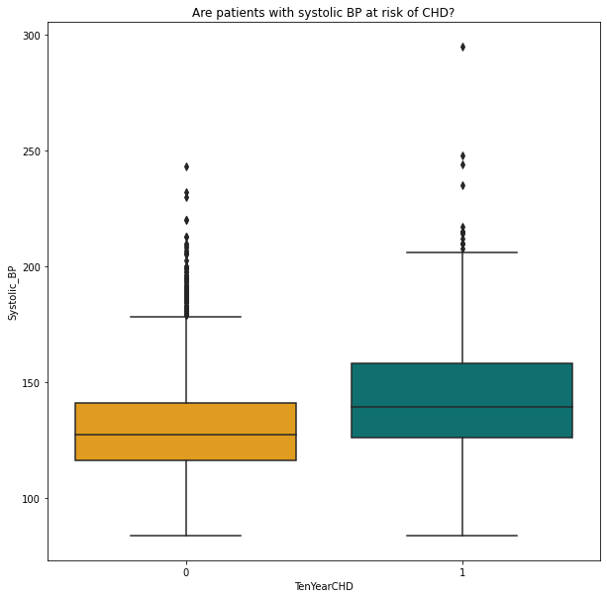
Are patients with systolic bp at risk of chd ?

Slide 24
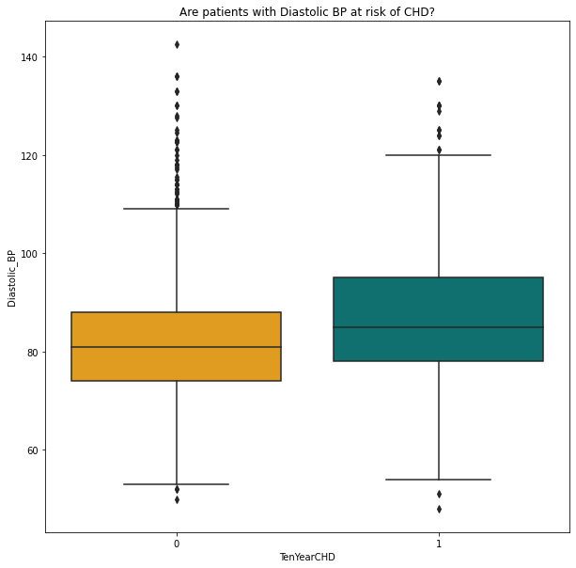
Are patients with diastolic bp at risk of chd ?

Slide 25
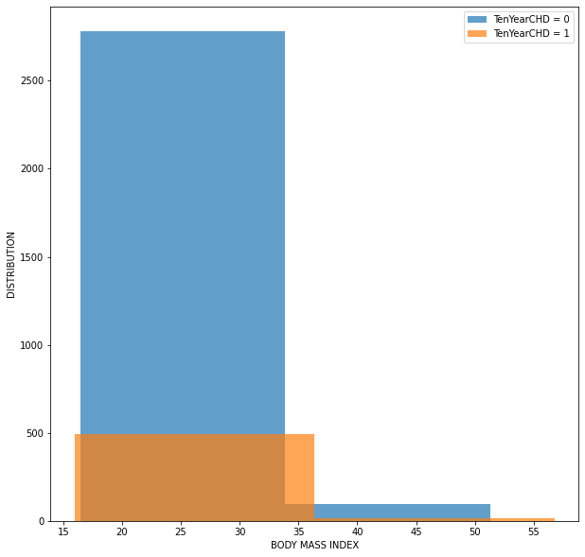
is patients bmi important to show the risk of chd ?

Slide 26
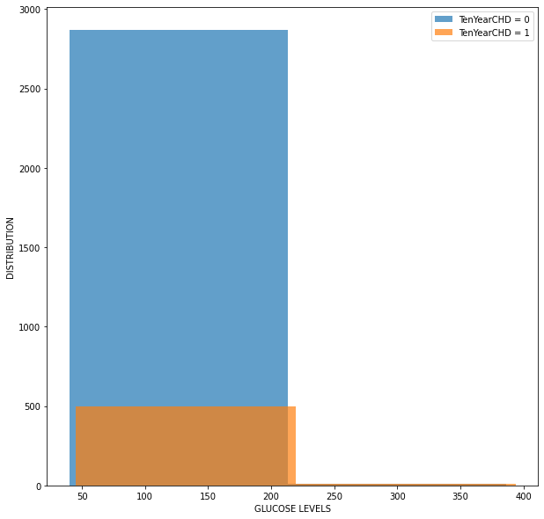
Can patients' glucose levels show the risk of chd ?

Slide 27
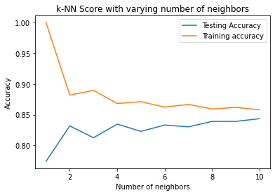
K-nn score with varying number of neighbors

Slide 28
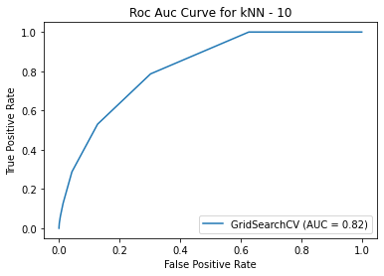
Roc auc curve for knn

Slide 29
The best fitting Model: -
Sr.no | ML Model | Test Accuracy Score | Train Accuracy Score
1. | Naive Bayes Classifier | 81 | 83
2. | KNN | 84 | 86
3. | Logistic Regression | 84 | 86
4. | Decision Tree | 75 | 76
5. | Random Forest | 89 | 99.8
6. | Gradient Boost | 87 | 90
7. | XGBoost | 97 | 83

Slide 30
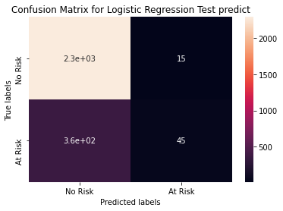
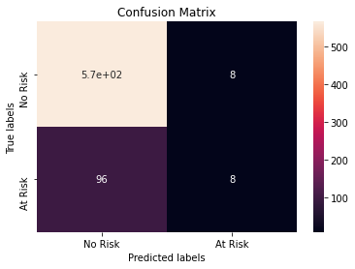
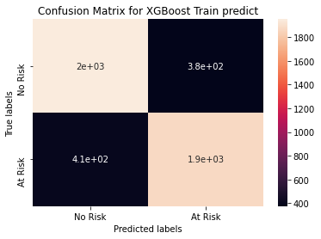
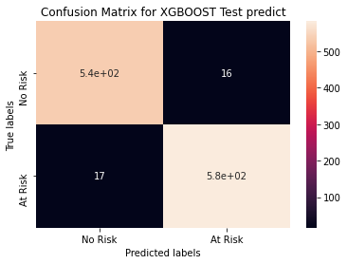
Confusion Matrix

Slide 31
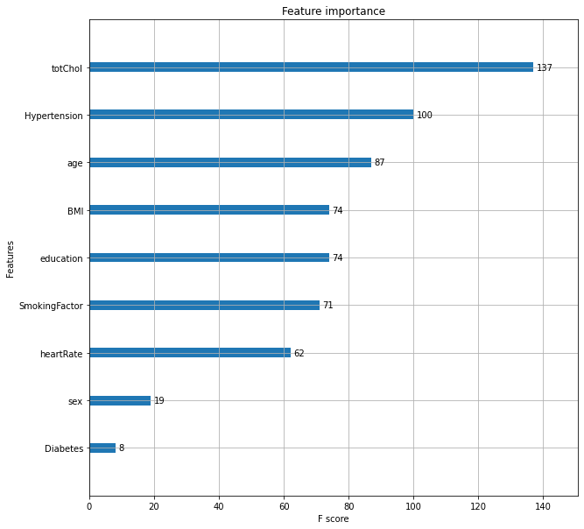
The Feature Importance

Slide 32
Result
A cardiovascular disease detection model has been built using no of ML classification modelling techniques.
This project once deployed can possibly help predict the parents for cardiovascular disease based to their past medical history Blood pressure, Body mass index, Sugar levels etc.
The algorithms used in building the model are Logistic regression, Decision trees, KNN, Random Forest classifier, Naive bayes classifier, Gradient boost and XGboost.
The top three models with best accuracy are Gradient boost, Random Forest & XGboost with accuracy of 87%, 89%, and 97%, respectively.

Slide 33
Conclusion
The project successfully developed a predictive model for CHD risk that can assist healthcare professionals in early diagnosis and treatment planning. The use of XGBoost, combined with careful data preprocessing and feature engineering, resulted in a model with high recall, crucial for minimizing the risk of undiagnosed CHD cases..

Slide 34
Future scope
Incorporating additional risk factors such as genetic data
Implementing real-time data processing for continuous risk assessment
Expanding the model to predict other cardiovascular diseases

Slide 35
References
KAGGLE DATASET:
https://www.kaggle.com/datasets/christofel04/cardiovascular-studydataset-predict-heart-disease
GITHUB :
https://github.com/AnandKumar56/Anand--Cardiovascular-Risk-Prediction

Slide 36
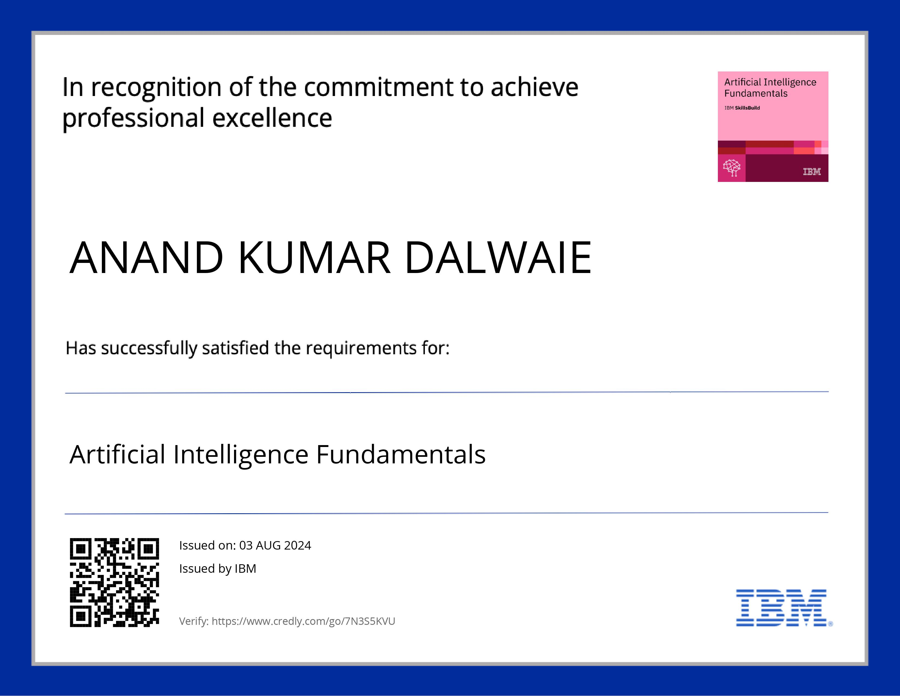
course certificate 1

Slide 37

course certificate 2

Slide 38
THANK YOU

