Slide 1

Team Hydra CMPE 202 Starbucks Final Demo
Anand Muralidhara
Chaitrali Deshmukh
Prathyusha Kasibhatta
Saylee Vyawahare

Slide 2

Scrum
Lack of Transparency & Collaboration
Unclear Priorities & Goals
No process for Adhoc Requests

Slide 3

Scrum
Offers Freedom of Implementation
Easy to learn & use
Scrum embrace the change
reduces the risk building the product by increments
continuous improvement

Slide 4
Scrum Process
Sprint Planning
Daily Standup Meetings
Sprint Retrospection

Slide 5
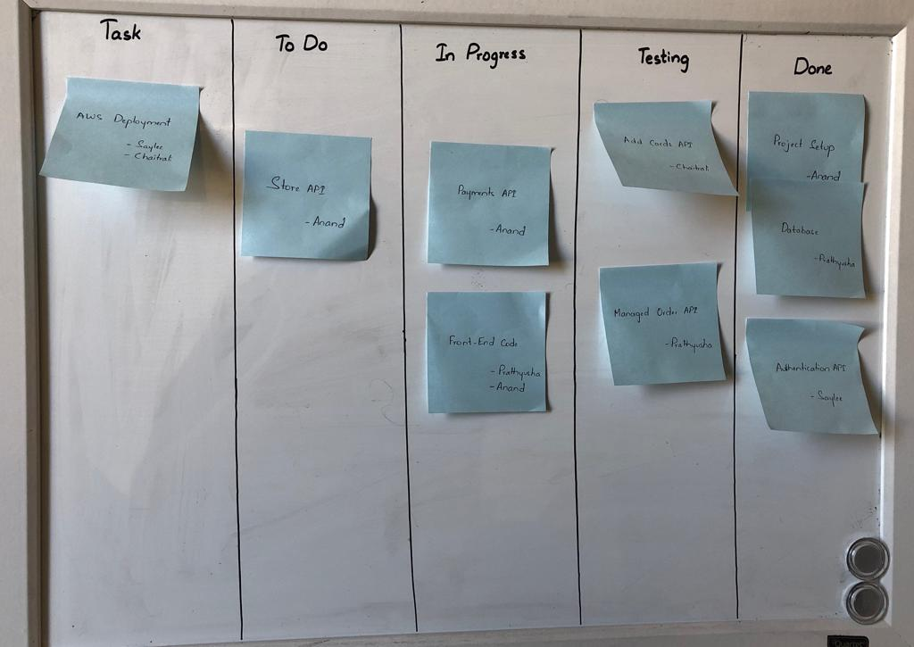
Kanban Chart

Slide 6
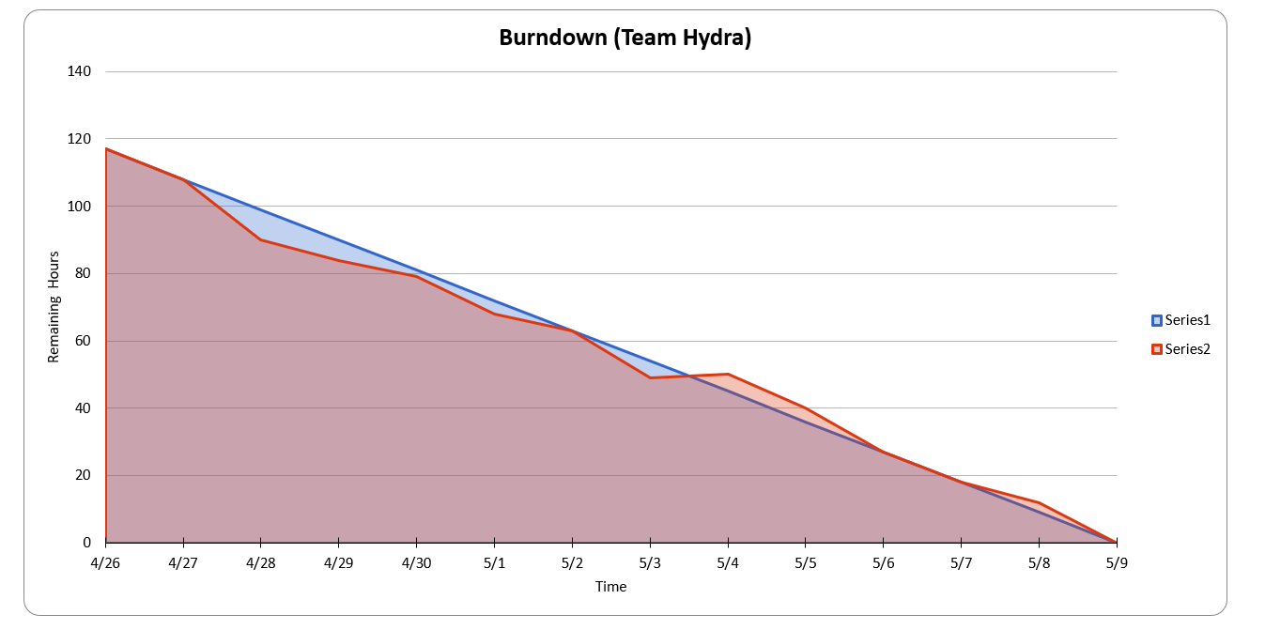
Burndown Chart

Slide 7
MVC Design Pattern
MODEL
View
Controller

Slide 8
Why MVC?
Simultaneous development
High cohesion
Low coupling

Slide 9

REST APIs
Authentication
Add Card
Manage Order
Payments
Stores

Slide 10
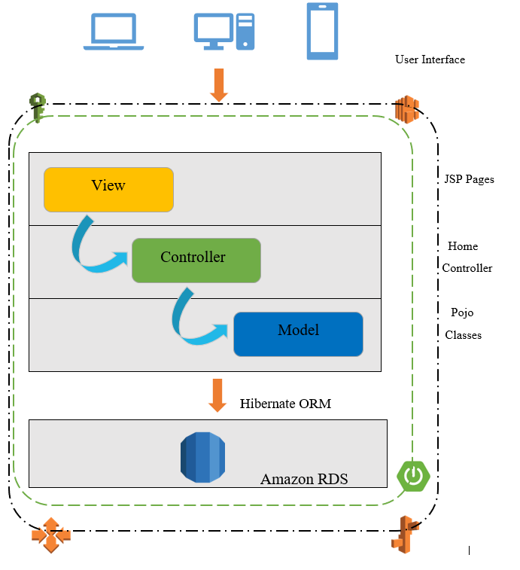
Architecture Diagram

Slide 11
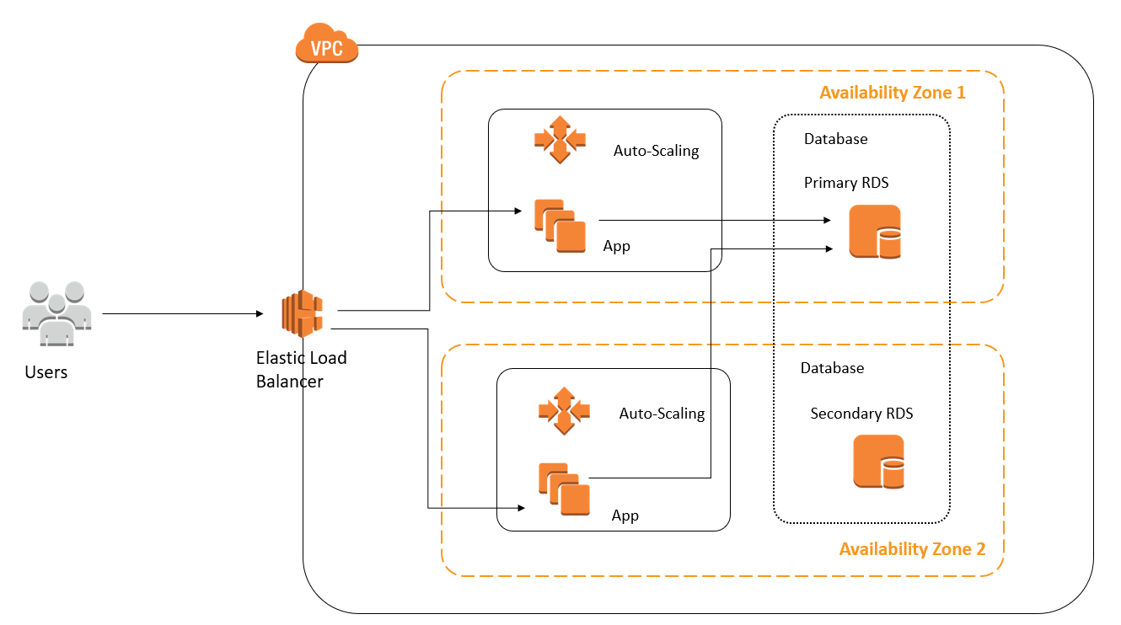
Deployment Diagram

Slide 12
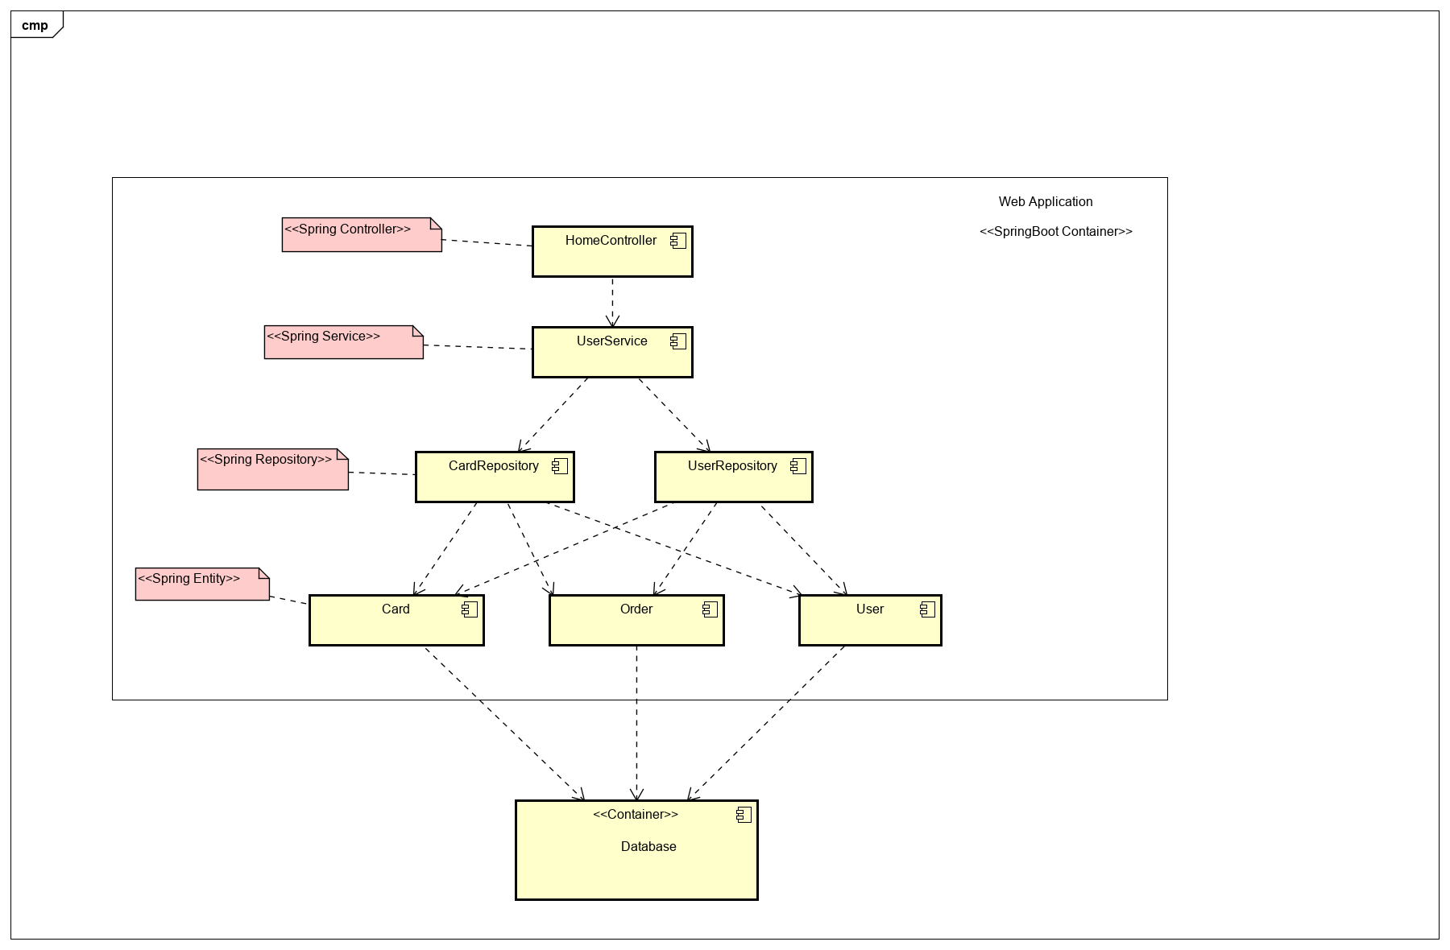
Component Diagram

Slide 13

Tools & Services
Java, JSP, JavaScript, Html5, CSS, Bootstrap
Spring Boot, Apache Tomcat, Maven
RDS MySQL, Hibernate
AWS: Elastic Beanstalk, RDS, IAM, ELB, S3
Google Maps API

Slide 14
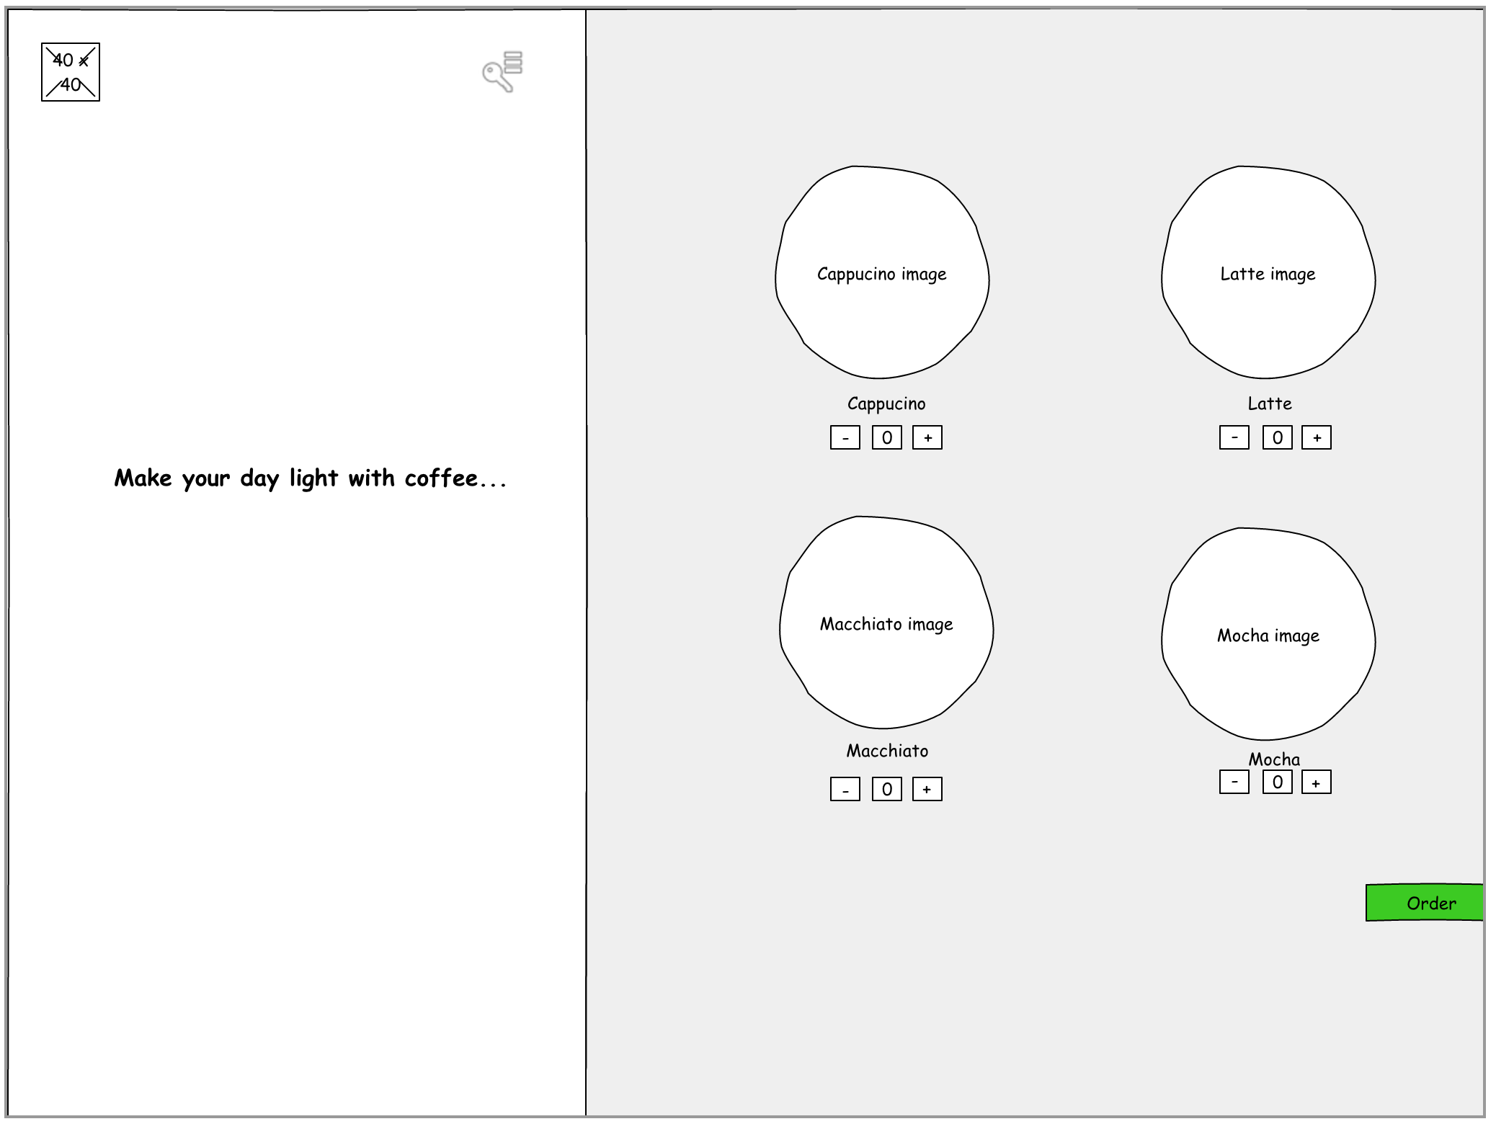
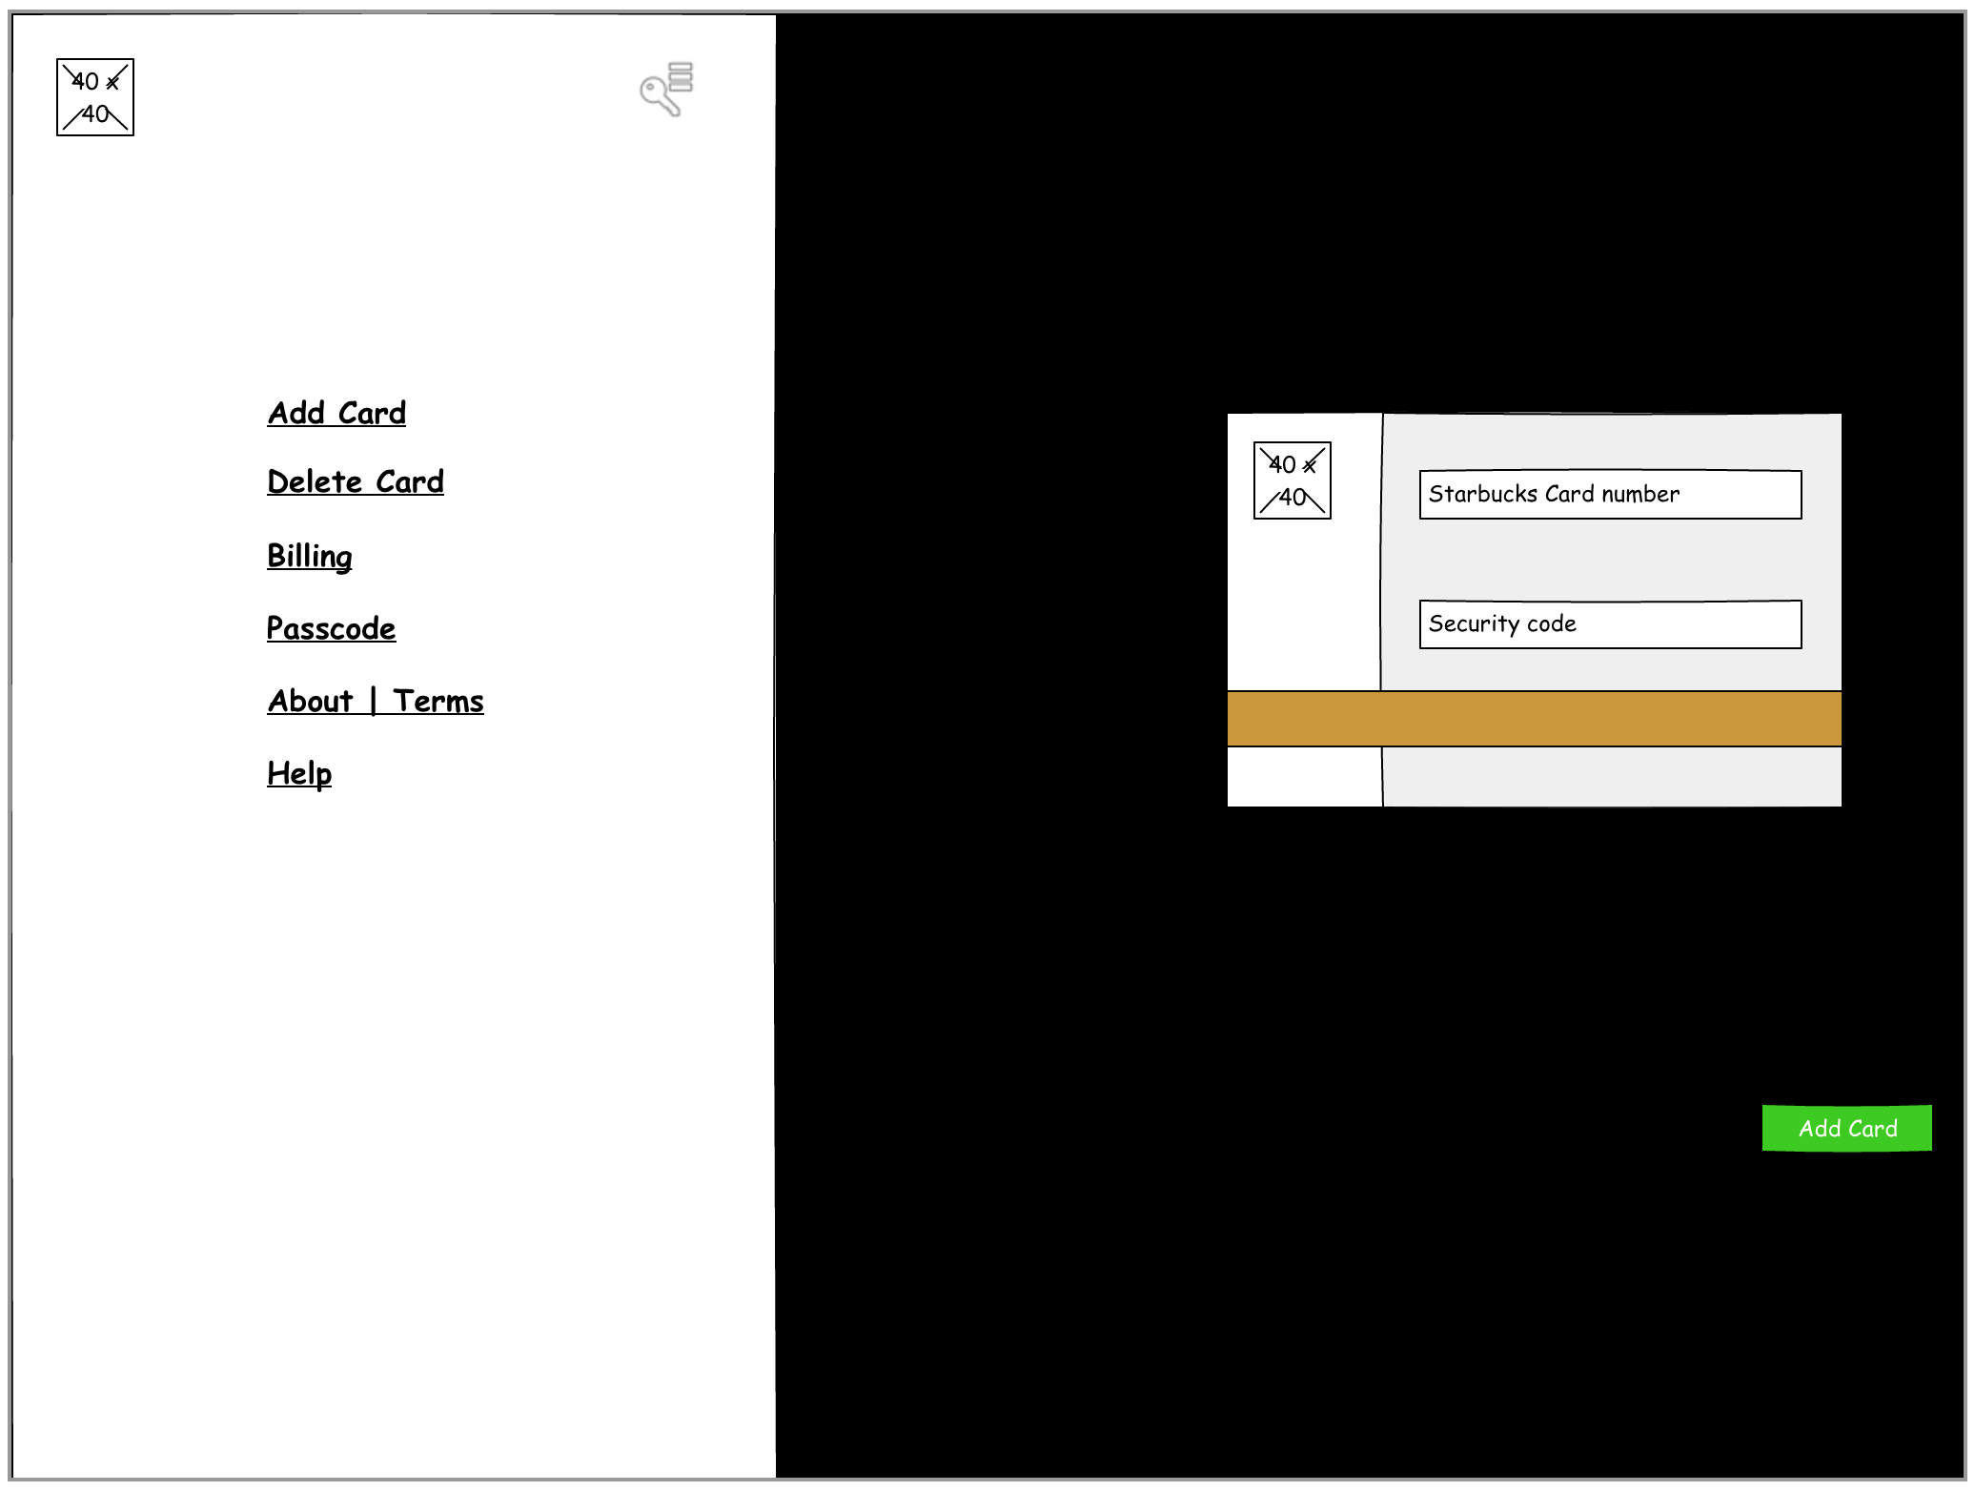
UI Wireframes

Slide 15

Demo

Slide 16

References
https://sourcemaking.com/design_patterns
http://mattkentzia.com/why-we-need-scrum-at-our-startup/
https://www.linkedin.com/pulse/7-reasons-use-scrum-project-development-david-nos/
https://www.mkyong.com/spring-boot/spring-boot-spring-data-jpa-oracle-example/
https://spring.io/guides/gs/accessing-data-jpa/
https://docs.aws.amazon.com/elasticbeanstalk/latest/dg/using-features.deploy-existing-version.html
https://developers.google.com/maps/documentation/javascript/adding-a-google-map
https://unsplash.com/search/photos/starbucks
https://www.starbucks.com/
https://www.planview.com/resources/articles/what-is-kanban-board/

Slide 17
Thank You!

