Slide 1
DDSAnalytics Employee attrition study for M/s Anheuser Busch Ltd
by Anand Rajan and Shantanu Godbole

Slide 2

DDSAnalytics
Our company’s expertise,
Employee management and retention solution
Workforce planning
Training programs
Attrition and prevention strategies
Use Data science for talent Management

Slide 3

Our Client - Anheuser Busch ltd
Established for 165 years
Head quartered in St Louis MO.
Brews more than 100 beer brands.
18 Billion in annual revenue.
- Anheuser Busch company website.

Slide 4

Reasons for Employee Attrition
Some of the factors leading to employee attrition are
Lack of Employee engagement
Lack of effective management
Weed out underperforming talent
Moderations in performance evaluation

Slide 5
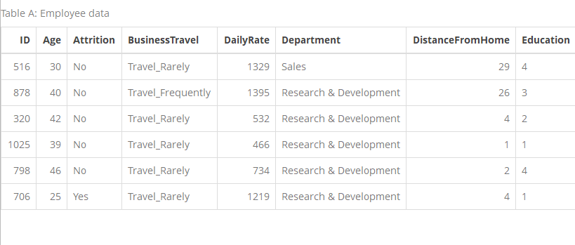
Story on Input data – Employee attrition
We have 1170 observations in the employee data provided with 37 attributes on employees.
Clean and consistent data for analysis. There are no missing attributes and data for the study.
Some data had to be discarded from study (example: ID,EmployeeCount,Over18, Standard Hours, Rand – some are constant across all employees)
16.6 % Attrition rate

Slide 6
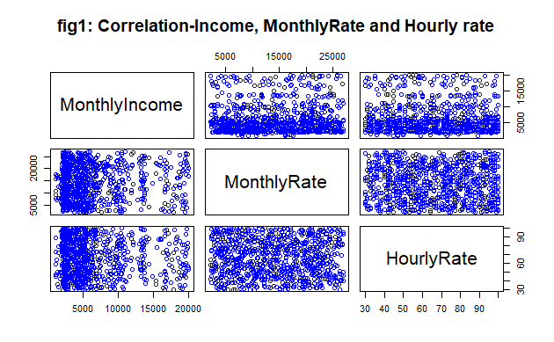
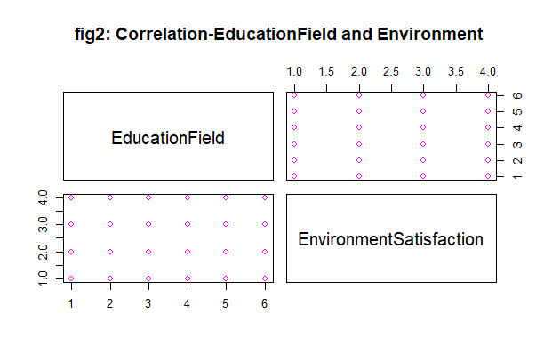
Correlation checking within the data
Income, Monthly Rate and Hourly Rate
Education field and Environment Satisfaction

Slide 7
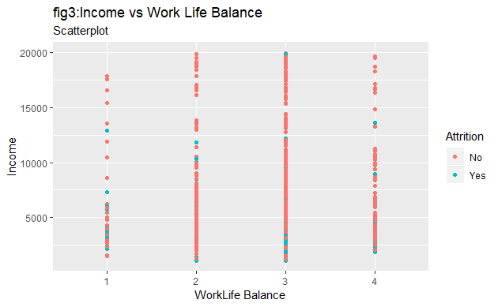
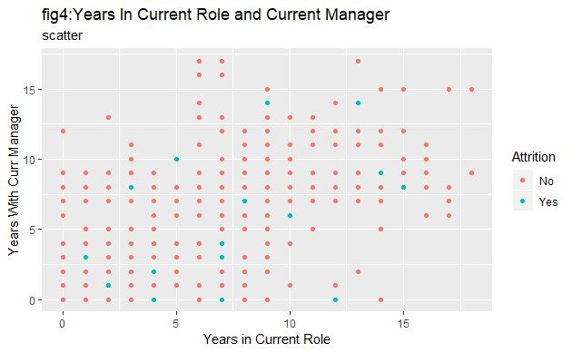
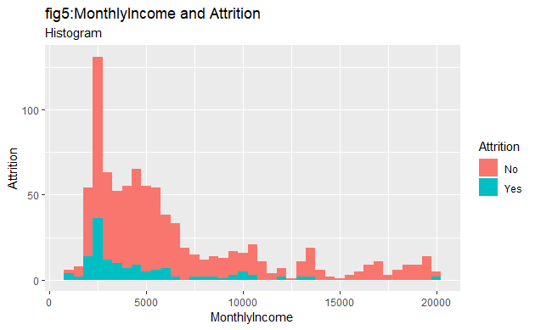
Attrition relationship with Income and Management
Income and work-life balance
Monthly income and employee attrition
Years with current role and current manager shows better as employees have more service

Slide 8
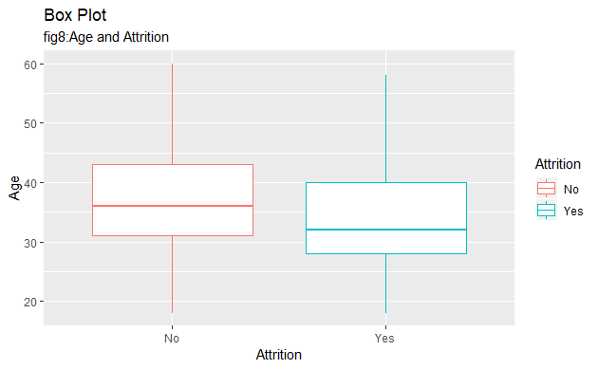
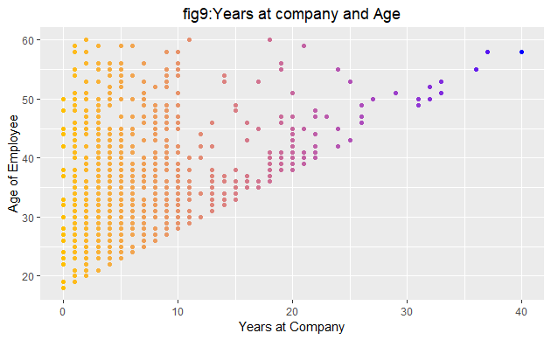
Employee attrition vs AGE
1. Attrition median age is around 32 and Median age where attrition goes down is around 36.
2. There is correlation between Age and service. The is more concentration in lower the age group.

Slide 9
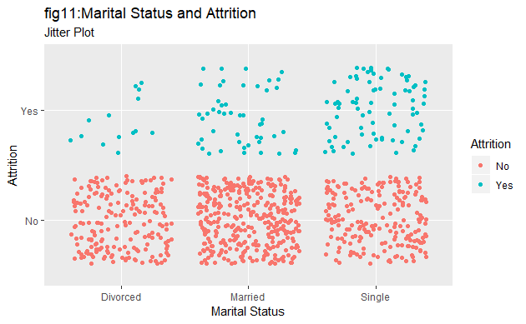
Marital Status and Attrition
Married employees rate is less
Single employees and divorced employees tend to seek greener pastures

Slide 10
KNN CROSS VALIDATION variable selection

Slide 11
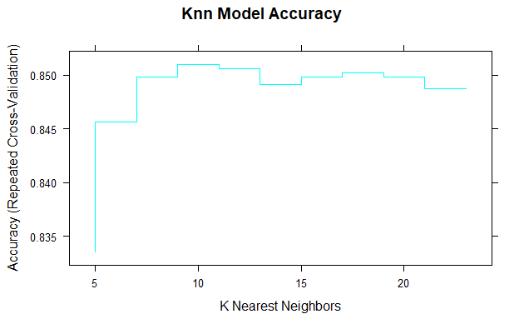
KNN CROSS VALIDATION was done with the input data to ascertain accuracy
Data was split to training and test 75% for training and 25% for validation.

Slide 12
Final results
We could predict attrition rate with Machine learning algorithm with 86.6 % accuracy. (Yes means attrition)

Slide 13
To Conclude
Management action:
Incentives and periodic promotions
Employee Engagement
Leadership development
Stock options(profit sharing)
Employer sponsored events
Monitor: Keeping attrition around 10%
“Employees need to feel valued in an organization to show their loyalty”

