Slide 1
Handwriting Recognition

Slide 2
Team Members
Tejassingh Patoi-19BAI10087
Anand Sinha -19BAI10104
Mansi Shrivastav- 19BAI10175
Mandavi Pandey- 19BAI10133

Slide 3
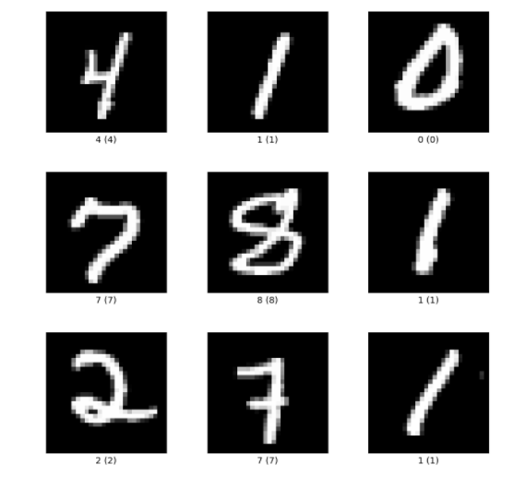
Introduction
A Machine Learning algorithm to recognize and convert handwritten text to digital text.
We are using the MNIST Dataset of handwritten digits

Slide 4
Model
Each image in the dataset is passed through gaussian blur filter to smoothen the images, then they are dilated and eroded to clear up the edges and further denoise the images.
The model begins by taking inputs to CNN layers. Importance is assigned to various features of the image so they are able to be differentiated among each other.
RNN will take the outputs of the CNN layer as inputs as it is able to accept large inputs which do not have fixed sizes unlike CNN which can only accept fixed sized inputs.
We have used a bidirectional LTSM to verify predictions against true class labels.
CTC loss is used to remove inconsistencies with predictions in cases where characters have slight variations with characters next to them.
Adam Optimizer is used to minimize CTC loss within the model.

Slide 5
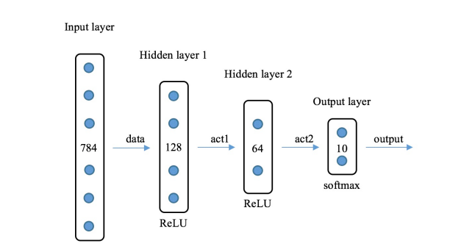
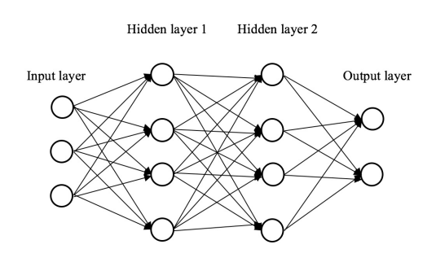
Model design

Slide 6
Model Workflow
Image in the IAM dataset are augmented to smoothen and denoise them. Their edges are clarified.
Then the images are passed to CNN which will extract features from each input and RNN is then used to reinforce these connections and features.
CTC loss is used as loss function and ADAM optimizer is used to minimize this loss within the model.

Slide 7
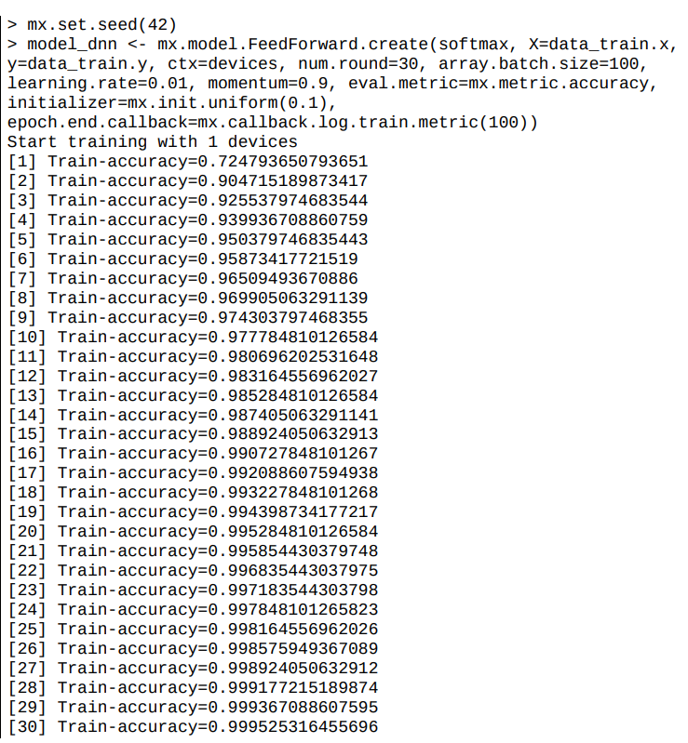
Results

Slide 8
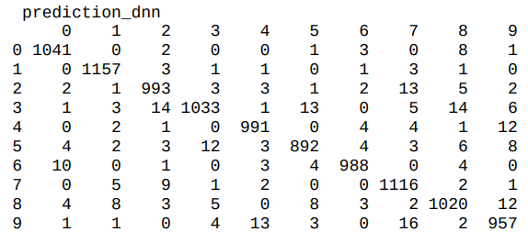
Results
Our model achieved 99.95% accuraccy
Confusion Matrix

Slide 9
Conclusion
Hopefully with these results we may extend our project to different languages and an extension could be created with which we could scan text in a different language and have it be translated to English in digital form.

