Slide 1
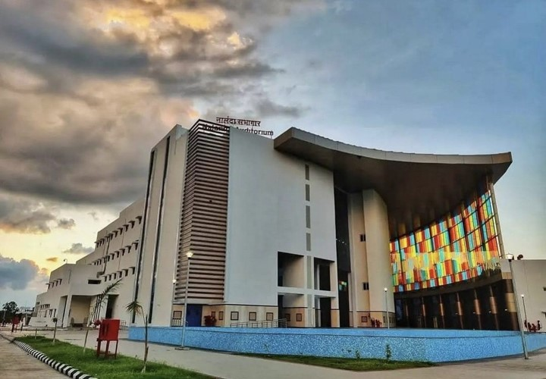




INDIAN INSTITUTE OF TECHNOLOGY
INDORE
VIMARSH:
Institute Public Lecture
Nuclear Science, Technology and Society
Distinguished Speaker:
Dr. Swaminathan Kailas, FNA, FASc
Former Director, Physics Group, BARC, Mumbai
INSA Honorary Scientist & Hon. Professor, UM-DAE Centre for Excellence in Basic Sciences, Mumbai
16 January 2026
4:30 PM IST
LRC Ground Floor Lecture Hall (Library)
Contact: outreach@iiti.ac.in
All are Welcome!

