Slide 1
ANANDA KRISHNAN P S
SHALINI R
Final Project
3/21/2024 Annual Review

Slide 2
Photorealistic face-generation using DCGANS
3/21/2024 Annual Review

Slide 3


AGENDA
Introduction & Problem Statement: Overview of the project's objectives and challenges in photorealistic face generation.
Solution Architecture: Explanation of the DCGAN architecture and its components.
Training & Results: Description of the training procedure and presentation of results.
Applications & Future Directions: Discussion of potential applications and future research directions.
3/21/2024 Annual Review

Slide 4

PROBLEM STATEMENT
Generating photorealistic human faces is essential for various industries such as computer graphics, gaming, virtual reality, and digital entertainment.
Current methods struggle to produce high-quality and diverse facial images with natural features, expressions, and variations.
Traditional techniques like hand-crafted feature extraction and template-based approaches are limited in capturing the complexity and diversity of human faces.
The uncanny valley effect remains a significant obstacle, where artificial faces appear unsettlingly non-human, impacting user engagement and immersion.
3/21/2024 Annual Review

Slide 5

PROJECT OVERVIEW
Data Preparation: Load and preprocess celebrity face images by cropping, resizing, and normalization.
Model Definition: Define discriminator and generator architectures using Keras Sequential API.
Training Procedure: Implement custom training loop to iteratively train discriminator and generator networks.
Visualization and Evaluation: Visualize generated images, monitor training progress, and optionally save the trained generator model.
3/21/2024 Annual Review

Slide 6

END USERS
Game Developers: Incorporating realistic character customization and facial animations in video games.
Filmmakers: Creating lifelike digital characters and visual effects for movies and animations.
Virtual Reality Content Creators: Designing immersive virtual environments with realistic avatars and interactions.
Digital Artists: Generating high-quality portraits, illustrations, and artwork for digital media.
3/21/2024 Annual Review

Slide 7
SOLUTION AND ITS VALUE PROPOSITION
Solution: Implementation of Deep Convolutional Generative Adversarial Networks (DCGANs).
Value Proposition: High-quality, diverse, and realistic face generation for various applications.
Solution: Overcoming the uncanny valley effect through advanced machine learning techniques.
Value Proposition: Enhanced user engagement, immersion, and realism in digital content and virtual experiences.
3/21/2024 Annual Review

Slide 8
THE WOW FACTORS
Realism: Generated faces exhibit natural features, expressions, and variations.
Diversity: Ability to produce a wide range of facial attributes, poses, and identities.
Innovation: Utilization of cutting-edge deep learning techniques like DCGANs.
Application Versatility: Enables realistic face generation across diverse industries such as gaming, film, and virtual reality.
3/21/2024 Annual Review

Slide 9
MODELLING
Network Architecture: Define discriminator and generator architectures using the Keras Sequential API.
Discriminator: Constructed with convolutional layers followed by dense layers for classification, utilizing LeakyReLU activation functions for non-linearity.
Generator: Comprises deconvolutional layers to upsample input noise into realistic images, employing LeakyReLU activation functions for non-linearity.
3/21/2024 Annual Review

Slide 10
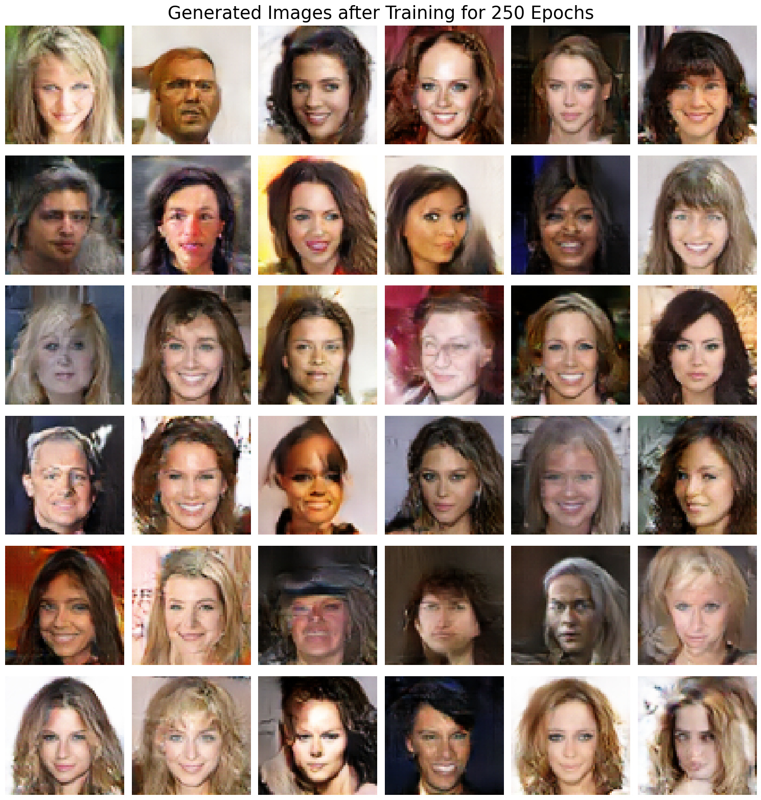
RESULTS
NAAN-MUDHALVAN/photorealistic-face-generation-using-dcgans.ipynb at main · AnandaKrishnan-ps/NAAN-MUDHALVAN (github.com)
3/21/2024 Annual Review

