Slide 1

Explore Brooklyn: Stay near Indian Restaurants, Start Business too
Ananda Pal
February 09, 2020
This Photo by Unknown Author is licensed under CC BY-SA

Slide 2
Introduction:
New York is the most densely populated area in United States.
New York City has been described as the cultural, financial and media capital of the world, and exerts a significant impact upon commerce, entertainment, research, technology, education, politics, tourism, art, fashion, and sports.
New York City is a collection of many neighborhoods scattered among the city’s five boroughs — Manhattan, Brooklyn, the Bronx, Queens, and Staten Island— each exhibiting its own lifestyle.
With almost 200 languages spoken, 40 percent of the NYC population was born outside of the United States. Conquering New York in one visit is impossible.

Slide 3
Problem Description:
As the culture is diverse in nature, there will be various food items which birth various restaurants like Chinese, Indian, Italian etc. Here, we'll visit "Brooklyn" and look at the Indian Restaurants.
Some of my colleagues from my company will go to Brooklyn and planning to stay there may be for some months. They wanted to find out where to stay so that they can get all their necessary amenities like - Indian Restaurants (more important), Chinese Restaurants, Gym or Fitness Centre etc. Based on above criterion, where to find the appropriate place for them to stay?

Slide 4
Target Audience:
People who wants to visit some place (here Brooklyn) and prefer Indian dishes and also other items like Chinese food, fitness center etc.
It’ll also helpful for the people who want to open Indian Restaurant in Brooklyn. They’ll able find out about Indian Restaurants there along with their ratings and likes and they can find out about their competitors.
Not only Indian Restaurant, after getting top 10 most common venues, they can choose their own business for a particular neighborhood

Slide 5
Data Description: Dataset 1
This dataset contains data for New York City including its Boroughs, Neighbourhoods along with their latitudes and longitudes.
Source: https://cocl.us/new_york_dataset
Details: This dataset contains total 306 data that will be used to get information about Boroughs, Neighbourhoods along with their latitudes and longitudes for New York City.

Slide 6
Data Description: Dataset 2
This dataset contains nearby venues of Brooklyn within 500m radius.
Source: Foursquare
Details: This dataset contains data that will be used to get information about Venues in Neighbourhoods of Brooklyn along with their IDs, latitudes and longitudes. This dataset contains total 288 unique categories of venues.

Slide 7
Data Description: Dataset 3
This dataset contains data for Indian Restaurants in Neighbourhoods of Brooklyn.
Source: Foursquare
Details: This dataset contains data that will be used to get information about Likes, Ratings, Tips for the Indian Restaurants for further analysis.

Slide 8

Methodology:
Analytical Approach:
Tools/Library Used: Numpy, Pandas, Matplotlib, Geopy, Folium, Foursquare API

Slide 9
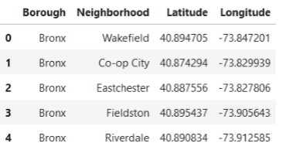
Analysis of Dataset-1:
The source of the dataset is: https://cocl.us/new_york_dataset
This dataset contains total 306 data with 5 Boroughs namely Queens, Brooklyn, Staten Island, Bronx, Manhattan and their corresponding Neighbourhoods and latitudes, longitudes.
The dataset looks like:

Slide 10
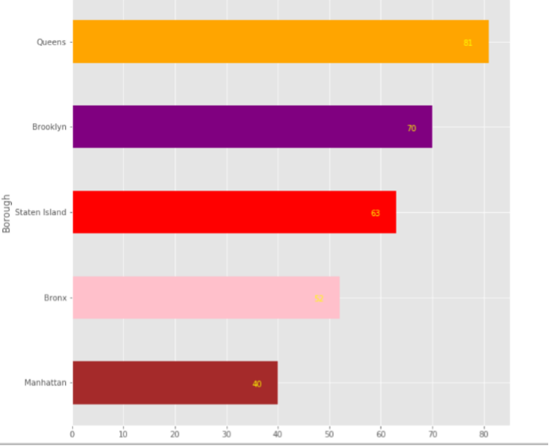
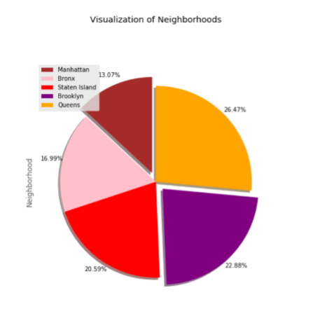
Analysis of Dataset-1 Contd. :
Neighborhoods-distribution for each Borough is shown right:
From the above bar chart, we can see Queens has maximum number of Restaurant (81) and 26.47% of total and followed by Brooklyn (70) 22.88% of total and others.

Slide 11
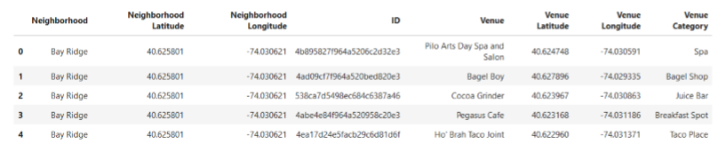
Analysis of Dataset-2:
This dataset contains data that will be used to get information about Venues in Neighbourhoods of Brooklyn along with their IDs, latitudes and longitudes.
As my colleagues want to Visit Brooklyn and planned to stay there may be for some months. For this, I need more info about Brooklyn to give recommendation.
Firstly, I’ve used geocode to get latitude and longitude of Brooklyn.
Next, using Foursquare API, explored the venues of Brooklyn within 500 meters of radius and got the data. This dataset contains total 288 unique categories of venues.
The dataset looks like:

Slide 12
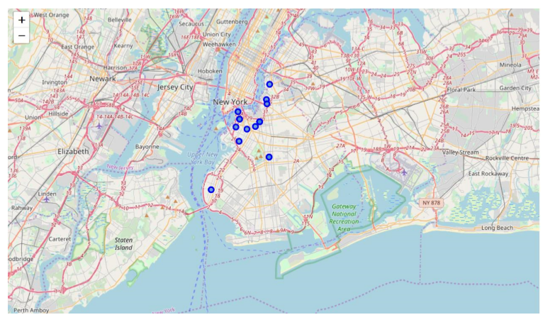
Analysis of Dataset-2 Contd. :
Now, my colleagues want to stay in a Neighbourhood where they can get good Indian food and other amenities. So, let's explore great Indian Restaurants nearby in each Neighbourhood.
After filtering out Indian Restaurants, I’ve got total 16 Indian Restaurants in Brooklyn.
So, let's visualize the Indian Restaurants I've got from Foursquare data in Map:

Slide 13
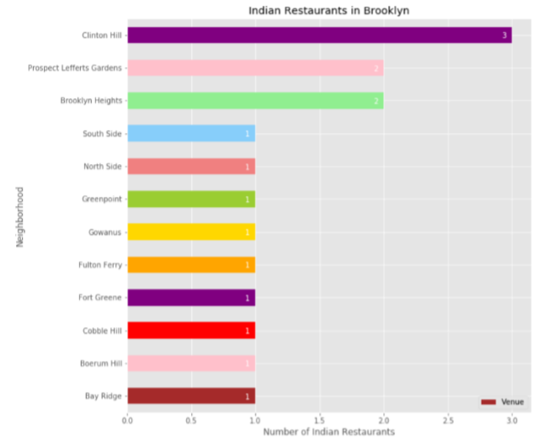
Analysis of Dataset-2 Contd. :
Now, I’ve analysed data for each neighbourhood in Brooklyn searching for Indian Restaurants. Look of my observation:
From the Bar chart, we can see that Clinton Hill has maximum number (3) of Indian Restaurants, followed by Prospect Lefferts Gardens, Brooklyn Heights and others.

Slide 14
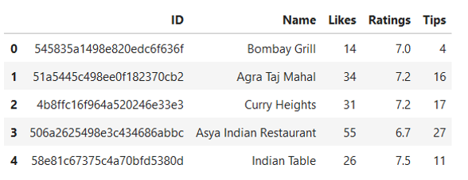
Analysis of Dataset-3:
The source of the dataset is: Foursquare
Now, I’ve got the Indian Restaurants info, restaurants that are much loved by people, i.e. highly rated and liked ones, should be known to me.
So, I had to use Foursquare API again to get the above-mentioned info and the dataset looks like:

Slide 15
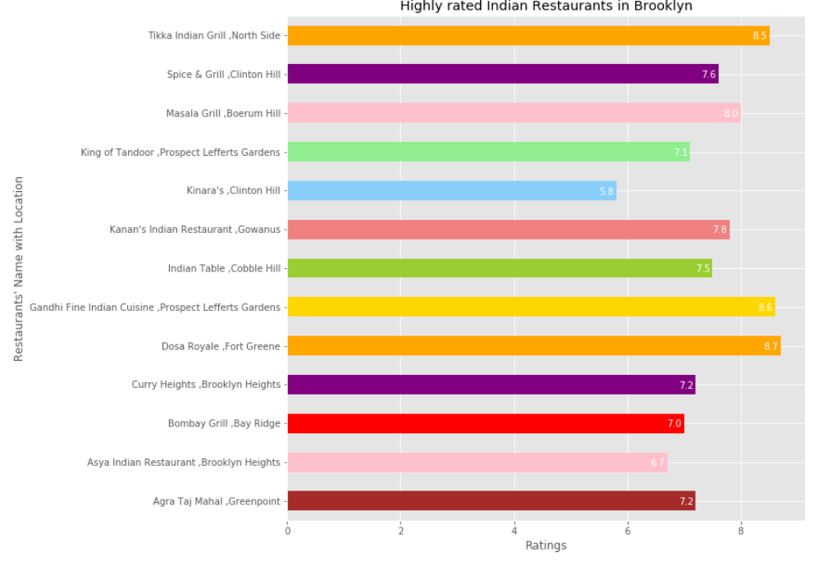
Analysis of Dataset-3 Contd. :
After doing some more analysis with data, let’s visualize data for Highly Rated Indian Restaurants:
From the bar chart, we can see that Dosa Royale which is in Fort Greene is highly rated (8.7), Gandhi Fine Indian Cuisine in Prospect Lefferts Gardens is second highly rated (8.6) and others are also close to each other.

Slide 16
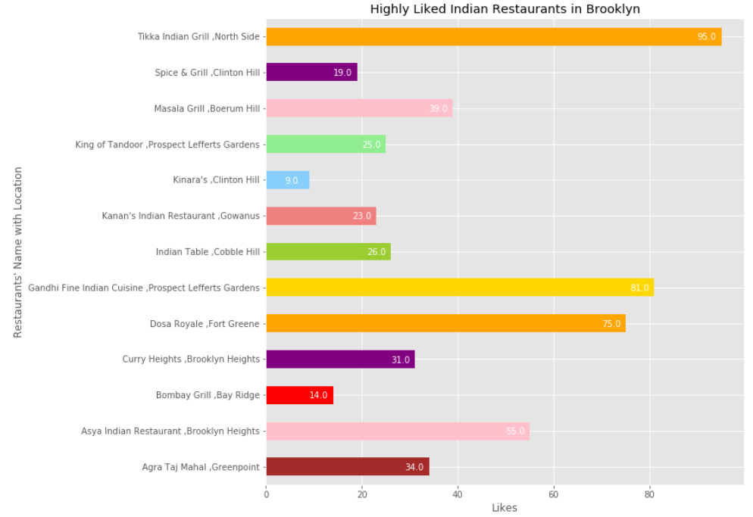
Analysis of Dataset-3 Contd. :
Let’s visualize highly Liked Restaurants:
From above chart, we can see that Tikka Indian Grill in North side is highly liked (95) restaurant. From previous chart, we can see Tikka Indian Grill also gets very good rating (8.5). Highly rated Dosa Royale gets good likes (75).

Slide 17
Analysis of Dataset-3 Contd. : Business Perspective:
Anyone who wants to open Restaurant in any Neighbourhood, after observing the rating, likes and types of food (We can understand by name like Dosa, Tikka etc), they can decide what types of Indian Restaurants they will open and which Neighbourhood.
Now we've found out which neighbourhood has which Indian Restaurants and also about their ratings and likes, but only Indian Restaurants?? These can be one of the Main reasons but not Only reason. Let's find out other amenities nearby.
Now, I’ll use the Neighbourhoods where all Indian Restaurants are.

Slide 18
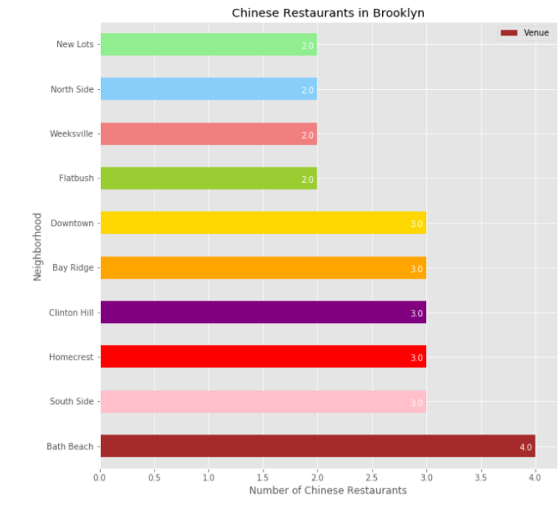
Analysis of combinations of all 3 Datasets:
Now, next priorities of my colleagues are like eating Chinese, joining Gym etc. Let's find out the places and then decide where to stay.
Chinese Restaurants: Further analysis helps to get Chinese Restaurants in Brooklyn.
We can see that Bath Beach has got maximum number of Chinese Restaurants (4). We can also look of other Restaurants too.

Slide 19
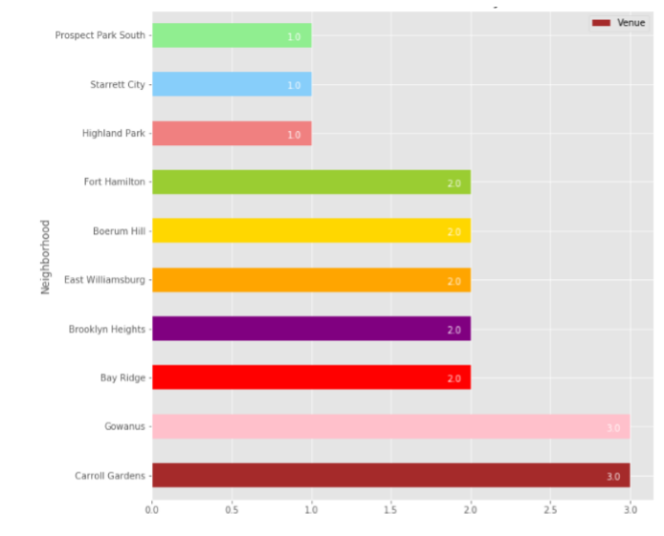
Analysis of combinations of all 3 Datasets Contd. :
Gym / Fitness Centre:
Let’s visualize neighbourhoods for Gym or Fitness Centre:
So, Caroll Gardens and Gowanus took the place when it comes about Fitness Centre.

Slide 20
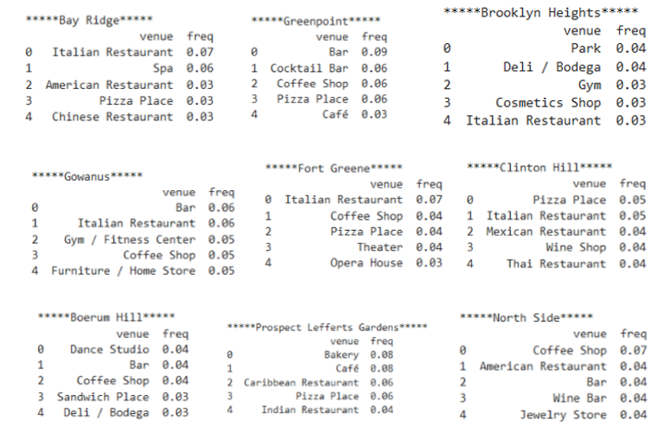
Analysis of combinations of all 3 Datasets Contd. :
Now, apart from Indian, Chinese Restaurants, Gym, let’s find out the top 5 most common venues of the neighbourhoods.
So, the top 5 lists will help them to decide besides Indian Restaurant what kind of amenities they want.

Slide 21
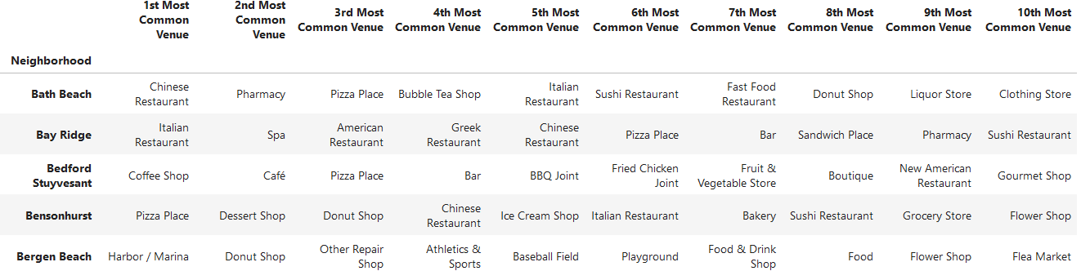
Analysis of combinations of all 3 Datasets Contd. : Business Perspective
Created a separate dataset which contains all the Top 10 common venues for all Neighbourhoods of Brooklyn. The dataset looks like (check below):
From the dataset, people can search the Neighbourhood name and will get the Top 10 venues and based on this they can choose their business.
This dataset will also help if anyone wants to visit Brooklyn for the first time.

Slide 22
Results / Takeaways:
So, Recommendation can be made after looking at the detailed analysis of Datasets and Bar Charts. For my colleagues, i.e. who wants Indian food mainly, recommended Places and Restaurants are:
1. Prospect Lefferts Gardens (Gandhi Fine Indian Cuisine, Rating = 8.6, Likes = 81, Tips = 47) and (King of Tandoor, Rating = 7.1, Likes = 25) • Top 5 Places: Bakery, Café, Caribbean Restaurant, Pizza Place, Indian Restaurant
2. North Side (Tikka Indian Grill, Rating = 8.5, Likes = 95, Tips = 29) • Top 5 Places: Coffee Shop, American Restaurant, Bar, Wine Bar, Jewellery Store
3. Fort Greene (Dosa Royale, Rating = 8.7, Likes = 75, Tips = 22) • Top 5 Places: Italian Restaurant, Coffee Shop, Pizza Place, Theatre, Opera House

Slide 23
Results / Takeaways: Business Perspective
From the dataset people who are planning to open Restaurants in Brooklyn, could find the Top 10 common venues. It varies from person to person for what they need. After they decide, further analysis can be done like I’ve done for Indian Restaurants.
From the Indian Restaurant dataset, they will find out the best neighbourhood and find Restaurants of different varieties of foods and their competitors looking at Ratings, likes, tips etc. It helps for decision making.

Slide 24
Conclusion:
I’ve performed all these analysis with the location details provided by the Foursquare. Data analysis is done for Brooklyn within 500 metres of radius. Venues could be different if analysis gets performed with different radius. So, I can that analysis is made based on a limited data.
Above, all the recommendations are totally mine based on my analysis. This varies from people to people about what really they want.
For business perspective, this analysis can be helpful. Different people have different opinions on venues, boroughs, neighbourhoods etc, and for that further analysis must be needed using the same dataset.

