Slide 1
Predicting Kubernetes Cluster Failures Using AI/ML
An AI/ML-based approach for proactive failure detection in Kubernetes clusters

Slide 2
Abstract
Kubernetes clusters encounter failures such as pod crashes, resource bottlenecks, and network issues. This project builds an AI/ML model that predicts these failures before they occur using historical and real-time cluster metrics. The model enhances Kubernetes reliability by using anomaly detection and time-series analysis.

Slide 3
Objective & Scope
- Predict Kubernetes failures: pod crashes, resource exhaustion, network disruptions.
- Utilize real-time & historical metrics (CPU, memory, network usage, logs).
- Develop a robust ML model (supervised learning, anomaly detection).
- Deploy model in Kubernetes for real-time predictions.

Slide 4
Dataset & Data Cleaning
- Metrics used: CPU, memory, network IO, pod/node status logs, Kubernetes events.
- Missing values handled via imputation.
- Noisy and redundant data removed.
- Standardized time-series metrics for consistency.

Slide 5
Data Splitting & Preprocessing
- 70% training, 30% testing split.
- Feature scaling via MinMax normalization.
- Encoding categorical variables (e.g., pod states).
- Time-series engineering: lag features, rolling averages.

Slide 6
Model Building
- Models tested:
Decision Tree
Random Forest Classifier
XGBoost Classifier
- Hyperparameter tuning with Grid Search.
- Model performance evaluated using accuracy, precision, recall, F1-score.

Slide 7
Model used
model | accuracy
decision tree | 83.1
Naïve bayes | 9.5
Random forest | 87.3
Logistic regression | 66.3
SVM | 57.2
KNN | 71.2
XGBoost | 87.4
MLP | 67.07

Slide 8
Final Model & Performance
Random forest and XGBachieved highest accuracy.
- Captured temporal dependencies effectively.
- Performance metrics:
Accuracy: 87.5%
- High confusion matrix score indicating effective failure prediction.

Slide 9
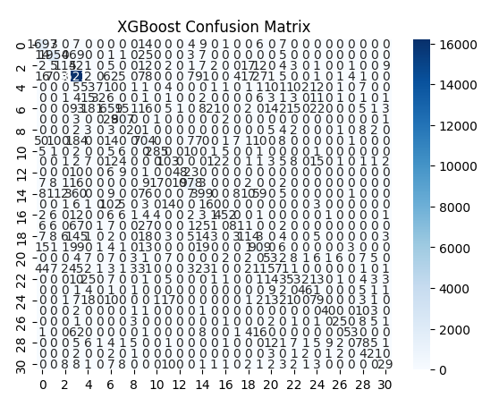
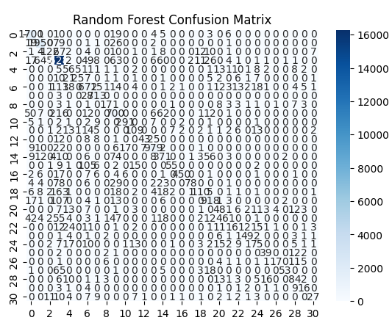
Confusion matrix

Slide 10
Conclusion
- AI/ML model successfully predicts Kubernetes failures.
- Enables proactive maintenance and reduces downtime.
- Future work:
* Integrate real-time anomaly detection.
* Deploy model as a microservice in Kubernetes.
* Improve model robustness with more diverse datasets.

