Slide 1
COMPILER DESIGN LAB
FINAL REVIEW
Accuracy
Constrained
Compilation
THE RESULT
6.1×
Image kernel at β = 0.01, against 1.8× for the precision-only tuner.
0 of 46,080 sampled runs exceeded their certified bound.
Built, certified and measured: one sound error budget
spent across four kinds of approximation
Anand B
Sathguruvasan Arunothayan
Karthik Senthilkumar
24BCE2199
24BCE2231
24BCE2205
Notes:
Final review. At Review 1 we promised a compiler that takes one accuracy budget and spends it across four kinds of approximation with a single sound bound. This deck shows the built system, its guarantee, and the measured results.

Slide 2
Agenda
02
03 – 05
The Promise, Kept
What Review 1 asked for and how each objective closed
06 – 11
The System as Built
Language, SSA IR, error engine, four levers, allocator, code generation
12 – 16
The Results
Six benchmarks, the soundness figure, Pareto curves, native timings
17 – 18
Risks and Limits
Which predicted risks materialised, and what we learned
19 – 21
Demo and Close
The working frontend, how to run it, conclusion
Notes:
Five parts: the promise and the scorecard, the system as built, results, risks, and a demo.

Slide 3
In One Sentence
03
Declare how wrong the answer may be.
The compiler returns the fastest program
it can prove stays inside that limit.
46,080
0
6 / 6
sampled executions checked against their certified bound
violations: no measured error ever exceeded its proof
kernels whose emitted C reproduces the interpreter bit for bit
At Review 1 this was a promise. It is now a working compiler with a frontend.
Notes:
Same sentence as Review 1, with one word changed: 'provably' is now backed by a certifier. Across 46,080 Monte Carlo executions (6,144 at the headline budgets, 39,936 across the budget sweeps) no measured error exceeded its certified bound.

Slide 4
The Empty Corner, Filled
04
Review 1 placed every prior system on two axes. Here is where the built compiler lands.
GUARANTEE
PROVEN
PROVEN
Every returned configuration carries a certified bound; 46,080 samples, 0 violations.
FPTuner, Satire
ACC
this work
BROAD
Four levers in one optimisation: precision, perforation, memoization, tables.
FASTER
6.1× image, 3.3× decay, 3.1× k-means (modeled); up to 9.8× measured natively.
Perforation, ACCEPT
BEATS THE BASELINE
Precision-only tuner on the same budgets: 1.8×, 1.8×, 1.0×.
NONE
SPEEDUP
Notes:
The quadrant from Review 1. Precision tuners proved bounds but only swapped formats; perforation and ACCEPT were fast with no guarantee. The top right was empty. Our compiler sits there: broad set of levers, one sound bound, and it beats the precision-only tuner on every benchmark where a structural lever applies.

Slide 5
Objectives Scorecard
05
The six objectives from Review 1, each with the evidence that closes it.
01
Define the language
DONE
02
Build the error engine
DONE
Numeric kernels: scalars, n-d arrays, counted loops, pure functions, a budget annotation. Lowered to SSA with phis.
Affine ranges plus affine error forms. Four error kinds become one currency and compose by addition.
03
Implement the menu
DONE
04
Model every cost
DONE
Precision (6 formats), perforation (3 modes), memoization (3 cell sizes), tables (5 sizes).
Per-op costs calibrated on this host with a gcc microbenchmark; tables, caches and conversions priced.
05
Solve the allocation
DONE
06
Prove it empirically
DONE
Exact ILP (HiGHS) on the multiple choice knapsack in ≈3 ms; simulated annealing fallback.
46,080 sampled runs, 0 violations; 71 automated tests, all passing.
Objective five was the research. It is solved exactly, in milliseconds, at the sizes these kernels produce.
Notes:
All six objectives are closed. The point to emphasise is objective five and six together: an exact solver whose every answer is re-certified, then checked by sampling.

Slide 6
Architecture: Every Phase Built
06
Front to back, 3,500 lines of Python plus a C back end. The optimizer carries the contribution.
Lexical analysis
›
Syntax analysis
›
Semantic analysis
›
SSA IR + reductions
›
Unroll to dataflow graph
lexer.py
parser.py
semantic.py
ir.py
ddg.py
↓
Affine range analysis
›
Error models, 4 levers
›
Allocate ⇄ certify
›
Code generation (C)
›
Verify: Monte Carlo + gcc
analysis.py
levers.py
allocator.py · certify.py
codegen.py
interp.py · cbench.py
AROUND THE COMPILER
Flask JSON API · browser frontend (editor, budget slider, lever toggles, six analysis views) · 71 pytest cases · host cost calibration
Navy boxes are the research. White boxes are standard compiler construction, all of it built rather than borrowed.
Notes:
Ten phases. The first five are classic front end work. Range analysis, error models and the allocate-certify loop are the contribution. Code generation emits real C, and verification runs both a Monte Carlo harness and gcc.

Slide 7
The Language and Its SSA Form
07
A source kernel and the IR the compiler reasons about. Reduction loops are detected here.
SOURCE · KMEANS.ACC
SSA IR (INNER LOOP)
kernel kmeans {
budget 1e-2;
input p[16, 8] in [0, 1];
input c[4, 8] in [0, 1];
output w[16, 4];
fn kern(d) = exp(-d) * (1 + d);
for i in 0..16 {
for j in 0..4 {
let d = 0;
for k in 0..8 {
let t = p[i, k] - c[j, k];
d += t * t;
}
w[i, j] = kern(d);
}
}
}
L3: for k in 0..8 { ; reduction (perforable)
d.1 = phi(d.0, d.2)
t1 = load p[i, k]
t2 = load c[j, k]
t.0 = sub t1, t2 ; site s4
t3 = mul t.0, t.0 ; site s5
d.2 = add d.1, t3 ; site s6
}
t4 = call kern(d.1) ; site s7
store w[i, j] = t4
ONE DEFINITION, ONE ERROR TERM
Every site is a static instruction; its dynamic instances share one choice.
COUNTED LOOPS UNROLL EXACTLY
k-means becomes 1,761 dataflow nodes; ranges and errors are tracked per instance.
Semantic checks reject what cannot be bounded: out-of-range indices, possible division by zero, log of a possibly non-positive value.
Notes:
The source language from Review 1, now implemented. Note the user function kern and the budget line. On the right the SSA IR with a phi for the accumulator; the compiler recognises the k loop as a reduction, so perforation is offered for it.

Slide 8
The Error Engine
08
Two affine analyses: one for the value of every node, one for its error.
E = Σ cₖηₖ + r, ηₖ ∈ [−1, 1], r ≥ 0
bound = maxⱼ (Σ|cₖ| + r) ≤ β
LINEAR OPERATIONS
NONLINEAR OPERATIONS
SIGN-UNCERTAIN TERMS
Coefficients stay exact. Errors with opposite signs cancel, which intervals can never do (x − x is exactly 0).
Mean value forms evaluated over the approximate operand range, so the result is a bound, not a first order estimate.
When an operand's range straddles zero the coefficient's sign is unknown; that part moves to r and can no longer cancel.
EACH LEVER'S LOCAL ERROR ENTERS AS A FRESH SYMBOL
Rounding
Perforation
Memo
Table
u·|x̂| + d
max|skipped term|
L·δ + own
h²/8·max|f″|
This is the common currency from Review 1, implemented: four kinds of error, one object, composed by addition.
Notes:
Value ranges use affine arithmetic with one noise symbol per input element. Error forms ride along: each local error event is a fresh symbol with a known magnitude. Linear operations keep exact coefficients. Nonlinear ones use mean value forms over the approximate range, which is what makes the final number a sound bound. The remainder r is where sign-uncertain contributions go; it is the main source of looseness, as we will see.

Slide 9
The Four Levers, As Built
09
Each option carries a sound error model, a cost, and a bit-faithful emulation.
Lever | Options offered | Error model | Emulated / emitted as
Precision | fp64 · fp32 · fp16 · bf16 · fp8 E4M3 · block FP | u·|x̂| + subnormal floor; block FP from a static shared exponent | Round-to-nearest-even on operands and result
Perforation | skip odd iterations · drop last 25% · drop last 50% | Σ max|skipped term| per instance, from proven ranges | New loop bounds or stride in C
Memoization | cache cells of width range/256 … /4096 | L·δ with L = max|f′| over the cell, plus fp32 call error | Per-site cache, first input in a cell fills it
Tables | 64 · 256 · 1024 · 4096 · 16384 entries | h²/8 · max|f″| + fp32 rounding of entries and interpolation | fp32 table literal + linear interpolation
Options that would overflow a format, leave a table's domain or exceed a block exponent are rejected by the certifier, never shipped.
Notes:
The menu from Review 1 is fully implemented. Precision covers six formats including fp8 and block floating point. Perforation drops reduction iterations and bounds the omission. Memoization and tables both target scalar function calls, including user-defined functions, whose derivatives we bound by interval Taylor-mode differentiation.

Slide 10
Allocate, Then Certify
10
The knapsack is solved on a linear model; every answer is re-proved before it is accepted.
minimise Σ cost(c,t) · x(c,t)
subject to Σ err(c,t) · x(c,t) ≤ β′
Σₜ x(c,t) = 1 per site c
x(c,t) ∈ {0, 1}
1
Solve
Exact ILP via HiGHS. Simulated annealing with greedy seeding beyond 4,000 options.
2
Certify
Propagate error forms for the chosen configuration: the true, sound bound.
3
Adjust β′
Bisect the budget handed to the solver until the certified bound is as close to β as possible.
MEASURED ON THE SIX BENCHMARKS
14–40
2.1–2.8 ms
0.81 s
candidate options per kernel
per ILP solve
slowest full compile, incl. 1,024-sample verification
The Review 1 subtlety, resolved: the linear model may be wrong, but it can only cost speed, never soundness, because nothing ships uncertified.
Notes:
Review 1 flagged that the error constraint is not truly linear. Our resolution: use the linear model only to search. Each candidate is re-certified by the full error-form propagation, and the effective budget beta-prime is bisected. Worst case we leave some speed on the table; we never return an unsound configuration. The ILP is tiny at these sizes and solves in milliseconds.

Slide 11
Code Generation and Cross-Check
11
One C source, two builds. The certified program is the program that is emitted.
-DACC_EMULATE
Native build
Every rounding emulated in double precision: fp16, bf16, fp8, block FP, tables, caches.
fp32 arithmetic, real loop bounds, real tables and caches, gcc -O2, best of 21 interleaved runs.
Compared with the Python interpreter on the same inputs: max difference 0.0 on all 6 kernels.
Times the structural levers on this machine. Precision-only changes compile to identical code on x86.
Kernel | Structural levers | Baseline | Approximated | Native speedup
FIR filter | none | 98 ns | 97 ns | 1.01×
k-means distance | table | 2930 ns | 299 ns | 9.79×
Dense layer | table | 201 ns | 196 ns | 1.03×
Newton iteration | none | 47 ns | 47 ns | 1.00×
Image kernel | table | 4611 ns | 615 ns | 7.49×
Decaying impulse | perforation | 218 ns | 119 ns | 1.83×
Notes:
The emitted C is the artefact we certify. Built with ACC_EMULATE it reproduces the interpreter bit for bit on all six kernels, so the Monte Carlo evidence applies to the emitted program. The native build times what x86 can actually accelerate: tables and perforation. Precision lowering runs as fp32 here, so FIR and Newton show no native change, as expected.

Slide 12
Results Across Six Benchmarks
12
Each kernel at its declared budget. Speedups are against unmodified fp32; the precision-only tuner is our own allocator restricted to lever one.
Kernel | Budget β | Certified | Measured | Bound ÷ measured | Speedup | Precision only | Levers chosen
FIR filter | 0.02 | 5.9e-3 | 6.3e-4 | 9.4× | 1.21× | 1.21× | precision
k-means distance | 0.01 | 3.9e-5 | 4.6e-7 | 85.0× | 3.09× | 1.00× | table
Dense layer | 0.01 | 5.9e-3 | 3.1e-4 | 18.9× | 1.65× | 1.37× | precision + table
Newton iteration | 1e-3 | 7.7e-5 | 1.3e-7 | 603.8× | 1.00× | 1.00× | none (fp32)
Image kernel | 0.01 | 8.8e-3 | 1.4e-3 | 6.3× | 6.09× | 1.78× | precision + table
Decaying impulse | 0.02 | 0.011 | 4.9e-3 | 2.2× | 3.27× | 1.83× | perforation + precision
Every row is sound. Where a structural lever applies, the joint allocator beats precision alone by 3.1× (k-means), 3.4× (image) and 1.8× (decay).
Notes:
Read the speedup column against the precision-only column. FIR has no transcendental and no decaying tail, so only precision applies and the two tie. Newton is the honest failure case: its bound is too loose to approximate anything at this budget; slide 17 explains why.

Slide 13
The Figure We Had to Produce
13
Review 1: “every sampled point must fall below the line.” Each dot is one certified configuration from the budget sweeps.
WHAT IT SHOWS
154
certified configurations plotted
0
points above the diagonal
2.2× – 604×
bound ÷ worst measured error at the headline budgets
No violation. The distance below the line is the price of soundness: tight for linear kernels, loose for long nonlinear chains.
Notes:
This is the figure Review 1 said would decide the project. Every point is a configuration the compiler certified during the budget sweeps across all six kernels, plotted as measured error against its certified bound on log scales. All 154 points lie below the diagonal. Points far below the line are where the bound is conservative, mostly the Newton kernel.

Slide 14
Pareto Curves: Joint Allocation Wins
14
Modeled speedup against the budget. Both curves are certified at every point and monotone by construction.
IMAGE KERNEL · IMAGE.ACC
DECAYING IMPULSE · DECAY.ACC
Image tops out at 7.2× with a table plus fp16 (precision alone: 2.0×). Decay reaches 3.4× once perforation unlocks (precision alone: 1.9×).
Notes:
Two sweeps of thirteen budgets each. On the image kernel the table makes the sigmoid almost free even at very tight budgets, so the full system starts above 4x where the precision tuner is stuck at 1x. On decay, perforation only becomes affordable around beta 6e-3, and then the curves separate.

Slide 15
Modeled Versus Measured Speedup
15
Modeled speedup comes from the calibrated cost model; measured speedup is the native gcc build on this laptop.
TABLES BEAT THE MODEL
libm's expf and tanhf are slower on this host than the latency model assumes, so k-means measures 9.8× and image 7.5×.
PRECISION DOES NOT SHOW NATIVELY
x86 scalar units have no faster fp16 or fp8 path; that gain needs vector or matrix units and is modeled only.
PERFORATION LANDS AS PREDICTED
Decay: 3.3× modeled, 1.8× measured, the gap being the precision share.
Structural levers deliver real speed today. Precision gains are honest model numbers that need vector hardware to be realised.
Notes:
Be explicit about which numbers are measured. The native timings use plain scalar fp32 for every precision choice, so only perforation, tables and memoization can show up. Where they apply, the measured speedup meets or exceeds the model.

Slide 16
Where Each Budget Went
16
Composition of the certified bound on the worst output, by error kind.
THE GREY BAR IS THE FRONTIER
Sign-uncertain terms dominate FIR, dense and Newton: centred input ranges make product signs unknown, so those errors cannot cancel.
DECAY SPENDS IT EVENLY
Half the budget buys fp16, half buys dropping the tail. The allocator found the split on its own.
TABLES ARE NEARLY FREE
On image the 4,096-entry table costs 3.8e-7 of a 0.01 budget.
The breakdown is shown live in the frontend for every compile, per lever and per site.
Notes:
This decomposes each certified bound. It tells us where future precision in the analysis would pay off: the sign-uncertain remainder, not the levers themselves.

Slide 17
Risks Revisited
17
The three risks named at Review 1, and what actually happened.
PREDICTED HIGH
PREDICTED MEDIUM
PREDICTED MEDIUM
Bounds loosen through long chains
Block format error is data dependent
ILP does not scale
MATERIALISED
MITIGATED
NOT REACHED
Newton: fp32 measures 1.3e-7, but we can only prove 7.7e-5 (604× loose). At β = 1e-6 the compiler must pay for fp64 (0.51×). The negative result Review 1 predicted, with its cause.
Shared exponent fixed statically from the proven range entering the block, as proposed. Forced onto every site of five kernels: sound in all tests.
At most 40 options per kernel, solved in ≈3 ms. Annealing fallback implemented and selectable in the UI, never needed.
The first risk is real and now quantified. It is the clearest direction for future work: relational or probabilistic bounds for iterative kernels.
Notes:
We named these before anyone asked. The high risk did materialise on the Newton kernel: Newton's method contracts errors, but interval partials cannot see the contraction, so amplification is overestimated hundreds of times. Soundness is untouched; speed is lost. Block formats behaved as designed. ILP scaling was never a problem at these sizes.

Slide 18
What We Learned, What Is Left
18
Findings we did not predict, and the boundaries of the current system.
FINDINGS
LIMITS
Tables dominate memoization
No pointers, recursion, data-dependent loops or concurrency: the Review 1 scope, kept deliberately.
Programs are unrolled for analysis; we cap at 60,000 operations.
Precision speedups are modeled; native gains need SIMD or tensor units.
The bound is against real arithmetic; verification compares with fp64, a 1e-16-relative proxy.
Block FP uses one static exponent per operand rather than per hardware block.
Under our cost model a table is cheaper than a cache whenever both meet the error bound. Memoization is implemented, certified and tested, but never selected.
Calibration matters
This host's libm is several times slower than a textbook model; calibrating per machine changed which lever wins.
The remainder is the real bottleneck
Most looseness comes from sign-uncertain terms, not from the levers' own error models.
Next steps: per-iteration contraction analysis for iterative kernels, vectorised code generation to realise precision gains, and real block FP.
Notes:
Two things surprised us: memoization never wins against tables under a calibrated cost model, and the dominant looseness is in the analysis remainder rather than in any lever. The limits are mostly the scope restrictions we chose at Review 1 so the guarantee could be real.

Slide 19
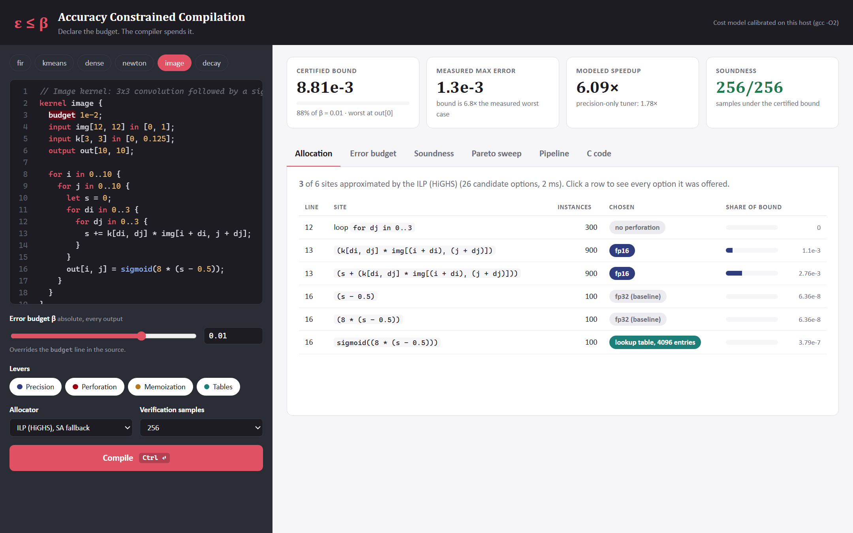
Demo: The Compiler in a Browser
19
Edit a kernel, drag the budget, toggle levers. Each compile runs every phase, certifies, and verifies.
Allocation
every site, its chosen option, and its share of the bound
Error budget
the bound split by lever, plus the top contributing sites
Soundness
per-sample measured error against the certified line
Pareto sweep
13 budgets, full system against precision only
Pipeline
phase timings, AST, SSA IR, allocator trace
C code
emitted kernel; one click compiles and times it with gcc
pip install flask numpy scipy · python acc/server.py · open http://127.0.0.1:5000
Notes:
Live demo order: pick image, show the allocation and the sigmoid table; drag the budget down and watch the table survive while fp16 disappears; open Soundness; run the Pareto sweep; then C code and the gcc button.

Slide 20
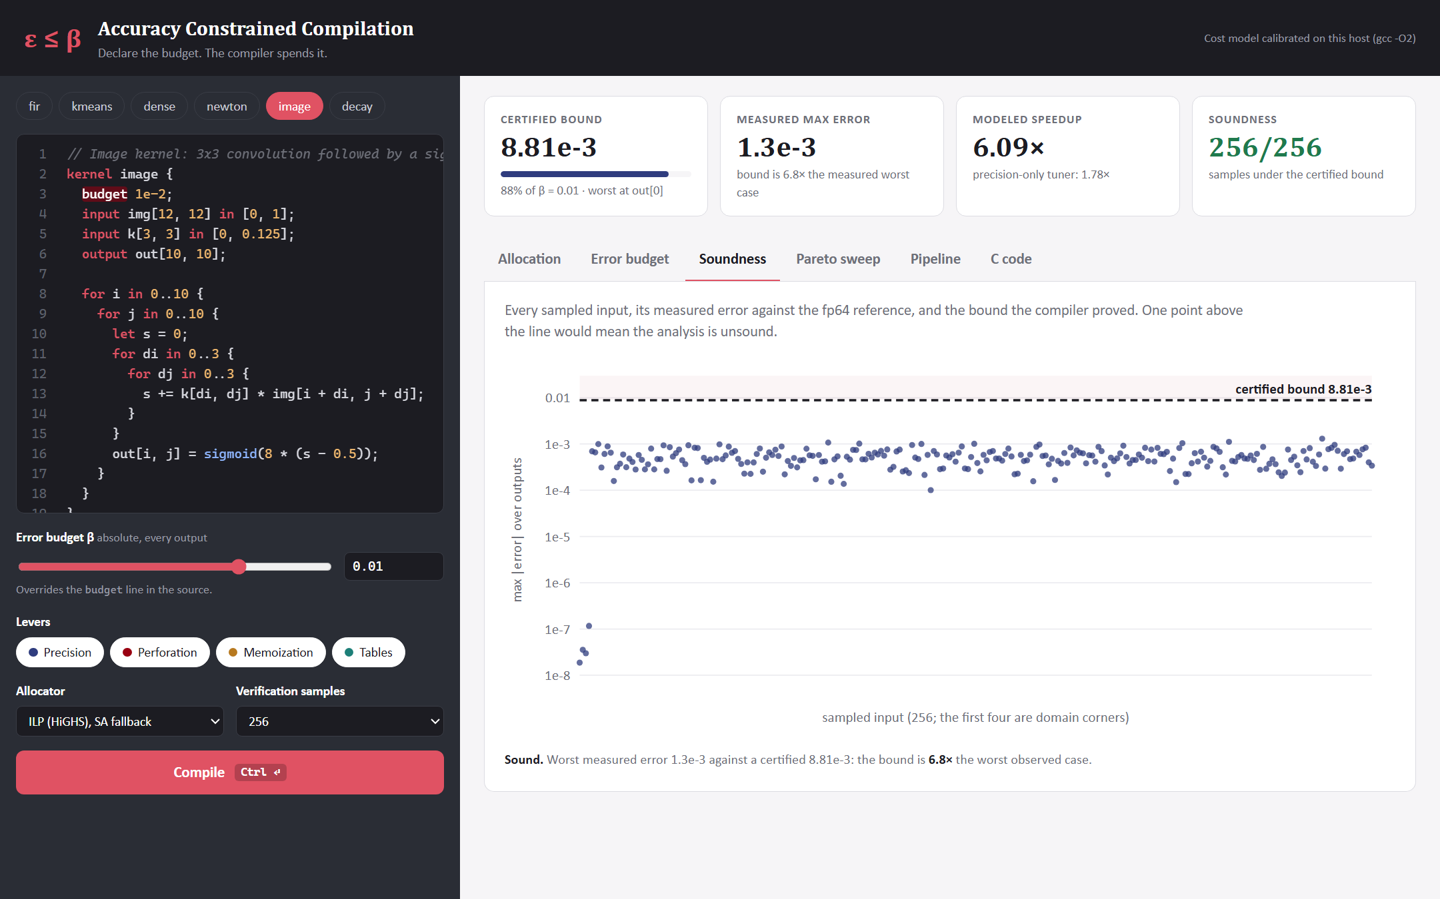
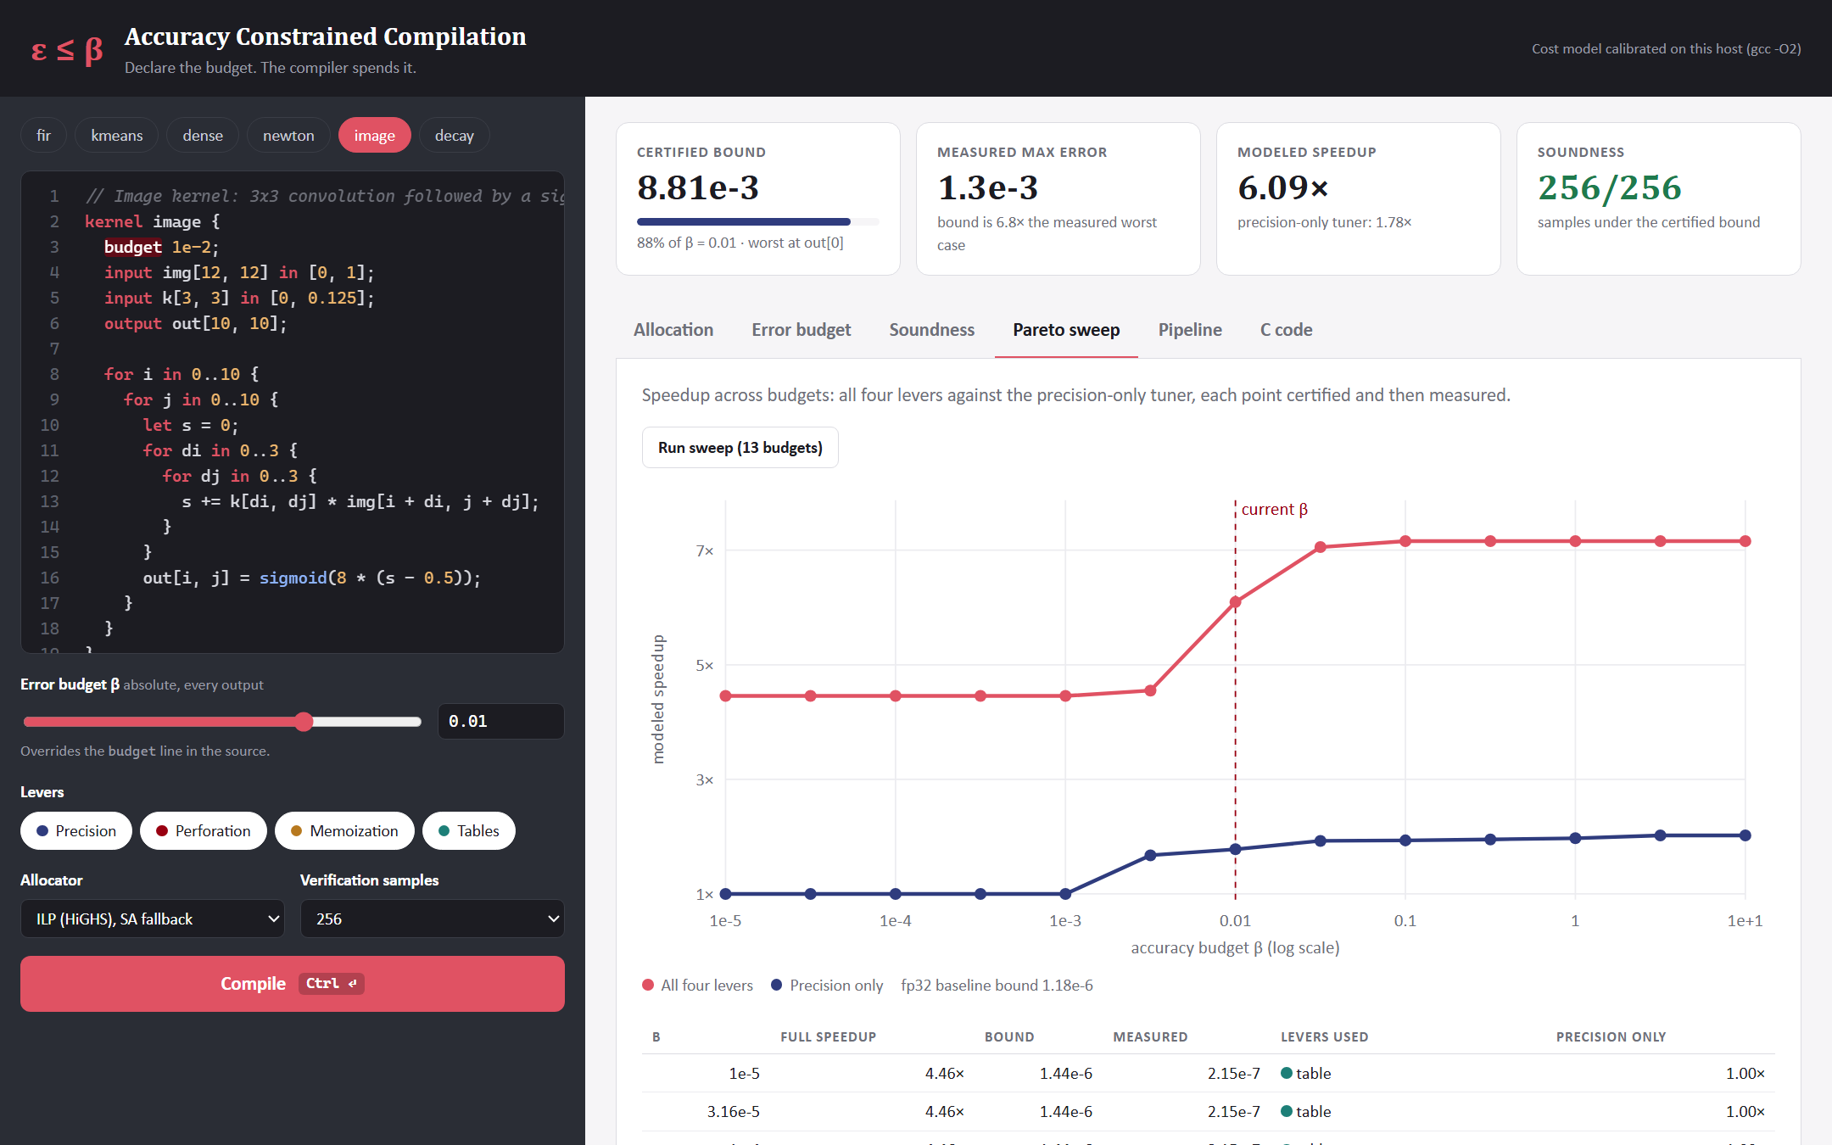
Demo: The Evidence Views
20
Soundness for the current compile, and the Pareto sweep, both generated on demand.
SOUNDNESS TAB
PARETO TAB
Image kernel, 256 samples; the first four are domain corners. Bound 8.8e-3, worst measured 1.4e-3.
Each point is allocated, certified and measured live, so the curve is regenerated for whatever kernel is in the editor.
Notes:
The same figures as slides 13 and 14, produced live by the tool for any kernel typed into the editor.

Slide 21
Where We Arrived
21
✓
✓
✓
✓
REVIEW 1
REVIEW 2
REVIEW 3
FINAL
Design locked
Engine working
Allocator working
Result defended
Language, IR, error model and menu specified.
Front end, SSA, affine propagation validated by Monte Carlo.
Four levers, ILP allocation, first speedups.
Soundness plot, Pareto curves, both baselines, native C.
Accuracy is a resource.
We built the compiler that spends it deliberately, proves every spend, and shows its work.
Thank you. Questions welcome.
Notes:
Every milestone from the Review 1 timeline is complete. Close on the claim and take questions.

