Slide 1
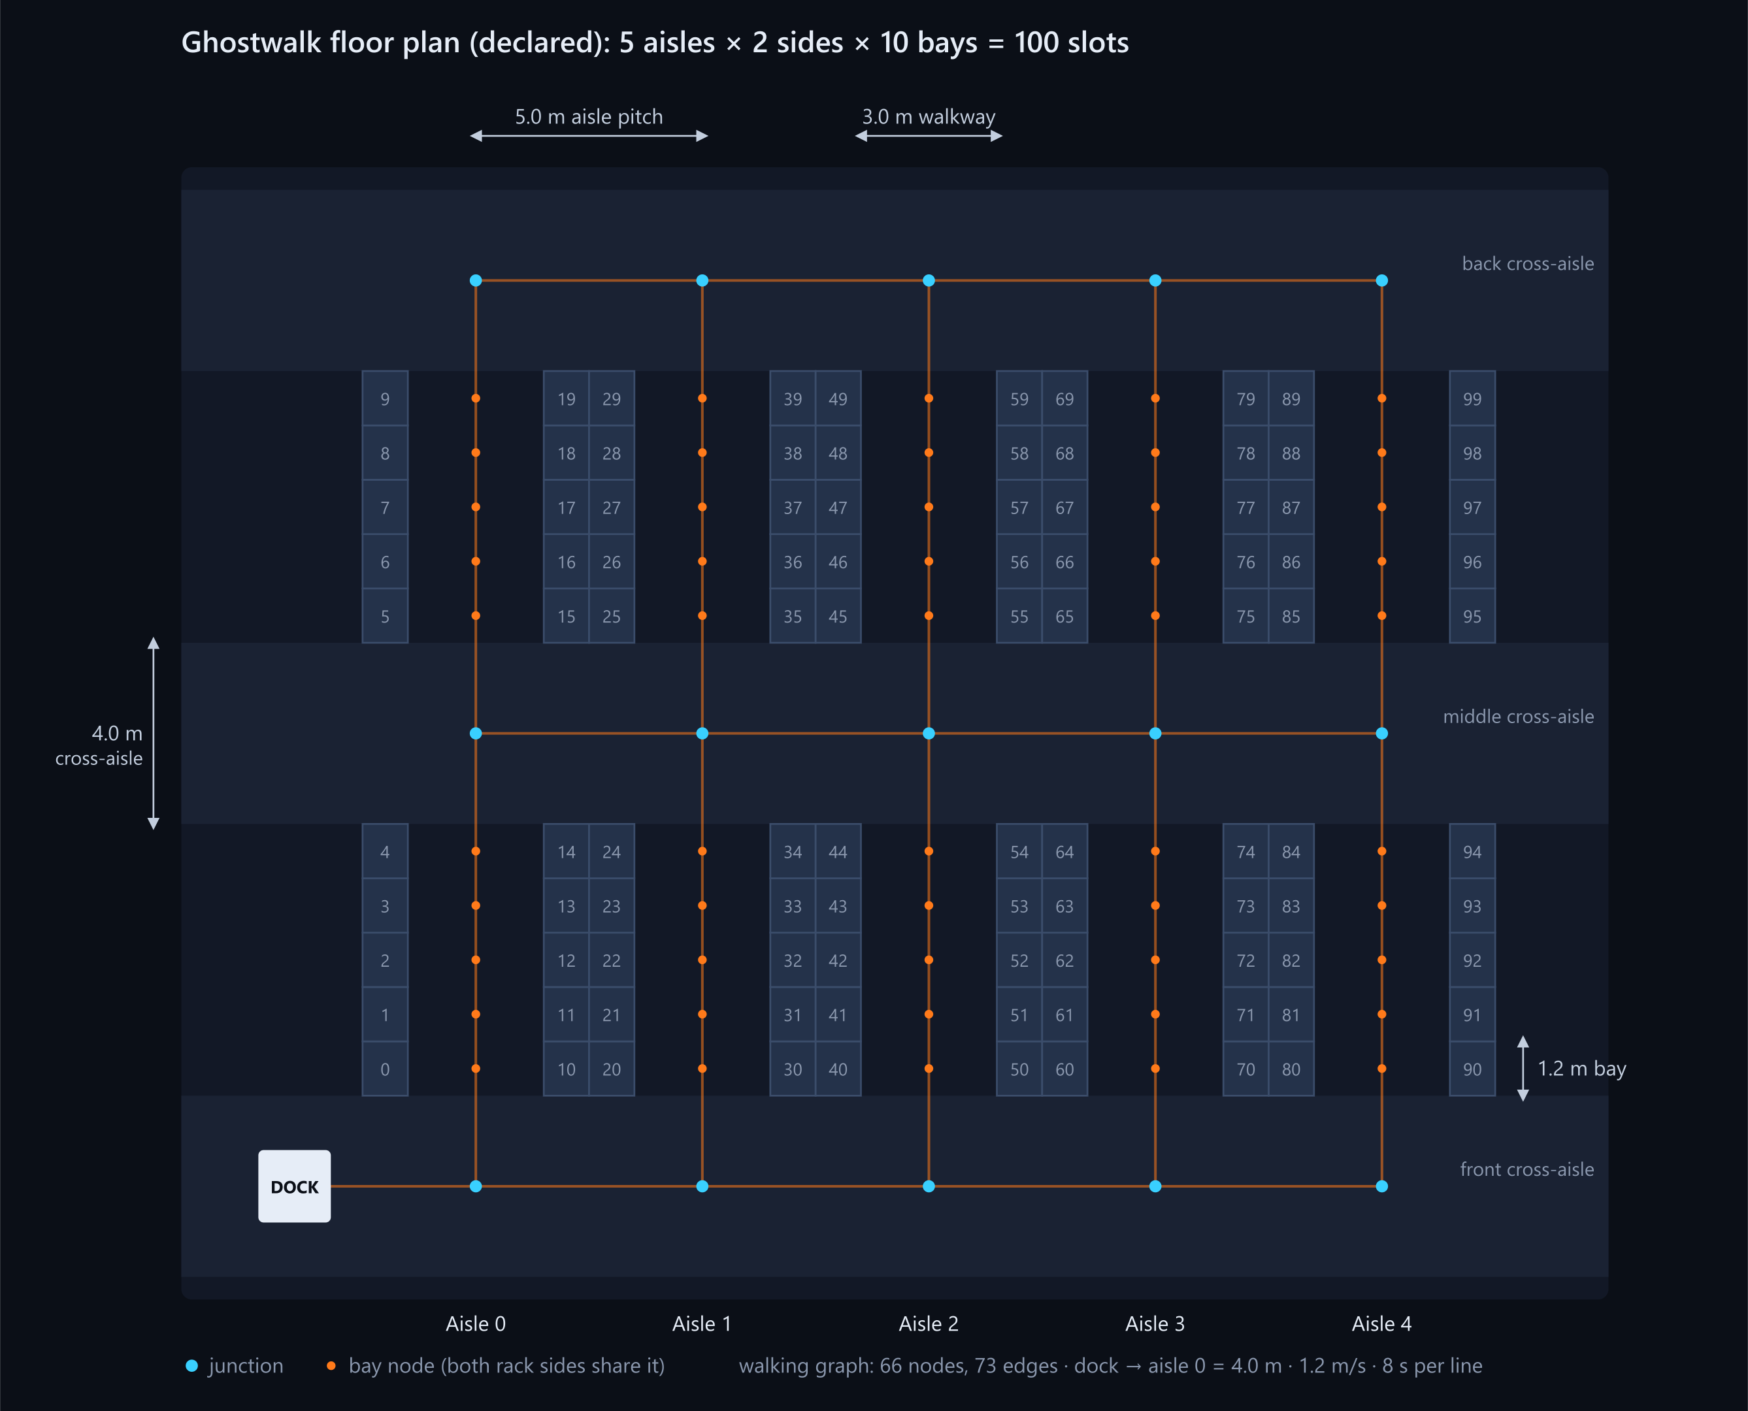
Race your old warehouse
GHOSTWALK
A 3D digital twin of a picking floor, driven by one real month of orders. A ghost picker walks the fast-movers baseline, a solid picker walks our optimised layout or yours, and every gain is measured on held-out orders.
NexAI Hack 2026 · Problem 4.2 · Warehouse Digital Twin
Anand B (@Anandb71) · Junaid Ahamed (@JunaidAhamed-7777)
Notes:
Hook line: same orders, two layouts. The ghost walks the baseline the brief told us to beat, the solid picker walks the layout our optimiser found. Ghostwalk is a browser 3D twin of a picking floor driven by real November 2011 orders from UCI Online Retail II. The rest of the deck backs up one claim: the walking we save is measured on orders the layout never saw.

Slide 2
Slotting decides how far pickers walk
1
The cost
2
The ask
3
The catch
Every order is a walk from the dock to each product's slot and back. Put the fast movers far away and every single order pays for it.
A browser 3D twin of a picking floor, driven by real orders, where the player re-slots products and the twin shows the walking saved.
The improvement has to be measured by replaying the same orders before and after, not claimed. Walking must follow aisles, never cut through racks.
Our answer replay real invoices on an exact aisle graph, and score every layout on orders it has never seen.
Notes:
Problem statement PS 4.2 in one line: where each product sits decides how far pickers walk. The core challenge is in card 3. The twin must be driven by real order data, and the gain has to be measured by replaying exactly the same orders before and after. That sentence shaped every design decision we made.

Slide 3
One real month of orders, cleaned and split
Cleaning (whole sheet, Dec 2010 – Dec 2011)
2,362
17,056
raw rows | 541,910
cancelled invoices removed | 9,288
quantity ≤ 0 removed | 1,336
price ≤ 0 removed | 1,181
non-product codes removed | 2,380
real invoices replayed
order lines
100
21.2 %
Chronological split of 2011-11
train · 1,130
held-out · 1,232
SKUs slotted (top by order lines)
of the month's lines they cover
1–15 Nov: the player, heatmap and optimiser see these
16–30 Nov: used only for scoring
Chen, D. (2019). Online Retail II. UCI Machine Learning Repository. https://doi.org/10.24432/C5CG6D. CC BY 4.0.
Notes:
Real data: UCI Online Retail II, a UK gift retailer, November 2011. We removed cancellations, returns and adjustments, and postage or fee codes, then kept the 100 most-picked products. That is what the problem statement asks for, and it is why the coverage figure is shown: we slot the top 100, not the whole catalogue. The split is chronological. The first half of November trains, the second half scores.

Slide 4
A declared floor, walked only along aisles
100 slots
5 aisles × 2 rack sides × 10 bays, one SKU per slot
66 nodes · 73 edges
the only places a picker can walk: no shortcuts through racks
3 cross-aisles
front, middle and back, 4.0 m wide; the dock sits on the front one
1.2 m/s · 8 s/line
declared walking speed and pick time
Diagram and numbers generated from web/src/sim/layout.ts
Notes:
The problem statement leaves the warehouse to us, so we declare it. One file, sim/layout.ts, is the single source of truth: the simulator, this diagram and the README table all come from it. Pickers move only on the aisle graph. Both rack sides of a bay share one node, because the picker stands in the aisle and turns.

Slide 5
Every order is an exact tour on the aisle graph
1
Order
2
Stops
3
Tour
4
Score
a real invoice and its lines
the distinct bay nodes of its products' slots
Held–Karp, exact up to 11 stops; NN + 2-opt above, flagged
path expanded edge by edge; seconds = m / 1.2 + 8 × lines
HK
Held–Karp dynamic programming
S
S-shape ablation
dp[mask][j] is the shortest walk from the dock through exactly the stops in mask, ending at j. That is O(2ⁿ·n²): about 250k steps at n = 11, solved once per stop set and cached. The share of metres routed exactly is reported.
What a human picker usually does: walk every aisle that has a pick, end to end. Toggling it separates the gain from routing from the gain from slotting. It can never beat the exact tour, and a test checks that.
Notes:
Why exact routing matters: if routing is heuristic, a layout can look better just because the heuristic got lucky on it. With exact tours, the difference between two layouts is the layout. Held–Karp is exponential, so we cap it at 11 stops and are open about the rest. The Evidence panel shows how many orders and what share of the metres were exact.

Slide 6
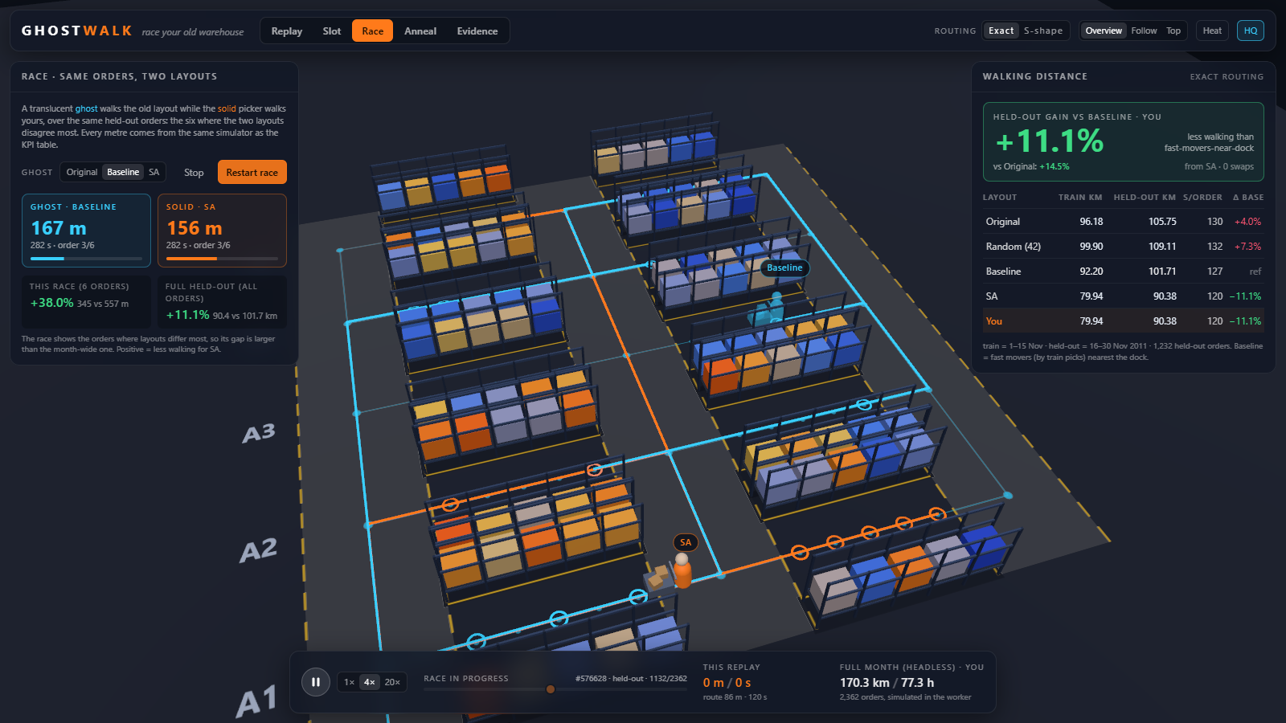
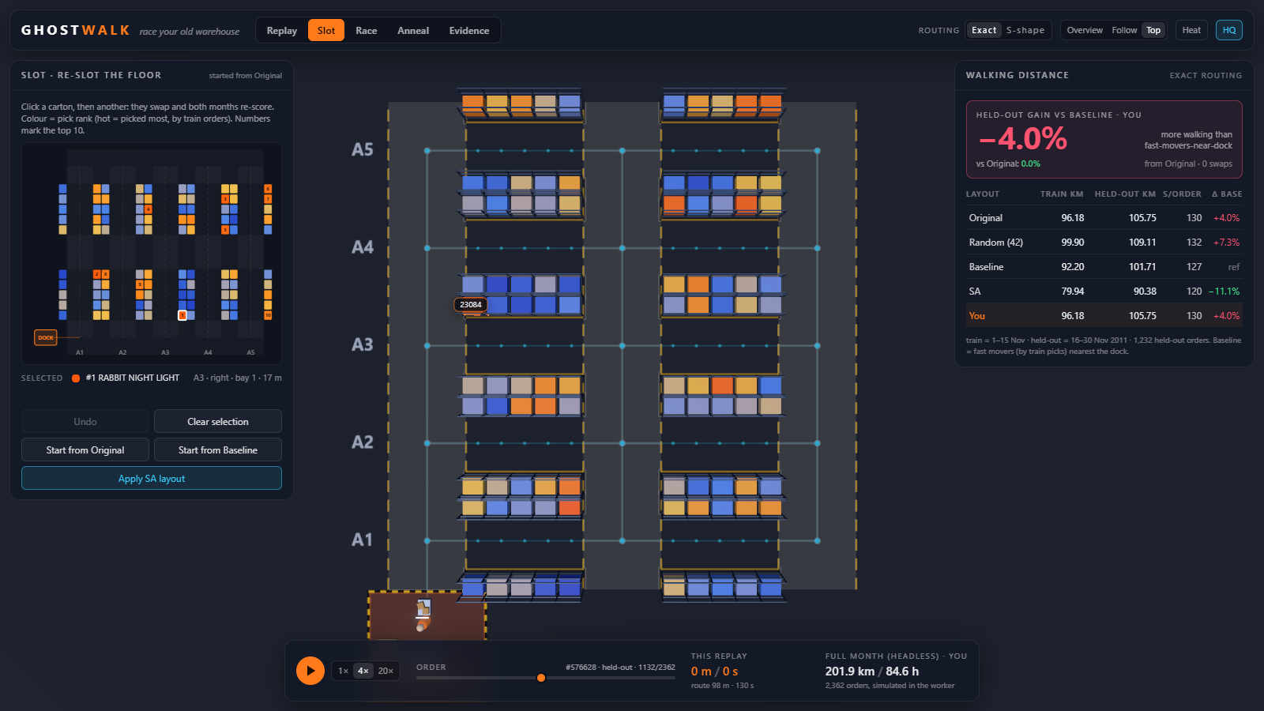
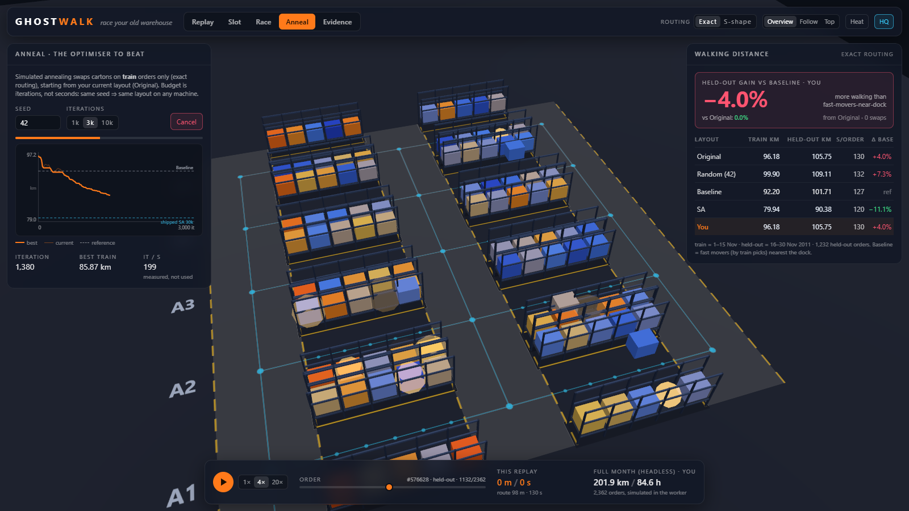
Re-slot, replay, race the ghost
Race: ghost = Baseline, solid = the SA layout or yours, over the same held-out orders
Slot: click a carton, click another to swap, in 3D or on the 2D map; train and held-out re-score
Anneal: the optimiser runs live in a worker, and cartons fly as swaps are accepted
Replay
Slot
Race
Anneal
Evidence
Must-haves: replay with live distance and time counters · swap and re-score before / after · automatic fast-movers baseline
Notes:
The game loop. Replay one invoice in 3D. Slot: press Baseline, then make your own swaps. Race: the Baseline ghost against the SA layout, or against your own. Anneal: watch the optimiser play. Evidence: the numbers behind it all. The three must-haves of PS 4.2 are on the bottom line. Heatmap and leaderboard are the stretch goals we built.

Slide 7
The opponent: simulated annealing
Swap two SKUs' slots
1
Re-route only the train orders that contain them
2
Accept if shorter, else with probability exp(−Δ/T)
3
Cool T from T₀ to T₀/1000 over the iteration budget
4
Seed 42 × 30,000 iterations gives the same layout on any machine. The optimiser sees train orders only.
Notes:
The opponent to beat after Baseline. Simulated annealing swaps two products, re-routes only the orders those products appear in, which is why it is fast, and sometimes accepts a worse layout early on to escape local optima. The budget is iterations, not seconds, so the result is reproducible. It never sees the held-out half.

Slide 8
One simulator: browser, worker and eval
online_retail_II.xlsx
UCI · CC BY 4.0
data/prepare.py
pandas · offline
orders.json
web/public/data
Browser · static site on Vercel · no backend
eval/run.ts
the same sim/ engine
store.ts
zustand state
eval/results.md
→ README and this deck
Web Worker · sim/
aisle graph · Held–Karp · S-shape · simulate · layouts · annealing
scene/
React Three Fiber: racks, cartons, picker + ghost
ui/
KPI · slot map · race · evidence · leaderboard
sa_seed42.json
→ shipped SA layout in the app
Node · npm run eval
Notes:
One simulator everywhere. The engine is plain TypeScript with no DOM. In the browser it runs in a Web Worker, so the 3D keeps animating while layouts are scored. The scene only plays back paths the simulator produced. The same files run in Node for npm run eval, which writes the results this deck and the README quote, plus the shipped SA layout.

Slide 9
Results on held-out orders (16–30 Nov)
Layout | Train km | Held-out km | Train s/order | Held-out s/order | Δ held-out vs Baseline | Δ train vs Baseline
Original (catalogue order) | 96.18 | 105.75 | 127.9 | 130.0 | +4.0% | +4.0%
Random (seed 42) | 99.90 | 109.11 | 130.7 | 132.3 | +7.3% | +8.0%
Baseline (fast movers nearest dock) | 92.52 | 101.67 | 125.2 | 127.2 | — | —
SA (seed 42, 30,000 it, from Baseline, train only) | 79.94 | 90.38 | 116.0 | 119.6 | −11.1% | −13.6%
−11.1 %
SA vs Baseline, Held-out km
walking distance on orders neither layout was built from
SA vs Baseline on train (in-sample): −13.6%, so in-sample → held-out shrinkage is 2.5 percentage points
Baseline vs Original, held-out: −3.9% (105.75 km → 101.67 km)
SA over seeds 42, 43, 44, 45, 46: held-out Δ vs Baseline −10.0% ± 0.9 pp (mean ± sd)
S-shape routing (ablation): Δ held-out vs Baseline (S-shape): −12.8%
Copied from eval/results.md, produced by npm run eval with the same engine as the app. No number on this slide is typed by hand.
Notes:
Read the headline as the held-out gain versus Baseline, the layout the problem statement told us to beat. Original and Random are there so nobody can say we picked a weak starting point. SA is reported over five seeds in eval/results.md, so the spread is visible. Why Baseline barely beats catalogue order: most of the top co-picked pairs are product families with neighbouring StockCodes, so catalogue order keeps them close by accident, while Baseline ranks products one at a time and scatters them. The annealer scores whole orders and puts them back together.

Slide 10
Built so the numbers can be trusted
1
Held-out split
2
Baseline is the target
Layouts are built on 1–15 Nov and scored on 16–30 Nov. The split is chronological, the way a real warehouse re-slots on the past and lives with the future.
The headline is the gain vs fast movers nearest the dock, ranked by train picks. Original (catalogue order) and Random (seed 42) are shown, but second.
3
Exact routing, limits reported
4
Deterministic, one simulator
Held–Karp up to 11 stops, NN + 2-opt above, flagged per order. The Evidence panel prints the exact share of metres.
No Math.random or Date.now in the engine; mulberry32 with the seed on screen. The worker, the 3D playback and npm run eval share one engine.
Notes:
These are the four questions we expect from judges, answered by design rather than by argument. The Q&A cards in docs/pitch go deeper on each.

Slide 11
What we assumed, and what we did not build
Declared, not observed
Not built (yet)
The warehouse geometry is ours. The orders are real; the building is not.
The time model is synthetic: metres / 1.2 m/s + 8 s per line. No acceleration, search or queueing.
Only the top 100 SKUs are slotted. They cover 21.2 % of the month's lines, and other lines are left out.
One retailer, one pre-Christmas month: gains may differ in other seasons or sectors.
Batch picking: one trip serving several orders.
Several pickers with congestion in narrow aisles.
Rack levels, carton sizes and weights.
Exact routing above 11 stops: those orders use a heuristic, and their share is reported.
Notes:
Read these aloud in the demo. Stating limits plainly is part of the result.

Slide 12

Thank you. Questions?
Repository
github.com/Anandb71/ghostwalk
Live app
pending deploy
Anand B
Junaid Ahamed
@Anandb71
@JunaidAhamed-7777
engine, worker, 3D scene, core UI, integration and deploy
leaderboard, README and docs, pitch deck, demo, posts
Scan for the repo
Built with Claude Code (Anthropic), declared in the README and DEV_LOG. Data: UCI Online Retail II, CC BY 4.0. Code: MIT.
Notes:
Close on the links and hand over for questions. Both of us can explain every module; see docs/pitch/qa_cards.md.

