Slide 1


ACE
Engineering College
An Autonomous Institution
Ankushapur (V), Ghatkesar (M), Medchal Dist. – 501 301
DEPARTMENT OF CSE(ARTIFICIAL INTELLIGENCE & MACHINE LEARNING)
-------------------------------------------------------------------------------------------------------------------------------------------------
-------------------------------------------------------------------------------------------------------------------------------------------------
Advanced AI-Powered Python Error Analyzer and Debugging Assistant
UNDER THE GUIDANCE OF
Mr.B.Avinash
PROJECT COORDINATOR
Mr.R.Rajesh
PRESENTED BY:
Anna Harish - 23AG1A6603
Banne Anand - 23AGIA6609
D. Swetha - 24AG5A6604

Slide 2
Introduction:
Python is widely used by beginners, but understanding and fixing errors remains a major challenge because python error messages are often technical and difficult to interpret. New programmers spend a lot of time searching for solutions without clearly understanding the cause of the error, which slows down learning and reduces confidence. Existing debugging tools mainly identify errors but do not explain them in a simple, human-friendly way. Therefore, there is a need for an intelligent system that can analyze python code and error messages and provide clear explanations and helpful debugging suggestions to assist beginners in learning python more effectively.

Slide 3
ABSTRACT
Python is one of the most popular programming languages because it is easy to learn and widely used. However, beginners often find it difficult to understand Python error messages and fix mistakes in their code. Most error messages are technical and do not clearly explain what went wrong or how to correct it, which makes learning slower and more confusing.
This platform introduces an Advanced AI-Powered Python Error Analyzer and Debugging Assistant that helps users understand errors in a simple and clear way. The system analyzes Python code and error messages using AI, Machine Learning, and Natural Language Processing to find the cause of errors and suggest easy solutions with good coding practices. A simple web interface makes the tool easy to use for beginners, helping them reduce debugging time and improve their programming skills.
Keywords:
Artificial Intelligence,
Python Debugging,
Error Analysis,
Machine Learning,
Natural Language Processsing

Slide 4
Current challenges faced
Complex Error Messages: Python error messages are often technical and difficult for beginners to understand, making debugging confusing and time-consuming.
Lack of Clear Guidance: Traditional debuggers only show where the error occurred but do not clearly explain why it happened or how to fix it.
Time-Consuming Debugging: Beginners spend a lot of time searching online or trying multiple solutions to fix simple errors, which slows down learning.
Limited Learning Support: Existing tools focus more on error detection rather than teaching users how to avoid similar mistakes in the future.
Dependency on External Help: Many learners rely on forums, tutorials, or experienced developers to resolve errors, which is not always immediately available.

Slide 5
Literature Review :
Paper 1
Title: Automated Program Debugging Using Machine Learning Authors: M. Monperrus, M. Martinez Journal: IEEE Transactions on Software Engineering Year: 2018 DOI: 10.1109/TSE.2017.2767601
Problem Defined: Traditional debugging techniques require manual effort and deep programming knowledge. Beginners struggle to identify root causes of program errors efficiently.
Method / Approach: The paper proposes machine learning models that learn from historical bug-fix data to automatically suggest fixes for software defects.
Key Findings: ML-based debugging reduces developer effort and improves accuracy in identifying bug patterns.
Research Gap Identified: Lack of beginner-friendly explanations and limited support for dynamic runtime errors.

Slide 6
Paper 2
Title: Intelligent Tutoring Systems for Programming Education
Authors: K. VanLehn
Journal: International Journal of Artificial Intelligence in Education
Year: 2016
DOI: 10.1007/s40593-016-0107-2
Problem Defined: Students face difficulties understanding programming errors due to lack of personalized guidance.
Method / Approach: Uses AI-driven tutoring systems to provide adaptive feedback based on learner behavior.
Key Findings: Personalized explanations significantly improve student learning outcomes.
Research Gap Identified: Limited integration with real-time Python debugging environments.

Slide 7
Paper 3
Title: Natural Language Processing for Software Error Explanation
Authors: S. Campbell, T. Nguyen
Journal: ACM Computing Surveys
Year: 2019
DOI: 10.1145/3317550
Problem Defined: Error messages generated by compilers are technical and hard to understand for beginners.
Method / Approach: Applies NLP techniques to translate technical error messages into simple natural language explanations.
Key Findings: NLP-based explanations improve comprehension and debugging speed.
Research Gap Identified: Does not provide corrective code suggestions or learning feedback.

Slide 8
Paper 4
Title: Deep Learning-Based Bug Detection in Python Programs
Authors: Y. Li, Z. Wang
Journal: IEEE Access Year: 2020 DOI: 10.1109/ACCESS.2020.2978234
Problem Defined: Manual bug detection in Python programs is time-consuming and error-prone.
Method / Approach: Uses deep neural networks to learn syntactic and semantic patterns in Python code.
Key Findings:
Deep learning models outperform rule-based systems in bug detection.
Research Gap Identified: Lacks explanation module for beginners.

Slide 9
Paper 5
Title: Program Repair Using Genetic Algorithms
Authors: W. Weimer, T. Nguyen
Journal: IEEE Software
Year: 2017 DOI: 10.1109/MS.2017.2650819
Problem Defined: Fixing bugs manually requires significant human effort.
Method / Approach: Applies genetic algorithms to automatically generate bug fixes.
Key Findings: Automated repair can fix common bugs efficiently.
Research Gap Identified: Not suitable for educational purposes due to lack of explanation.

Slide 10
Paper 6
Title: AI-Assisted Code Debugging Systems
Authors: J. Smith, R. Gupta
Journal: Springer – Software Engineering Notes
Year: 2021 DOI: 10.1007/s10664-021-09945-3
Problem Defined: Existing debuggers focus on professionals, not beginners.
Method / Approach: Introduces AI-based assistants that analyze code behavior and error patterns.
Key Findings: AI assistants improve debugging efficiency.
Research Gap Identified: User interface complexity for novice programmers.

Slide 11
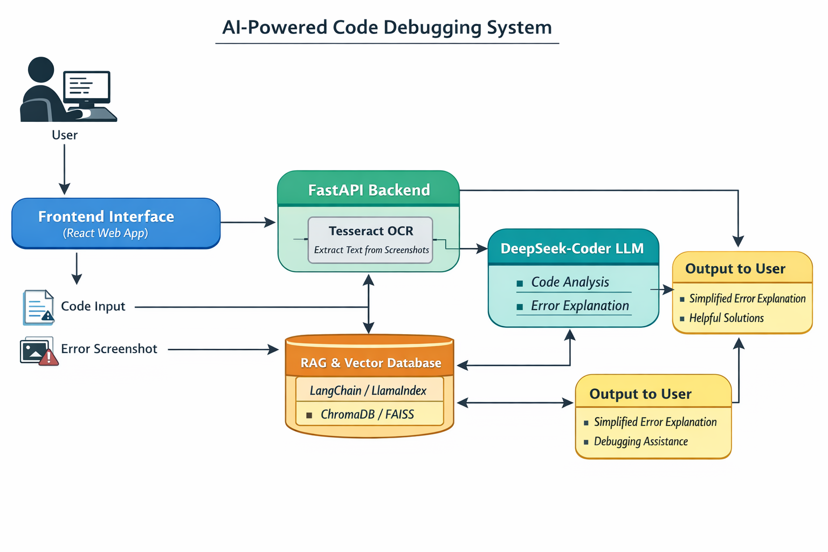
System Architecture:

Slide 12
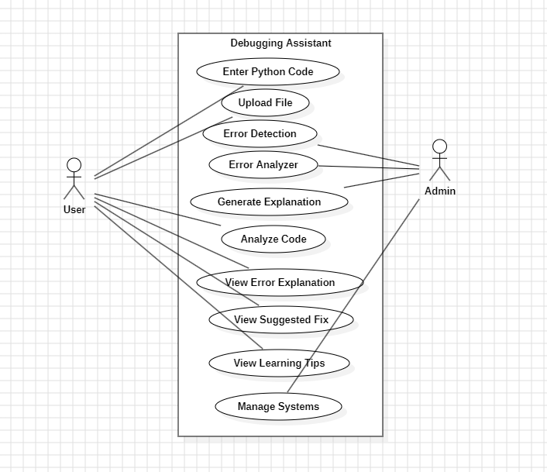
Usecase Diagram

Slide 13
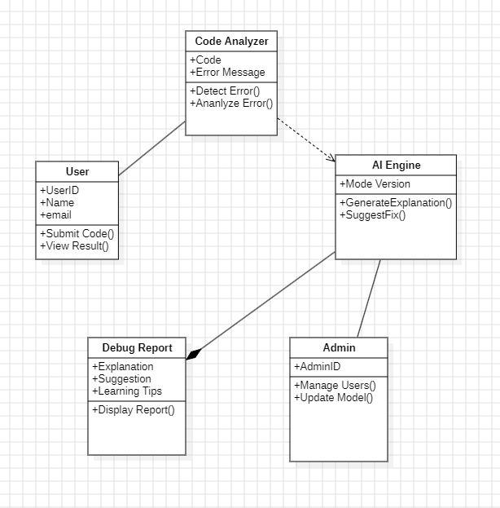
Class Diagram

Slide 14
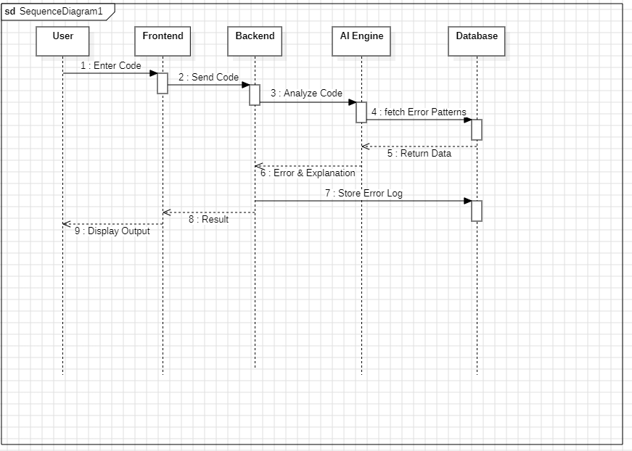
Sequence Diagram

Slide 15
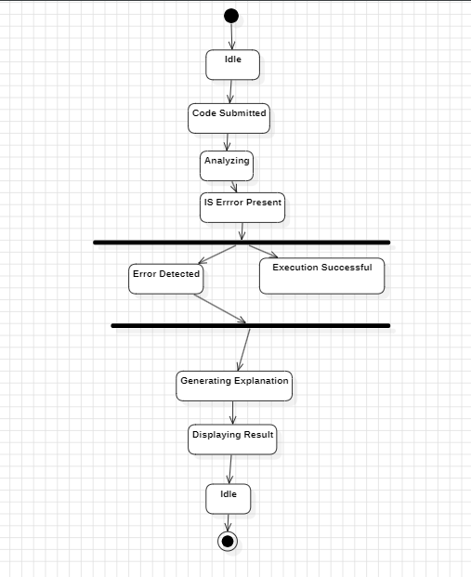
Activity diagram

Slide 16
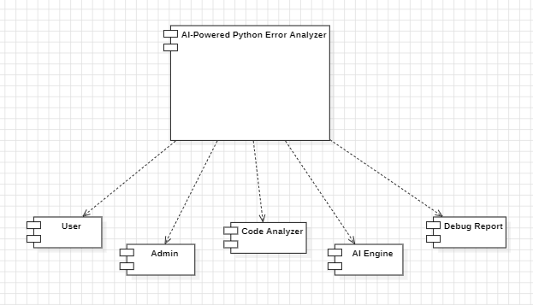
Component diagram

Slide 17
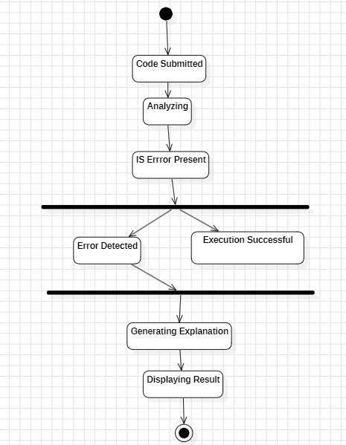
State chart diagram

Slide 18
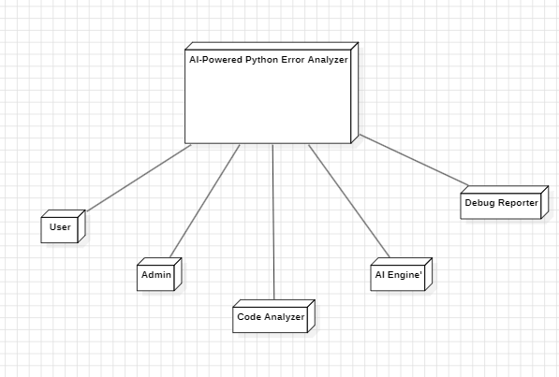
Deployment diagram

Slide 19
Existing System:
Approach:
The proposed system focuses on analyzing Python code, error messages, and user inputs to detect programming errors and provide meaningful explanations.
Methods:
The system utilizes AI-based models such as Google Gemini API for intelligent code analysis, Retrieval Augmented Generation (RAG) for improving response accuracy, and NLP techniques for understanding error messages and user queries.
Process:
User inputs Python code, file, or error screenshot into the system. The input is processed and sent to the AI model, where error detection and analysis are performed. The system identifies the type of error, explains the cause, and generates step-by-step solutions along with corrected code. The results are then displayed through an interactive chat-based user interface for easy understanding.
Drawbacks:
• The system depends on internet connectivity and external API services. • It may not handle very complex logical errors accurately. • Accuracy depends on the quality of user input and error clarity. • Limited support for only Python programming language.

Slide 20
Proposed system:
Approach:
Analyzes Python code and error messages using AI to provide easy-to-understand solutions.
Methods Used:
Uses Google Gemini API, NLP techniques, and RAG for accurate error analysis.
Process:
• Needs internet and API • Limited to Python • Not perfect for complex errors

Slide 21
Code Implementation:
App.tsx
import React, { useState, useEffect, useRef } from 'react';
import { Sidebar } from './components/Sidebar';
import { Message } from './components/Message';
import { InputArea } from './components/InputArea';
import { SYSTEM_INSTRUCTION } from './lib/gemini';
import { GoogleGenAI } from '@google/genai';
import { Terminal, BrainCircuit, Sparkles, ChevronRight } from 'lucide-react';
import { motion, AnimatePresence } from 'motion/react';

Slide 22
interface Chat {
id: string;
title: string;
created_at: string; }
interface MessageData {
role: 'user' | 'assistant';
content: string; }
export default function App() {
const [chats, setChats] = useState<Chat[]>([]);
const [currentChatId, setCurrentChatId] = useState<string | null>(null);
const [messages, setMessages] = useState<MessageData[]>([]);
const [isLoading, setIsLoading] = useState(false);

Slide 23
const scrollRef = useRef<HTMLDivElement>(null);
useEffect(() => {
fetchChats();
}, []);
useEffect(() => {
if (currentChatId) {
fetchMessages(currentChatId);
} else {
setMessages([]);
}
}, [currentChatId]);

Slide 24
useEffect(() => {
scrollRef.current?.scrollIntoView({ behavior: 'smooth' });
}, [messages]);
const fetchChats = async () => {
const res = await fetch('/api/chats');
const data = await res.json();
setChats(data); };
const fetchMessages = async (id: string) => {
const res = await fetch(`/api/chats/${id}`);
const data = await res.json();
setMessages(data); };
const handleNewChat = () => {
setCurrentChatId(null);
setMessages([]);
};

Slide 25
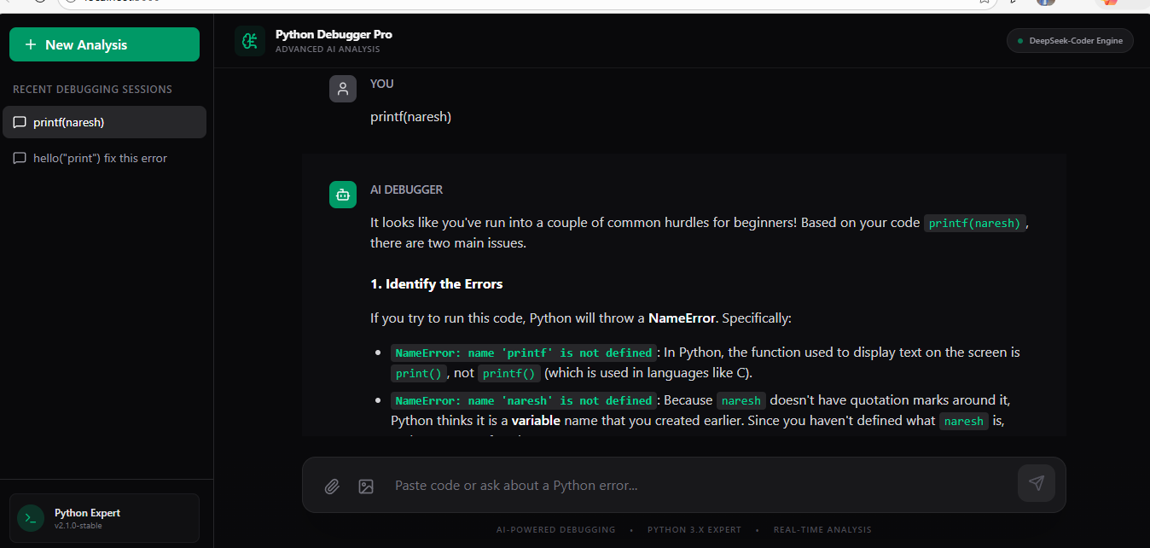
OUTput:

Slide 26
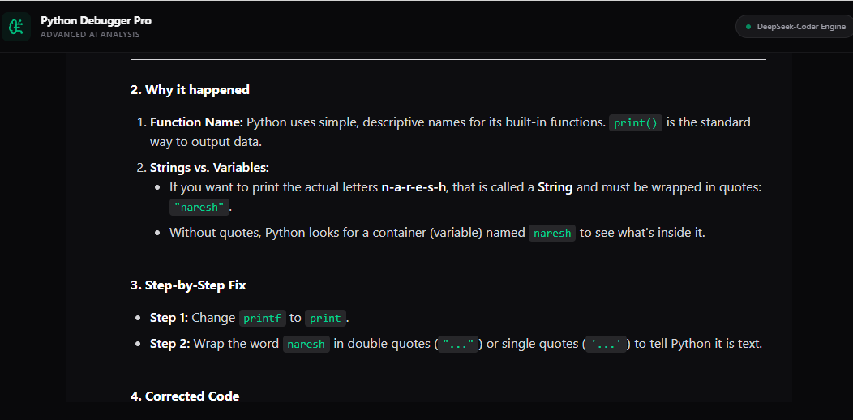

Slide 27
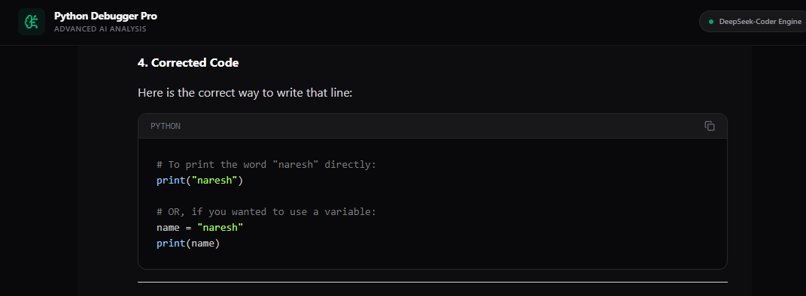

Slide 28
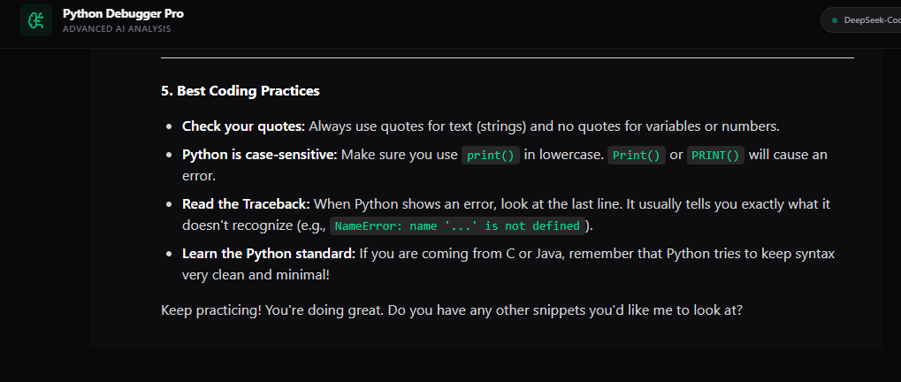

Slide 29
Overview
The Advanced AI-Powered Python Error Analyzer and Debugging Assistant is designed to help beginners understand and fix Python programming errors easily. Many new programmers struggle with technical and confusing error messages, which slows down their learning process. This project solves that problem by using Artificial Intelligence, Machine Learning, and Natural Language Processing to analyze Python code and error messages. The system identifies the root cause of errors and provides simple, human-readable explanations along with suggested fixes and coding tips. It includes a user-friendly web interface where users can enter their code and receive instant feedback. By reducing debugging time and improving clarity, this tool helps beginners learn Python more effectively and confidently.

Slide 30
-------------------------------------------------------------------------------------------------------------------------------------------------
THANK YOU
-------------------------------------------------------------------------------------------------------------------------------------------------

