Slide 1
Team ID COEPCL-0080
Deep Learning-Based Gait Recognition for Person Re-Identification Using CNN-LSTM
Presentation By,
CVV ANAND (23BTRCL176)
B.VIKAS (23BTRCL098)
CH YASWANTH (23BTRCL174)
C GANESH (23BTRCL254)
M VISHNUVARDHAN BHARADWAJ (23BTRCO057)
D PARDHA SANDEEP (23BTRCL180)
Guided By,
Dr. Archana Sasi
Assistant Professor / CSE- AIML

Slide 2
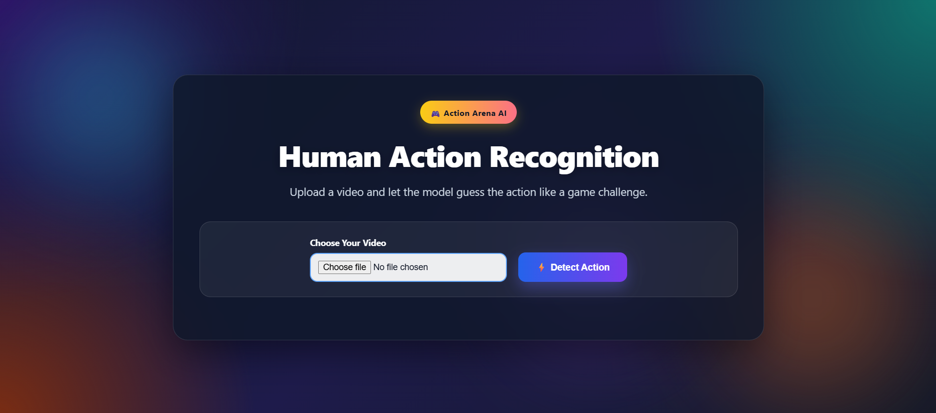
PROJECT SUMMARY
Human Action
Recognition with Deep Learning using CNN+LSTM
Upload a video and let the system automatically identify the human action using an AI-based recognition model. This application makes action detection simple, fast, and interactive through an easy-to-use web interface.
Dataset ready
CNN+LSTM built
Upload
→
Frames
→
Model
→
Action
Upload UI built
Testing done
B.Tech / final-year implementation snapshot
Notes:
[Sources],- User-provided UI screenshot used on this slide (local upload).

Slide 3
Methodology
Step 1: Data Collection
Collected video dataset of human actions
Each action stored in separate class folders
Step 2: Data Preprocessing
Extract frames from videos using OpenCV
Resize frames (e.g., 224×224)
Normalize pixel values (0–1)
Step 3: Model Training
Use CNN / CNN-LSTM model
Train on extracted frames
Learn spatial and temporal features

Slide 4
Step 4: Model Evaluation
Split data into train and test sets
Evaluate using accuracy and loss
Improve model performance
Step 5: Prediction System
Upload video through web interface
Extract frames and preprocess
Predict action using trained model
Step 6: Result Display
Show predicted action on screen
User-friendly web application (Flask)

Slide 5
1. Project objective and scope
Selected topic: human action recognition rather than gait-only analysis.
Goal
Target action classes
Accept an uploaded video of one person performing an action.
Predict the action label such as walking, jogging, running, boxing, handclapping, or handwaving.
Show the result in a simple web interface with video preview and confidence score.
Walking
Jogging
Running
Boxing
Why this topic?
Hand clapping
Hand waving
Easier to explain and demonstrate than a gait re-identification system.
Can be implemented with standard student-friendly tools: OpenCV, TensorFlow/Keras, Flask.
Scope in this phase
Single-person uploaded-video classification; not real-time multi-person recognition.
Notes:
[Sources],- Project scope and selected action classes are based on the user’s project decisions in this conversation.

Slide 6
2. Dataset preparation completed
KTH was chosen because it directly matches the six target actions and is manageable for a student project.
Dataset used
Folder structure
dataset/
├── walking/
├── jogging/
├── running/
├── boxing/
├── handclapping/
└── handwaving/
6
action classes
KTH Human Actions Dataset
Six actions: walking, jogging, running, boxing, handwaving, handclapping.
Videos arranged into action-wise folders for easy loading during training.
.avi files are acceptable for training because OpenCV can read video files frame by frame.
AVI
training videos supported
OpenCV
used to load frames
✓ Verified folders created and populated
Dataset-to-code alignment was a major step completed before model training.
Notes:
[Sources],- KTH official dataset page lists the six action classes used here. Source: https://www.csc.kth.se/cvap/actions/,- OpenCV documentation states VideoCapture can read video files. Source: https://docs.opencv.org/4.x/dd/d43/tutorial_py_video_display.html

Slide 7
3. End-to-end system pipeline implemented
The project currently follows a standard uploaded-video classification workflow.
Upload video
Frame extraction
Preprocessing
Model inference
Prediction output
Flask form accepts video files
→
OpenCV reads selected frames
→
Resize, normalize, fixed sequence
→
CNN + LSTM or silhouette model
→
Action label + confidence
Two variants explored
RGB pipeline
Silhouette pipeline
UI integration
Direct frame-based action recognition using the uploaded video.
Prediction result is returned inside a Flask web page.
Background subtraction creates motion-focused silhouette frames before classification.
Notes:
[Sources],- OpenCV VideoCapture is used for reading video files frame-by-frame. Source: https://docs.opencv.org/4.x/dd/d43/tutorial_py_video_display.html,- Keras provides an official example for video classification with a CNN-RNN architecture. Source: https://keras.io/examples/vision/video_classification/,- Flask file-upload pattern documentation describes the upload-and-serve workflow used by the UI. Source: https://flask.palletsprojects.com/en/stable/patterns/fileuploads/

Slide 8
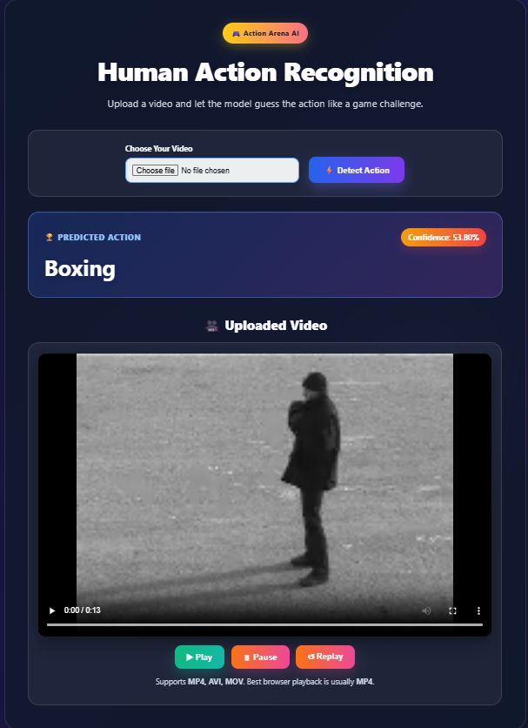
4. Implementation progress: training code + upload interface
Core modules were created for preprocessing, training, prediction, and the Flask front end.
Modules completed
utils.py
frame extraction / preprocessing
train.py
model training with Keras
predict.py
single-video inference
app.py
Flask upload + result page
HTML/CSS
UI improved and customized
Current UI can upload a video, run prediction, and display the detected action with confidence.
Notes:
[Sources],- User-provided screenshot of the working Flask UI used on this slide.

Slide 9
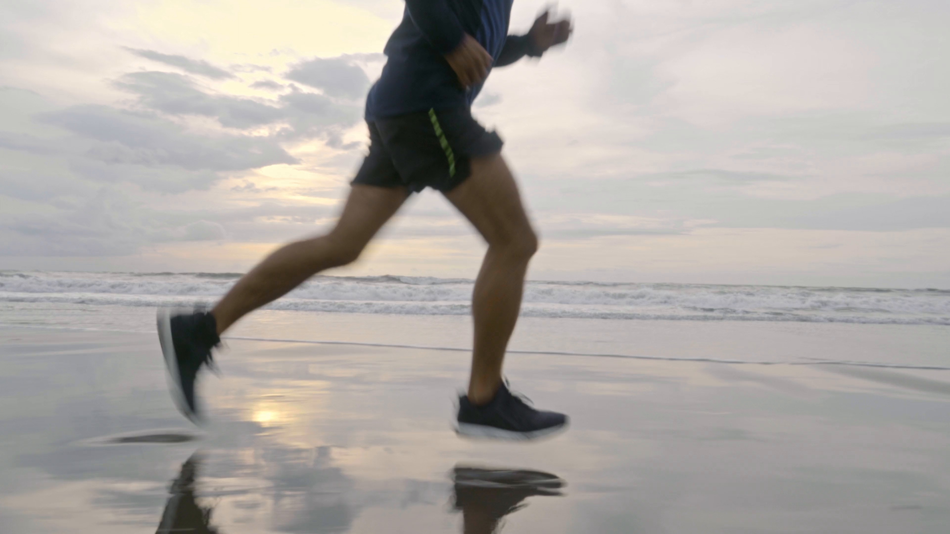
5. Testing observations and issues faced
The main challenge was domain mismatch between clean training videos and real-world uploaded clips.
Main problems identified
Model accuracy
Initial accuracy around 50% is usable but not yet strong for robust real-world videos.
Browser playback
MP4 generally plays in-browser; AVI/MOV often require conversion for reliable playback.
Silhouette extraction
Background subtraction struggles when the scene is dynamic or the body is partially visible.
Example of a difficult uploaded video
Training time
Dataset loading and frame extraction can take noticeable time before each training run.
Real-world clip had a beach background, reflections, and a close cropped view.
Full body was not visible in many frames, so action cues became weaker.
This is very different from KTH-style training videos.
Notes:
[Sources],- User-provided frame from a difficult uploaded test video used on this slide.

Slide 10
6. Current status: what is working now
The project is already functional as a student demo, with clear paths for improvement.
Completed
Working demo
Known limitations
Topic finalized as action recognition
Dataset folders prepared
Training and prediction scripts written
Flask upload UI built
Basic results shown with confidence
Upload a video clip
Read frames with OpenCV
Run trained model
Return predicted action label
Generalization to random internet videos is weak
AVI browser playback is unreliable
Model still needs stronger accuracy and robustness
Notes:
[Sources],- Status items summarize the implementation and testing completed in this conversation.

Slide 11
7. Next steps to improve the project
The immediate focus is better robustness for uploaded real-world videos.
Step 1
Step 2
Step 3
Step 4
Convert uploads to MP4
Use person cropping
Increase training quality
Test on more videos
→
→
→
Improve browser playback for AVI/MOV
Focus the model on the human body instead of background
More frames, stronger model, balanced data
Collect examples closer to real use cases
Notes:
[Sources],- Improvement ideas reflect issues discovered during implementation and testing in this conversation.

Slide 12
References
Wang, Z., Hu, R., Chen, C. et al. (2016) “Person re-identification by discriminative selection in video ranking”. IEEE Trans. Cir. and Sys. for Video Technol.
Chung, P.C., Liu, C.D. (2008) :”A daily behavior enabled hidden Markov model for human identity recognition”. IEEE Trans. Autom. Sci. Eng. 5, 257–272
C. Cui et al., "Simultaneous recognition and assessment of post-stroke hemiparetic gait by fusing kinematic, kinetic, and electrophysiological data," IEEE Trans. Neural Syst. Rehabil. Eng., vol. 26, no. 4, pp. 856–864, 2018.
[23] Thamaraimanalan T, Anandakumar Haldorai, Suresh G and Archana Sasi, “Hybrid Machine Learning Methodology for Real Time Quality of Service Prediction and Ideal Spectrum Selection in CRNs”, Journal of Machine and Computing 5(2), ISSN: 2788–7669, 2025

Slide 13
CONCLUSION
The Human Action Recognition System demonstrates how artificial intelligence and computer vision can be effectively used to automatically identify human activities from video input. The system processes videos by extracting frames, preprocessing them, and using a trained model to accurately predict the action performed. It reduces manual effort, saves time, and improves accuracy compared to traditional methods. The integration of a web-based interface makes the system easy to use and suitable for real-world applications such as surveillance, healthcare monitoring, and smart security systems. Overall, this project highlights the practical implementation of AI in solving real-life problems, and it can be further enhanced for real-time detection and more advanced functionalities in the future.
Github Link: -
https://github.com/Anandcvv05/human-activity-recognition-project.git

