Slide 2
GIT version control system
Satish
03-06-2016

Slide 3

Agenda
Understanding Git
Getting started
Making Commits
Remote Access
Branching
Merging
Undoing and Editing Commits
Tracking other repositories
Naming Commits
Viewing History
Editing History
2

Slide 4
What is Git?
4

Slide 5
What is Git?
Git is a
Distributed
Version Control System
5

Slide 6
What is Git?
OR
6

Slide 7
What is Git?
Git is a
Directory
Content Management System
7

Slide 8
Git is a
Stupid
content tracker
8

Slide 9
What is Git?
How ever you think about it…
Git is SUPER cool
9

Slide 10
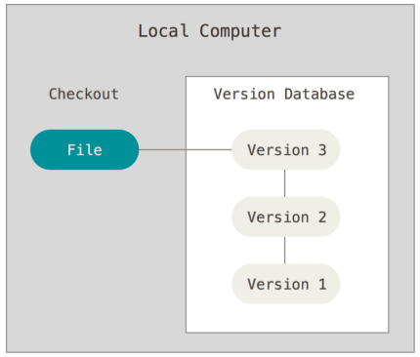
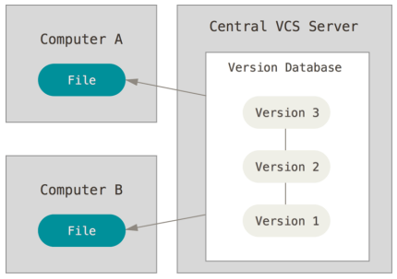
Getting started
About Version Control
Types of version control systems( Local VCS, Centralized VCS, Distributed VCS)IT
Local Version Control System
Centralized Version Control System
10
Notes:
RCS:- works by keeping patch sets (that is, the differences between files) in a special format on disk; it can then re-create what any file looked like at any point in time by adding up all the patches.
VCS has to collaborate with developers on other systems that is when CVS(SVN, Perforce) was introduced

Slide 11
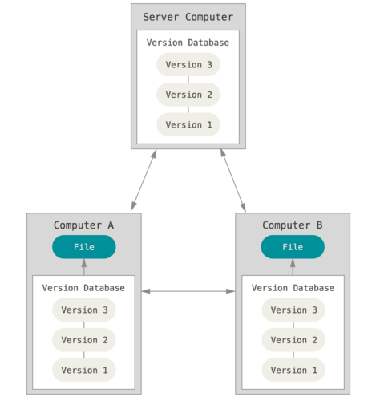
Getting started
Distributed Version Control System
11
Notes:
If that Central server goes down for an hour, then during that hour nobody can collaborate at all or save versioned changes to anything they’re working on.
Whenever you have the entire history of the project in a single place, you risk losing everything, that is when DVCS(GIT, Mercurial) was introduced.
clients don’t just check out the latest snapshot of the files: they fully mirror the repository. Thus if any server dies, and these systems were collaborating via it, any of the client repositories can be copied back up to the server to restore it.
Every clone is really a full backup of all the data.

Slide 12
Distributed
Everyone has the complete history
12

Slide 13
Distributed
Everyone has the complete history
Everything is done offline
…except push/pull
13

Slide 14
Distributed
Everyone has the complete history
Everything is done offline
No central authority
… except by convention
14

Slide 15
Distributed
Everyone has the complete history
Everything is done offline
No central authority
Changes can be shared without a server
15

Slide 16
Short History of GIT
Some of the goals Linus was looking at new DVCS is as follows:
Speed
Simple design
Strong support for non-linear development (thousands of parallel branches)
Fully distributed
Able to handle large projects (speed and data size)
16

Slide 17
Benefits of GIT
Nearly Every Operation Is Local
Git Has Integrity(it’s impossible to change the contents of any file or directory without Git knowing about it)
A SHA-1 hash looks something like this:
24b9da6552252987aa493b52f8696cd6d3b00373
Git Generally Only Adds Data( After you commit a snapshot into git you’ll never loose the data)
17
Notes:
Everything in Git is check-summed before it is stored and is then referred to by that checksum.
You can’t lose information in transit or get file corruption without Git being able to detect it.
The mechanism that Git uses for this check summing is called a SHA-1 hash.
This is a 40-character string composed of hexadecimal characters.

Slide 18





Understanding GIT
Created by Linus Torvalds for work on the Linux kernel ~2005
Some of the companies that use git:
3

Slide 19
GIT Object Types
Git places only four types of objects in the object store
Blobs:- Blob stands for Binary Large Object. Each version of a file is represented by blob. A blob holds the file data but doesn’t contain any metadata about the file. It is a binary file, and in Git database, it is named as SHA1 hash of that file.
Trees:-Tree is an object, which represents a directory. It holds blobs as well as other sub-directories. A tree is a binary file that stores references to blobs and trees which are also named as SHA1 hash of the tree object.
Commits:-Commit holds the current state of the repository. A commit is also named by SHA1 hash. Every commit object has a pointer to the parent commit object. From a given commit, you can traverse back by looking at the parent pointer to view the history of the commit
Tags:-Tag assigns a meaningful name with a specific version in the repository. Tags are very similar to branches, but the difference is that tags are immutable.
18
Notes:
Once a tag is created for a particular commit, even if you create a new commit, it will not be updated. Usually, developers create tags for product releases.

Slide 20
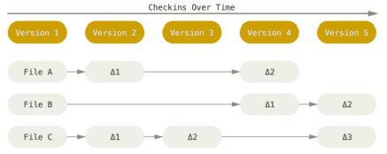

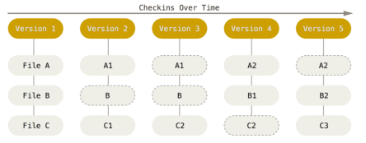
GIT Basics(very important)
Other VCS systems store information as a list of file-based changes.
These systems think of the information they keep as a set of files and the changes made to each file over time
Storing data as changes to a base version of each file.
Storing data as snapshots of the project over time
Git thinks of its data more like a set of snapshots
if files have not changed, Git doesn’t store the file again, just a link to the previous identical file it has already stored
19
Notes:
The major difference between Git and any other VCS is the way Git thinks about its data.
Every time you commit, or save the state of your project in Git, it basically takes a picture of what all your files look like at that moment and stores a reference to that snapshot

Slide 21
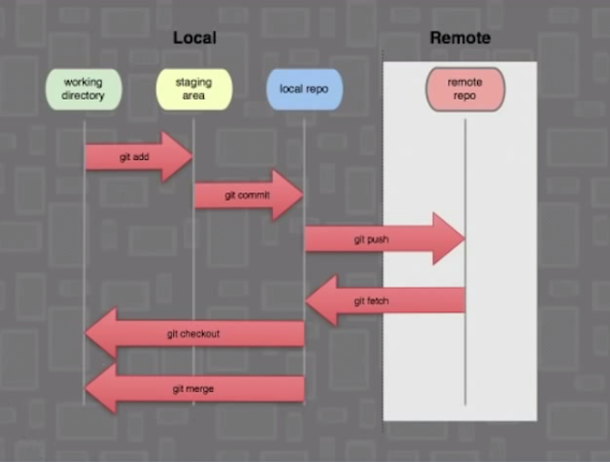
GIT workflow
GIT Workflow
The basic Git workflow goes something like this:
You modify files in your working directory.
You stage the files, adding snapshots of them to your staging area.
You do a commit, which takes the files as they are in the staging area and stores that snapshot permanently to your Git directory.
20

Slide 22
Installing GIT
Installing on Windows
https://git-for-windows.github.io/
Installing on Linux
$ sudo yum install git-all
21

Slide 23
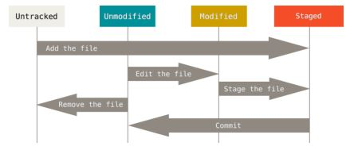
Lifecycle of status if files
Remember that each file in your working directory can be in one of two states: tracked or untracked.
Tracked files are files that were in the last snap-shot; they can be unmodified, modified, or staged.
Untracked files are every- thing else – any files in your working directory that were not in your last snap-shot and are not in your staging area.
22
Notes:
When you first clone a repository, all of your files will be tracked and unmodified because Git just checked them out and you haven’t edited anything.
As you edit files, Git sees them as modified, because you’ve changed them since your last commit. You stage these modified files and then commit all your staged changes, and the cycle repeats.

Slide 24
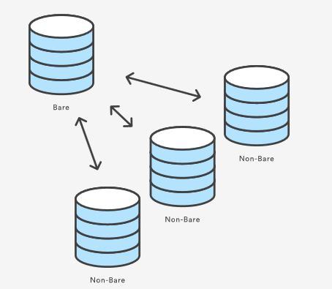
Setting up a repository
What is bare repositories?
Repositories created with $git init --bare are called bare repo
23
Notes:
The --bare flag creates a repository that doesn’t have a working directory, making it impossible to edit files and commit changes in that repository.
Central repositories should always be created as bare repositories because pushing branches to a non-bare repository has the potential to overwrite changes.

Slide 25
DEMO

Slide 26
Thank you
www.temenos.com

