Slide 1

History
Who ? Linux Torvalds (Invented Linux)
When? 2005
Why? To track changes in files and folders
What is a version control system?
Software which helps the s/w teams to manage the changes to source code over time to time.
Version control software keeps track of every modification to the code in a special kind of database.

Slide 2
Types of Version Control System
Local Version Control System
Centralized Version Control System
CVS – Concurrent Versions System
SVN – Subversion
TFS – Team Foundation Server
Distributed Version Control System
Mercurial
GIT

Slide 3
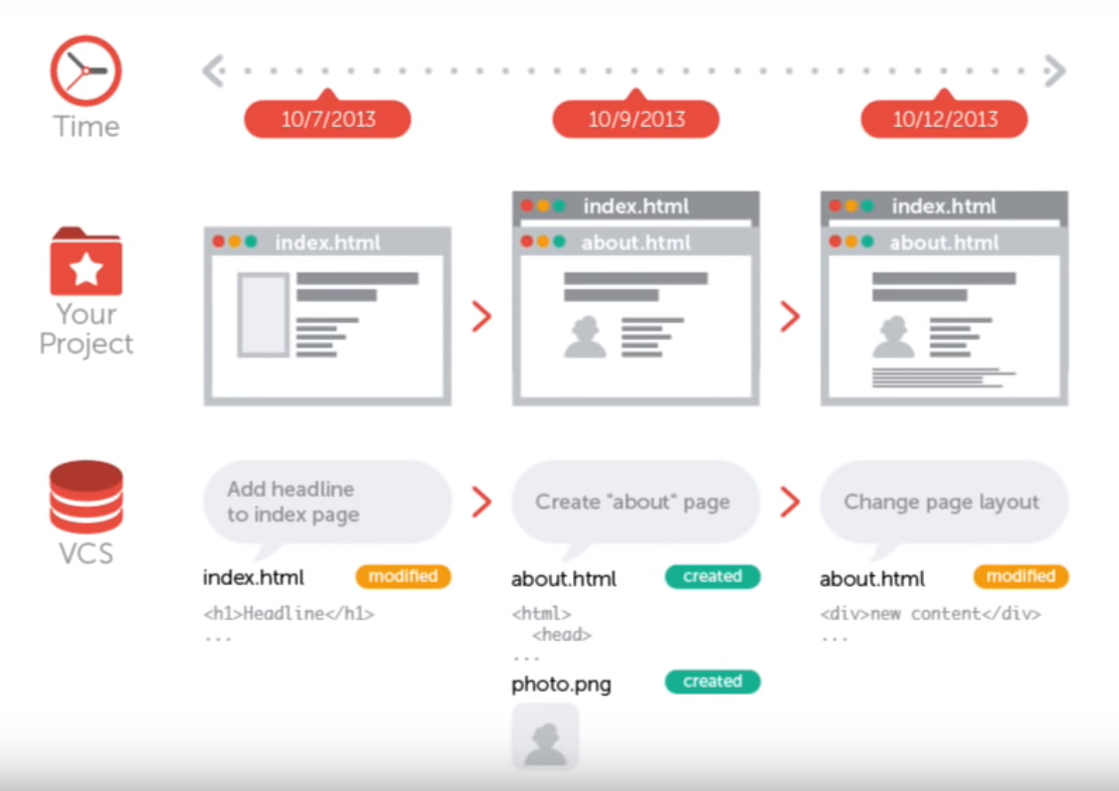
Local Version Control System

Slide 4
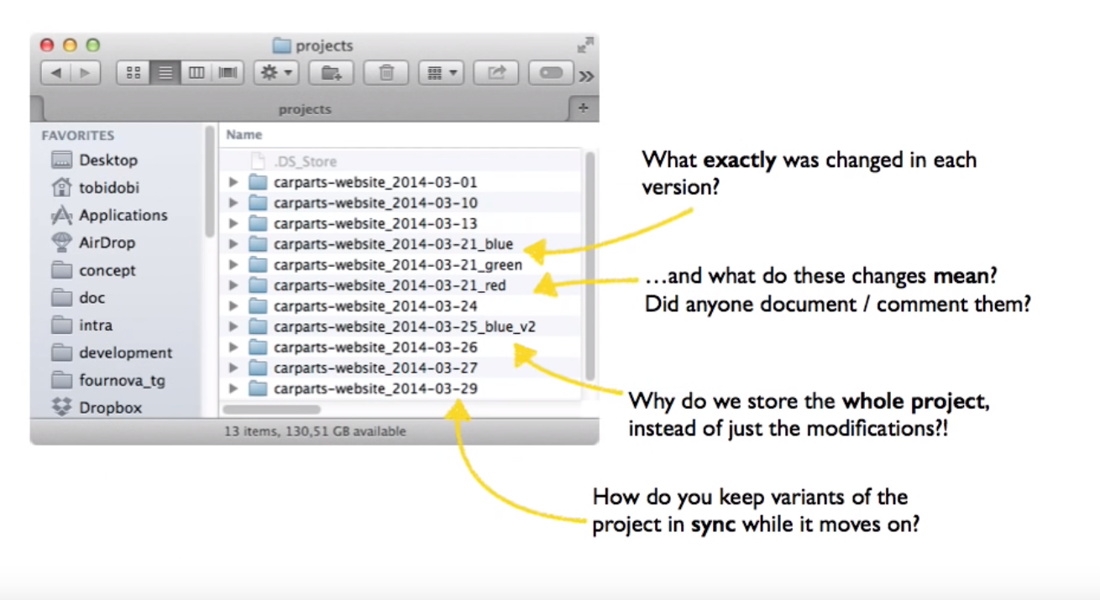
Versioning of files

Slide 5
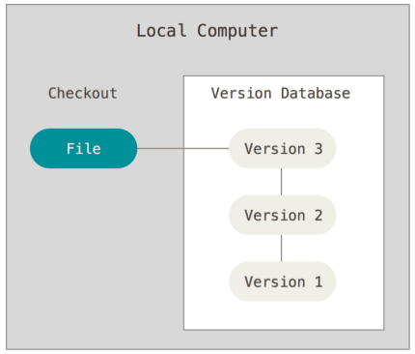
Disadvantages of Local VCS
Single point of failure (if server fails then changes will not be available)
File conflicts due to updates from different people.

Slide 6
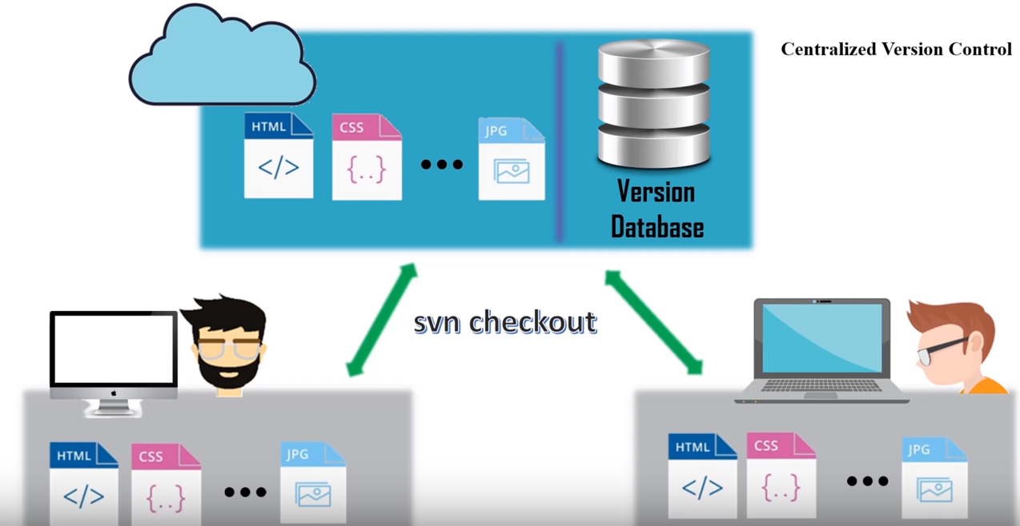
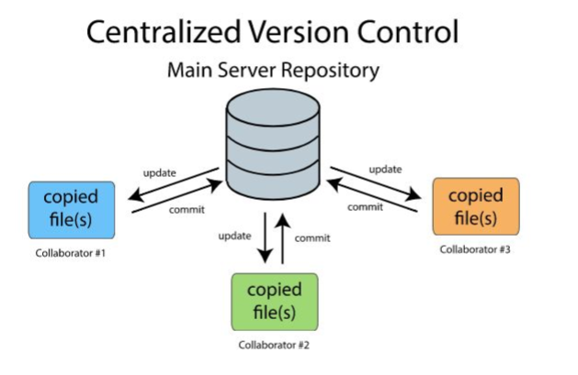
Centralized Version Control System

Slide 7
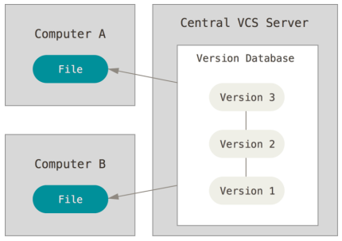
Disadvantages of CVCS
If the main server goes down, developers can't save versioned changes.
Remote commits are slow.
If the central database is corrupted, the entire history could be lost (security issues)

Slide 8
GIT

Slide 9
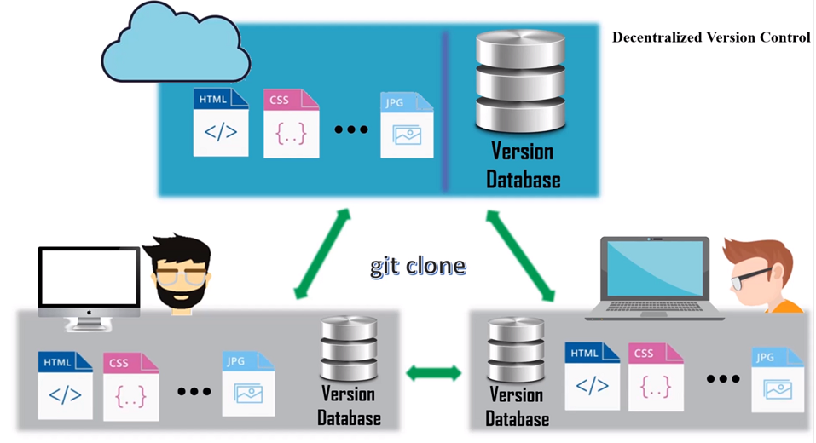
Distributed Version Control System

Slide 10
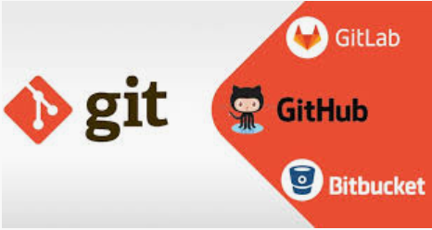
GIT vs (GITHUB, GITLAB, BITBUCKET)
GIT is a command line tool
GITHUB is a website used to manage GIT repositories.
Provides a backup.
Provides a visual interface to your repositories.
Makes collaboration very easy.

Slide 11
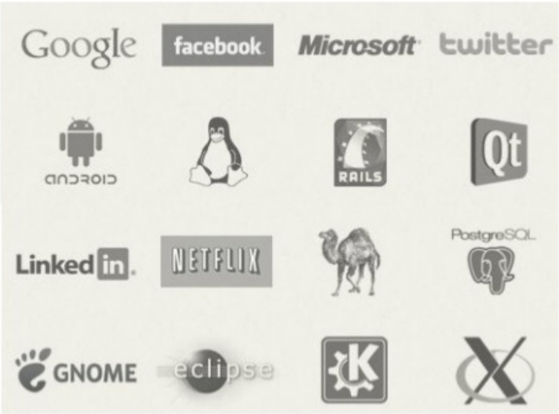
Companies which use GIT

