Slide 1
MAKE
Build Automation Tool

Slide 2

History
“Stuart Feldman” created “Make” utility in 1976.
“Make” was widely used those days due to its inclusion in Unix.
“Steve Johnson” (author of YACC) came up with a problem to Feldman, that his executable accidently not being updated with the changes.
This paved was for Feldman and then the birth of “Make”.
“Make” even builds Linux Kernel.

Slide 3
Introduction
Compiling several C/C++ files at once from terminal was difficult earlier.
A tool simply known as “Make” uses a “Makefile” solved the problem.
“Make” automatically determines which source files of a program need to be recompiled and/or linked.
Hence it was used as a build automation tool.
Makefile is a script which has a set of commands with variable names and targets to create object file and also to remove them.

Slide 4
Make – Saves build time
The make utility keeps track of the last time files were updated so that it only updates the files containing changes.
Make will skip the re-compilation of already compiled code.
Hence reducing the time of build process.
Can pick the source code from multiple directories.
Can build different versions of programs for different platforms.
During build “Make” utility looks for a file name “Makefile” in the Project’s home path.
In case of several Makefile’s, use command $ make –f Makefile.

Slide 5
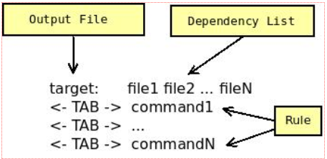
Makefile - Rule
Syntax :
Example:
hello: hello.c ${CC} hello.c -o hello

Slide 6
Sample Makefile
all:
echo "Use 'build' to compile, and 'clean' to remove the run file."
build:
g++ main.cpp helper.cpp -o run
doit:
./run
clean:
rm run

