Slide 1
MAKE
Build Automation Tool

Slide 2
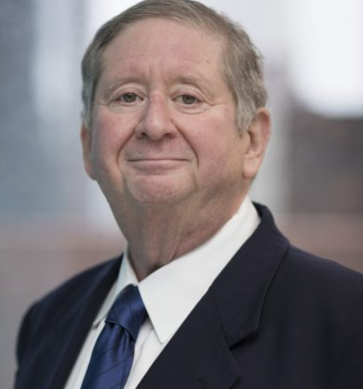
History
“Stuart Feldman” created “Make” utility in 1976.
“Make” was widely used those days due to its inclusion in Unix.
“Steve Johnson” (author of YACC) came up with a problem to Feldman, that his executable accidently not being updated with the changes.
This paved was for Feldman and then the birth of “Make”.
“Make” even builds Linux Kernel.

