Slide 1
UIDAI Hackathon
Team Reference ID : bwAOAvyI2C
Team Member Details
S. No. | Name | E-Mail ID
1. | Harish G | harishganesh246@gmail.com
2. | Anandha Krishnan S | anandhshiva27@gmail.com
3. | Siva Harini V | sivaharini2k@gmail.com
4. | Alfrin Samraj P | alfrinsamrajp007@gmail.com
5. | Mrinalini Sendhil | smrinu@gmail.com

Slide 2
About the Problem Statement
Theme : Address Update
Problem Statement : Address Update Challenge in Urban Areas
Abstract:
On relocation, you landed up in a situation, wherein you need to provide your updated Aadhaar to apply for a Broadband connection. You do not have any supporting documentation to prove your current address. As per the current policy, Aadhaar requires a supporting Proof of Address (POA) document or an Introducer who can lend his address to update the Aadhaar.
In such a scenario, we make use of the landlord’s address as POA for updating the tenant’s address and verifying the integrity of the same.

Slide 3
Approach
Our proposed solution is to build an app / portal that uses Aadhaar ID and mobile number for authorized access privilege in which both the tenant and the landlord can communicate by means of a two-way handshake encryption technique which leverages the use of their Aadhaar numbers and mobile numbers linked to them.
By this means, we create a token which establishes a secured exchange medium through which the landlord gives his consent and also shares his/her address via the Aadhaar E-KYC API, which is received by the tenant who can make minor changes to the address which is consequently verified by the geolocation.
Their history of exchanges are completely hashed and stored in our back-end database
which can be accessed by privileged UIDAI admin members via their portal.

Slide 4
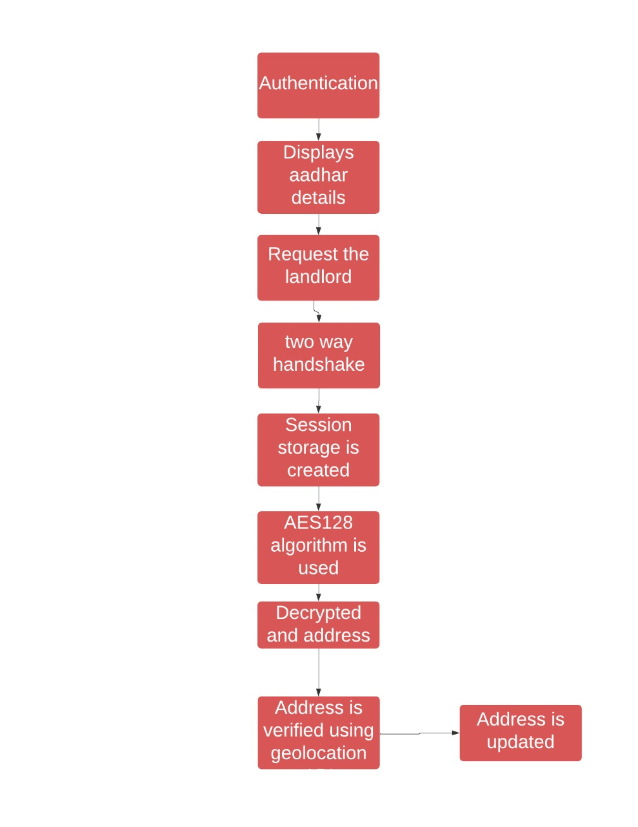
Architectural Diagram

Slide 5
API Usage
OTP API - OTP Request API is used to generate OTP for the resident whose mobile number is registered with his/her Aadhaar number. The generated OTP will be subsequently used for authentication.
AUTH API - Auth API is the single entry point for all modes of authentication in the UIDAI ecosystem. Auth API supports OTP, Face, Biometric, Demographic authentication. Any modality used by residents or organizations must call the Auth API to authenticate the resident.
Aadhaar E-KYC API - Aadhaar E-KYC API is used to fetch the E-KYC details of a resident.
Offline E-KYC API - Aadhaar E-KYC API provides Aadhaar letter data in electronic and secure (encrypted and digitally signed) fashion instead of leaving paper copies of the identity document everywhere. It eliminates the need for the residents to provide photo copy of Aadhaar letter.
Geolocation - The HTML Geolocation API is used to get the geographical position of a user. Since this can compromise privacy, the position is not available unless the user approves it.

Slide 6
Security Considerations
We use AES-128 encryption standard to chain the hashing and facilitate the two-way handshake between the landlord and tenant.
Also, we make use of JWT token for authorizing the validity of the transaction.
Since we use Aadhaar ID and the associated mobile number to generate the encryption, we can avoid fraudulent or unprivileged access to the transaction medium.
Finally, the confidentiality of individual users is preserved as every user has to undergo two-step authentication using OTP to access the portal.

