Slide 1
Detection of defacement URL’s
CSD 334
Mini Project

Slide 2
Team Members
Anandha Krishnan S – LIDK21CS074
Arun Babu – LIDK21CS079
Aiswarya M – LIDK21CS069
Project Guide
Prof. Philumon Joseph
Assistant Professor
Dept. Computer Science
Govt.Engineering College Idukki

Slide 3
Introduction
Protecting websites from unauthorized modifications is crucial for cybersecurity. Machine learning offers a promising solution for automated detection of defacement URLs.
Defacement URLs are web addresses that direct users to websites or pages that have been tampered
Importance of detecting defacement URLs
Role of machine learning in addressing this challenge

Slide 4
Problem Statement
The challenge lies in accurately identifying unauthorized modifications to website content amidst a large volume of web pages and evolving attack techniques.
Detecting defacement URLs
Challenges associated with the detection process

Slide 5
Motivation and Application
Detecting defacement URLs is essential for preserving the integrity and security of websites.
Potential consequences of leaving defacement URLs undetected
Real-world applications in various industries (e.g, e-commerce, banking, government)

Slide 6
Literature Survey
[1] Defacement url :URL Features-Based Phishing Detection System Using Machine Learning
Authors: Jain A.K,Gupta B B
Proposed a URL-based anti-phishing machine learning method.
They have taken 14 features of the URL to detect the website as a malicious or legitimate to test the efficiency of their method.
DISADVANTAGE:
Limited Evaluation: The paper might have a narrow evaluation scope.
Scalability and Efficiency: The proposed system may not be enough to handle large-scale phishing detection tasks in real-time, which could limit its practical utility.

Slide 7
Literature Survey
[2] Detecting Defaced Web Pages with Visual Similarity Assessment Based on Earth Mover's Distance (EMD)
Authors: Anthony Y Fu,Liu Wenyin,Xiaotic Deng
A virtual honey pot that is used to study the nature of malicious URLs that cybercriminals use to steal information.
DISADVANTAGES:
Dependency on Visual Features: The author may overlook non-visual indicators of phishing, such as URL structure, content semantics, or behavioral patterns.

Slide 8
Implementation Details
Hardware: Standard server or cloud computing resources
Software: Programming languages (e.g., Python), libraries/frameworks (e.g., scikit-learn, Flask), web scraping tools

Slide 9
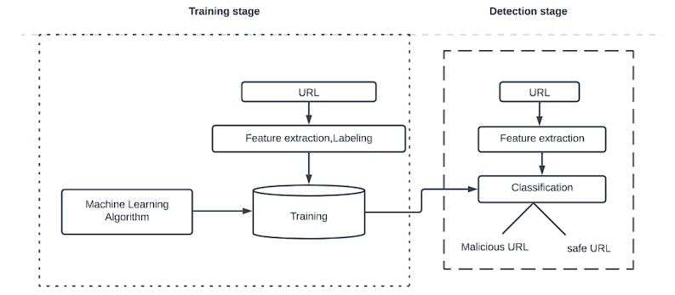
Architecture diagram

Slide 10
Architecture diagram
Dataset (features 25)
tld,urlLen,domainlength,fileNameLen,pathurlRatio,NumberofDotsinURL,Query_DigitCount,LongestPathTokenLength,delimeter_Domain,delimeter_path,SymbolCount_Domain,Entropy_URL,Entropy_Domain,count_hyphen,count_slash,count_question_mark,count_equal,count_at,count_excl,count_tilde,count_comma,count_plus,count_star,count_hash,
count_dollar.
Notes:
1. **tld**: Top-Level Domain (e.g., ".com", ".org", ".net").
2. **urlLen**: Length of the URL.
3. **domainlength**: Length of the domain name.
4. **fileNameLen**: Length of the file name in the URL.
5. **pathurlRatio**: Ratio of path length to URL length.
6. **NumberofDotsinURL**: Count of dots in the URL.
7. **Query_DigitCount**: Count of digits in the query part of the URL.
8. **LongestPathTokenLength**: Length of the longest token in the path.
9. **delimeter_Domain**: Presence of delimiters in the domain name.
10. **delimeter_path**: Presence of delimiters in the path.
11. **SymbolCount_Domain**: Count of symbols in the domain name.
12. **Entropy_URL**: Entropy of characters in the URL.
13. **Entropy_Domain**: Entropy of characters in the domain name.
14. **count_hyphen**: Count of hyphens in the URL.
15. **count_slash**: Count of slashes in the URL.
16. **count_question_mark**: Count of question marks in the URL.
17. **count_equal**: Count of equal signs in the URL.
18. **count_at**: Count of at symbols in the URL.
19. **count_excl**: Count of exclamation marks in the URL.
20. **count_tilde**: Count of tilde symbols in the URL.
21. **count_comma**: Count of comma symbols in the URL.
22. **count_plus**: Count of plus symbols in the URL.
23. **count_star**: Count of asterisk symbols in the URL.
24. **count_hash**: Count of hash symbols in the URL.
25. **count_dollar**: Count of dollar symbols in the URL.

Slide 11
Architecture diagram
Data preprocessing
Preprocess the testing data similarly to the training data including cleaning and standardizing the URLs.
Feature Extraction
Feature extraction condenses raw data into meaningful representations, aiding machine learning algorithms in making accurate predictions or classifications.
Notes:
1. **tld**: Top-Level Domain (e.g., ".com", ".org", ".net").
2. **urlLen**: Length of the URL.
3. **domainlength**: Length of the domain name.
4. **fileNameLen**: Length of the file name in the URL.
5. **pathurlRatio**: Ratio of path length to URL length.
6. **NumberofDotsinURL**: Count of dots in the URL.
7. **Query_DigitCount**: Count of digits in the query part of the URL.
8. **LongestPathTokenLength**: Length of the longest token in the path.
9. **delimeter_Domain**: Presence of delimiters in the domain name.
10. **delimeter_path**: Presence of delimiters in the path.
11. **SymbolCount_Domain**: Count of symbols in the domain name.
12. **Entropy_URL**: Entropy of characters in the URL.
13. **Entropy_Domain**: Entropy of characters in the domain name.
14. **count_hyphen**: Count of hyphens in the URL.
15. **count_slash**: Count of slashes in the URL.
16. **count_question_mark**: Count of question marks in the URL.
17. **count_equal**: Count of equal signs in the URL.
18. **count_at**: Count of at symbols in the URL.
19. **count_excl**: Count of exclamation marks in the URL.
20. **count_tilde**: Count of tilde symbols in the URL.
21. **count_comma**: Count of comma symbols in the URL.
22. **count_plus**: Count of plus symbols in the URL.
23. **count_star**: Count of asterisk symbols in the URL.
24. **count_hash**: Count of hash symbols in the URL.
25. **count_dollar**: Count of dollar symbols in the URL.

Slide 12
Architecture diagram
Model training
The Random Forest model was trained on a dataset containing features and a target variable. It leverages an ensemble of decision trees, each trained on random subsets of the data and features, to make predictions with improved accuracy and generalization.

Slide 13
Architecture diagram
Testing random forest
Apply the trained random forest model to the testing dataset to classify URLs as defacement or benign.
Model Evaluation
Assess the random forest model's performance on the testing dataset using identical metrics as those applied to the decision tree model.

Slide 14
Packages
sklearn
In python, sklearn is a machine learning package which include a lot of ML algorithms. Here, we are using some of its modules like train_test_split, Decision Tree Classifier, Logistic Regression and accuracy score.
Flask
Python web framework for building web applications with simplicity and efficiency.
NumPy
It is a numeric python module which provides fast maths functions for calculations.
Pandas
Used to read and write different files. Data manipulation can be done easily with data frames.
Matplotlib
Data visualization is a useful way to help with identify the patterns from given dataset.

Slide 15
Model Evaluation
We assessed three models—Logistic Regression, Decision Trees, and Random Forest—by executing the following steps for each :
1. Data extraction from a CSV file.
2. Data preparation through Train-Test splitting.
3. Model execution.
4. Evaluation of model performance using metrics such as Accuracy, Confusion Matrix, Precision, Recall, and F1 Score.

Slide 16
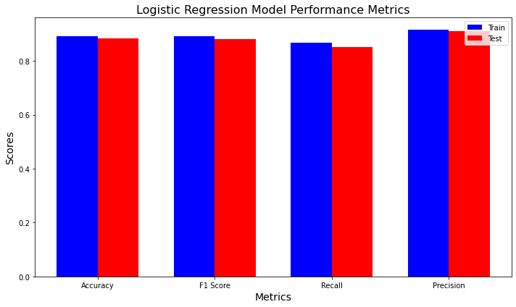
Logistic Regression

Slide 17
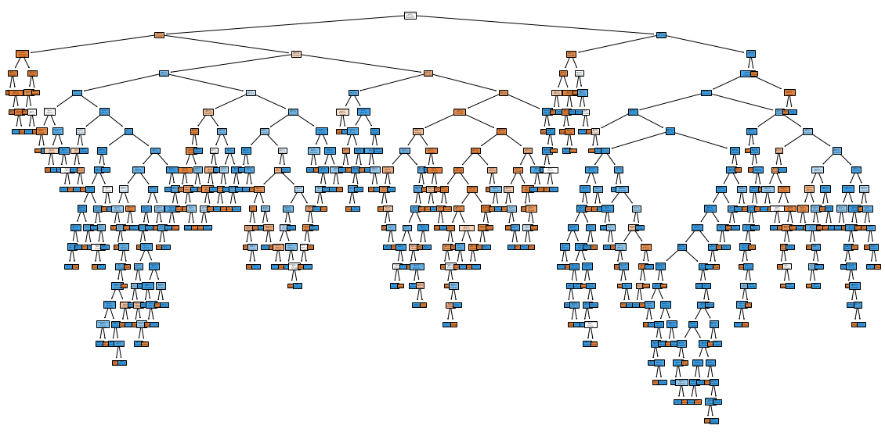
Decision Tree

Slide 18
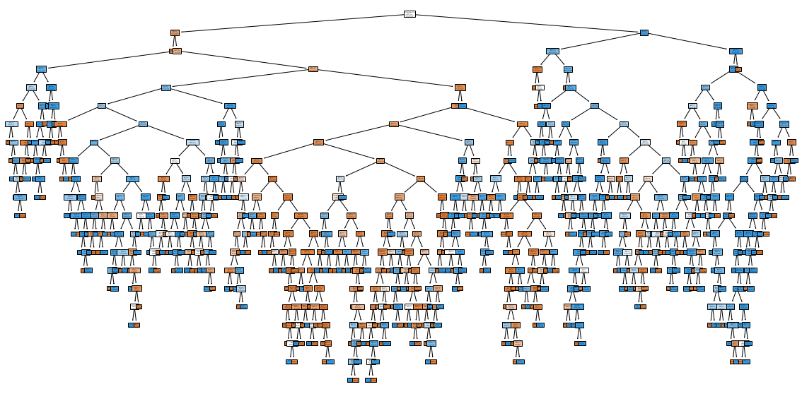
Random Forest

Slide 19
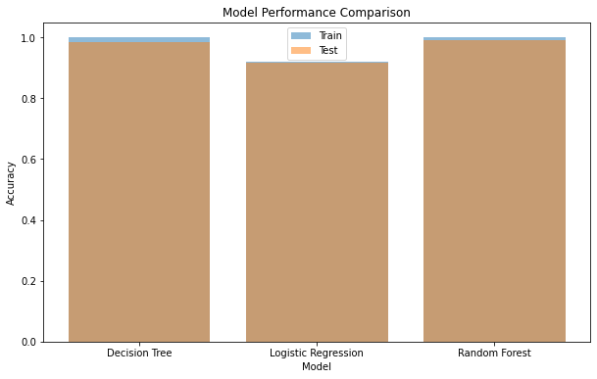
Comparison

Slide 20
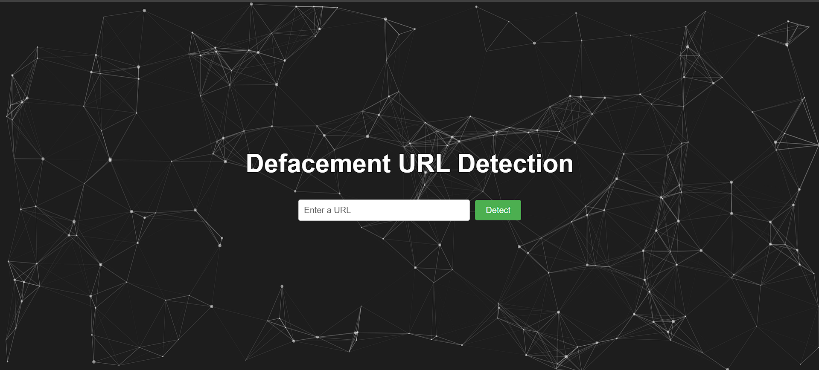
Screenshots

Slide 21
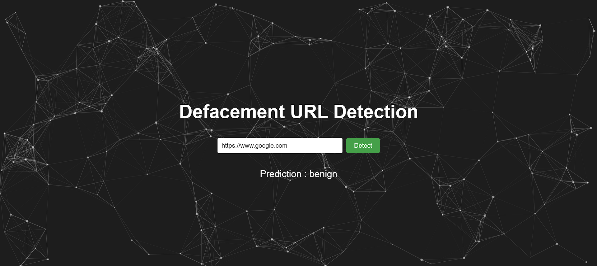
Screenshots

Slide 22
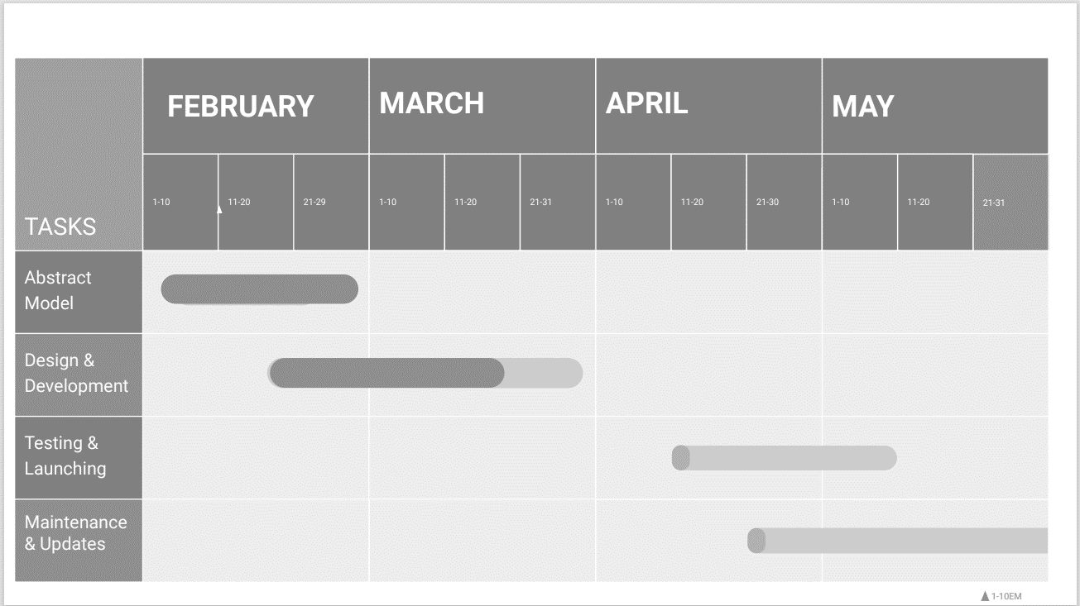
Time Line Chart

Slide 23
Conclusions
Our proposed architecture presents a practical and effective solution for detecting defacement URLs using machine learning.
Evaluation results demonstrate the efficacy of our system in accurately identifying unauthorized modifications.
Moving forward, we suggest further exploration of advanced machine learning algorithms and real-time monitoring capabilities

Slide 24
References
[1] Luca Invernizzi and Stefano Benvenuti. Evilseed: A guided approach for find- ing malicious webpages. In IEEE Security Symposium, 2012.
[2] J. Nazario. Phoneyc: A virtual client honeypot. In USENIX Workshop on Large-Scale Exploits and Emergent Threats, 2009.
[3] N. Provos and P. et al. Mavrommatis. All your iframes point to us. USENIX, 2008.
[4] N. Provos and D. et al. McNamee. The ghost in the browser: Analysis of web- based malware. USENIX Workshop on Hot Topics in Understanding Botnet, 2007.
[5] M. A. Rajab and L. Ballard. The nocebo effect on the web: An analysis of fake anti-virus distribution. In USENIX Workshop on Large-Scale Exploits and Emergent Threats, 2010. 16

Slide 25
THANK
YOU

