Slide 1
MERn

Slide 2
agenda
What is MERN?
Introduction of different Web Technology
Basic Concepts
Overview of Web Technologies
Introduction to HTML

Slide 3
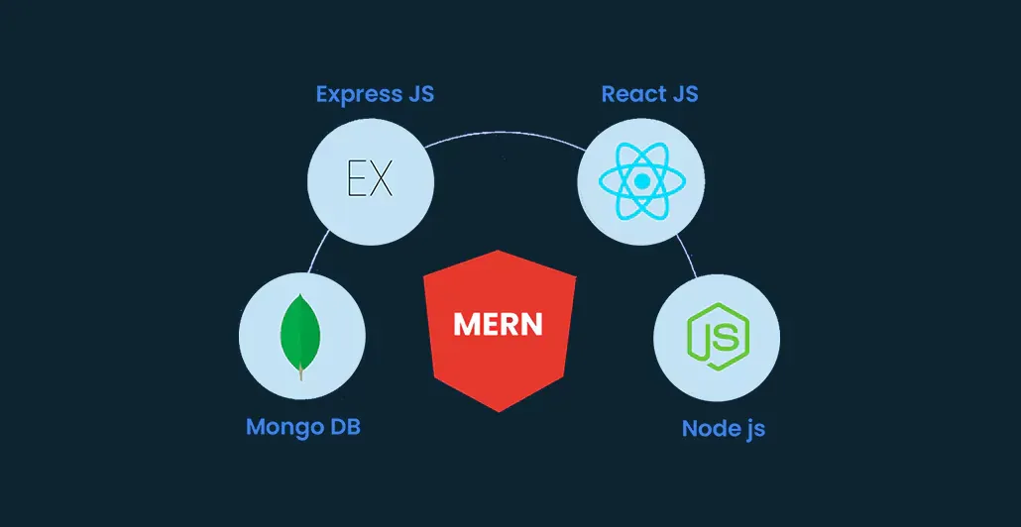

Slide 4
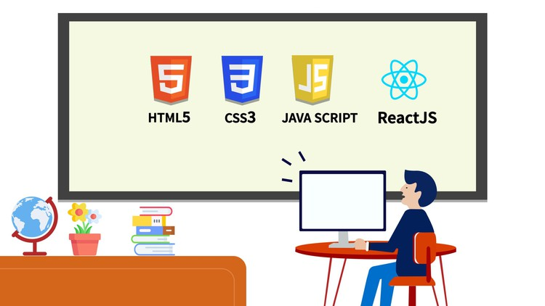

Slide 5
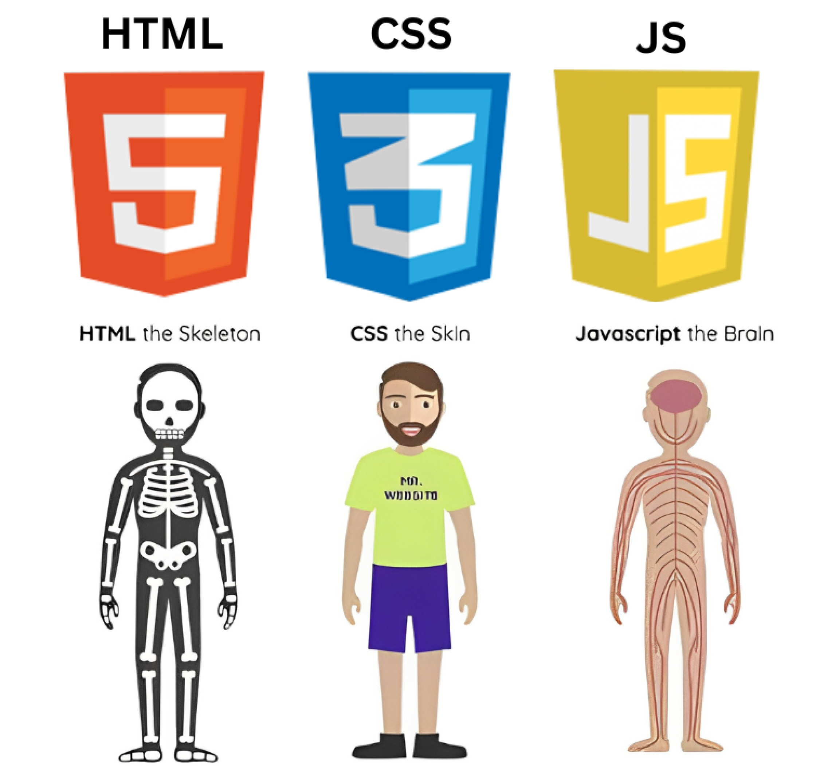

Slide 6
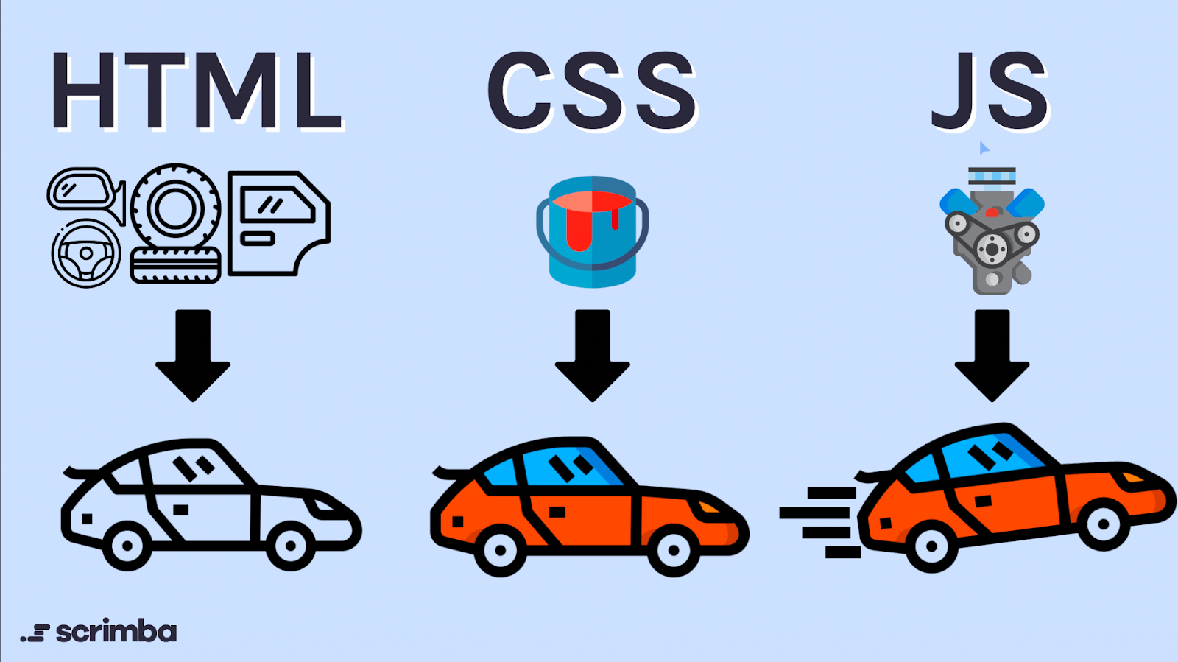

Slide 7
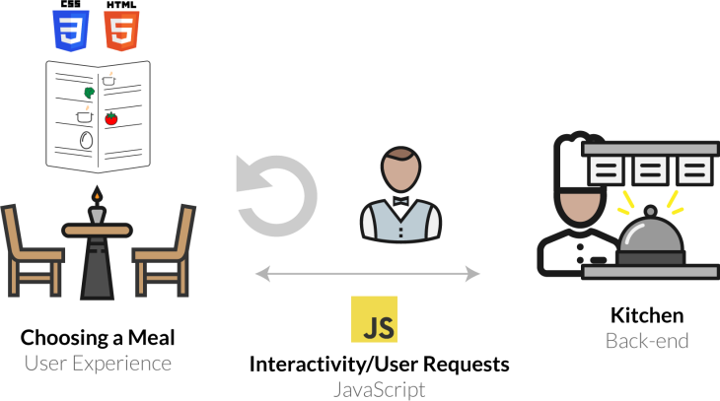

Slide 8
Thank you
Anandhakumar M

