Slide 1
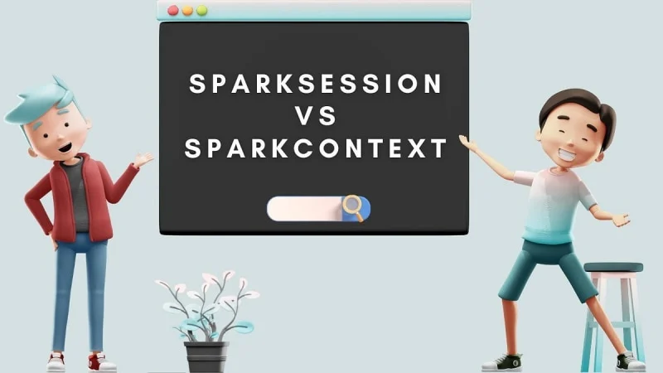

Slide 2
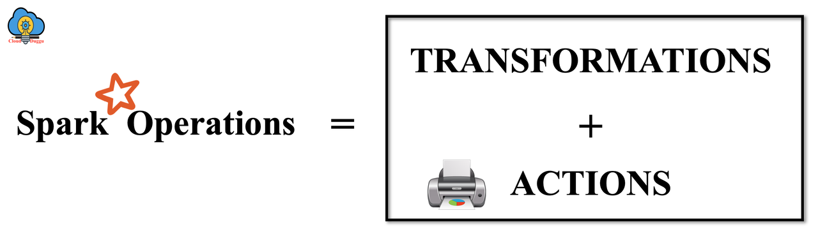

Slide 3
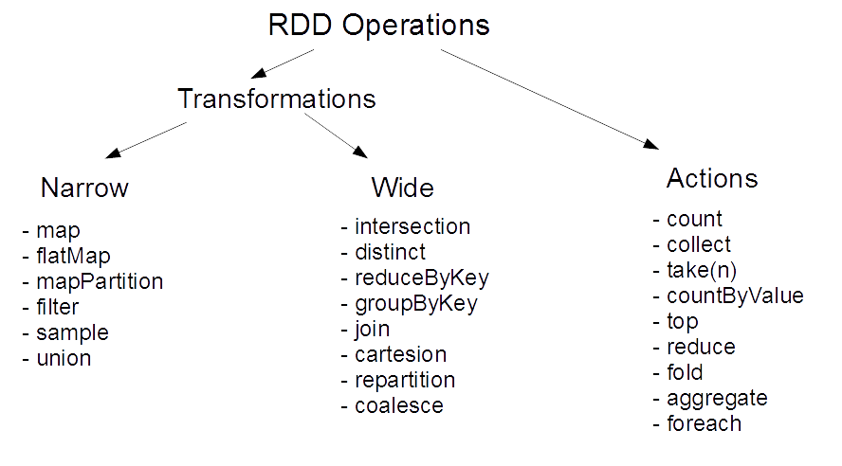

Slide 4
Introduction
Apache Spark provides both SparkContext and SparkSession for managing and interacting with Spark clusters.
Knowing the difference helps optimize usage and understand the evolution of Spark.

Slide 5
SparkContext Overview
Core of Apache Spark: Responsible for the connection to the cluster.
Initialization: Before Spark 2.0, SparkContext was the main entry point to interact with Spark.
Key Responsibilities:
Manages the configuration of the cluster.
Handles job execution and cluster resource management.
Responsible for connecting to storage systems (HDFS, S3).
Creates RDDs (Resilient Distributed Datasets), accumulators, and broadcast variables.

Slide 6
SparkSession Overview
Unified Entry Point: Introduced in Spark 2.0 to replace SparkContext and SQLContext/HiveContext.
Simplified API: Provides a single entry point to all Spark functionality (SQL, streaming, data processing).
Key Features:
Manages SQL queries, DataFrame APIs, and Dataset APIs.
Offers access to SparkContext internally.
Provides backward compatibility with older Spark versions.
Manages catalog metadata and caching.

Slide 7
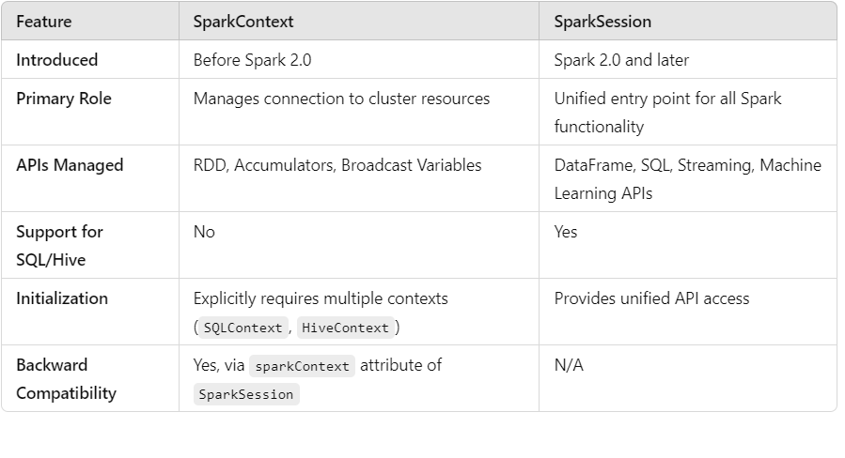
Key Differences

Slide 8
Evolution from SparkContext to SparkSession
Simplified API: No need for multiple contexts (SQLContext, HiveContext).
Backward Compatibility: SparkSession includes access to the old SparkContext via spark.sparkContext.
Supports More Functionalities: Provides DataFrame and Dataset APIs, SQL query support, and seamless interaction with Spark's ecosystem.

Slide 9
When to Use SparkContext and SparkSession
SparkContext:
Older applications using Spark 1.x.
Applications primarily using RDDs and not leveraging DataFrames or SQL.
SparkSession:
Recommended for all modern Spark applications (post Spark 2.0).
Unified API for all functionalities.
Preferred when working with DataFrames, Datasets, and SQL.

